Slide 1
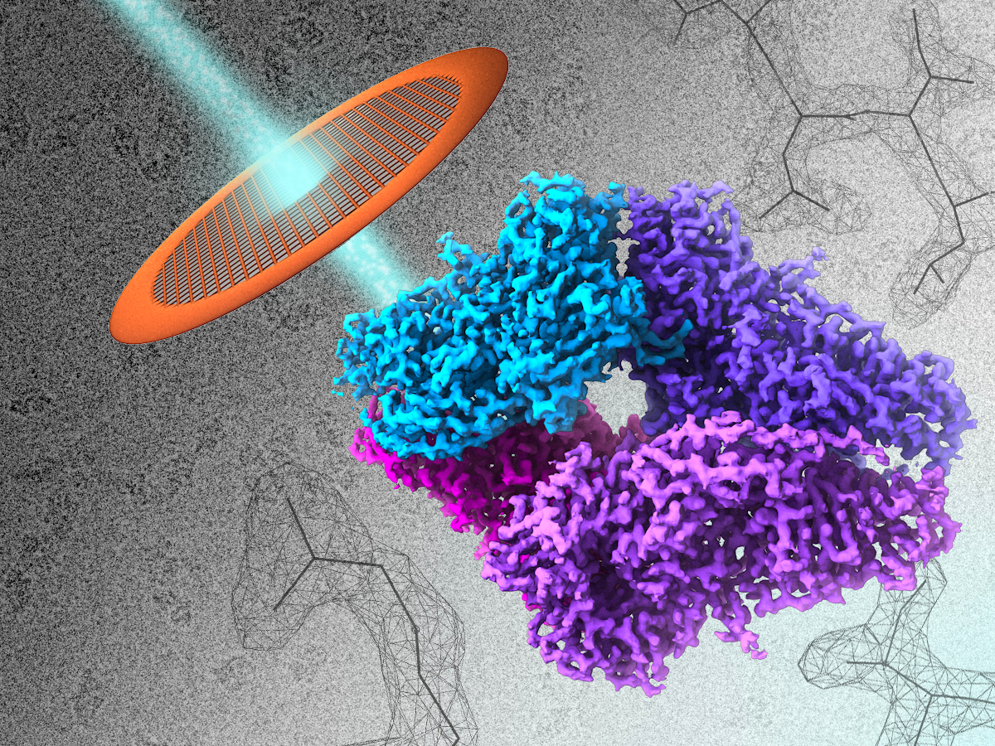
Preparing biological samples for transmission electron microscopy
Helene Malet
helene.malet@ibs.fr

Slide 2
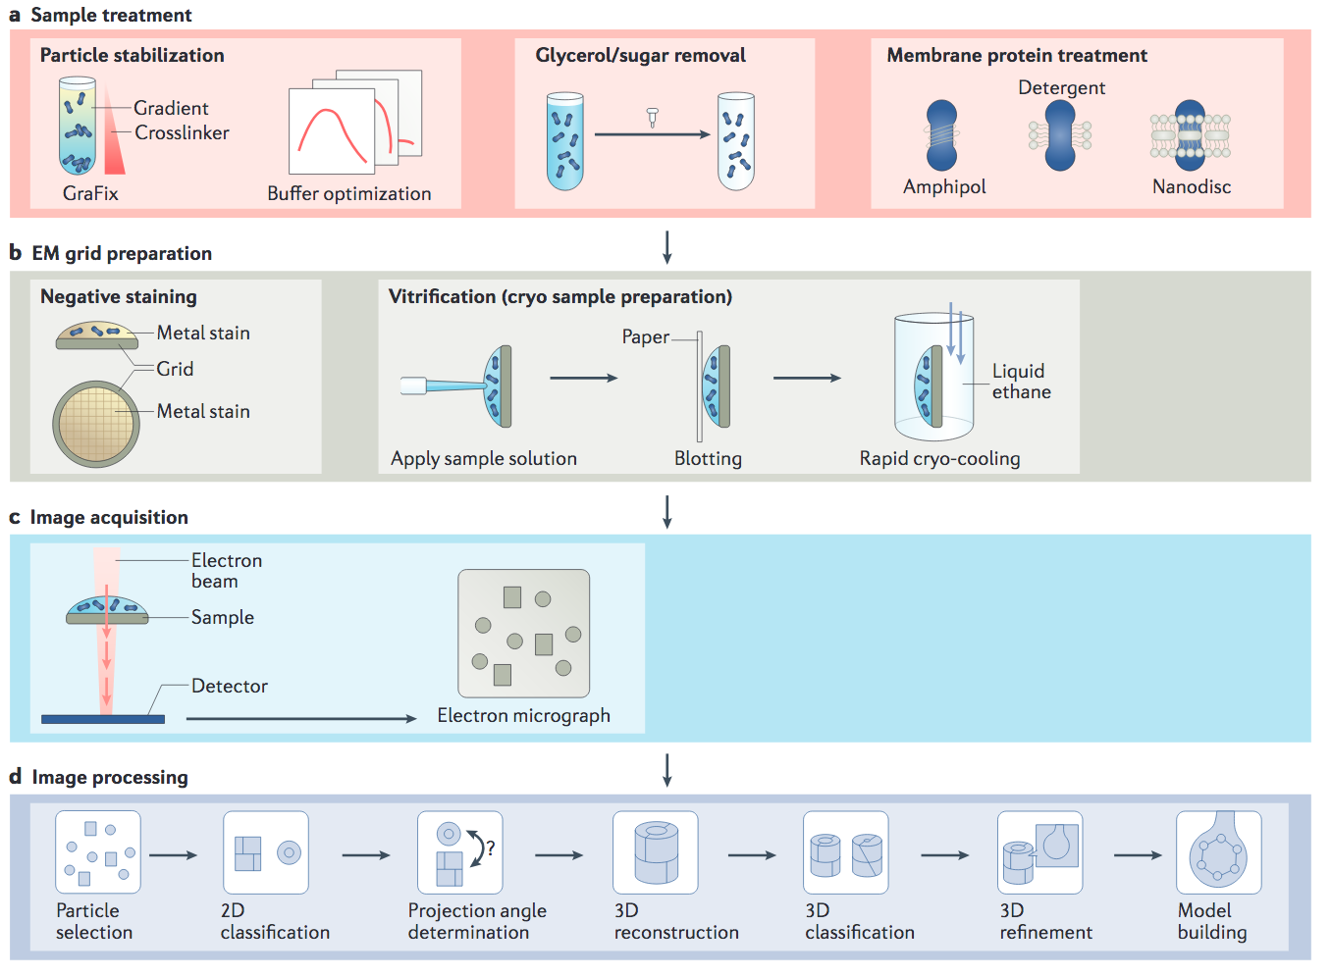

Slide 3
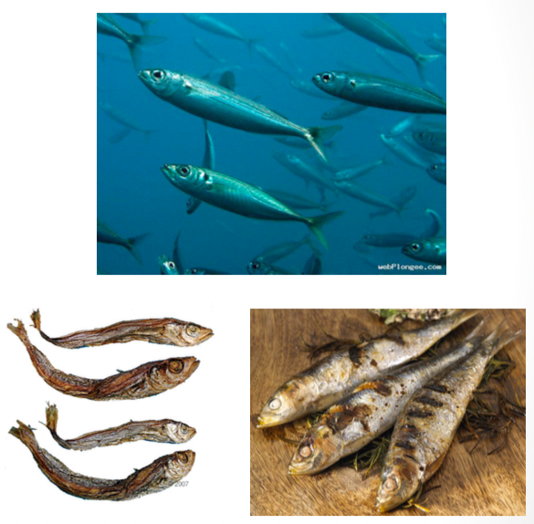
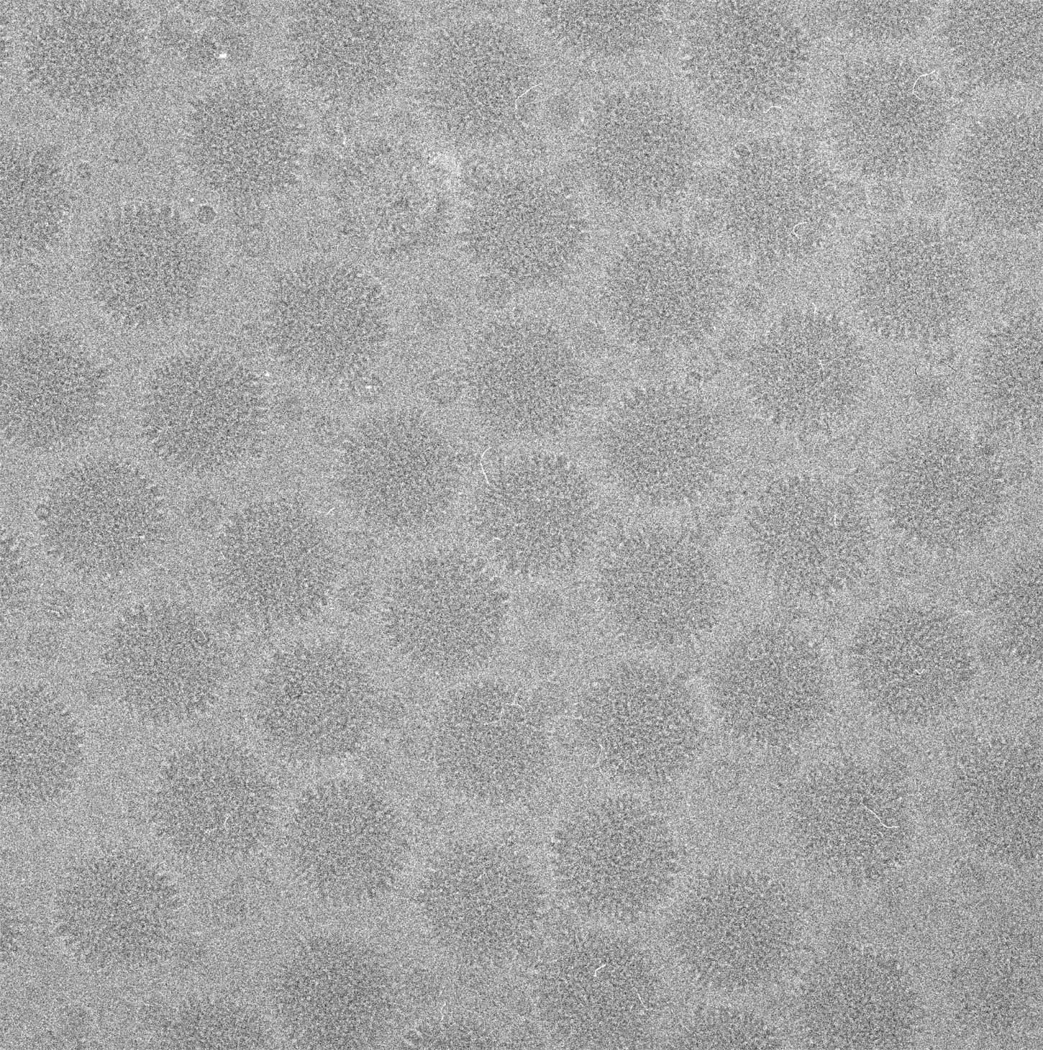
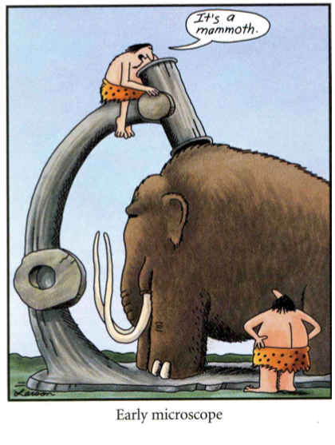
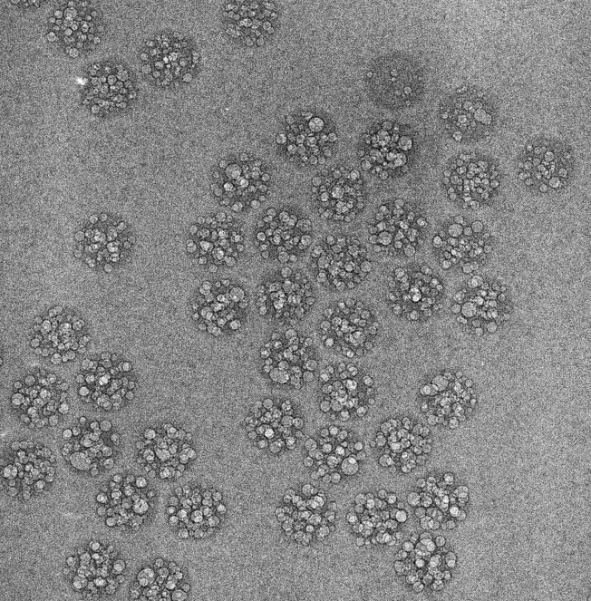
Requirements for biological samples to be imaged by transmission electron microscopy
  Stay in their native form
  Resist to the vacuum
  Resist to the electrons
  Be thin enough

Slide 4
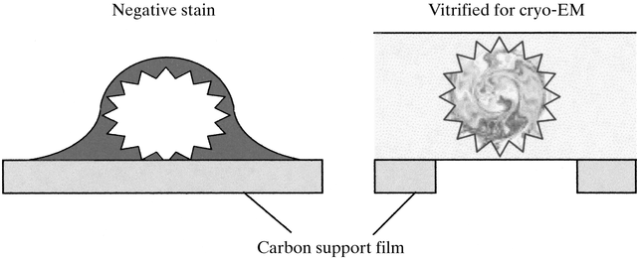
Two main methods
Negative stain
Cryo

Slide 5
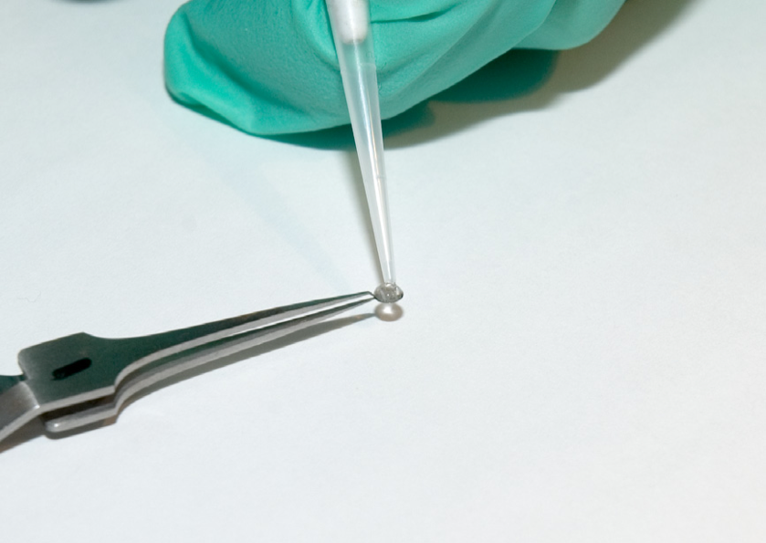
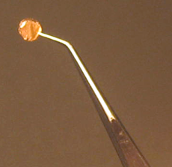
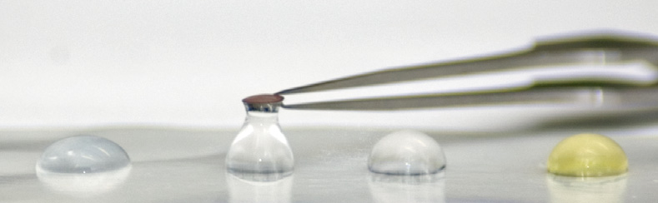
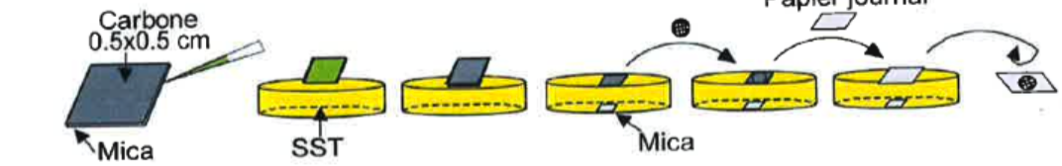
Negative stain EM: sample preparation
Journal paper
Negative stain EM grid

Slide 6
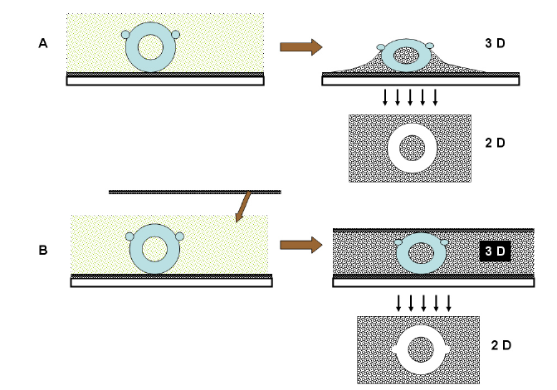
Negative stain EM: Advantages and drawbacks
Advantages:
  Fast
  Small amount of protein
  (concentration around 0.01-0.1mg/ml, few μl)
  Small proteins visible
  High contrast
Drawbacks:
  Limit in resolution (15 Å)
  Flattening and drying of the sample.
  Artifacts due to the stain.

Slide 7
Optimizing negative stain EM grids: importance of the stain
Uranyl acetate
  High contrast
  Radiation resistant
  Stable
  Coarse grain
  Acidic (pH 4)
Uranyl formate
  Finer grain
  Unstable
  Sodium SilicoTungstate (SST)
  Thin layer of stain (often used for small proteins)
  Neutral pH
  Lower contrast
  Ammonium Molybdate
  Thick layer of stain
  Neutral pH
  Lower contrast

Slide 8
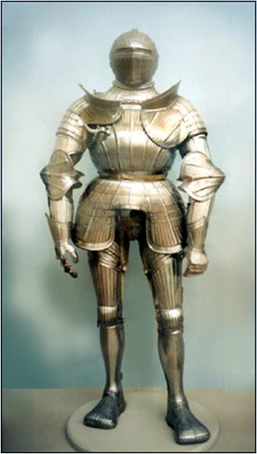
What we see in negative stain

Slide 9
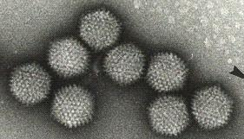
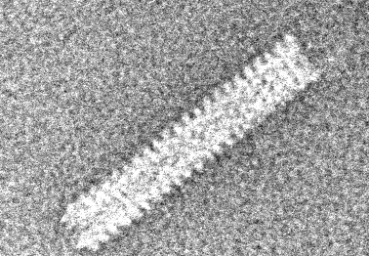
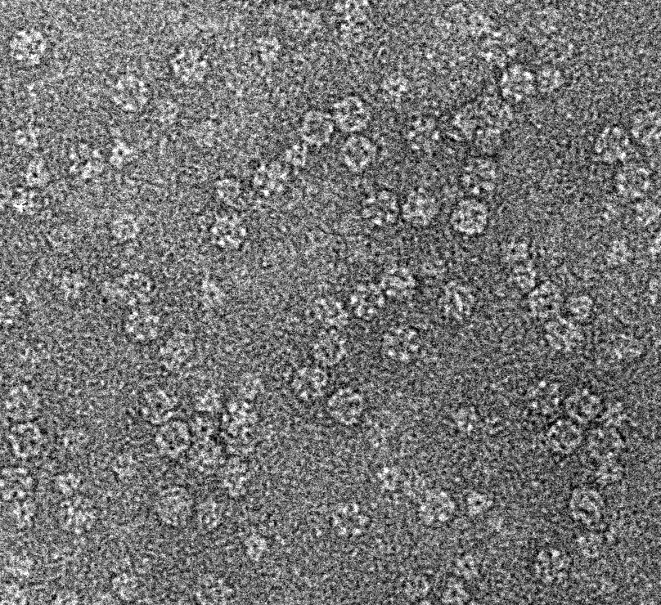
Single particles visualized by negative stain EM: examples
Notes:
Adeno ???
TMV ??
What is that ???

Slide 10
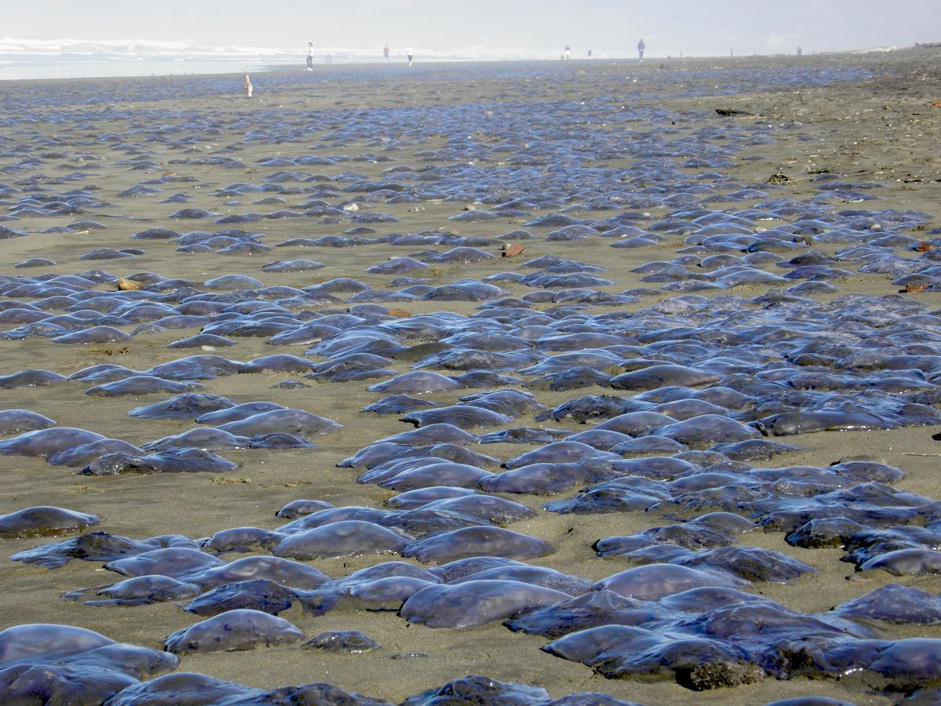
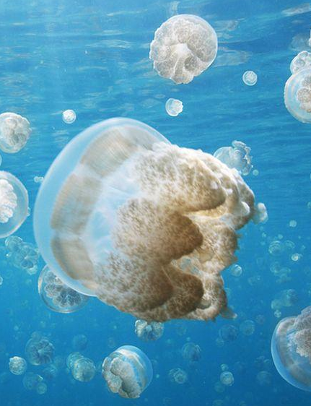
Object seen in negative stain
Real object to be visualized

Slide 11

To solve this problem: preparation of cryo grids

Slide 13
Principle behind vitrification of sample
H₂O - liquid
Hexagonal ice
Slow freezing
Rapid freezing
Heat
Heat
Amorphous ice
Cubic ice

Slide 14
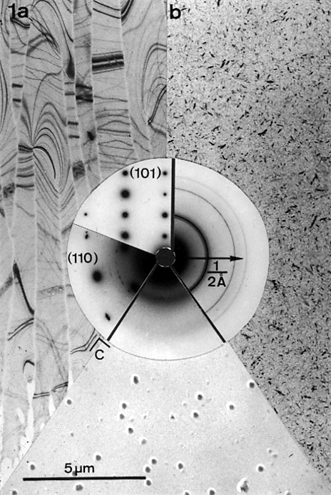
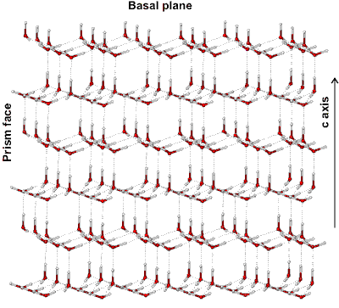
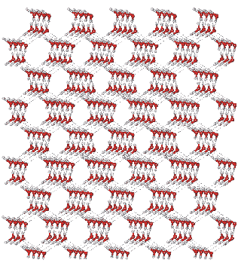
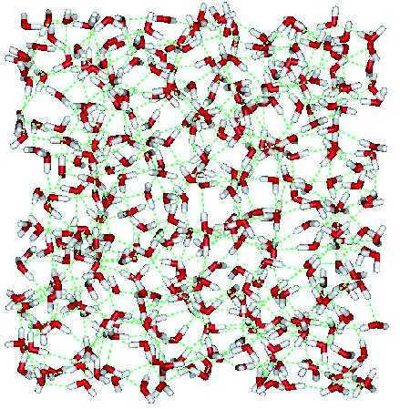
Dubochet et al., (1982)
a)
b)
c)
a) hexagonal b) cubic c) vitrified

Slide 15
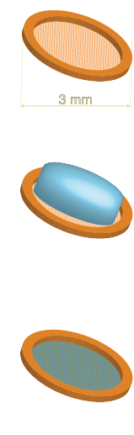
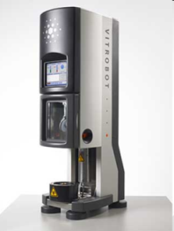
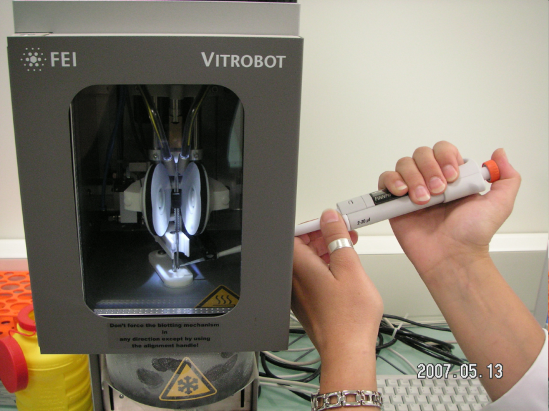
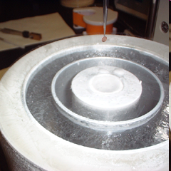
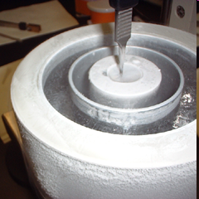
Vitrification of sample : plunge-freezing
EM grid
Apply sample
Blot excess buffer before plunging
Liquid Nitrogen
Liquid Ethane

Slide 16
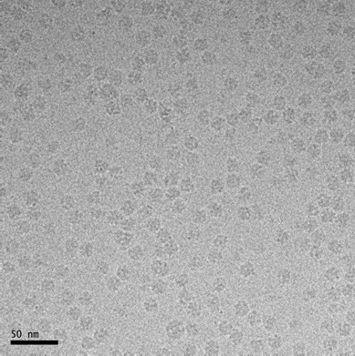
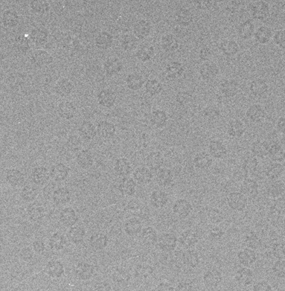
Cryo preparation: advantages and drawbacks
Advantages:
  Native state
  Higher resolution
  Small amount of protein (1 grid = 4 μl at 0.1-1mg/ml)
Drawbacks:
  Low contrast
  Highly sensitive to radiations
  Minimal size limit: around 100 kDa

Slide 17
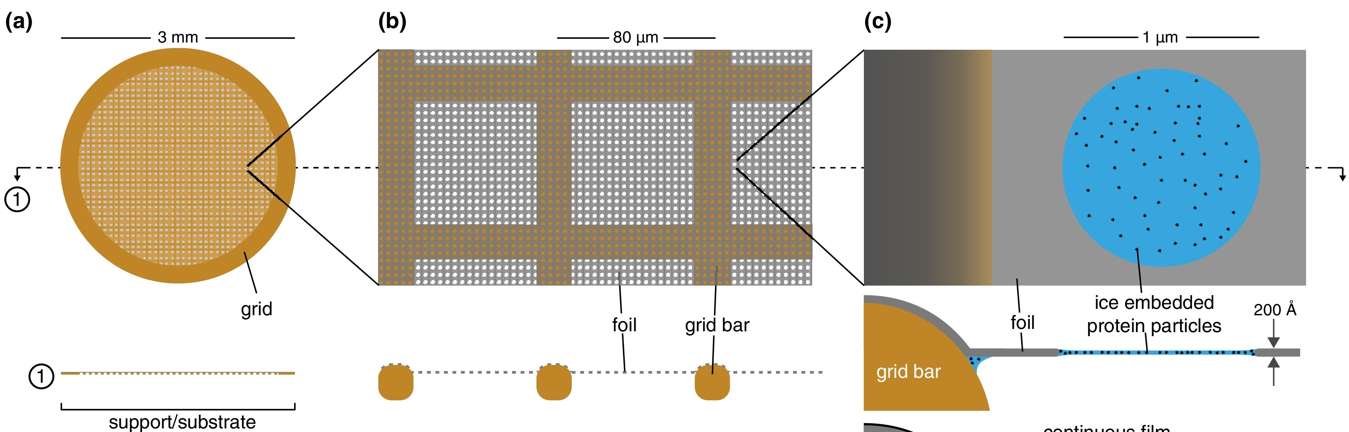
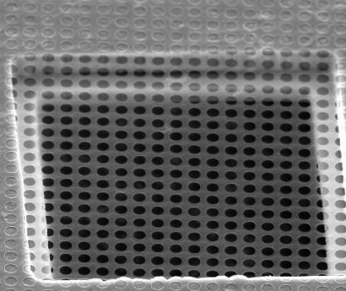
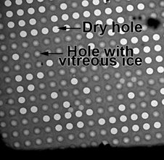
Zoom on the grid used

Slide 18
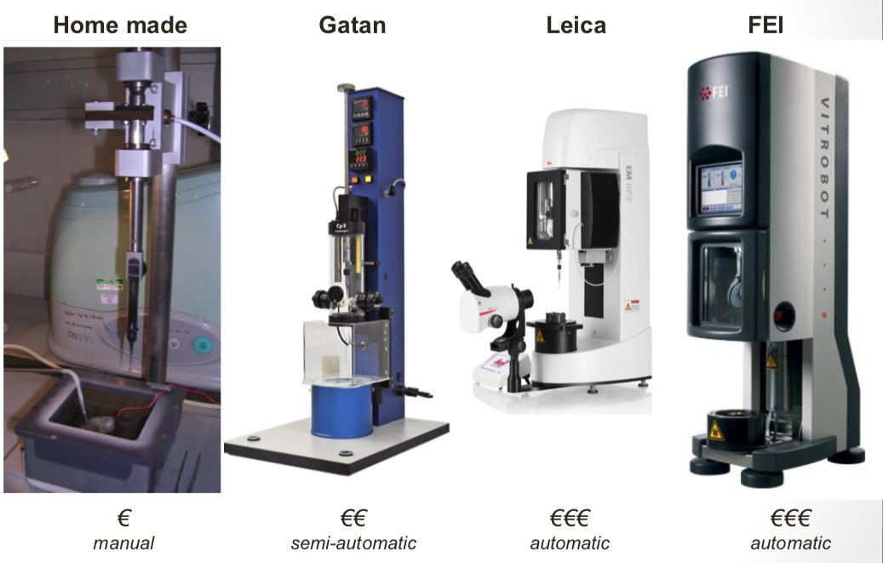
Zoom on the different instruments used to freeze grids

Slide 19
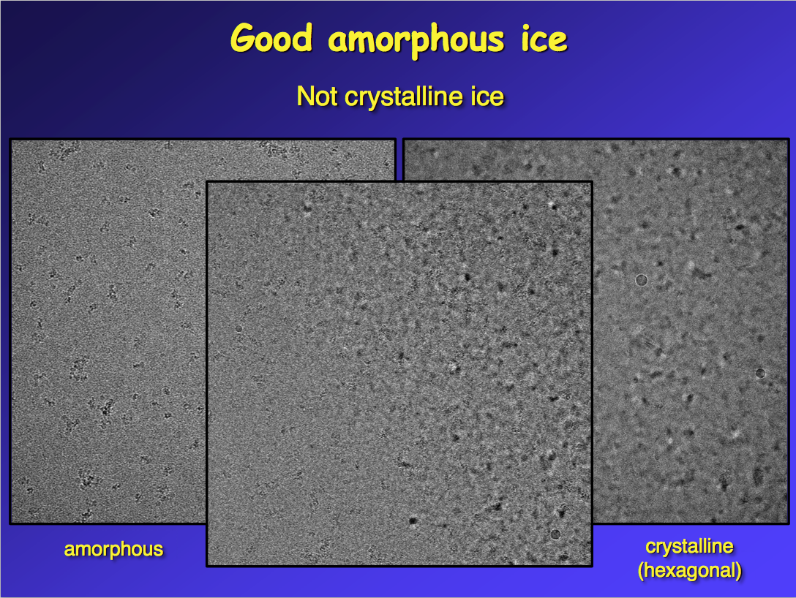
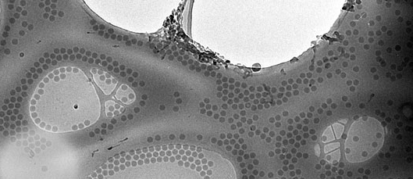
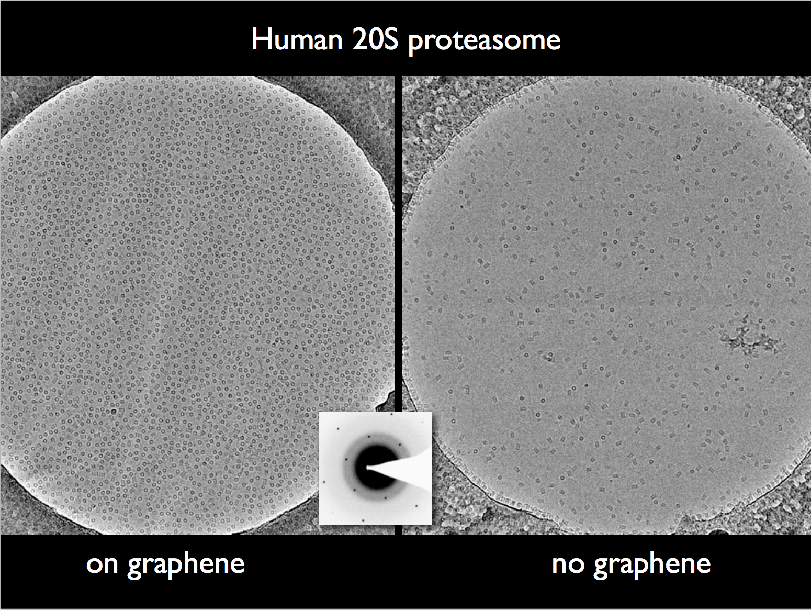
What is a good cryo-EM grid?
Good amorphous ice
-not crystalline ice
-no « leopard skin »pattern
-no contamination
Appropriate ice thickness
-typically as thin as possible
Clearly visible particles
-particle size and shape
-buffer composition
Good particle distribution
-in holes
-dense but particles not touching
-randomly distributed orientations

Slide 20
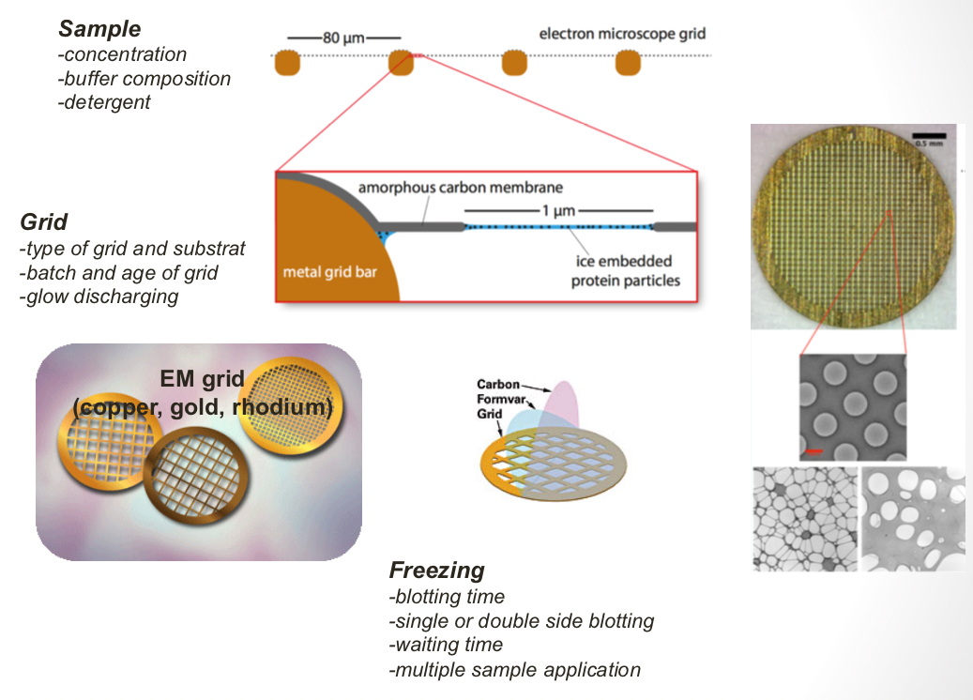
Parameters to improve grid quality
Notes:
Thick specimen: more inelastic and multiple scattering effect: decreases image quality
300 Å thich for 2 Å resolution

Slide 21
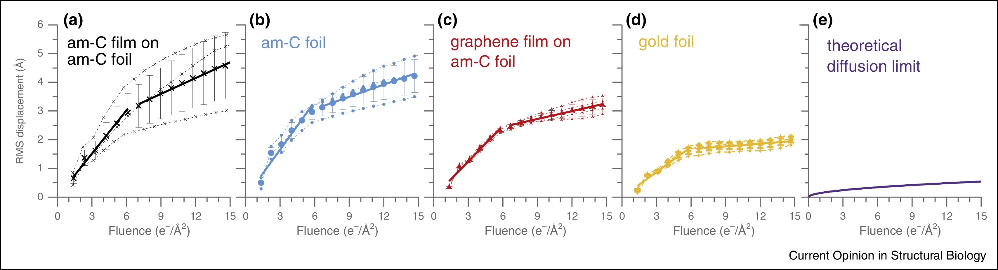
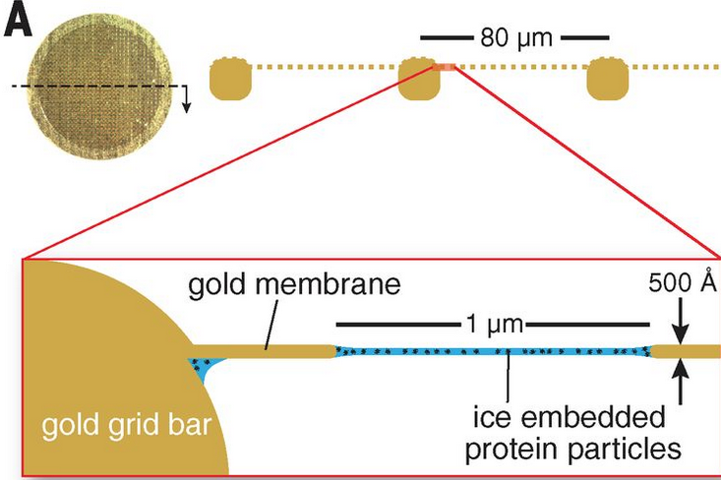
Influence of the grid foil
When irradiated, movement of biological specimen due to semi-static charge: 4 Å or more in the 1st 10 e⁻/Å²
Partially due to the fact that:
  Carbon shrinks less than metals used for the grid.
  Carbon has poor conductivity and may contribute to specimen charging.
Development of Gold foils to replace Carbon foils
Notes:
Much of the movement is due to the support : lack of tension in the carbon foil after cooling
Usage of high speed camera

Slide 22
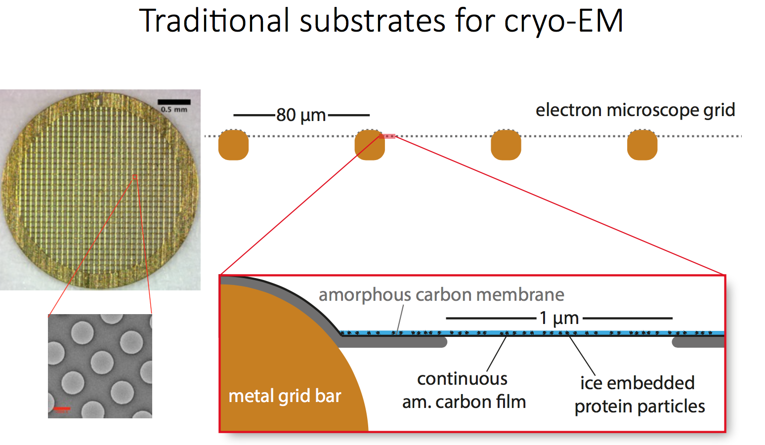
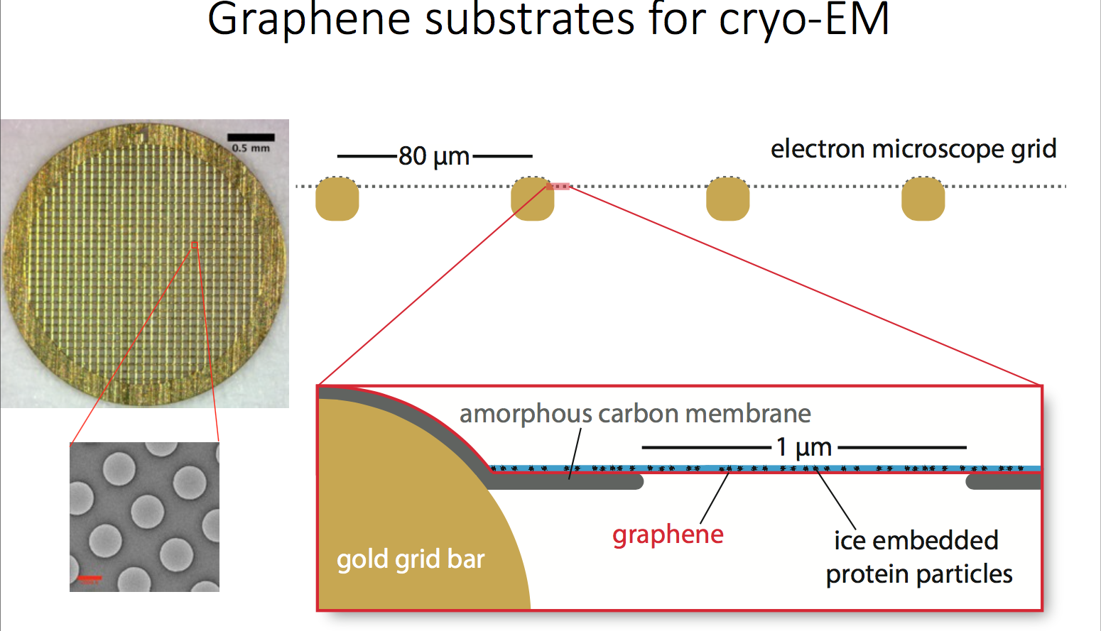
Influence of the grid substrate

Slide 23
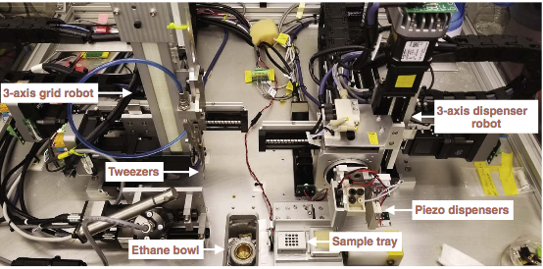
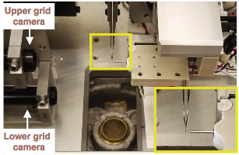
Method developments to increase grid preparation reproducibility and quality: the spotiton
Piezo electric dispensing head delivers small droplets 2-15 nl to a self-blotting nanowire grid
The nanowire acts as a blotting paper to wick the sample from the surface as soon as the liquid comes into contact with the nanowire
The resuling thin wet film in plunged into liquid ethane
Notes:
Piez electric inc jet
Spotting on the fly (250ms between droplet application to entry into ethane
Camera for optimization

