Slide 1
The Magnetic Measurement System Based on Coordinate Measuring Machine
CHEN, Fusan
28th June 2019

Slide 2
The HEPS Magnet
High Energy Photon Source (HEPS)
4th generation light source with small beam emittance.
High gradient quadrupole/sextupole with small aperture.
The quantity of quad. and sext. is very large.
Measurement of the high gradient magnets
All key technologies are developed and verified during the HEPS Test facility (HEPS-TF) stage

Slide 3
The CMM based Measurement System
CMM + Rotating coil system + Stretched wire system
A multi-purpose system for magnet measurement
Mechanical size and tolerance measurement
Magnetic harmonics measurement
Integral field/gradient measurement
Magnetic field center measurement
Rotating coil system
Stretched wire system

Slide 4
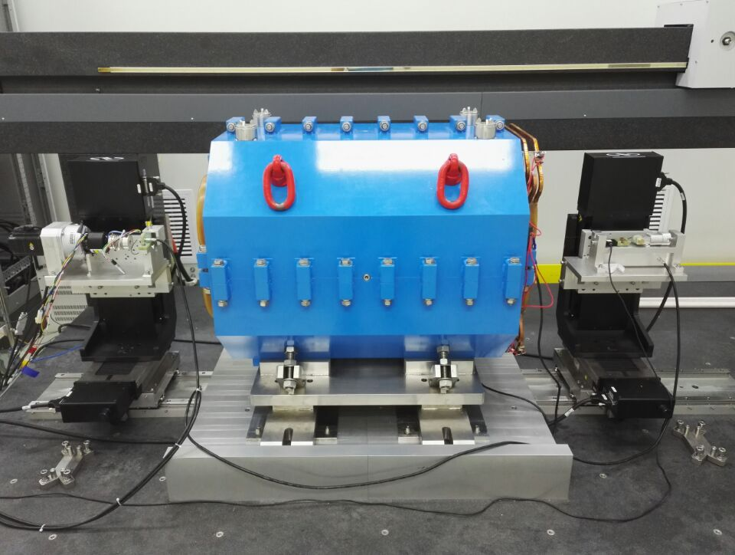
The CMM based Measurement System
System setup
CMM
Servo Motor
Tension Adjustor
High gradient quadrupole type I
Angle Encoder
Tensiometer
Motorize linear stage
Motorize linear stage
Longitudinal guide

Slide 5
Main Component Specifications
CMM
Moving range [mm] | 2500×1200×800
Accuracy [μm] | 3.3+3.3L/1000
Motorize linear stage
Moving range [mm] | 100×100
Positioning accuracy [μm] | ±2.5
Repeatability [μm] | ±0.5
Minimum increment [μm] | 0.6
FDI2056
Channel number | 3
Sample rate [kS/s] | 500
Resolution [Vs] | 10⁻¹⁴
Gain accuracy [ppm] | 10
Integrator drift [Fs/min] | 10⁻⁵
Power supply
Output voltage [V] | 60
Output current [A] | 300
Current stability [ppm] | 20

Slide 6
Main Component Specifications
Rotating coil specifications
Skeleton material
Diameter: 23.6mm
Coil sag
G10: 0.393mm
ZrO₂: 0.145mm
Al₂O₃: 0.051mm
R1 [mm] | 11 | N1 | 120
R2 [mm] | 7.92 | N2 | 180
R3 [mm] | -7.84 | Coil length [mm] | 1100
R4 [mm] | -4.4 | Bucking ratio | 88

Slide 7
Measuring Process
Create coordinate system
Measure the mechanical
Align the magnetic measurement devices
Measure the magnetic field

Slide 8
The Coordinate System

Slide 9
Measure the Mechanical Dimension

Slide 10
Align the Rotating Coil

Slide 11
Align the Stretched Wire

Slide 12
Measurement Data

Slide 13
Measurement Data

Slide 14
The Vertical Magnetic Center

Slide 15
Conclusion

