Slide 1
ESRF Operation Status Report &
Accelerator Upgrade Programme
P. Raimondi
On behalf of the Accelerator & Source Division
Grenoble, November 25 - 2014

Slide 2
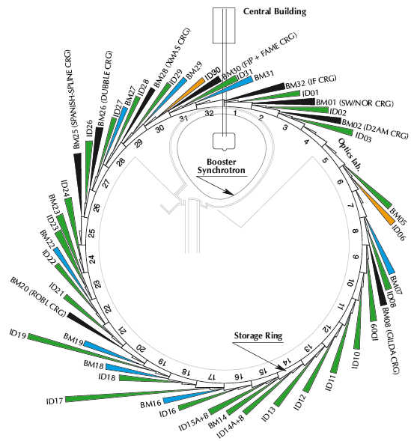
The ESRF today
Storage ring
6GeV, 844 m
Energy | GeV | 6.04
Multibunch Current | mA | 200
Horizontal emittance | nm | 4
Vertical emittance | pm | 3.5
Booster synchrotron
200 MeV ➔ 6 GeV
300m, 10 Hz
32 straight sections
DBA lattice
42 Beamlines
12 on dipoles
30 on insertion devices
72 insertion devices:
55 in-air undulators, 6 wigglers,
11 in-vacuum undulators, including 2 cryogenic
E- Linac
200 MeV

Slide 3
Accelerator and source division (ASD) mission
Deliver the X-ray Beam to the USERs > 5000 hours/year
Deliver the Accelerator Phase I Upgrade Programme
Implement the proposed Accelerator Phase II Upgrade Project
The ASD has the additional duty of constantly improving
the performances and reliability of the Source independently
from the Upgrade Programmes.
Page 3

Slide 4
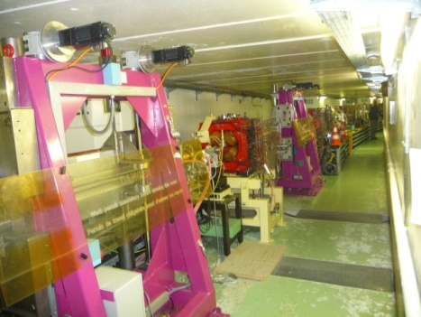
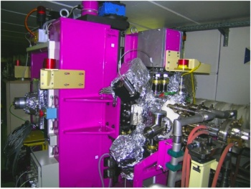
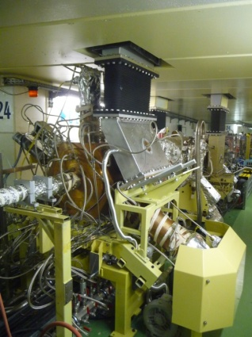
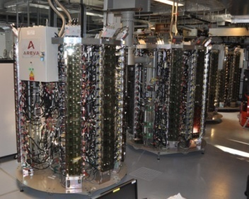
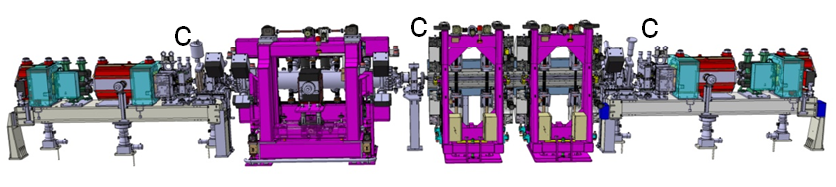
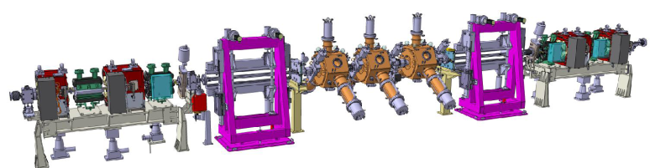
Accelerator Upgrade Phase I 2009-2015 Main Projects
Done
Upgrade of BPM electronics
  Improvement of the beam position stability
  Coupling reduction
6 m long straight sections
Cryogenic in-vacuum undulators
7 m straight sections
New RF SSA Transmitters
New RF Cavities
Top-up operation
Studies for the reduction of the horizontal emittance
Done
Done (4pm)
CPMU
7 metre
ID23
Done
Single cell HOM damped cavity
Done
Done
Done
Done
SSA
Project ongoing
Standard cell
TDS completed
6 metre canted ID16
7 metre ID23
Page 4

Slide 5
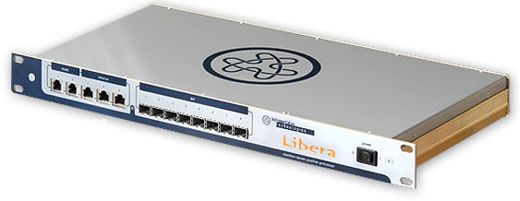
Upgrade of BPM Electronics
Slow Acquisition
(10 Hz, orbit correction)
Turn by Turn
(355 kHz, for lattice studies)
First Turn mode
(For injection tuning)
224 Libera
Brillance
Post-Mortem
(Data logging on trigger)
Fast Acquisition (10 kHz)
For fast global orbit correction
Sum signal of the 4 buttons:
  Lifetime monitor
  Instant Fractional-Beamloss monitor

Slide 6
Coupling reduction
Maintaining low emittance during USM: 1 week delivery
Current
200 mA
Vertical emittance
3.5 pm
50 hours
Lifetime
@ Vertical Diffraction Limit reached routinely

Slide 7
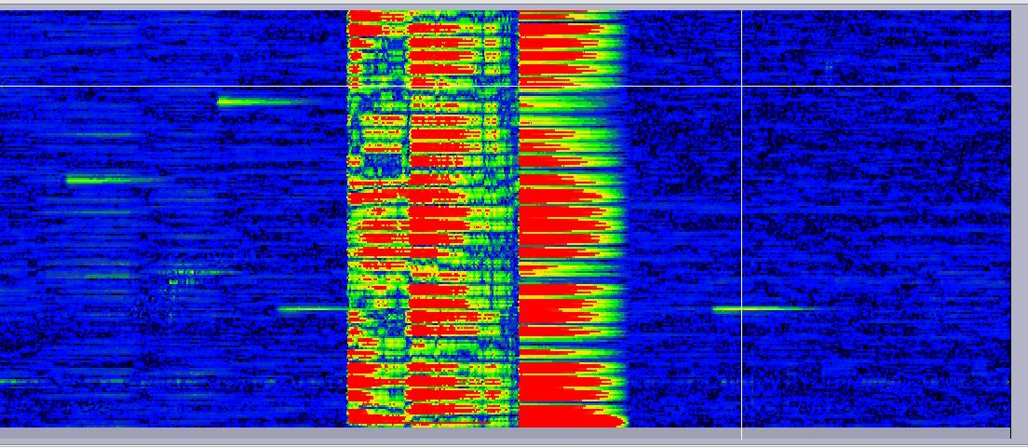
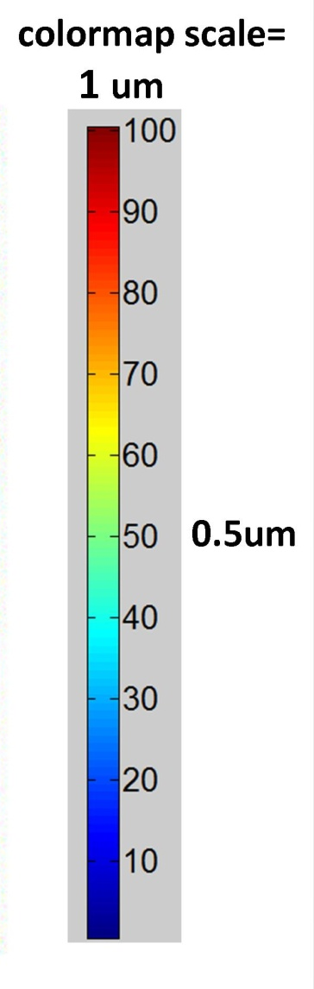
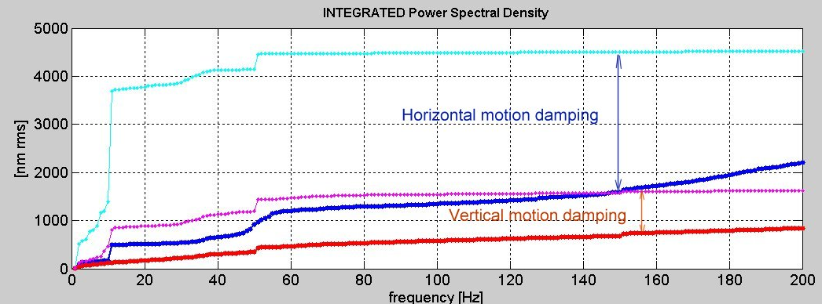
New orbit feedback
Cell1
rms
ID11
ID17
224 BPM
Feedback OFF
ID27
Cell32
8 mn
Horizontal OFF
Horizontal ON
Vertical OFF
Vertical ON
2.5 μm
0.9 μm
~0.1μm stability routinely achieved in V
~1.0μm stability routinely achieved in H

Slide 8
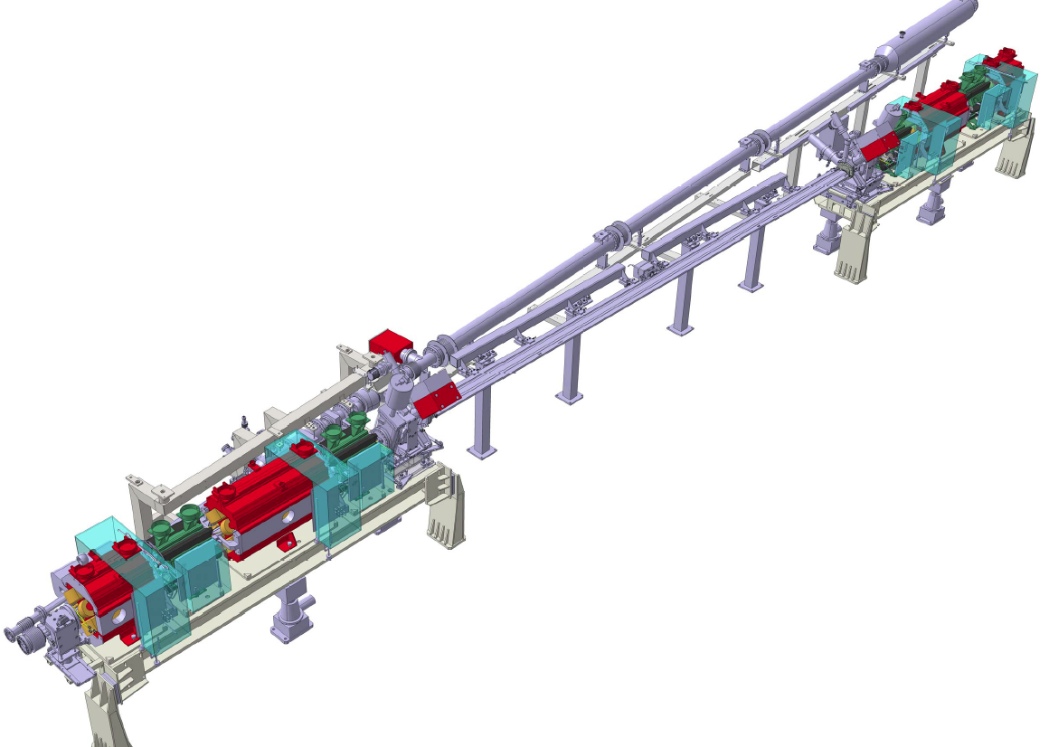
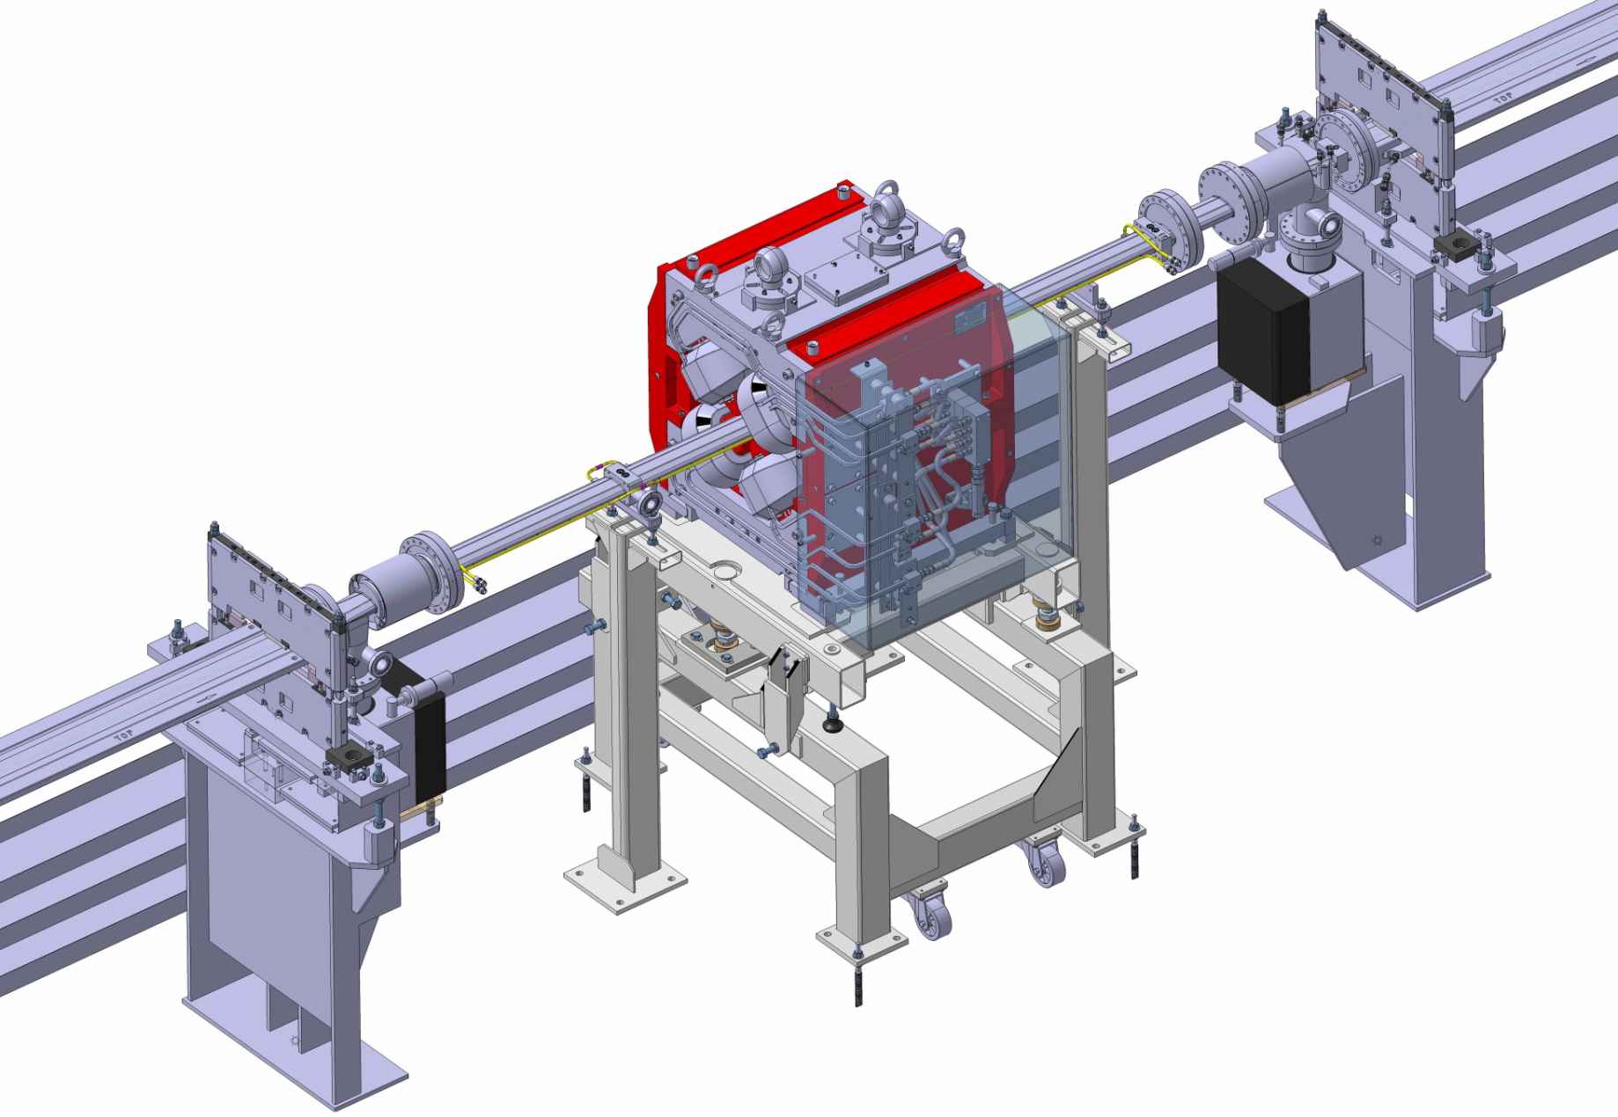
6&7 m straight sections
5 metre standard Section
7 straight sections already converted to 6 metres
First large canting installation this summer
6 metre Section (6173 mm)
7 metre Section
7 m section installed in 2013
RF cavities installed in the second half 2013

Slide 9
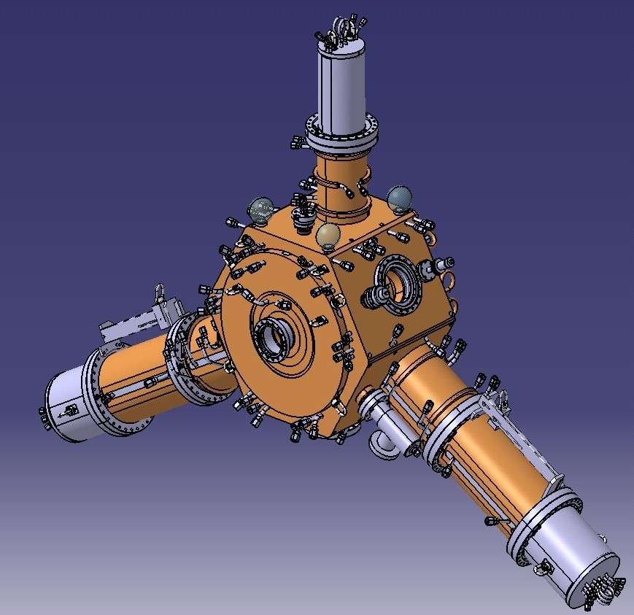
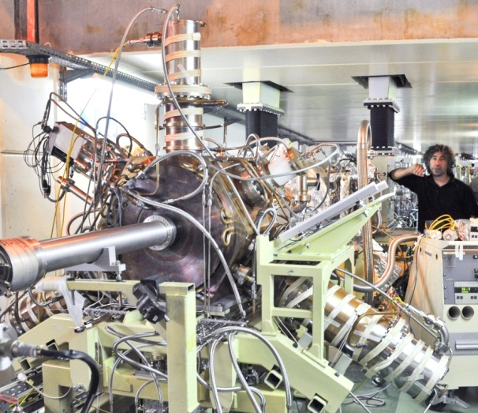
Single cell NC HOM damped cavity
9 MV with 12 to 18 cavities (4.7 ± 0.4 MΩ)
Planned operation at 300 mA
Power capability to sustain up to 500 mA
No HOM up to 1 A
Goal:
RF distribution to create a new experimental station
Prepare future upgrades
HOM absorbers:
Ferrite loaded tapered ridges
3 cavities operational in the SR
352 MHz
HOM dampers = ridge waveguides
Based on 500 MHz BESSY, MLS, ALBA design [E. Weihreter et al.]
ESRF 352.2 MHz design: several improvements

Slide 10
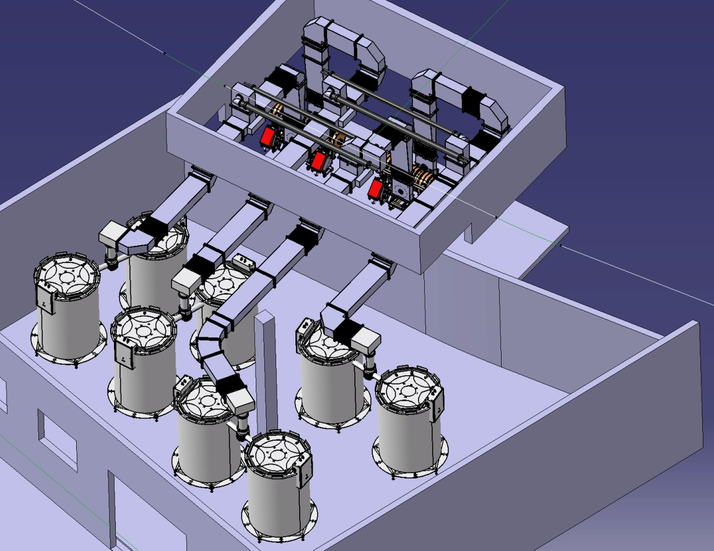
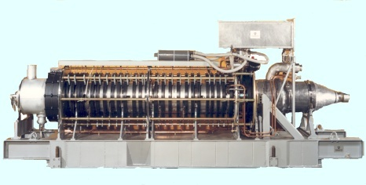

Solid State RF transmitters
Klystrons at l’ESRF
2 five-cell cavities
x 2 couplers
1.3 MW -352MHz
4 Waveguide switches to
4 water loads
Goal:
Prevent klystron obsolescence
Prepare future upgrades
SY: Booster Synchrotron
75 kW tower of
128 RF modules
Booster RF :
Four 150 kW amplifiers in operation
Replacing one 352.2 MHz 1.3 MW
klystron booster transmitter
SYRF now ready for TopUp operation,
(Electrical power reduced from 1200 to 400 kW).

Slide 11
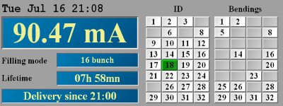
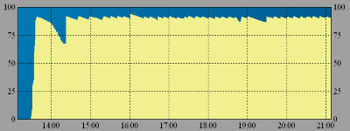
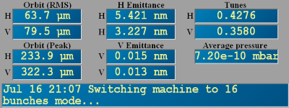
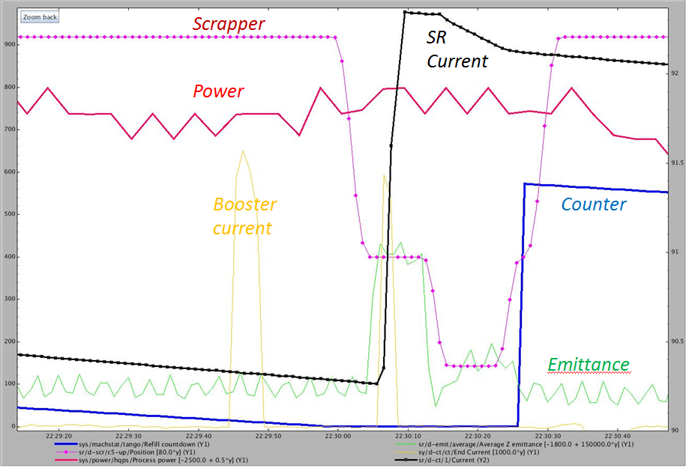
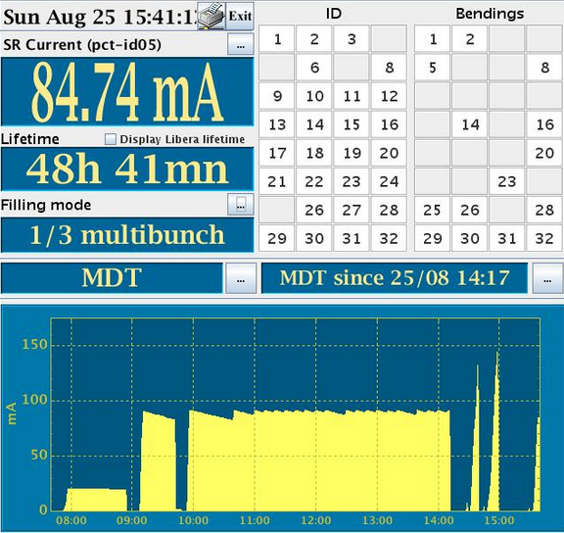
PHASE I: top-up feasibility
Optimise the topping sequence
Check the injector reliability
Reduce the injection time
20 seconds
Top-Up Operations will start at
beginning of 2016
Page 11

Slide 12
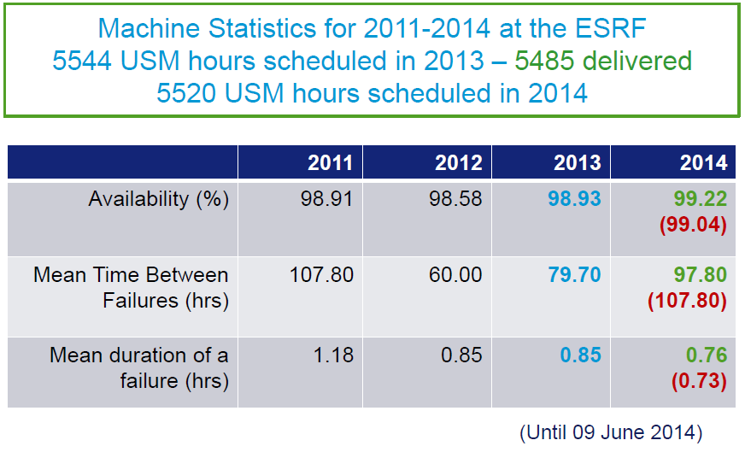
Operation statistics through phase I Up implementation
Despite the Phase I activities…
machine performances kept to record levels!
Page 12

Slide 13
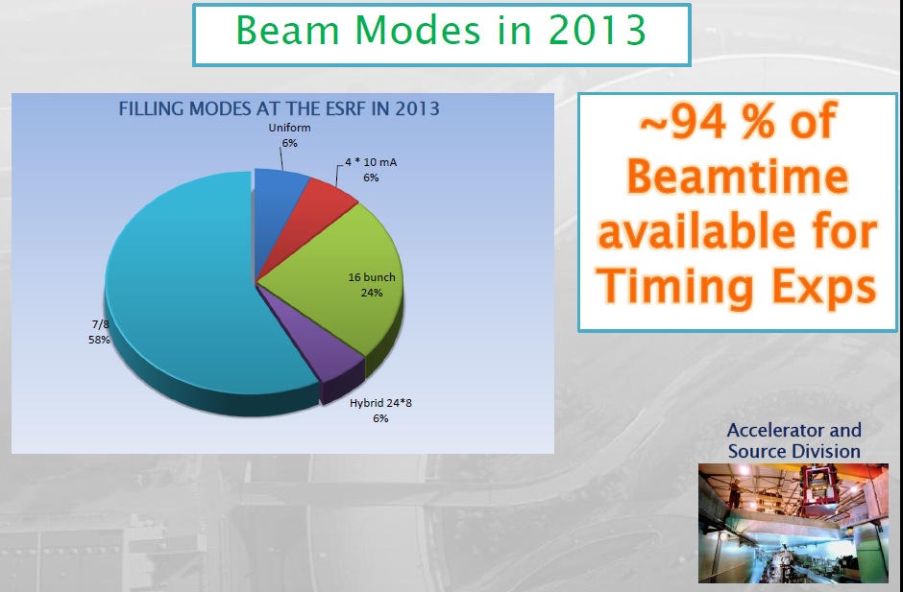
OPERATION STATISTICS

Slide 14
Main hardware activities programmed for the period 2014-2016
Spares: Linac Modulator, Buncher, Accelerating Structures
2 Extra cavities in the Booster
Bunch cleaning in the Booster
New Bpms electronics and orbit control (movers) in the Booster
New Booster Power Supply
12 HOM Cavities in the SR
Phase II prototyping: Magnets, Vacuum Components, Diagnostic etc…
Conditioned to maintain
Record Performances Operations!
Page 14

Slide 15
Accelerator Upgrade Phase II
The Accelerator Upgrade Phase II aims to:
- Substantially decrease the Store Ring Equilibrium Horizontal Emittance
Increase the source brilliance
Increase its coherent fraction.
In the context of the R&D on “Ultimate Storage Ring”, the ESRF has developed a solution, based on the following requirements and constraints:
Reduce the horizontal equilibrium emittance from 4 nm to less than 150 pm
Maintain the existing ID straights and beamlines
Maintain the existing bending magnet beamlines
Preserve the time structure operation and a multibunch current of 200 mA
Keep the present injector complex
Reuse, as much as possible, existing hardware
Minimize the energy lost in synchrotron radiation
Minimize operation costs, particularly wall-plug power
Limit the downtime for installation and commissioning to 19.5 months.
Maintain standard User-Mode Operations until
the day of shut-down for installation
Page 15

Slide 16
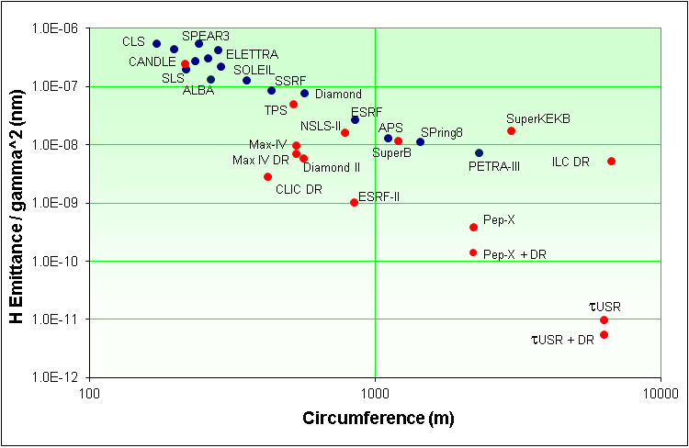
Low Emittance Rings Trend
Based on 1980 KnowHow
Based on state of the art
technologies
Sirius
APS
SPring8
Existing machines
In Construction
Advanced Projects
Concept stage
Several facilities will implement
Low Horizontal Emittance Lattices
by the next decade
Page 16

Slide 17
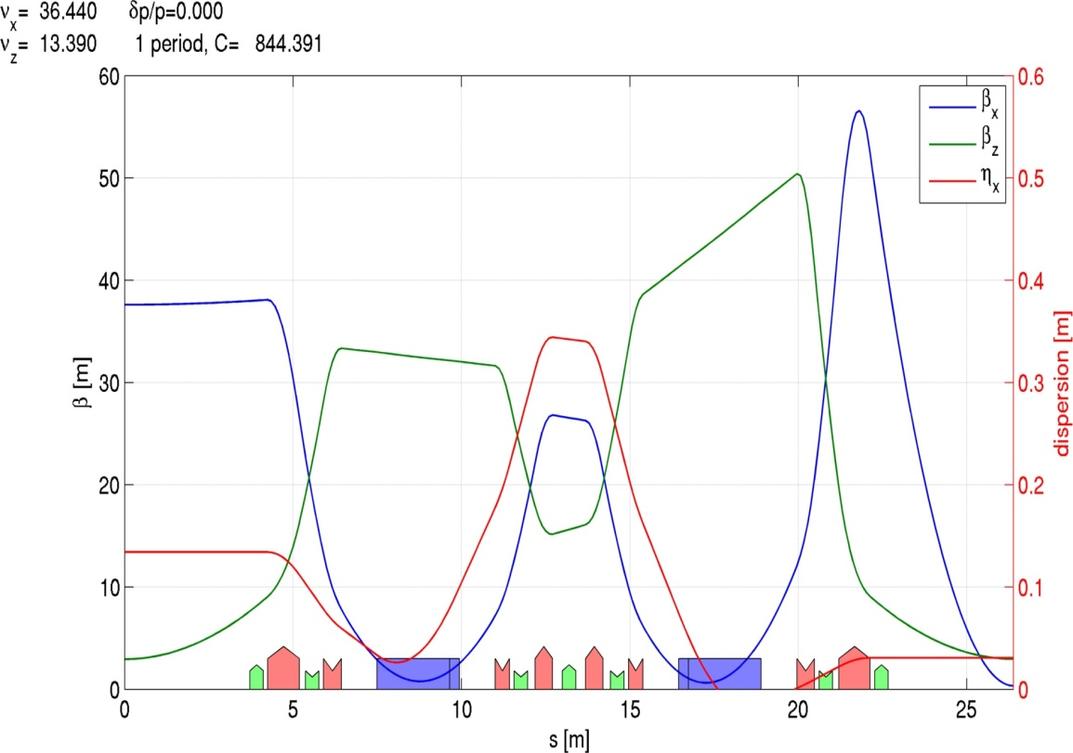
The evolution to Multi-Bend Lattice
Double-Bend Achromat (DBA)
  Many 3rd gen. SR sources
  Local dispersion bump (originally closed) for chromaticity correction

Slide 18
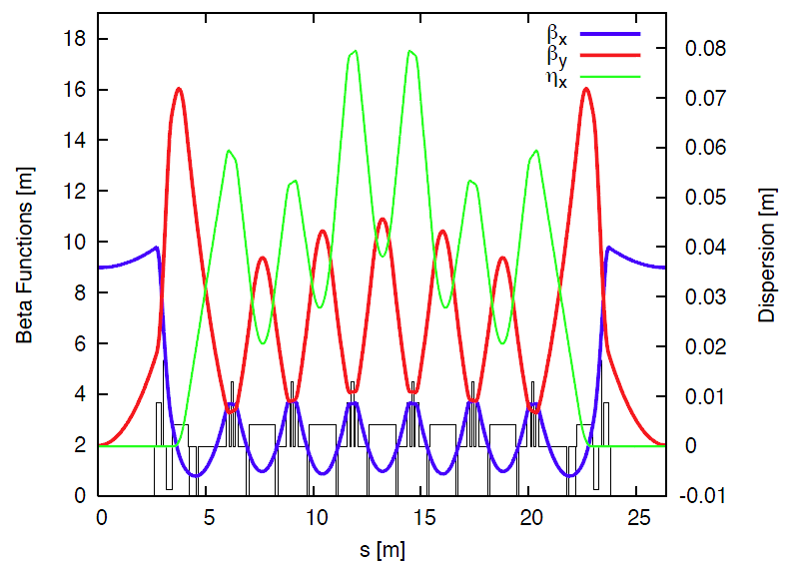
The evolution to Multi-Bend Lattice
Double-Bend Achromat (DBA)
  Many 3rd gen. SR sources
  Local dispersion bump (originally closed) for chromaticity correction
Multi-Bend Achromat (MBA)
  MAX IV and other USRs
  No dispersion bump, its value is a trade-off between emittance and sextupoles (DA)

Slide 19
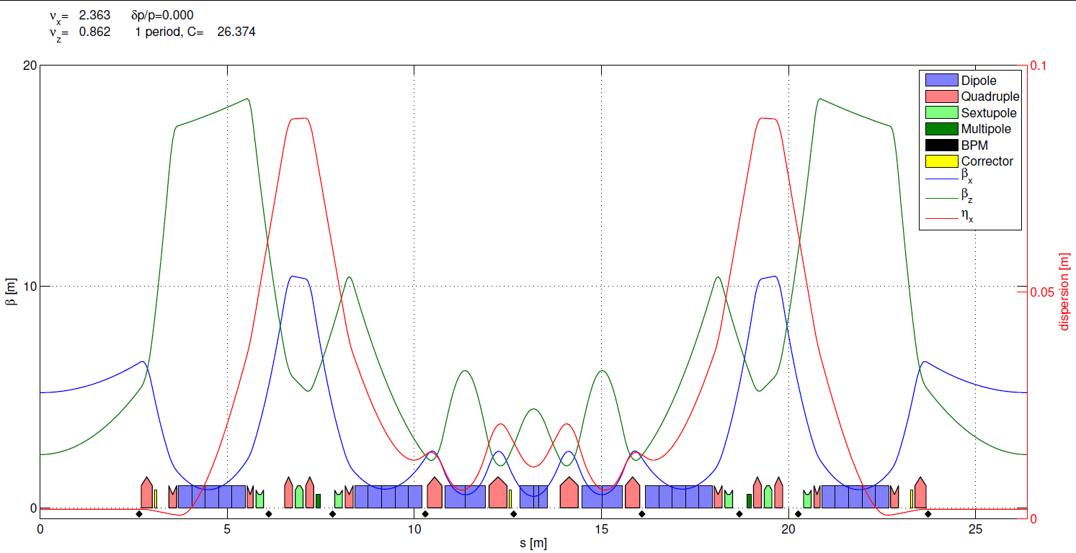
The Hybrid Multi-Bend (HMB) lattice
ESRF existing (DBA) cell
  Ex = 4 nm•rad
  tunes (36.44,13.39)
  nat. chromaticity (-130, -58)
  - Multi-bend for lower emittance
  Dispersion bump for efficient chromaticity correction => “weak” sextupoles (<0.6kT/m)
  Fewer sextupoles than in DBA
  Longer and weaker dipoles => less SR
  - No need of “large” dispersion on the inner dipoles => small Hx and Ex
Proposed HMB cell
  Ex = 140 pm•rad
  tunes (75.60, 27.60)
  nat. chromaticity (-92, -82)

Slide 20
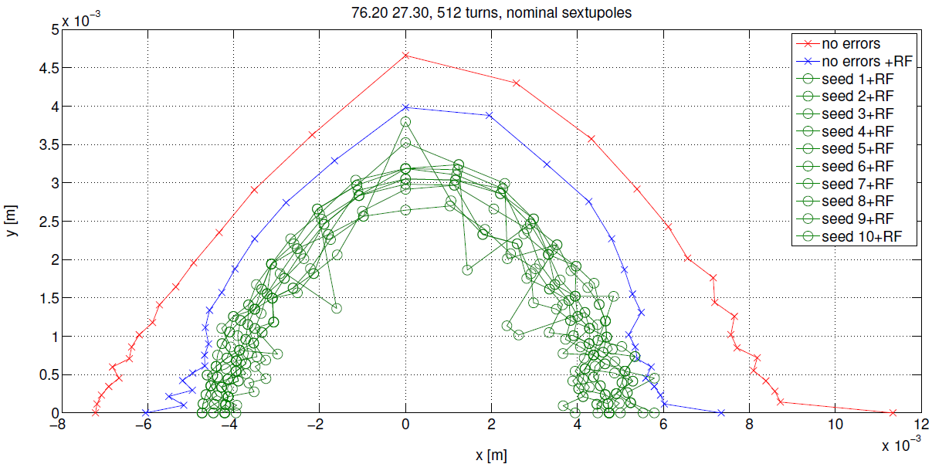
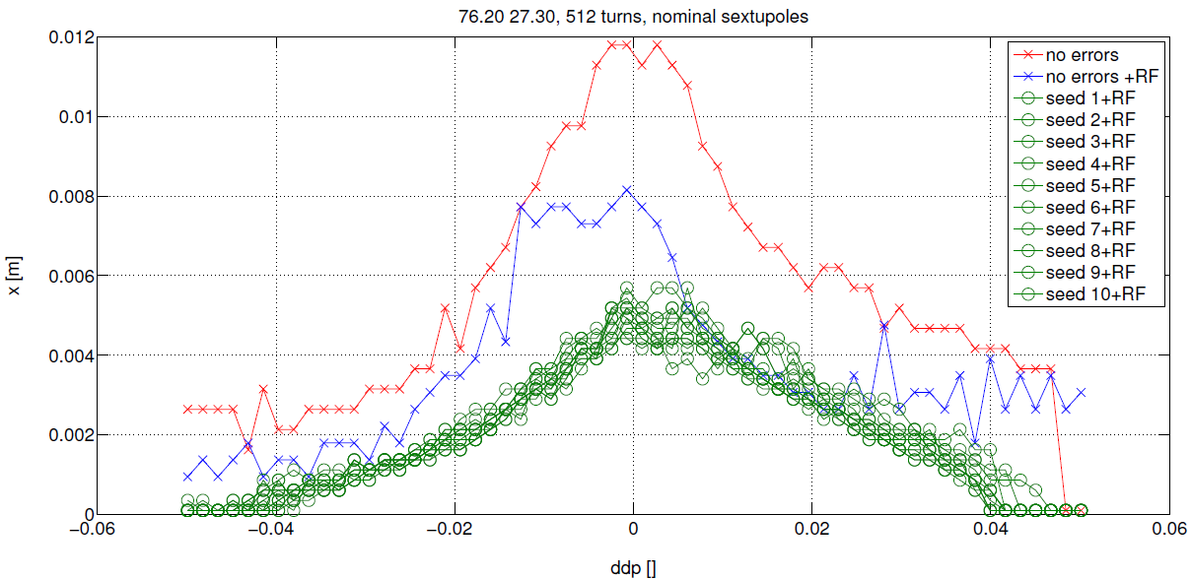
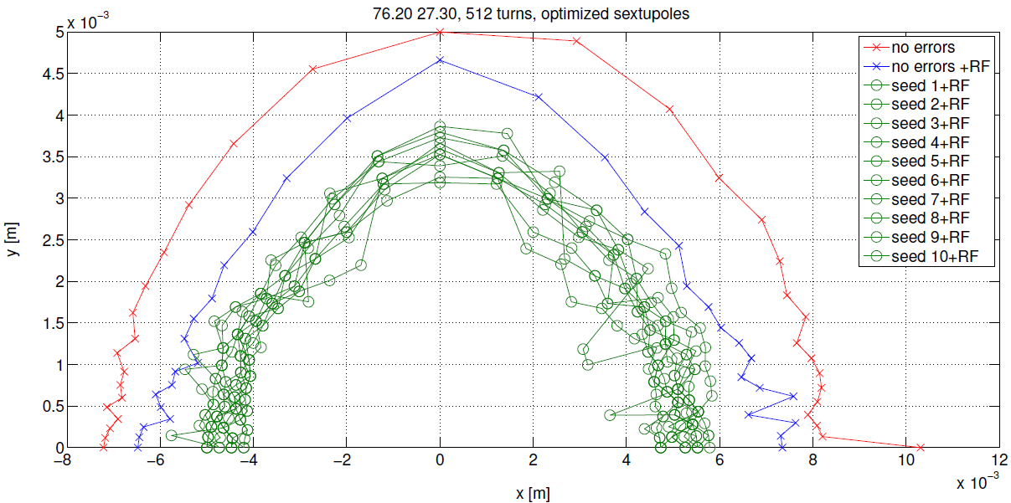
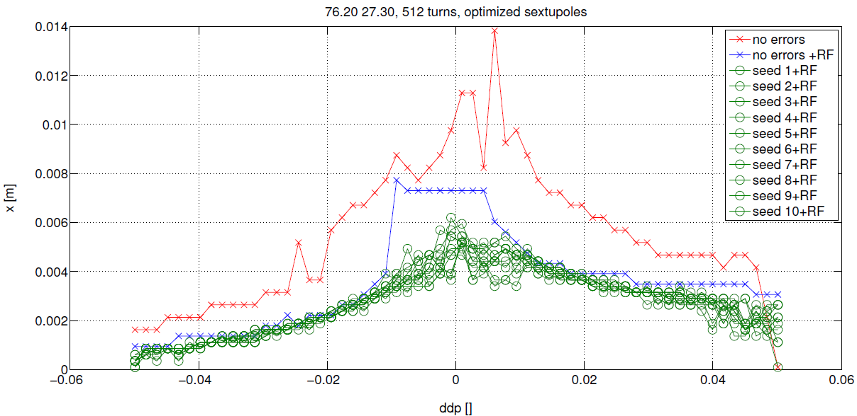
Dynamic apertures: wp 76.23 27.34 lifetime > 24hrs (with errors)
Nominal
sextupoles
Beta_x = 5.3m (Injection cell will have beta_x at least 2 times larger)
Optimized
sextupoles

Slide 21
The ESRF Low Emittance Lattice
Proposed hybrid 7 bend lattice Ex = 146 pm.rad
Design virtually finalized. Only minor modifications (~cm) are expected upon complete engineering of all the elements
Several iterations made between:
Optics optimization: general performances in terms of emittance, dynamic aperture, energy spread etc…
Magnets requirements: felds, gradients…
Vacuum system requirements: chambers, absorbers, pumping etc
Diagnostic requirements
Bending beam lines source
Page 21

Slide 22
Improved Coherence
brilliance and coherence increase
Brilliance
Hor. Emittance [nm] | 4 | 0.15
Vert. Emittance [pm] | 3 | 2
Energy spread [%] | 0.1 | 0.09
β_{x}[m]/β_{z} [m] | 37/3 | 4.3/2.6
Coherence
Page 22

Slide 23
Improvement of undulator X-ray beam
Undulator: CPMU18,
K=1.68
L=2m
Hor. Emittance [nm] | 4 | 0.15
Vert. Emittance [pm] | 3 | 2
Energy spread [%] | 0.1 | 0.09
β_{x}[m] High/Low | 37/0.3 | 5.2
β_{z} [m] | 3.1 | 2.6
Page 23

Slide 24
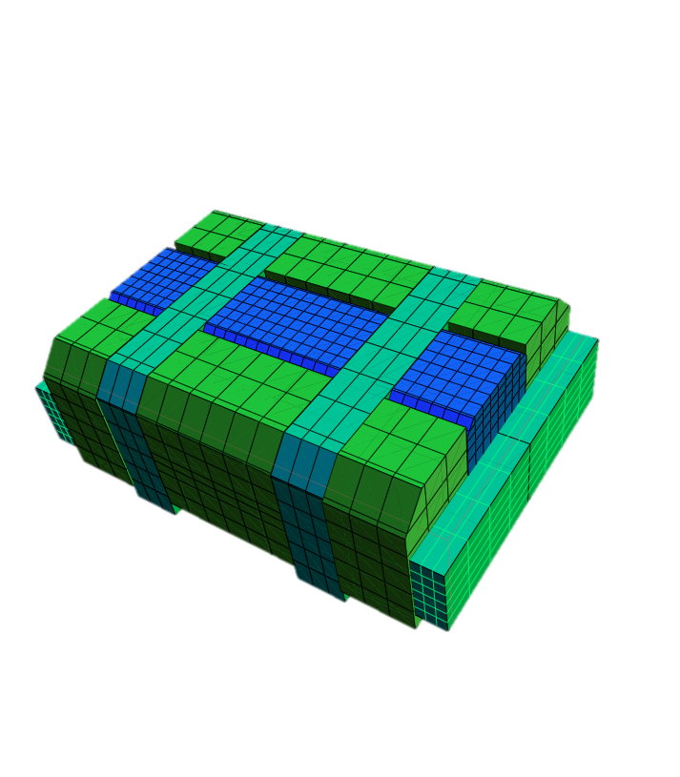
Bending magnets source: 3-Pole wiggler
Field Customized
Large fan with flat top field
2 mrad feasible for 1.1 T 3PW
2 mrad difficult for 0.85 T version
Mechanical length ≤ 150 mm
Half assembly
All new projects of diffraction limited storage rings have to deal with:
Increased number of bending magnets / cell => BM field reduction
Cconflict with hard X-ray demand from BM beamlines
ESRF will go from 0.85 T BM to 0.54 T BM
The BM Source can be replaced by a dedicated 3-Pole Wiggler
Flux from 3PW

Slide 25
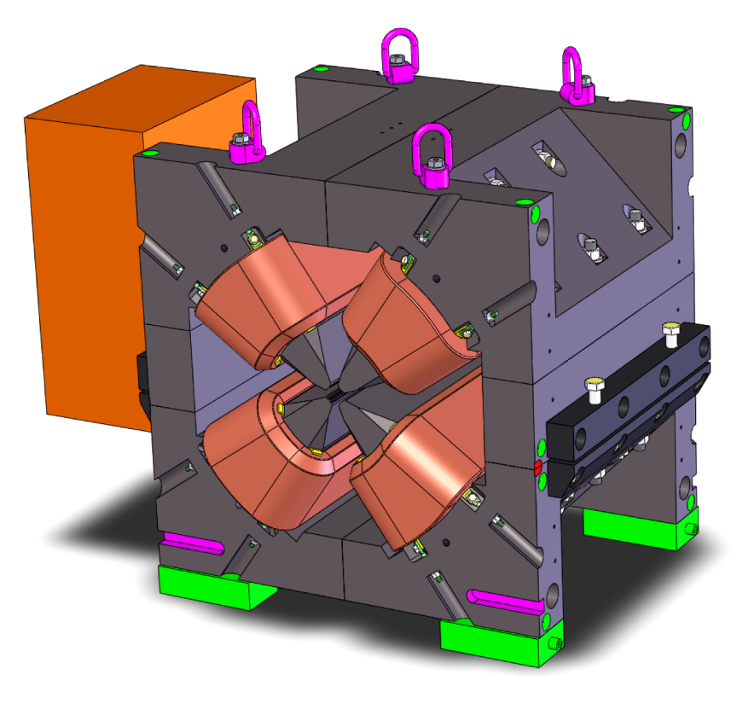
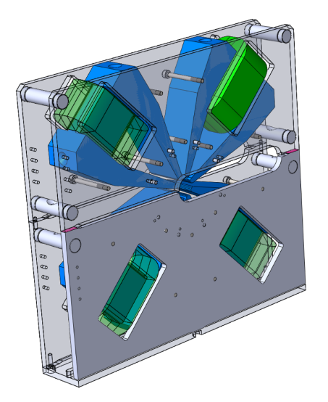
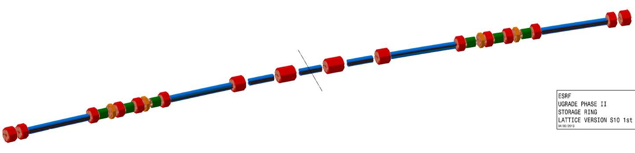
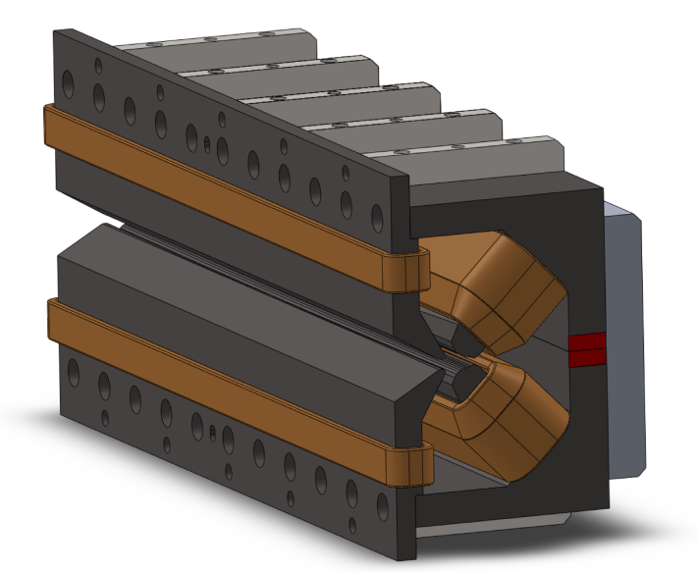
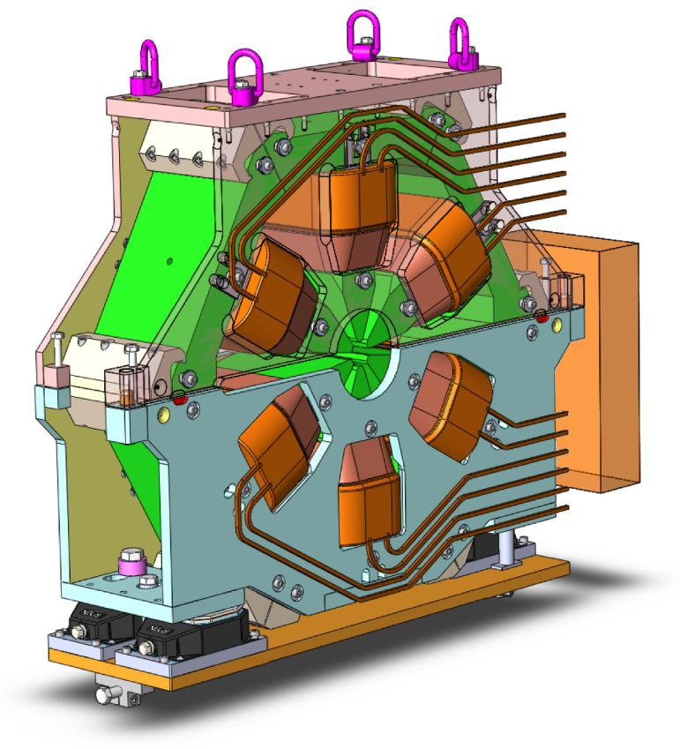
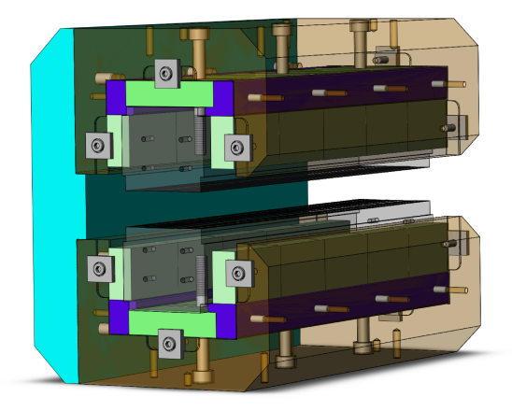
Technical challenge: Magnets System
Mechanical design final drawing phase
Soft iron, bulk yoke
Large positioning pins for opening repeatability
Tight tolerances on pole profiles
Prototypes to be delivered in the period:
September 2014-Spring 2015
Quadrupole
Around 52Tm⁻¹
D₇
D₆
High gradient quadrupoles
D₂
D₅
Gradient: 90 T/m
Bore radius: 12.5 mm
Length: 390/490 mm
Power: 1-2 kW
D₃
D₄
D₁
Sextupoles
Length 200mm
Gradient: 3500 Tm⁻²
Combined Dipole-Quadrupoles
0.54 T / 34 Tm⁻¹ & 0.43 T / 34 Tm⁻¹
Permanent magnet (Sm₂Co₁₇) dipoles
longitudinal gradient 0.16 − 0.65 T, magnetic gap 25 mm
1.8 meters long, 5 modules
Page 25

Slide 26
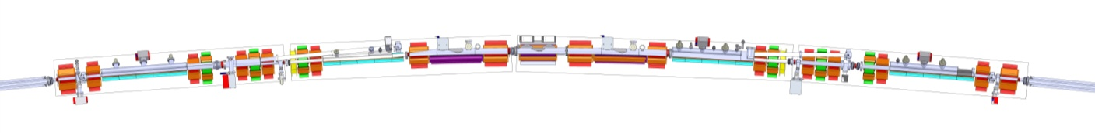
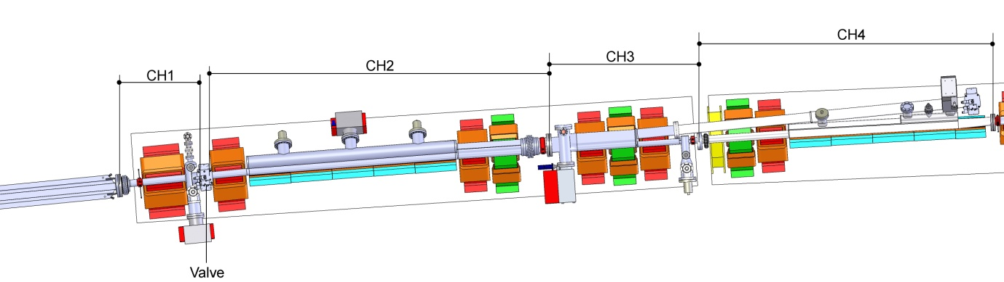
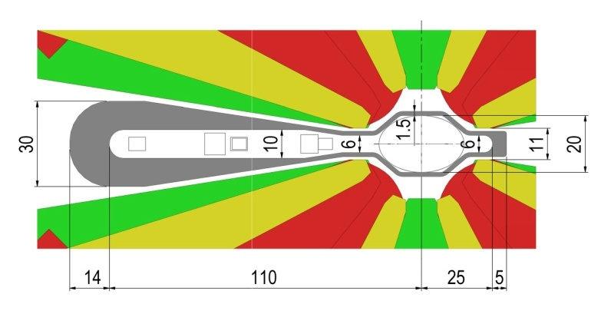
Technical challenge: Vacuum System
Vacuum System Design very advanced
System solutions very similar to the present ones
Expected performances similar or better than the present ones
Antichambers everywhere
Synchrotron Radiation handling by lumped absorbers
Page 26

Slide 27

Preparing the Upgrade phase II
Technical Design Study (TDS)
Completed and submitted to:
Science Advisory Committee (SAC)
Accelerator Project Committee (APAC)
Cost Review Panel (CRP)
ESRF Council
All committees very positive to go ahead

Slide 28
Accelerator Project Roadmap
Project Schedule:
◊ Nov 2012 White paper
Nov 2012- Nov 2014 Technical Design Study
◊ June 2014 Project approved by Council
Jan 2015 – Oct 2018 Design finalized, Prototypes,
Procurement, Pre-Assembly
Oct 2018 – Sep 2019 Installation
Sep 2019 – Jun 2020 Commissioning
◊ Jun 2020 User Mode Operation
Done
TDS submitted for review
Design very advanced
Prototyping in progress
10 Work Packages defined in the TDS:
WP0: Installation
WP1: Beam dynamics
WP2: Magnets
WP3: Mechanical and Vacuum Engineering
WP4: Power supplies
WP5: Radiofrequency
WP6: Control System
WP7: Diagnostics and feedbacks
WP8: Photon source
WP9: Injector upgrade
Accelerator Project Budget:
103.5 M€ Construction and commissioning of the new storage ring

Slide 29
Conclusions
Through the years ASD has delivered very high quality beam that have greatly contributed to maintain ESRF among the leaders of the SR facilities.
Phase I has been the opportunity to further push the Source performances, the programme is being completed while maintaining the high standards beam delivery.
Phase II will further expand the ESRF frontiers and will insure the continuation of its leadership in Science and in Synchrotron Accelerators for the next decade.
Page 29

Slide 30
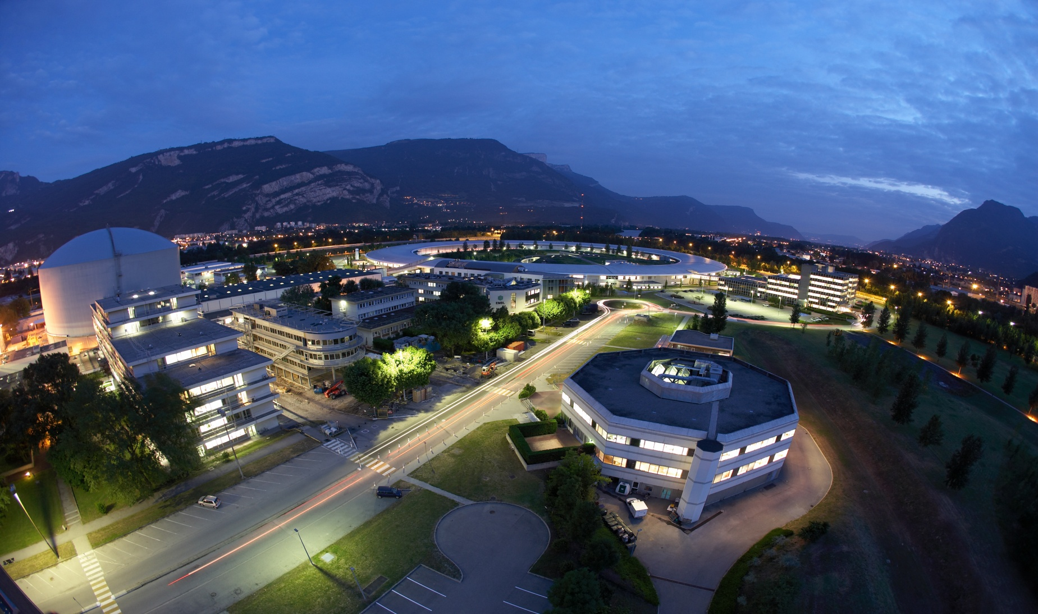
Many thanks for your attention

