Slide 1
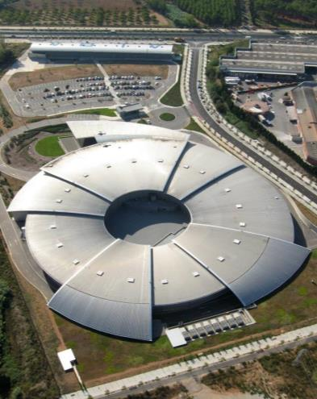
ALBA Status
Francis Perez

Slide 2
Outline
2
Introduction
Operation 2014
  Statistics
  Problems
Top Up
Accelerator Developments
  FOFB
  Energy measurement
  Interferometry beam size
  “67 MeV” injector

Slide 3
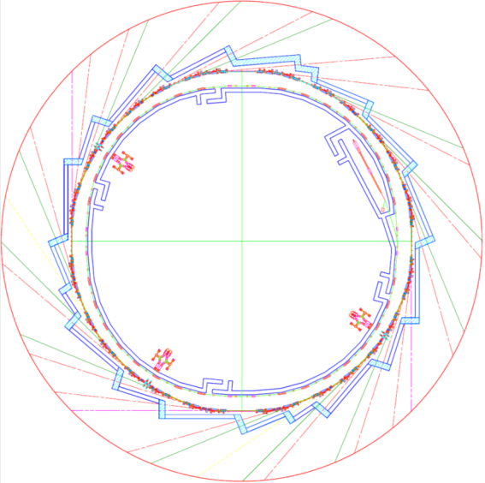
ALBA Accelerators
LINAC
100 MeV
BOOSTER
100 MeV – 3 GeV
STORAGE RING
3 GeV

Slide 4
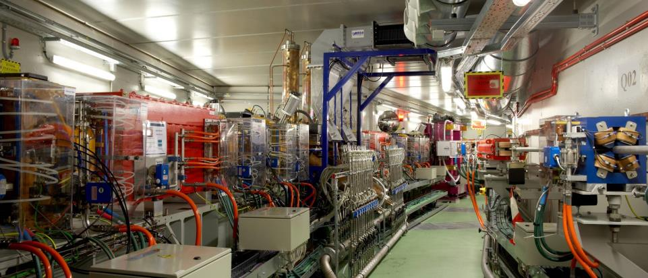
ALBA Accelerators
Bending
RF cavities
In vacuum undulator
SR
Booster

Slide 5
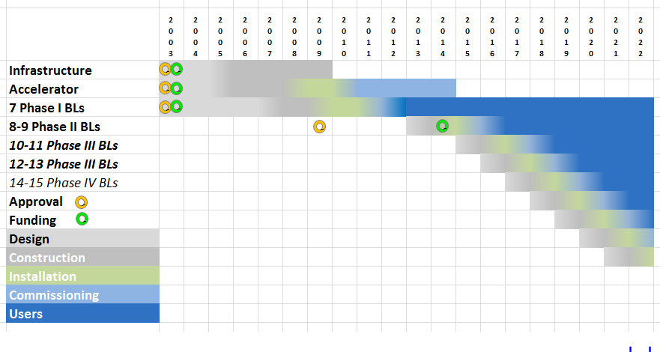
ALBA New Beamlines schedule
‘Austerity’
shift
By 2020 → 13 Operational Beamlines

Slide 6
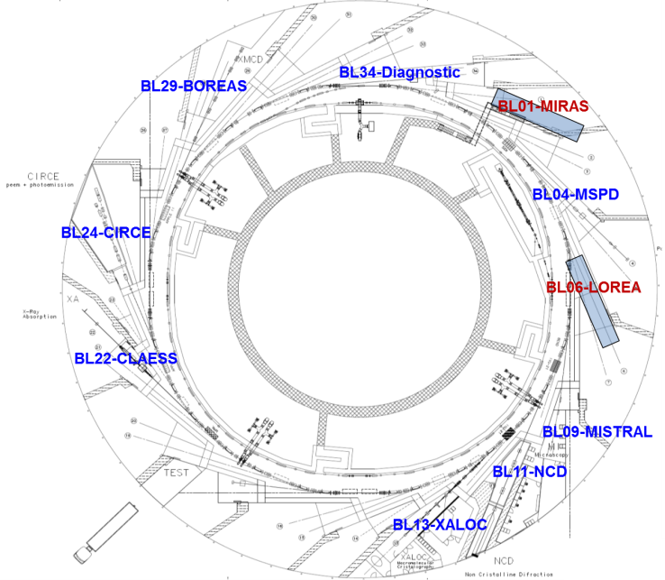
ALBA BLs Phase II in execution
MIRAS: Infrared microscopy
LOREA: Photoemission with Low Angle Resolution

Slide 7

ALBA BLs Phase III
Proposals received in October
SAC Meeting in December
Evaluation by January 2015

Slide 8
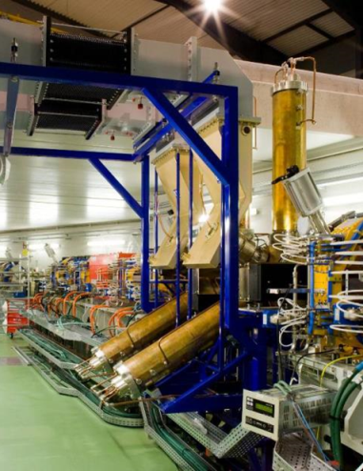
Operation 2014
Statistics
Problems

Slide 9
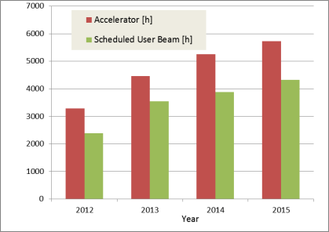
Beam for users at ALBA
 | 2012 | 2013 | 2014 | 2015
Accelerator operation [h] | 3280 | 4464 | 5250 | 5730
Scheduled user beam [h] | 2387.3 | 3539.5 | 3888.0 | 4320.0
Availability [%] | 77.0 | 83.8 | 96.5*
Delivered beamtime [h] | 1838 | 2967 | 3752
MTBF [h] | 21.0 | 25.0 | 31.0*
MTTR [h] | 1.0 | 0.8 | 1.1*
Beam for BLs: scheduled user beam, including injection time
MTBF: Mean time between failures
MTTR: Mean time to have the beam back
* Data until 10/11/2014

Slide 10
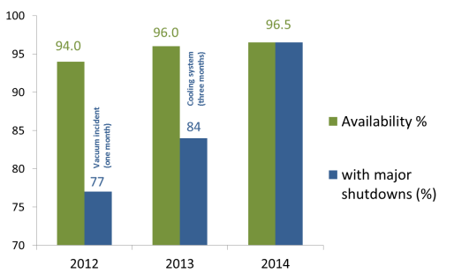
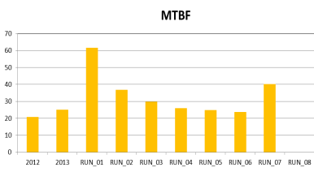
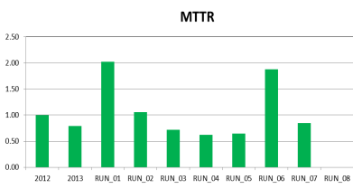
Beam Availability (until 10th Nov)
25 h
31 h
1.0 h
1.1 h
21 h
0.8 h

Slide 11
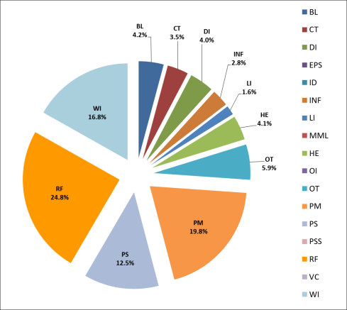
Operation 2014 (until 10th Nov)
Analysis of failures per sub-system
Total of 110.7 h of beam downtime
BL Beamlines PSS
CT Controls
DI Diagnostics
EPS EPS interlock
ID Insertion Devices
INF Infrastructure
LI Linac
MML High Level Software (MML)
OE Human error
OI Orbit Interlock
OT Others
PM Pulsed magnets
PS Power Supplies
PSS PSS (except BLs)
RF Radio Frequency
VC Vacuum
WI Water interlocks

Slide 12
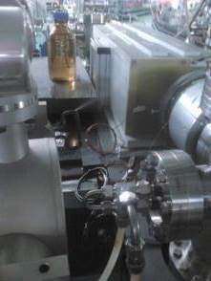
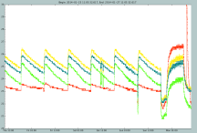
Pinhole aluminium window water leak
Damaged
Kicker
Electronics
FE absorber temperature – ok

Slide 13
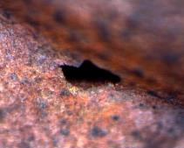
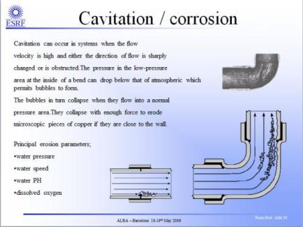
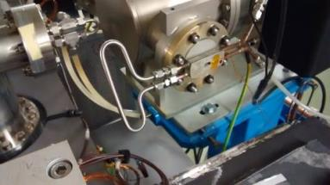
Pinhole aluminium window water leak
Small (350um) hole in the Cu cooling pipe
?
Microscope image
Repaired the following day

Slide 14
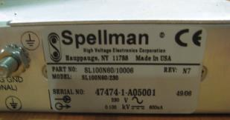
LINAC Gun High Voltage PS
Before starting run #3, during the subsystem tests,
the LINAC Gun High Voltage PS (-90 kV) did broke.
We did not have available spare:
Exchanged by -50 kV PS (from RF group) and commissioned the Linac with reduced e-gun beam energy.
BESSY lend us a -90 kV as back-up
(many thanks to Andreas that pick up the phone on May 1st and SOLEIL that offered also their spare)
Back to normal in a week, just in time for Users.

Slide 15
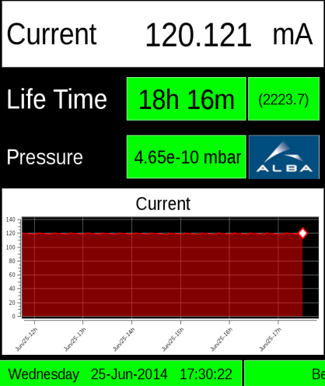
Top Up

Slide 16
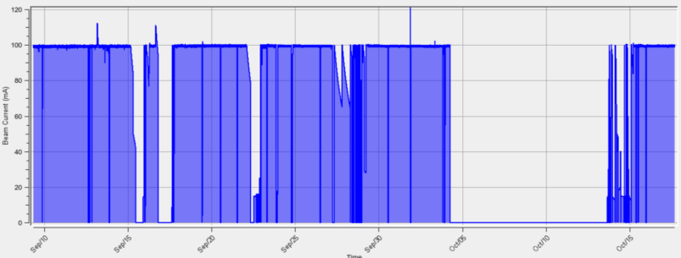
Top Up
Test with users: 3 weeks in July
Routine Operation Started: 9 September 2014
M
M
M
W
M

Slide 17
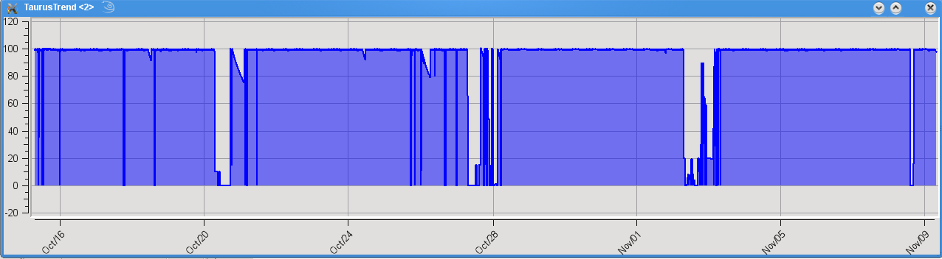
Top Up during RUN07
100% availability 28 Oct- 7 Nov
Machine studies
Machine studies
Machine studies
Beam availability RUN07: 97.8 %

Slide 18
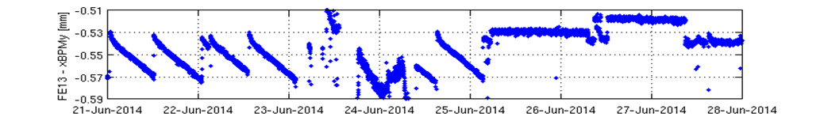
Top Up
Stability at the Beam lines, measured at the xBPMs:
XALOC: xBPM_{(y)}
Machine day
Decay mode
Top-up
(jumps are due to changes in the ID gap & xBPMs not properly calibrated)

Slide 19
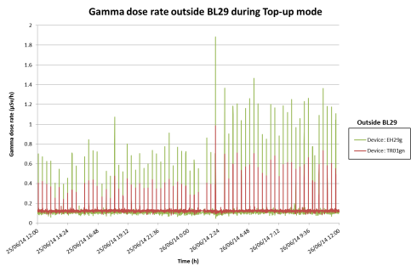
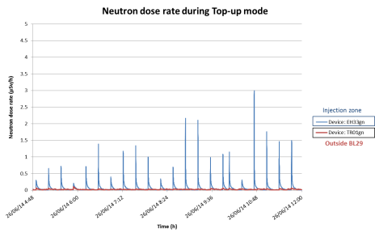
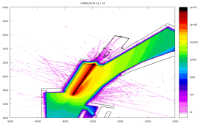
© Safety
Radiation measured during Top-Up
Only gammas detected
at BOREAS
Under investigation

Slide 20
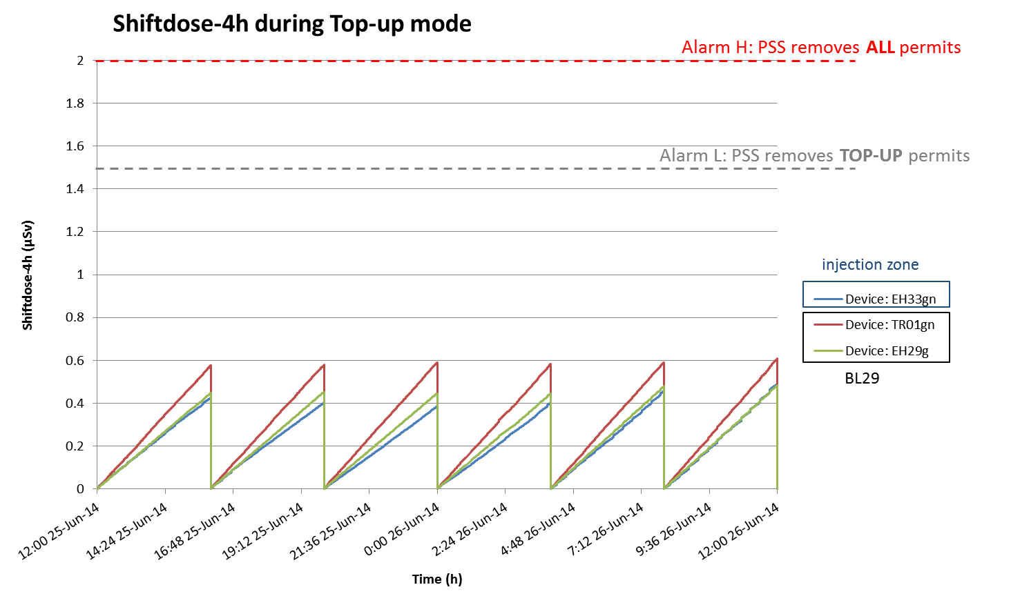
© Safety
Radiation measured during Top-Up
June 25th
Well below Public Zone & Similar to decay mode

Slide 21
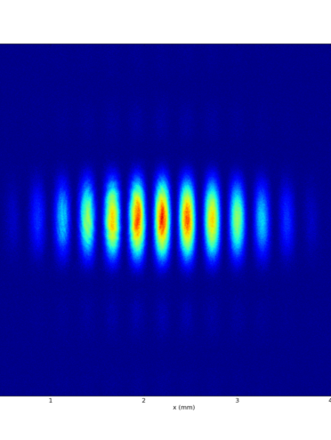
Accelerator Developments
FOFB
Energy measurement
Interferometry beam size
“67 MeV” injector

Slide 22
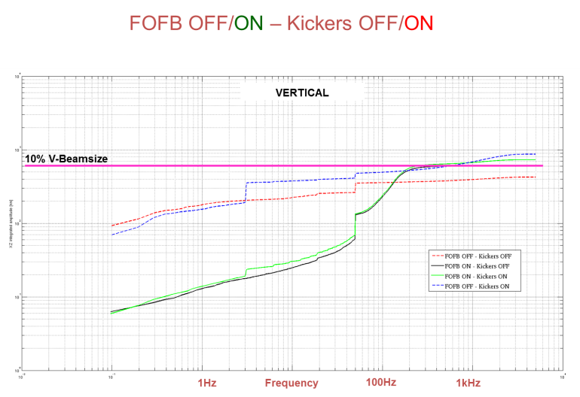
Fast Orbit FeedBack (Vertical)
3 Hz
FOFB OFF
FOFB ON
Notes:
22

Slide 23
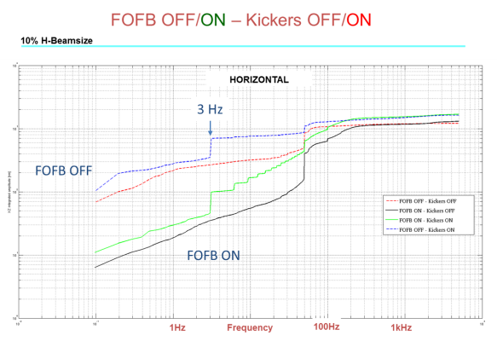
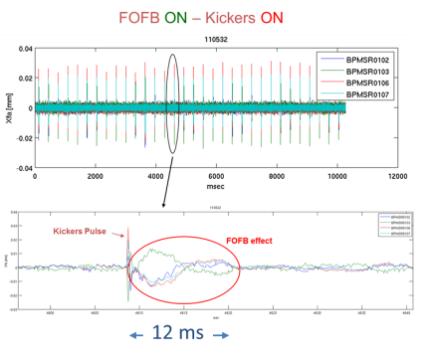
Fast Orbit FeedBack (Horizontal)
3 Hz horizontal
kicker induced noise
is amplified by FOFB
Notes:
23

Slide 24
Fast Orbit FeedBack
FOFB is working but still:
  Fine tune required
  Robustness (long runs) to be tested
  Error handing
  Friendly user interface
Notes:
24

Slide 25
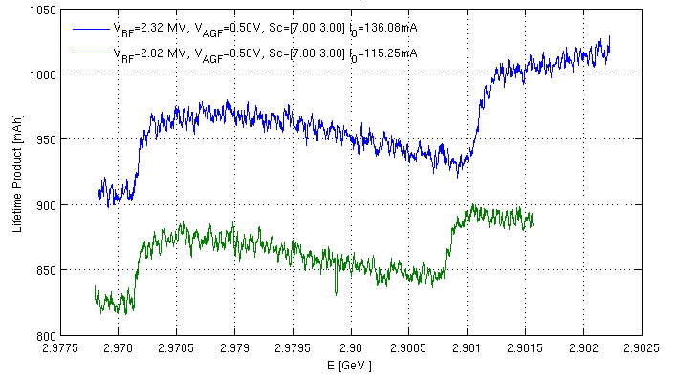
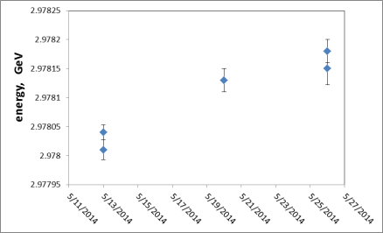
Energy Measurement
Spin depolarization
2.97813 ±0.00002 GeV
3 different days
3 different RF frequencies
3 different energies: ±0.0001 GeV

Slide 26
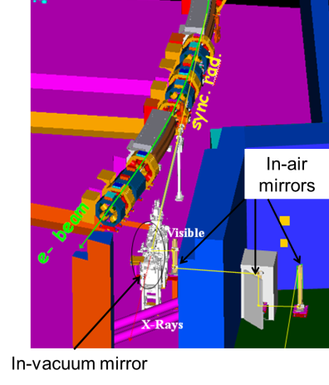
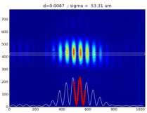
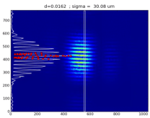
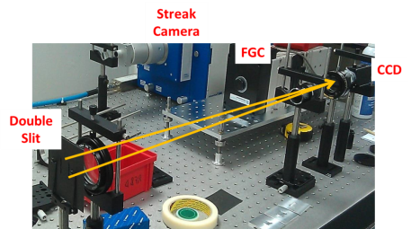
Interferometry beam size
Working on some vibration issues

Slide 27
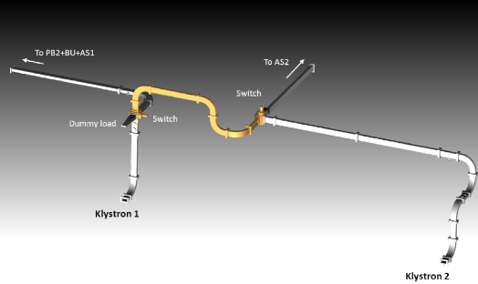
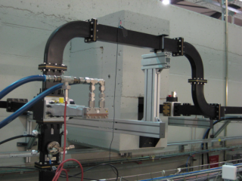
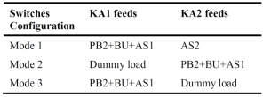
“67 MeV” injector
Objective:
Operate the LINAC with only one Klystron:
  Either KA1 or KA2, for redundancy
  Compatible with installation and test of the second one

Slide 28
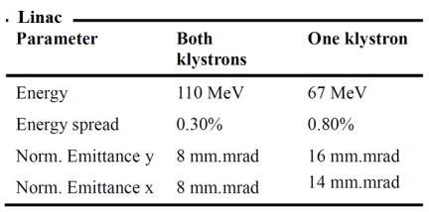
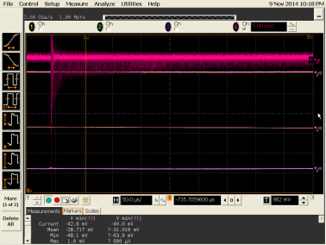
“67 MeV” injector
500 turns in Booster

Slide 29
Summary
Accelerators operate reliable for users
    96,0 % 2013 (excluding cooling problem)
    96,5 % 2014 (so far)
Top Up operational
Objectives for 2015
    FOFB operational
    Injector “67 MeV”
    Increase operation current

Slide 30
Accelerator Division Head
F. PEREZ
Operations
M. PONT
Operators
F.FERNANDEZ
M. ALVAREZ
O. SERRES
D. YEPEZ
P. SOLANS
RF & Linac
RF
A. SALOM
B. BRAVO
J. OCAMPO
Linac
R. MUÑOZ
D. LANAIA
IDs
J. CAMPMANY
Magn Lab
J. MARCOS
V. MASSANA
Beam Physics
U. IRISO
Beam Dynamics
G. BENEDETTI
T. GÜNZEL
Z. MARTÍ
M. CARLÀ
oPAC
Diagnostics
A. OLMOS
A. NOSYCH
L. TORINO
oPAC
J.C GIRALDO
M. SOS
N. AYALA
R. FOS
MINECO
Thanks to you,
to the accelerators team
and many others

