Slide 1
Status and new developments at ASTRID2
ESLS XXII, Grenoble 25-26/11 2014
Niels Hertel, ISA
University of Aarhus, Denmark

Slide 2
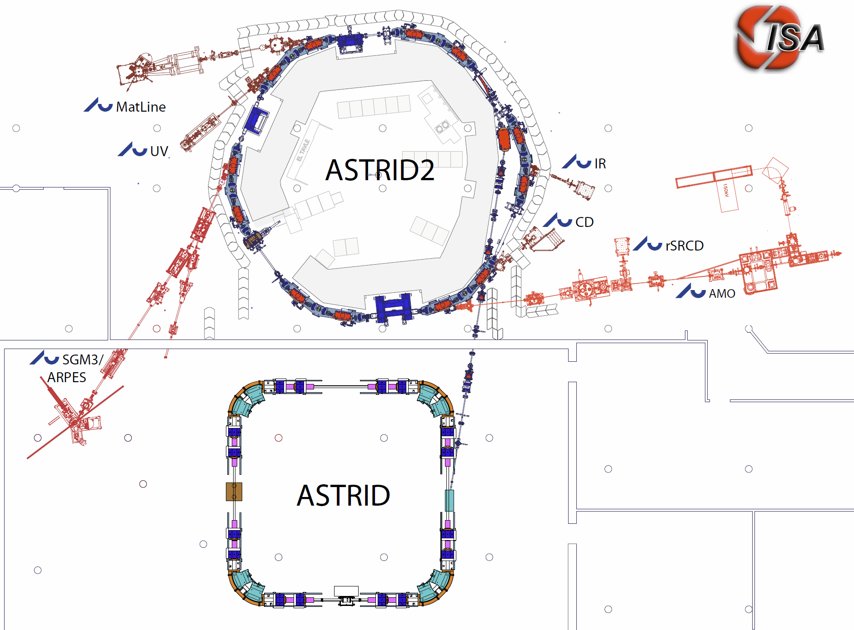
The ASTRID 2 facility
ASTRID2 main parameters
Circumference 45.71m
Energy 580MeV
Current 200mA
Characteristic energy 257eV
RF frequency 105MHz
Harmonic 16
Horiz. emittance 12nmrad
Straight sections 6
Length straight sections 2.82m
ID’s 3
Microtron (100MeV)
Notes:
Microtron, Booster, Inj. Bl., A2 ring, 5 beamlines now. 2 under construction.

Slide 3
Operation
Mode: Top-up from ASTRID. Unmanned 24/7 operation.
Typically 3mA are injected in ASTRID2 at 580MeV every 2-3 minutes
Extraction from ASTRID: 3 Slow bumpers (1s), a fast kicker (risetime 30ns), and a slow septum (2s)
Injection in ASTRID2: 3 bumpers (1.6µs, ½ sine) and septum (70µs)
Lifetime in ASTRID2: 1.3h at 90mA, with coupling adjusted to 10% with a skew quadrupole.
We are presently unable to have a stable beam at 200mA (bumpers, instabilities)
MTBF: ASTRID2: ~14 days. Booster and injection: ~5 days.

Slide 4
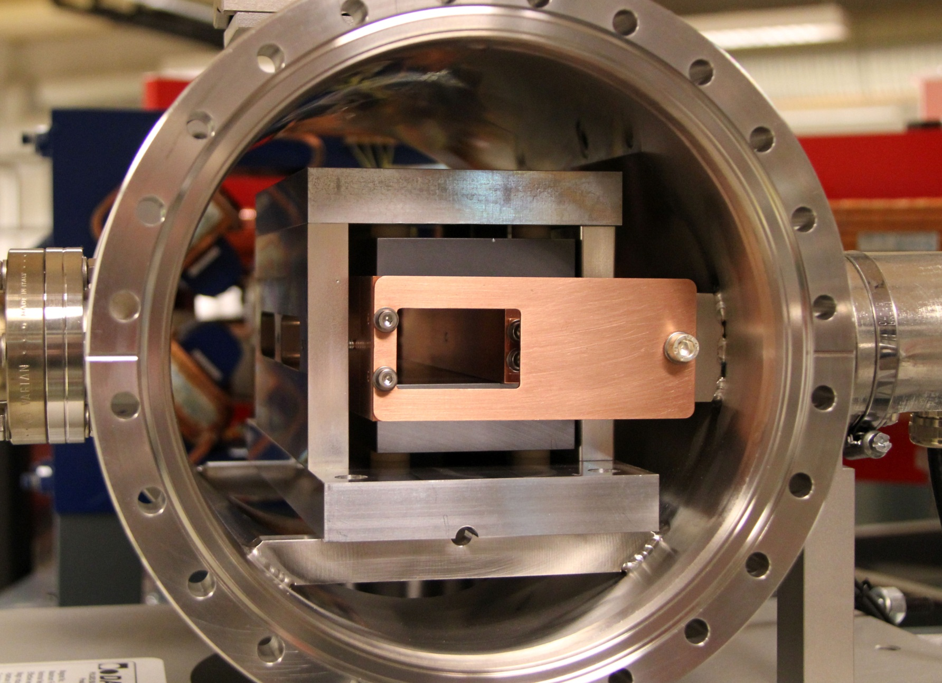
New developments
Bumper problem
At high currents, the beam- induced currents in the ferrite causes it to heat to more than the Curie temperature of the material (130°C), causing the kick angle to decrease.
A 200mA beam can be ‘topped-up’ for about 20min before injections fail

Slide 5
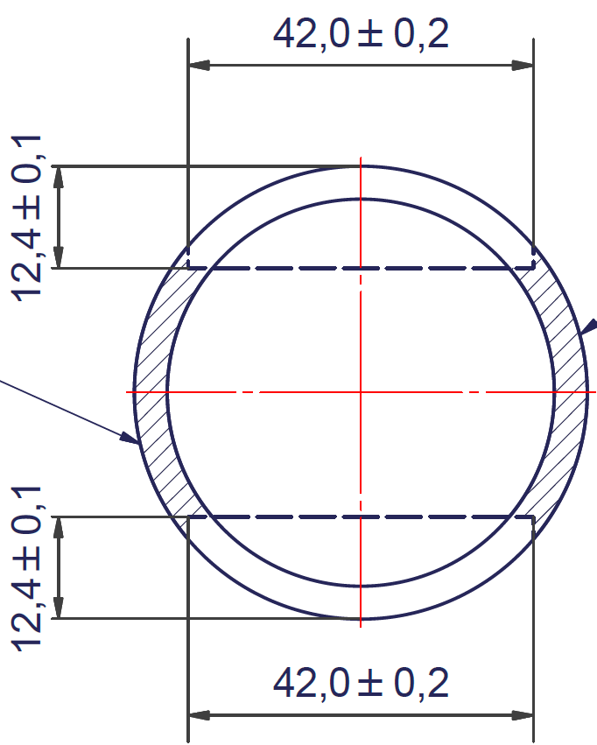
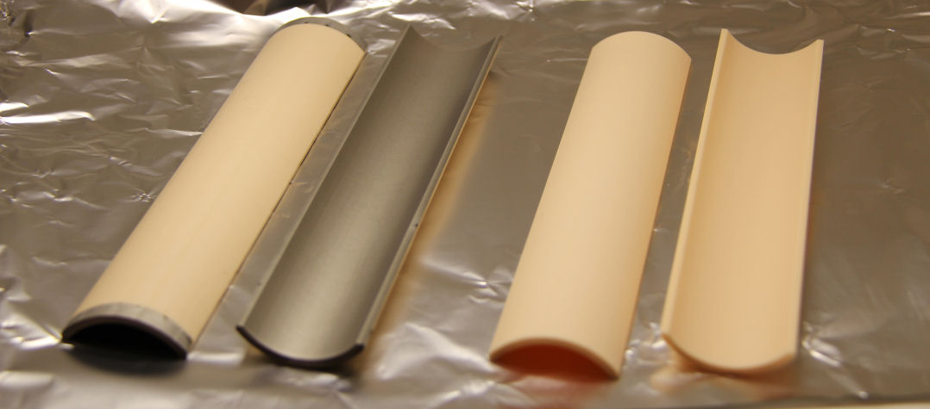
New developments: Bumpers
To repair this situation, Ti coated ceramic ‘shells’ are mounted in the gap of the bumper to form a metallized beam tube to shield the ferrite from the beam.
The shells are made of ‘Frigalit AL23’ Al₂O₃, and coated with 2-2.5µm Ti by the Danish Technological Institute.
The cost of modifying all three bumpers is ~€4000.

Slide 6
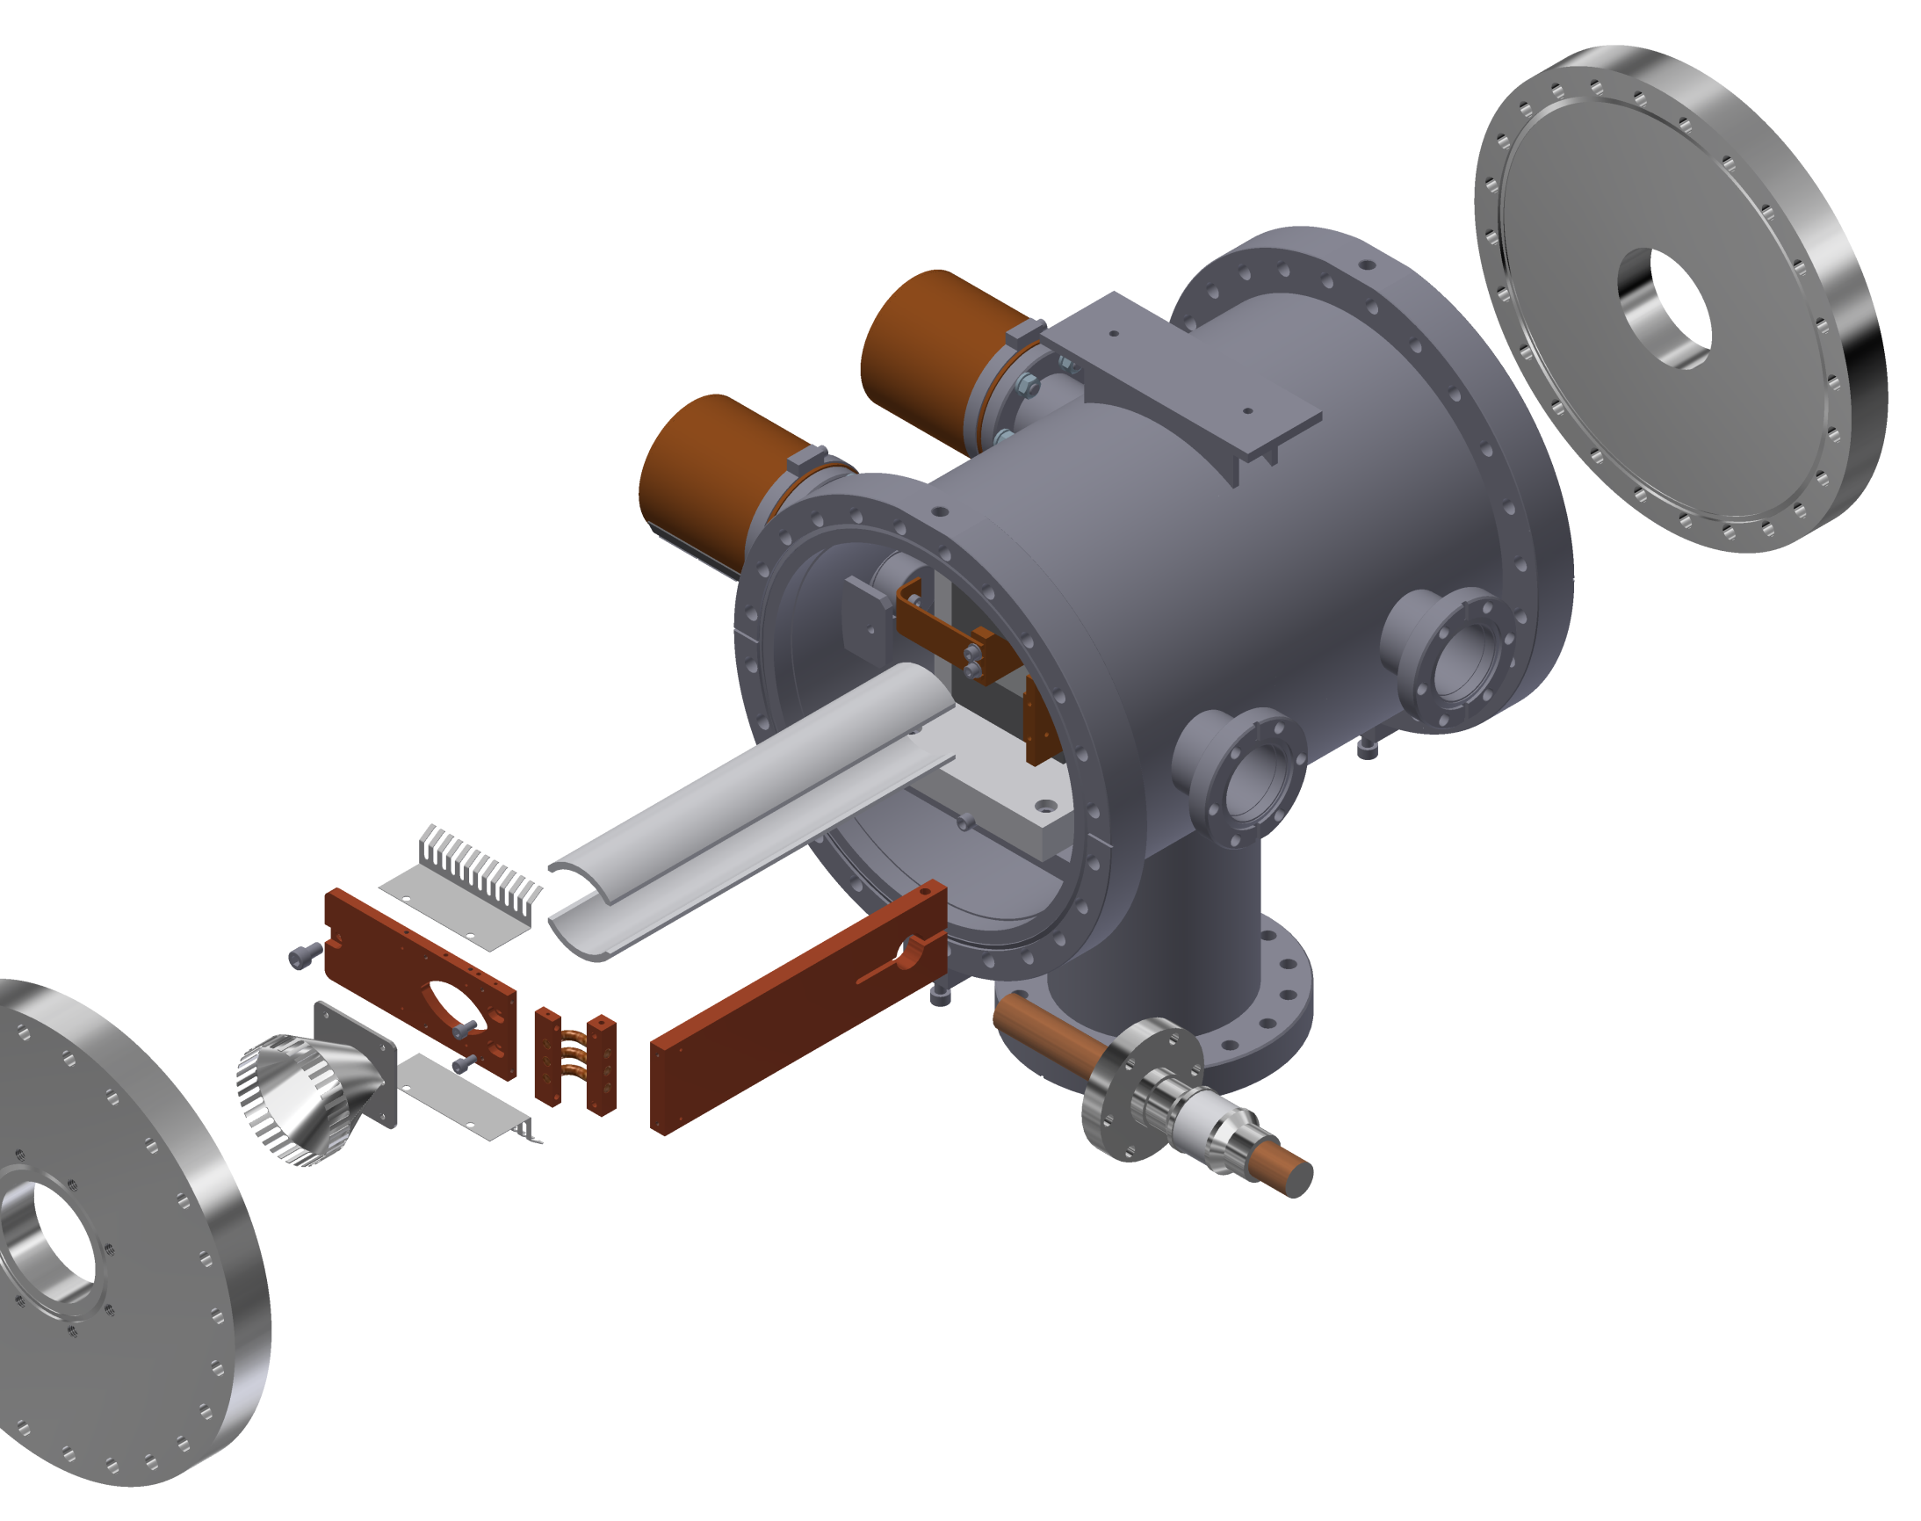
Bumper modification

Slide 7
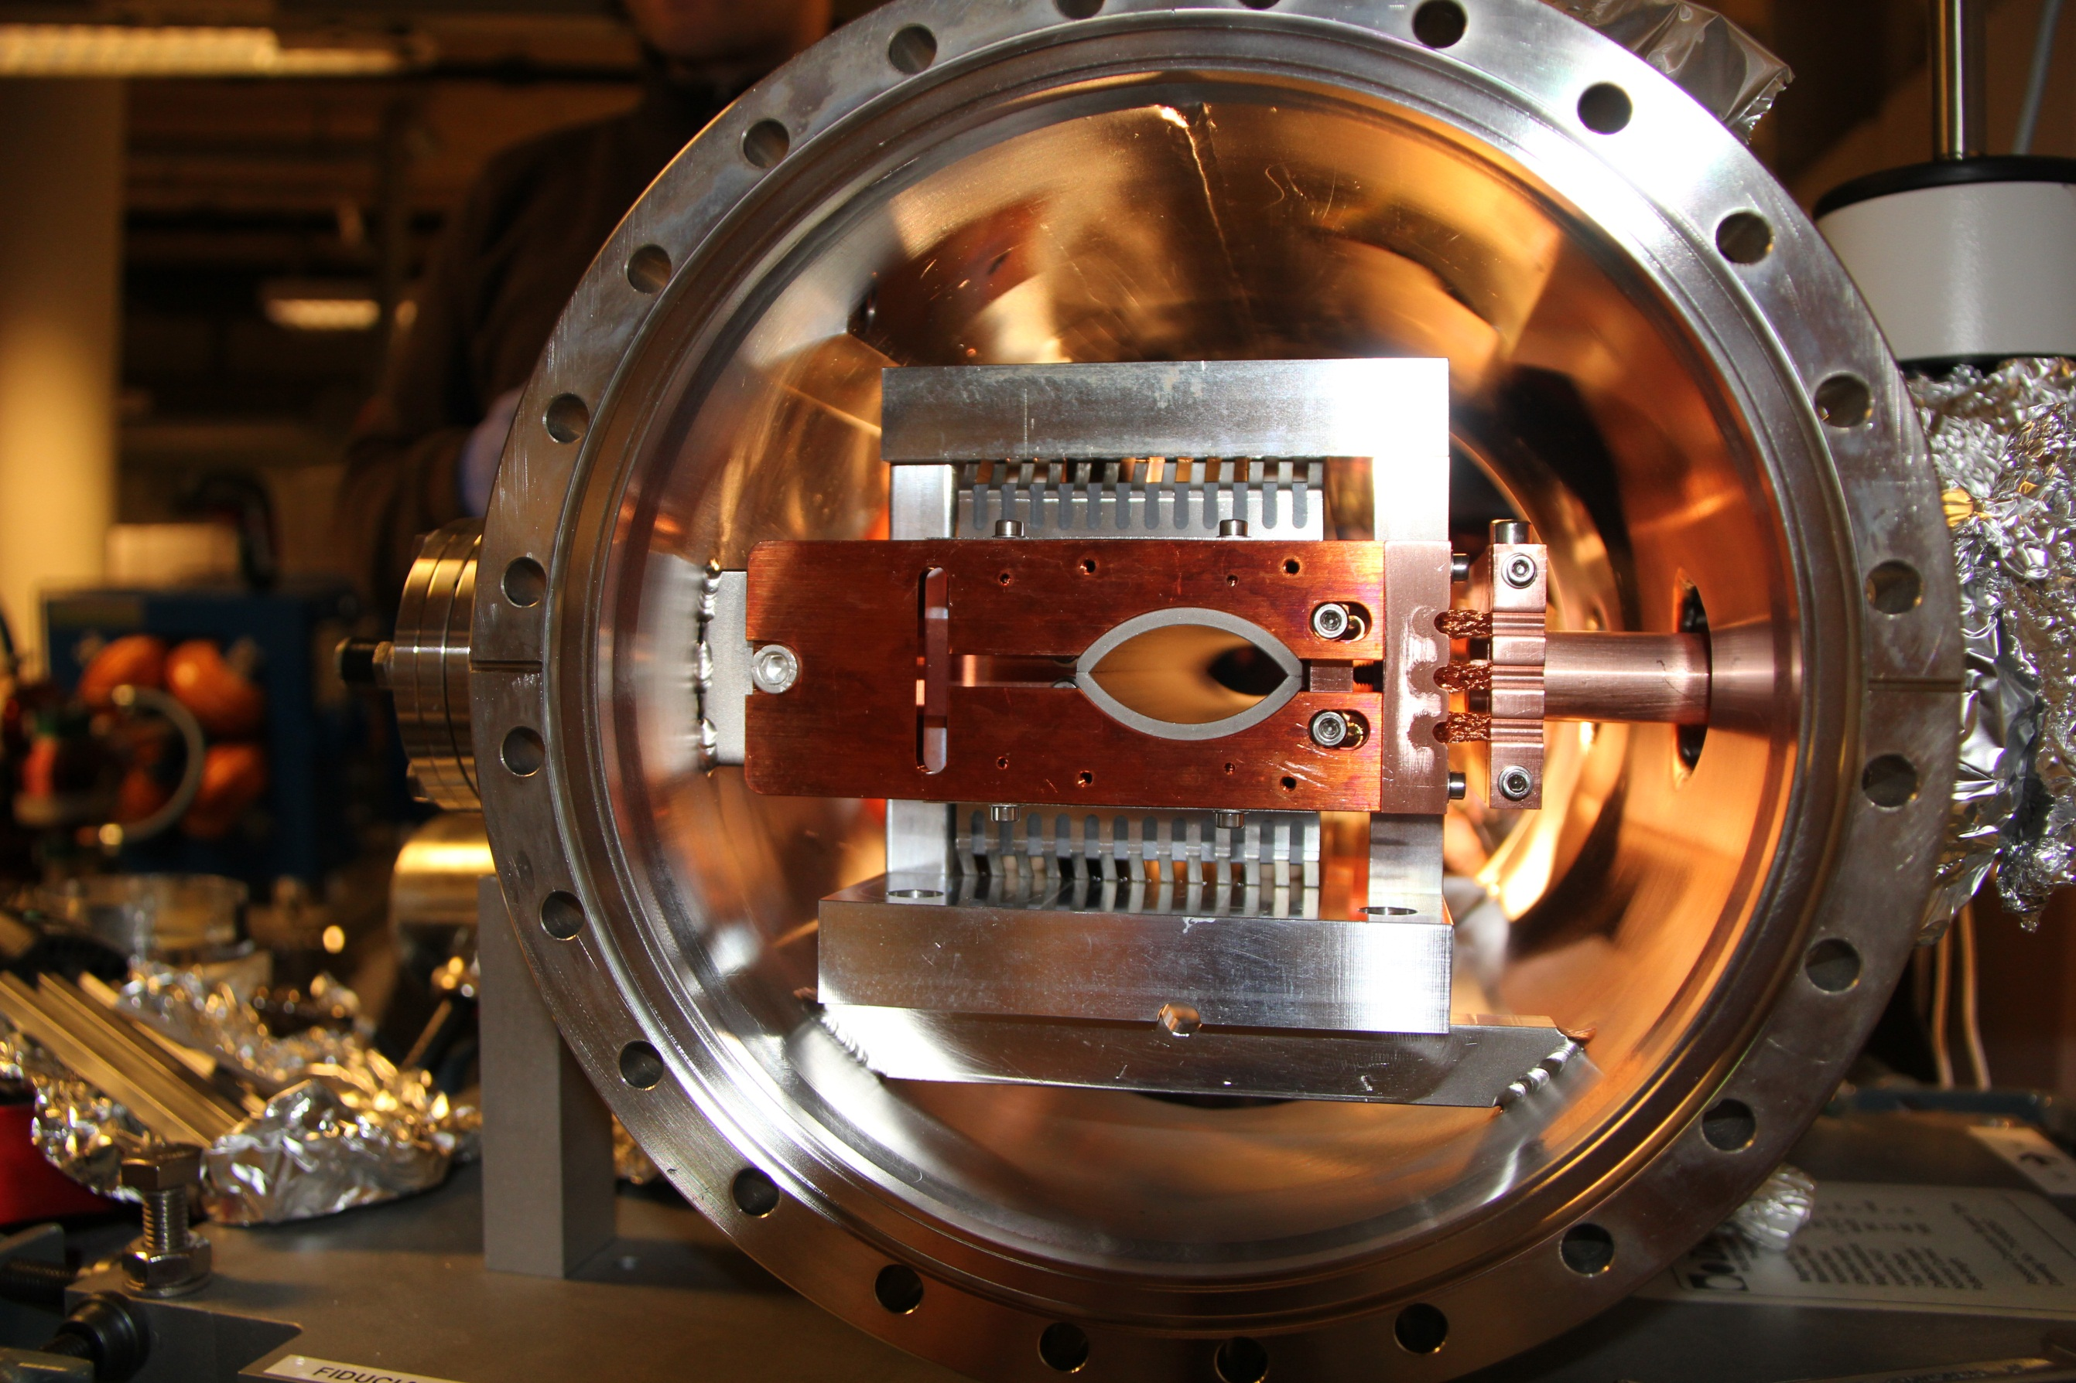
Modified bumper

Slide 8
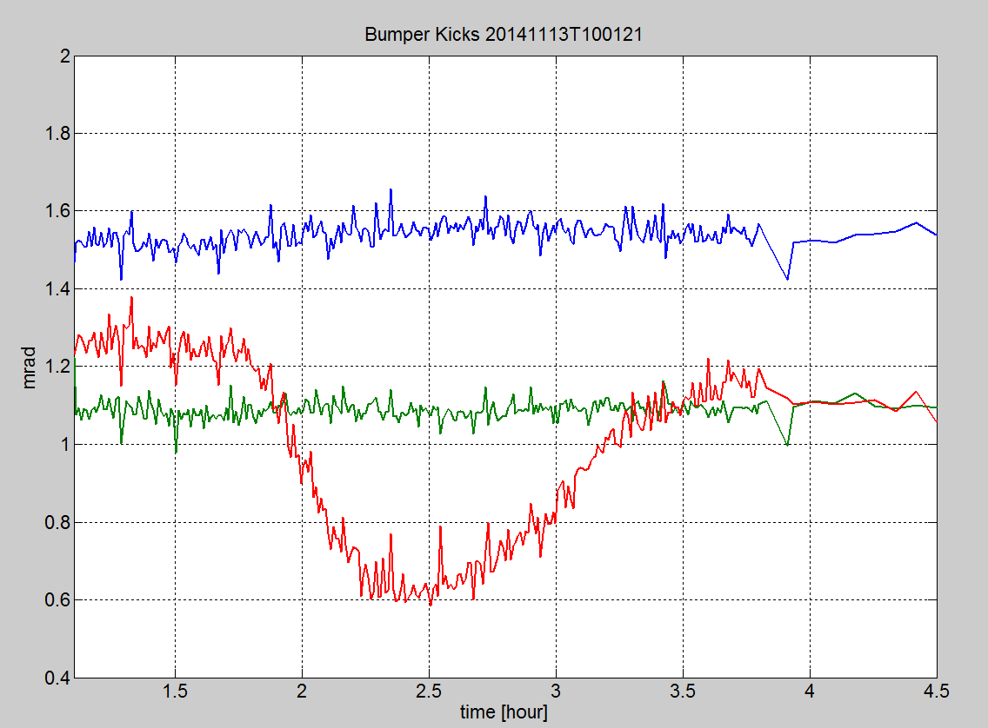
Kick angles at high stored current
Modified bumpers
Unmodified bumper

Slide 9
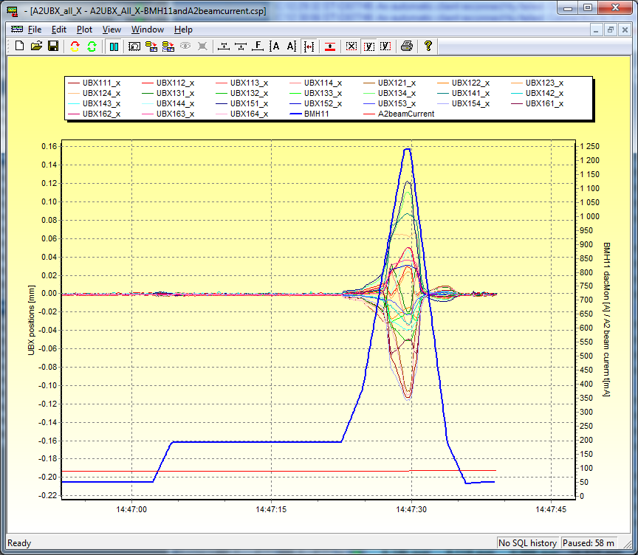
Magnetic interference from ASTRID
When ramping ASTRID to full energy just before an injection, the field from the ASTRID dipoles extends to ASTRID2, moving the stored beam in ASTRID2 by up to 120µm horizontally, and 20µm vertically.
To fix this problem 5mm iron plates were mounted on the concrete wall and floor in the ASTRID hall.

Slide 10
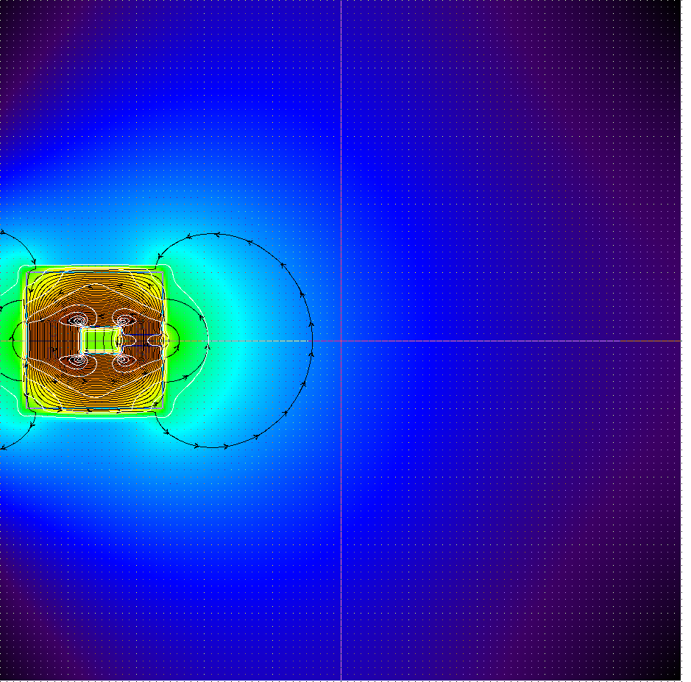
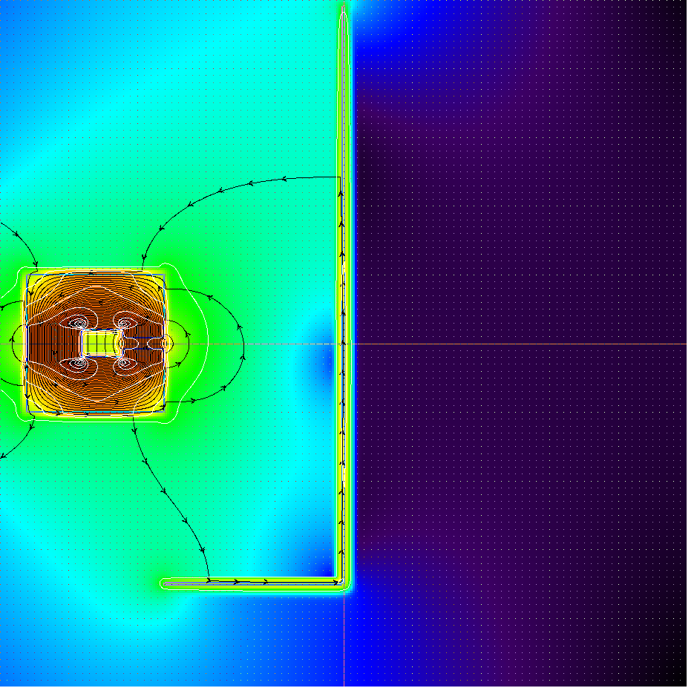
Magnet shield calculations
Leak field reduction of >90% with proposed ‘L’ shaped layout.
3.5mT
0.25mT

Slide 11
The ”iron curtain”
The magnetic shield consists of 60m² 5mm thick ARMCO pure iron.

Slide 12
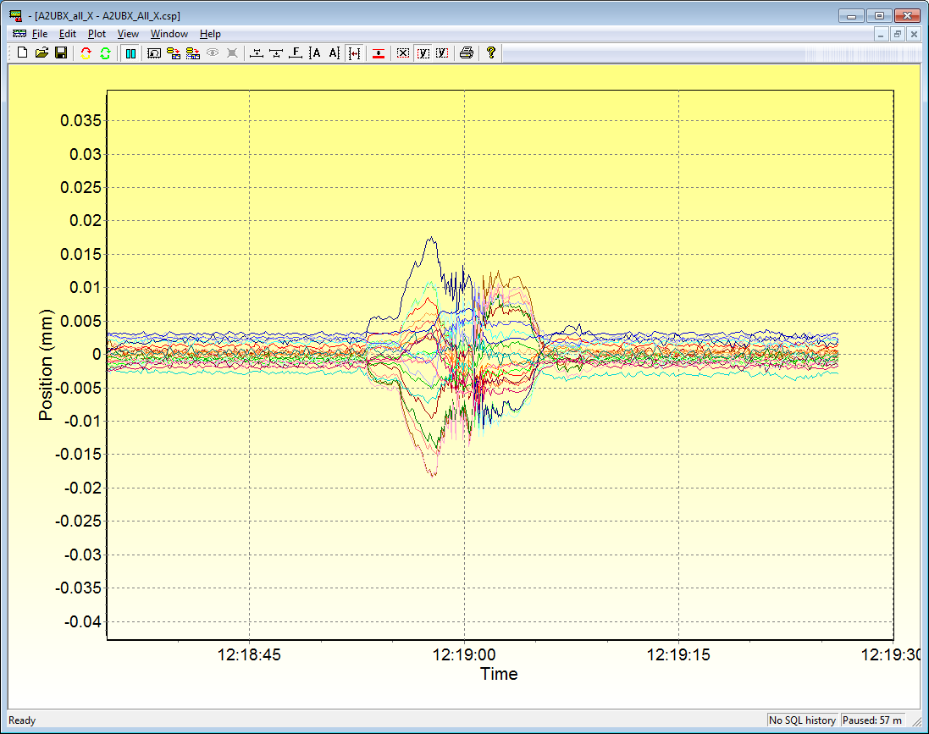
Magnetic shield
Unfortunately, it did not work as expected!
We had expected a reduction in stray field at ASTRID2 of >90%
but only saw a reduction of ~5%.
Instead: Feed forward using ASTRID2 correction dipoles, at least until another solution is found.
This gives a 90% reduction of beam excursions.

Slide 13
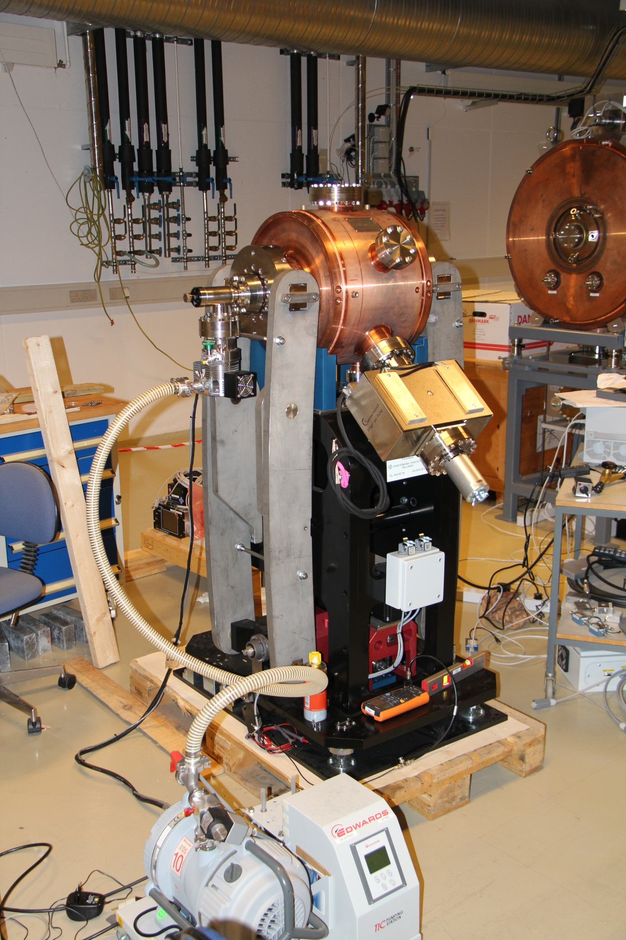
New developments
Landau cavity
In week 51/2014, our new Landau cavity will be installed
It is based on the MAX IV Landau cavity, modified from 300 to 315MHz.
At the back you see our spare ASTRID 105MHz cavity

Slide 14
New developments
Landau Cavity

Slide 15
Skew Quadrupole / Lifetime

Slide 16
Thank you for your attention

