Slide 1

Beam Size
Measurements at ALBA
U. Iriso, A. Nosich, and L. Torino
Accelerator Division, CELLS
May 2014

Slide 2
Introduction
Pinhole Camera
Double slit interference
In-air X-ray Detectors

Slide 3
Introduction
Pinhole Camera
Double slit interference
In-air X-ray Detectors

Slide 4
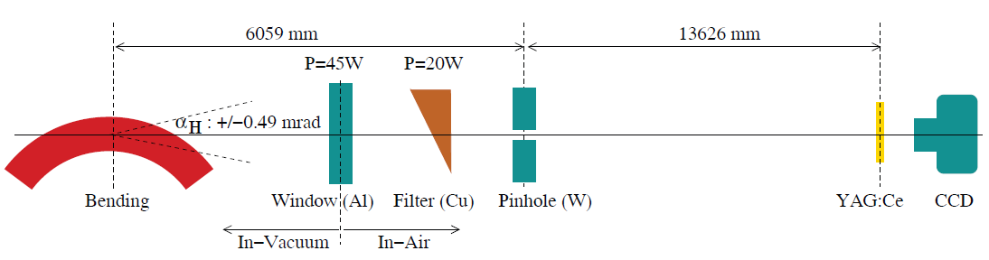
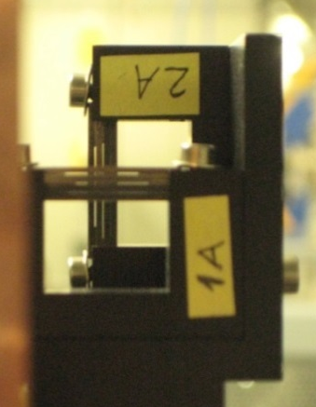
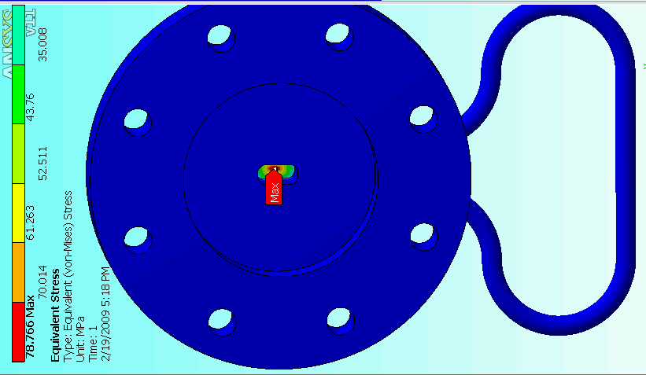
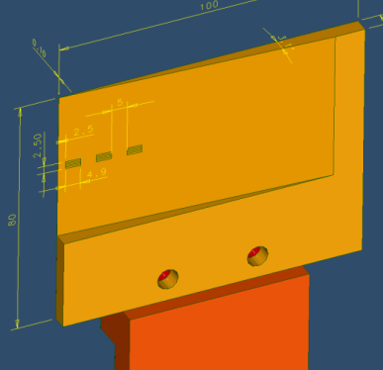
X-Ray Pinhole Camera
Light from an object (beam) goes through a single aperture (pinhole) and projects an inverted image of the source
Image is magnified by a factor L2/L1
ALBA magnification factor 2.27 (18m length system)
Use x-rays: Al-window and Cu-filter (~45keV)

Slide 5
X-Ray Pinhole Resolution
Limited by geometric constrains: while L2 and L1 are usually fixed, pinhole aperture w can be optimized at design stage to minimize the PSF
Diffraction:
Blurring:
Our system PSF ~ 15um
Considering our 2.3 magnification, this means we can measure down to ~7um*
w=10um
*M.A. Tordeaux, et al, “Ultimate Resolution of Soelil Pinhole Cameras”, DIPAC’07

Slide 6
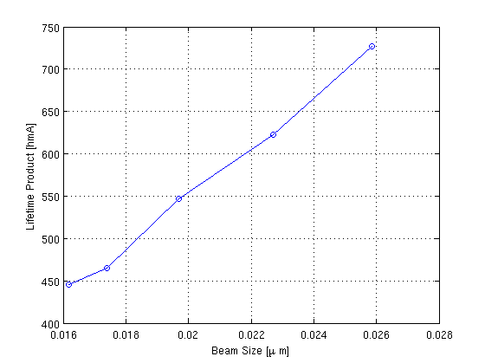
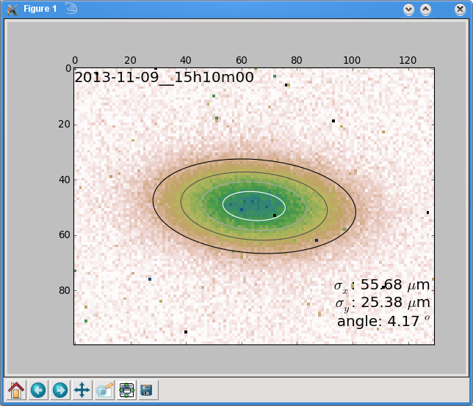
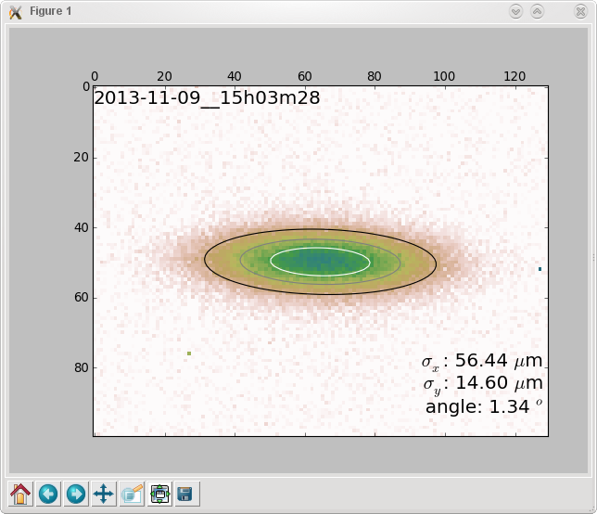
X-Ray Pinhole Results
Example: correlation between beam lifetime and beam size while reducing koupling.
Example at 0.5% koupling
Minimum koupling = 0.1%

Slide 7
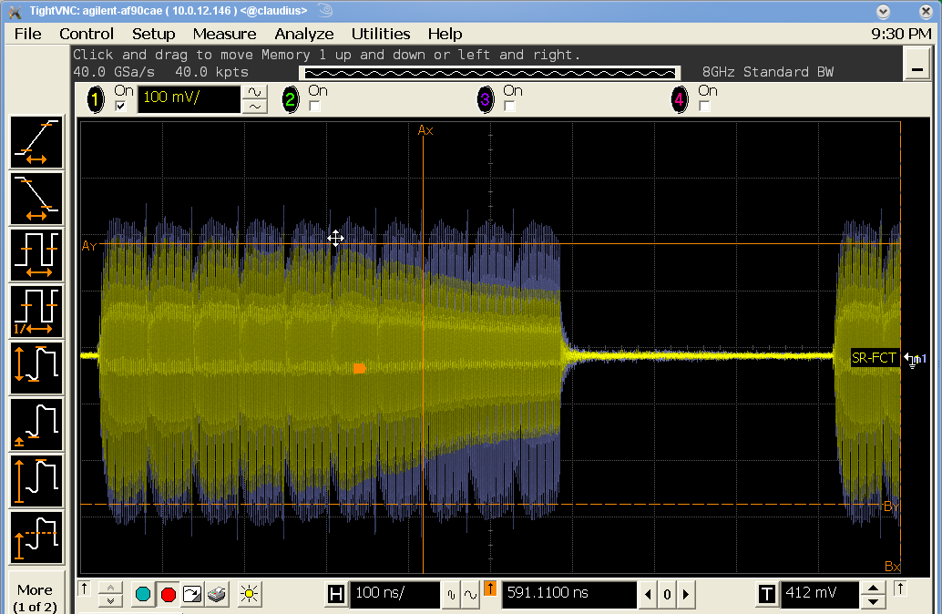
But…
Beam size at pinhole is an average of all the bunches
Actually, we have seen that we are affected by some CBI, whose nature is unclear
SCRV at 10mm
SCRV at 0.28mm
➔ Can we get a Bunch By Bunch (BBB) beam size measurements using interferometry?

Slide 8
Classical Pinhole Camera
Double slit interference
In-air X-ray Detectors

Slide 9
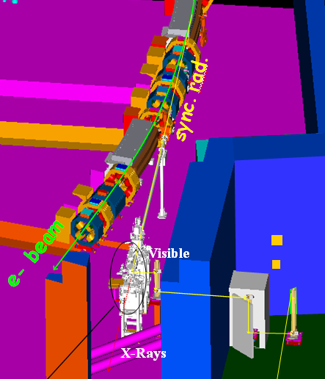
Double Slit Interferogram
MOTIVATION:
Alternative emittance measurement
Almost “for free”, since basic instrumentation is already in place at Di Hutch
Better resolution than pinhole
➔ Using a Fast Gated Camera (FGC), can we have BBB diagnostics?
In-air mirrors
In-vacuum mirror
DIAGNOSTICS HUTCH

Slide 10
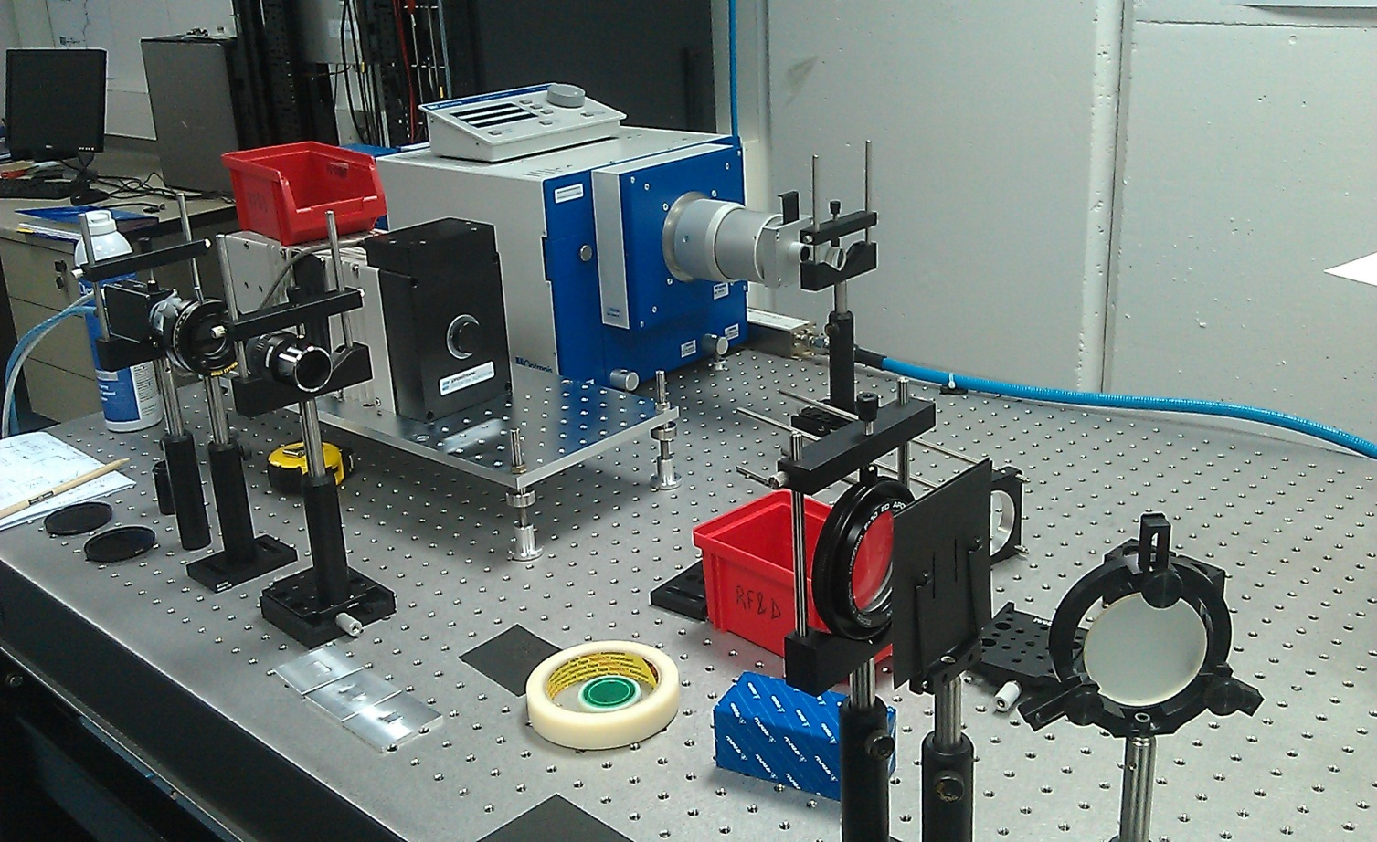
Double Slit Interferogram
Source point
(BM01)
Set of 6 in-air
mirrors
Double
Slit
Lens
Polarizer
Image Plane
(camera)
Wavenlength
Filter
Vac. Windw
In-Vac. Mirror
Streak Camera
FGC
CCD
Double Slit

Slide 11
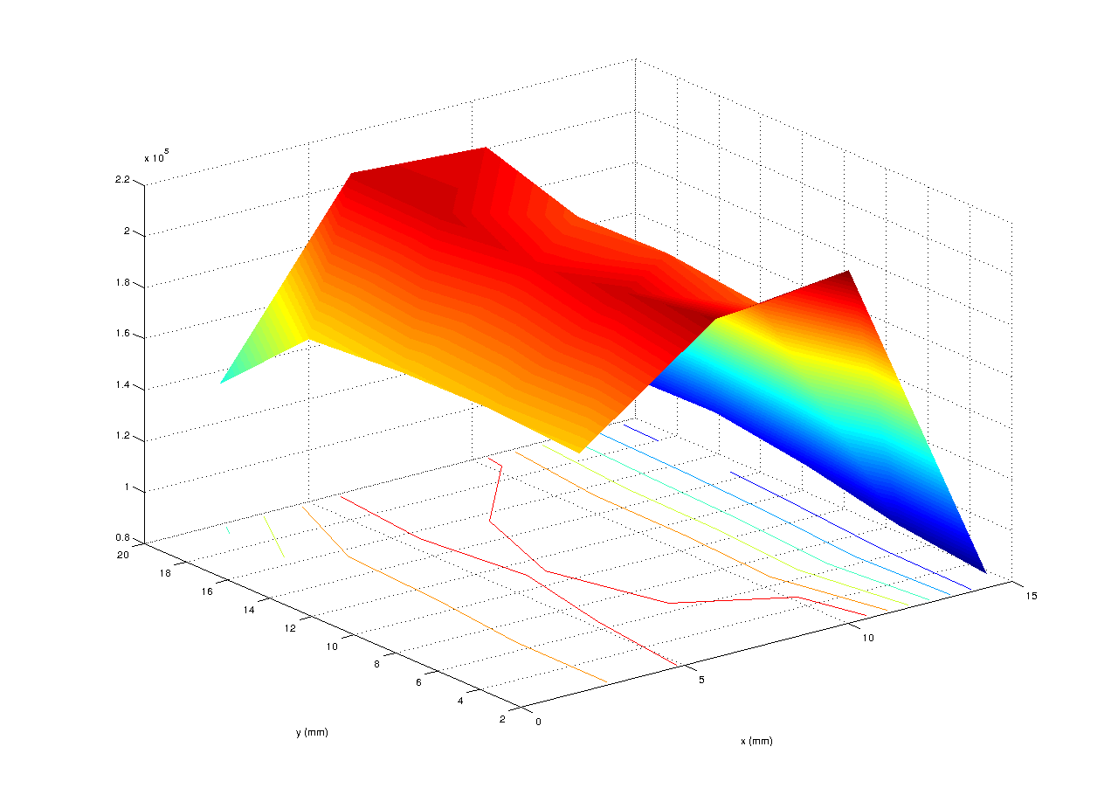
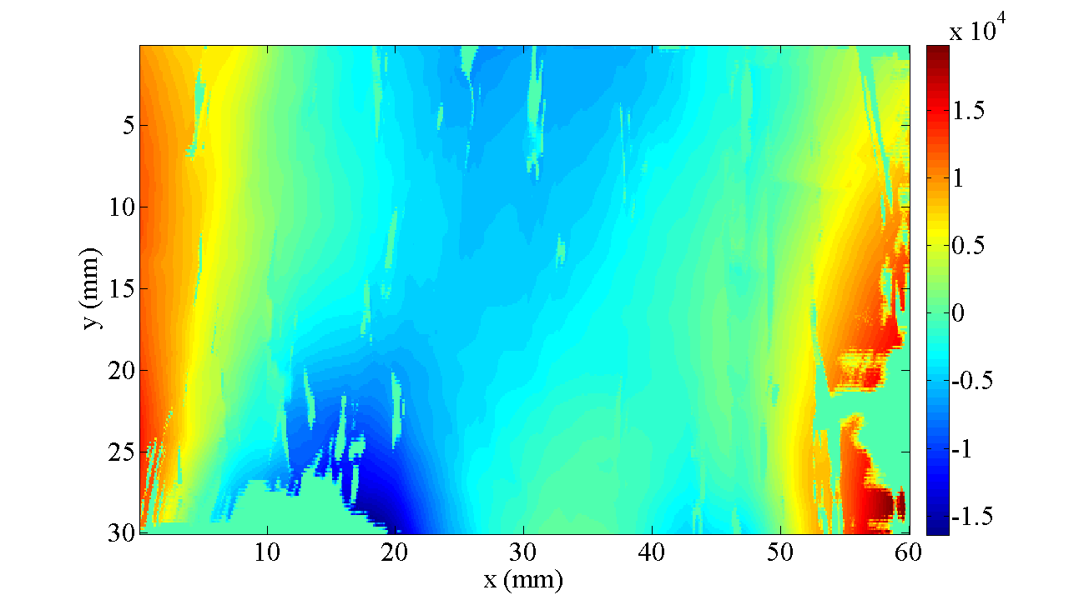
Problems with Old Mirror
March 2013:
Measurements limited by wavefront distortion produced by in-vacuum mirror
Detected using Hartman Mask measurements, analyzing spatial degree of coherence, and finally confirmed with the PTV surface flatness measurement using Fizeau.
Hartmann Mask Measurements: ~ λ/0.5
Fizeau Measurements: ~ λ/1

Slide 12
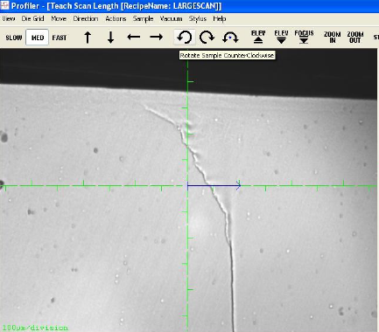
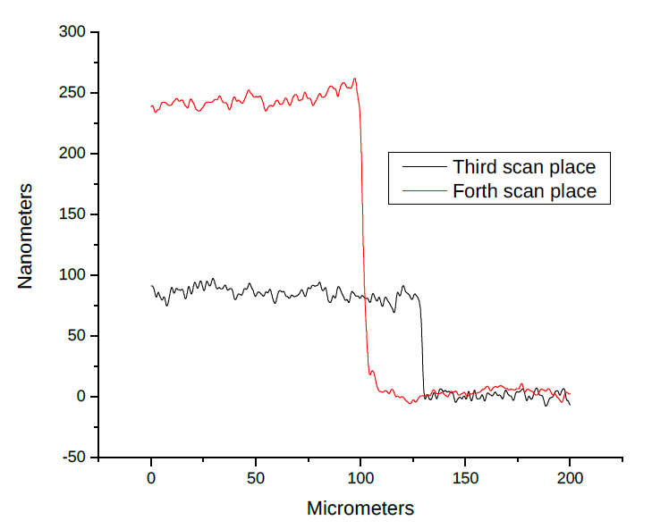
Old Mirror Deterioration (Exp. Div.)
Old mirror presented clear irregularities, visible on simple eye
Study using Profilometry: they are not scratches, but steps
→ Something has grown up in the surface of our old Cu mirror

Slide 13
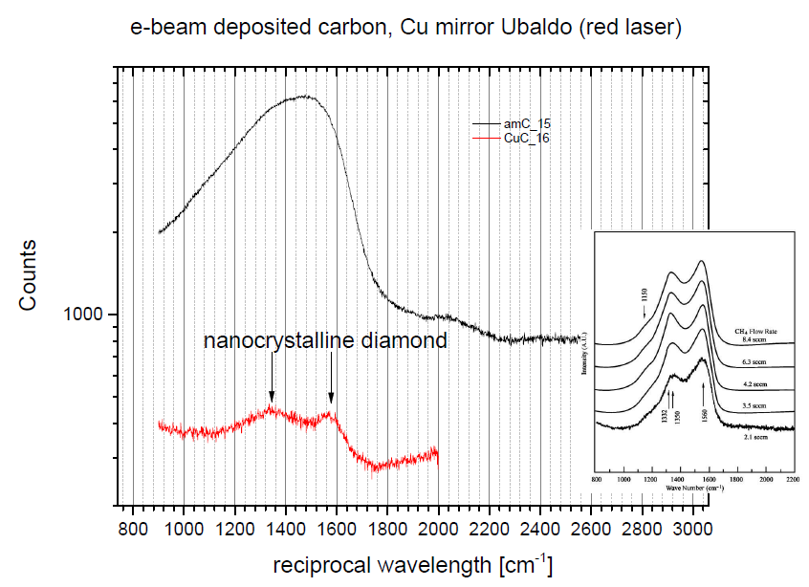
Old Mirror Deterioration (Exp. Div)
Raman Spectroscopy study: nano-Crystalline Diamond
➔ Next Steps: cutting the Cu mirror to perform XPS studies and confirm the carbon chemistry

Slide 14
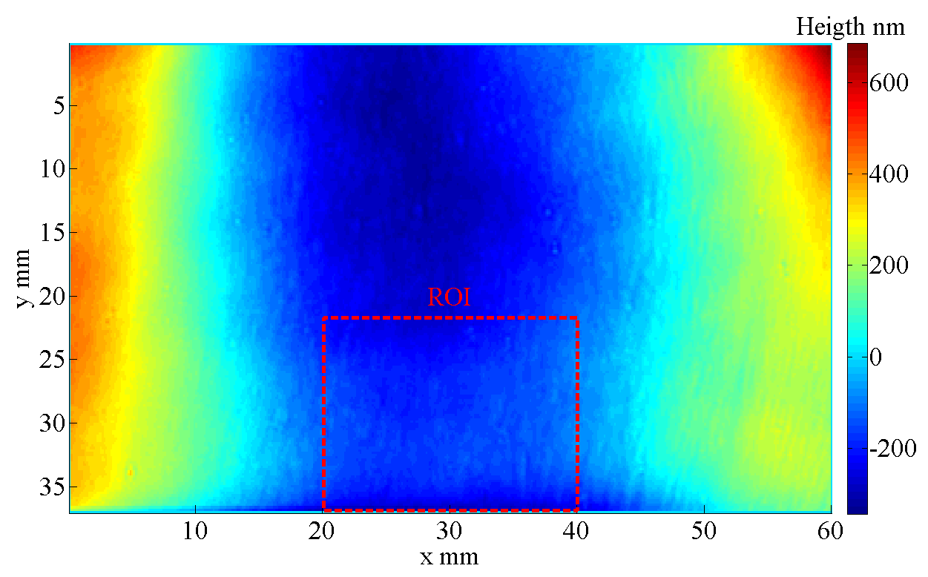
New Mirror and Vacuum Window
New Mirror ~ λ/10
Mirror, vacuum window, and in-air mirrors exchanged in Jan. 2014
➔ New mirror slightly larger (+1mrad vertically more). Better resolution of interferometry
➔ Better PTV flatness and “Kanigen” coating to protect from contamination

Slide 15
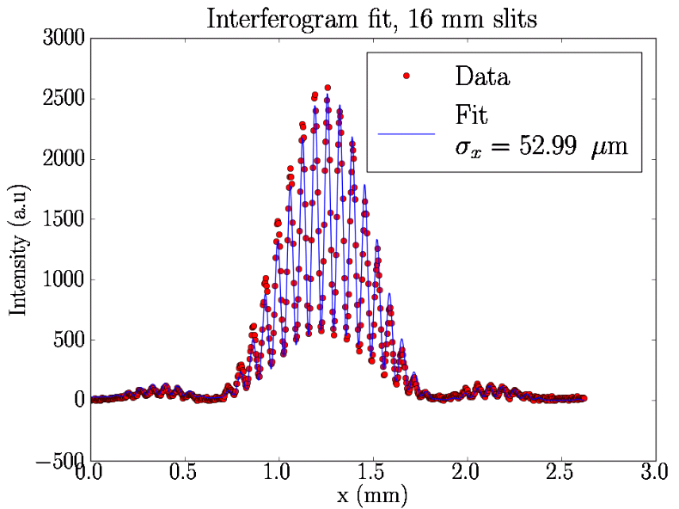
Interference using NEW equipment
March 2014:
Results after exchanging in-vacuum mirror, vacuum window, and in-air mirrors
Wavefront arriving at double slit more homogenous
First measurements showed better reproducibility and in agreement with theory
NEXT STEPS:
Increase system robustness and to use it as on/line monitoring
Bunch-by-bunch size measurements using a Fast Gated Camera (CERN collab.)
Four-slits interferograms to simultaneously obtain hor and ver beam size

Slide 16
Classical Pinhole Camera
Double slit interference
In-air X-ray Detectors

Slide 17
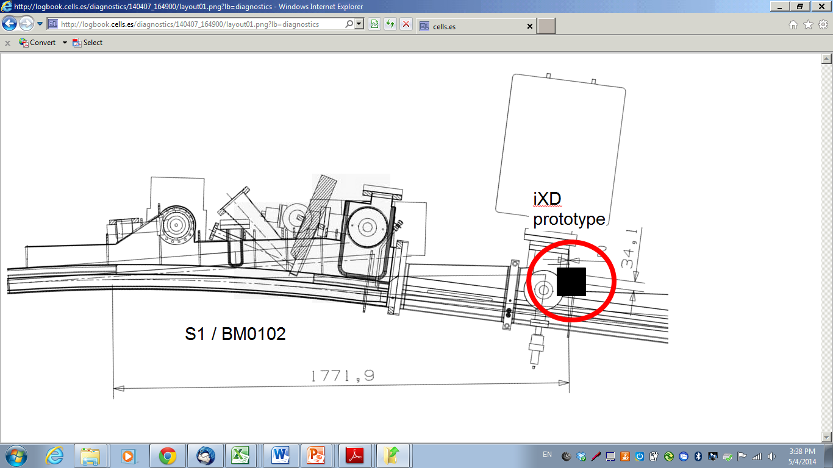
In-air X-Ray Detectors (iXD)
Based on projection from very hard x-rays from sync. rad traversing the dipole absorbers*
Absorber
X-rays
DIPOLE
e-beam
MOTIVATION: alternative emittance measurement
PROS: cheap and easy, iXD can be located outside vacuum
CONS: Only vertical beam size is inferred
    No much room to improve resolution
*K.Scheidt, Proc. Of DIPAC’05; A.Muller, Proc. Of EPAC’06

Slide 18
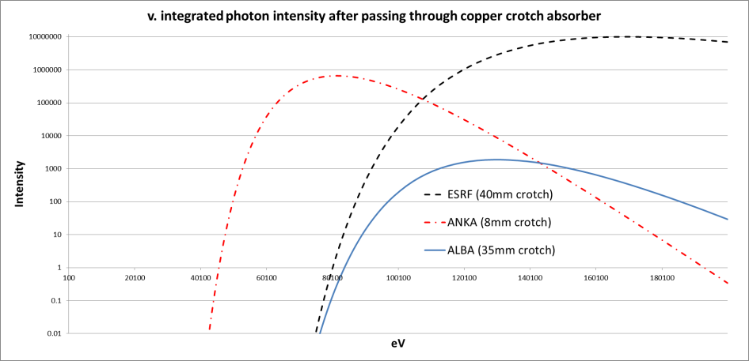
In-air X-Ray Detectors
So far, only successfully used at ESRF and ANKA due to favourable conditions
(combination of high energy and absorber thickness)
 | ANKA | ESRF | ALBA
E, GeV | 2.5 | 6 | 3
Cu thickness | 8mm | 40mm | 35mm
Need to work on scintillator material and optical system to optimize every photon

Slide 19
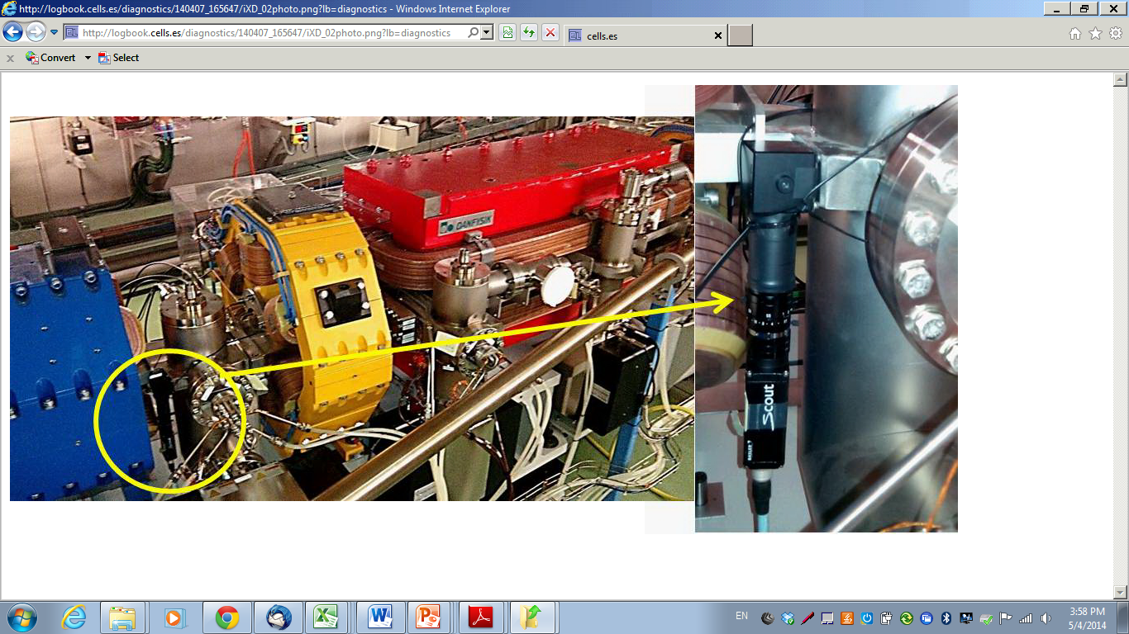
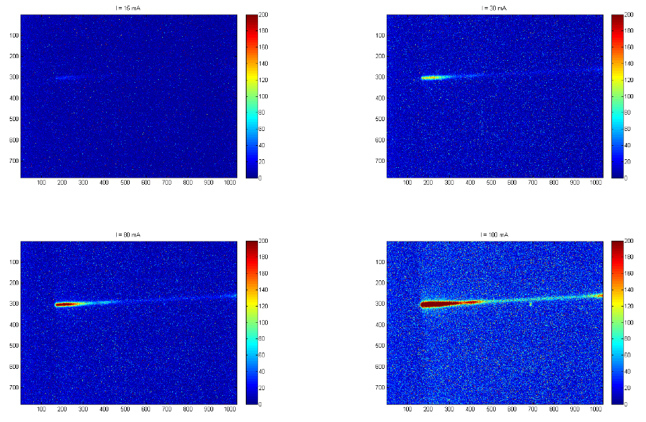
iXD: First Results (March 2014)
For FIRST FEASIBILITY TESTS with scintillating material, an iXD prototype was (rudimentary) installed for
Material tested:
YAG:Ce (no success)
Prelude - LuYSiO5 (success)
With Prelude screen, 0.8mm an image is obtained with exposure times >1sec
Beam size roughly agrees with theoretical values
15mA
30mA
80mA
100mA

Slide 20
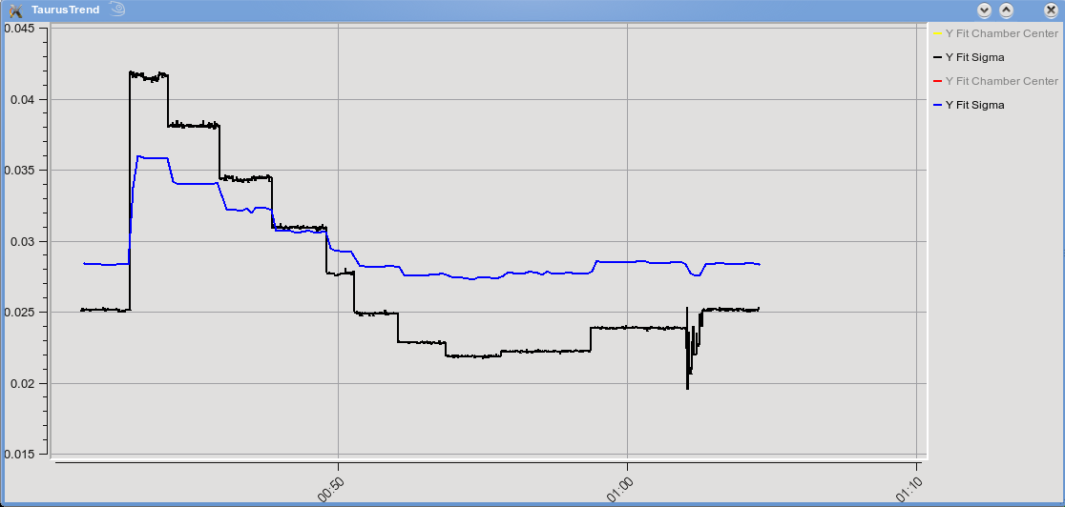
First Results
Pinhole (black), and iXD (blue) during a Coupling scan

Slide 21
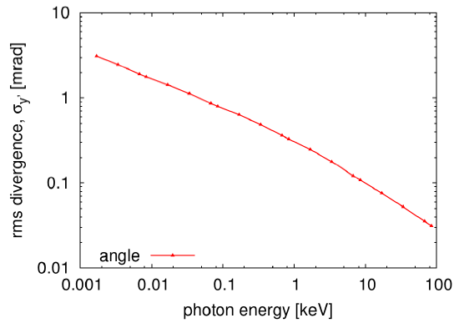

In-air X-ray Detector Limitations
PSF is limited by distance between source-point to iXD location and photon divergence
$σ_{sc}2=$ $σ_{b}2$ + (L·α)²
For this first case, PSF is quite large:
E~130keV; α=0.025mrad; L=1.7m
PSF = (L·α) ~ 42um!
...but we are seeing smaller beams...
NEXT STEPS:
use 1mm thick Prelude screen, still looking for better materials
Better mechanical fixation
Ray tracing to understand the “comet-like” spot
To be used at IR beamline to monitor beam position drifts

Slide 22
Summary
Classical Pinhole Camera
Double slit interference
In-air X-ray Detectors
Installed and working since Day-1
Reliable and robust
Minimum beam sizes ~7um (8pm*rad)
In progress: in-vacuum mirror and vacuum window exchanged in Jan.2014
Due care shall be taken to keep wavefront homogeneity
Expected beam size ~4um, resolution~1um
Tests to obtain Bunch-by-bunch beam size in the near future
In-progress: feasibility studies done successfully with Prelude
Two setups going to be precisely installed at dipoles
Right now, PSF~42um, few room to improve it since we are mechanically limited for the minimum source-to-screen distance

Slide 23
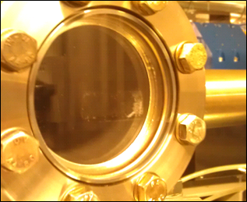
“dust” footprint outside
Blackening inside

