Slide 1

Beam Energy Measurements through Spin Depolarization at ALBA
Z. Martí, U. Iriso
Accelerator Division, CELLS
May 2014

Slide 2
Introduction: the recipe
Inject a fresh beam up to a beam current whose lifetime is limited by Touscheck
Wait until beam gets polarized (anti-parallel to the dipole Bfield), noticeable because lifetime increases
Scan a vertical excitation at a frequency around expected energy resonant tune. When the vertical excitation is in resonance with the spin tune, and beam gets depolarised
When the beam is depolarised, the beam gets a sudden loss, producing:
        lifetime drops
        beam losses increase
        Product (DCCT * lifetime) decays

Slide 3
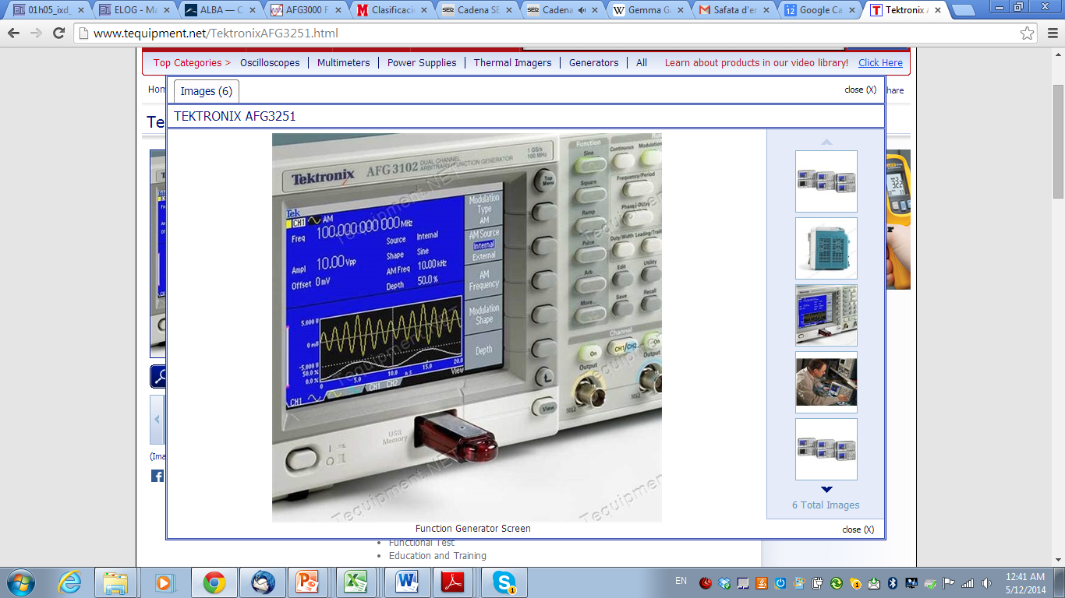
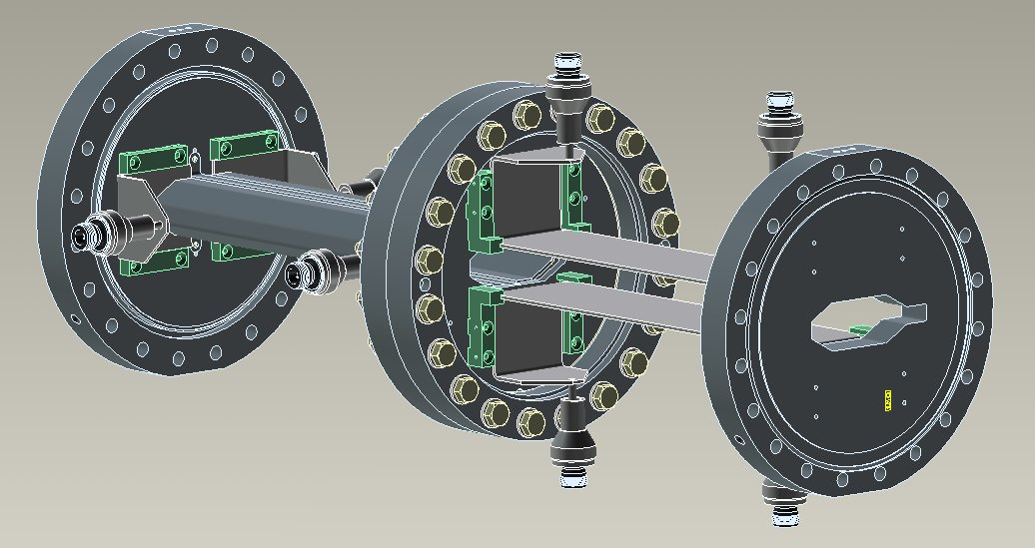
Excitation Hardware
Arbitrary Function Generator - AFG3102
100W Amplifiers
Fast Feedback Kickers: Zsh = 45 kOhms
Kick: 0.67urad (7 uT·m)
Kick numbers comparison with other labs (numbers for IPAC references)
ALBA | Soleil | SLS | Diamond
7uT m | 4.8uT m | 3.5uT m | 45uT m

Slide 4
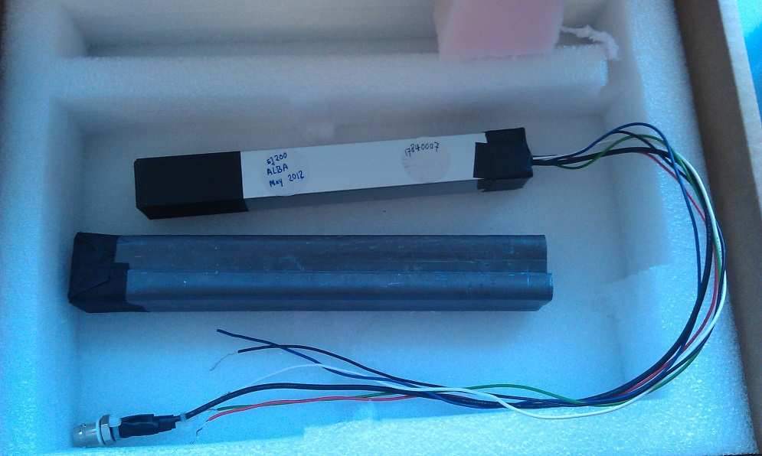
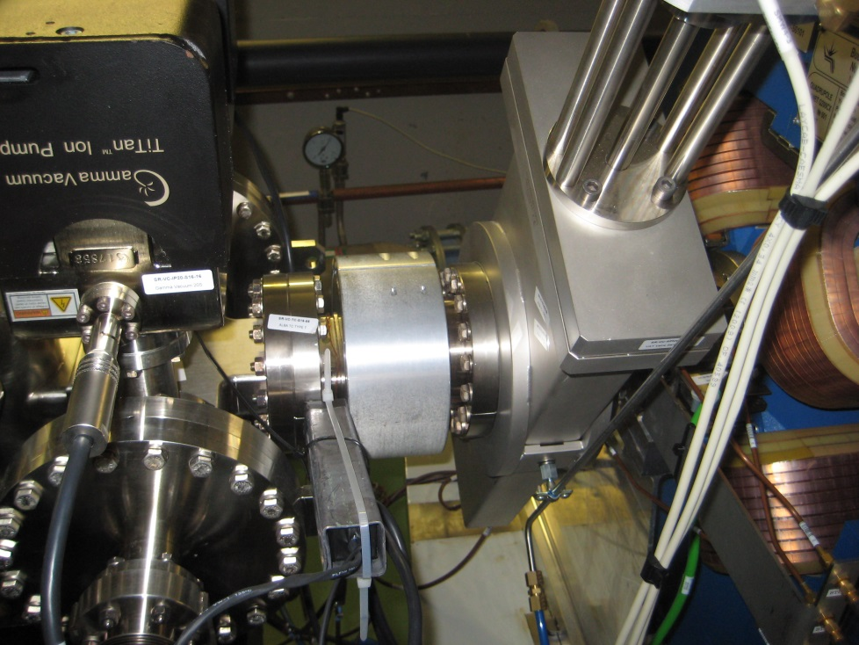
Measurement Hardware
Lifetime (or product) DCCT
Lifetime (or product) using BPMs Sum signal
1 Scintillator based loss monitor (Beam Loss Detector – BLD)
120 PinDiodes Bergoz Beam Loss Monitors (BLM)
Keees BLD
BLD Location in the Ring:
Downstream Hor and Ver Scraper
Both are slightly closed to increase losses at this location

Slide 5
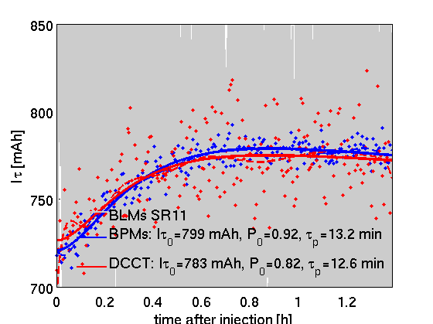
Results: Polarization
First, polarization build up is confirmed.
For this case, BPMs fans and gains shall be fixed.

Slide 6
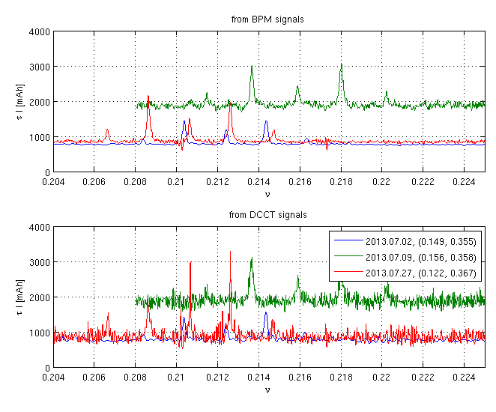
First Results: frequency scans
Scaning the excitation frequency with steps up to 5Hz/s, no lifetime drop is observed.
Instead some strange peaks appear in the lifetime.
Suspected Qy-Qx, but moving the tunes the peaks do not move consistenty.

Slide 7
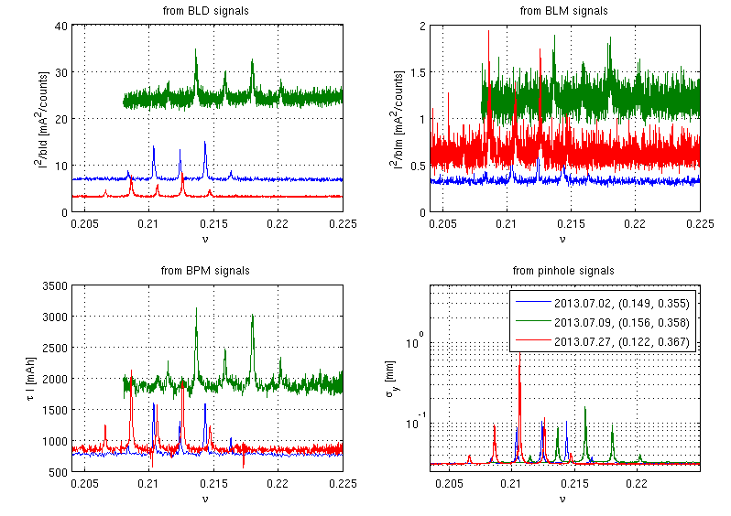
Peaks study – changin WP

Slide 8
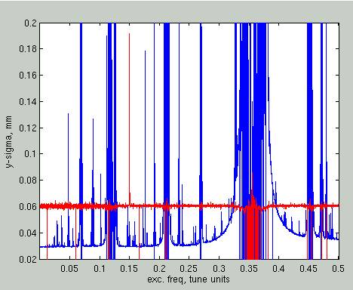
Full scan: [0 – 0.5]
Ver beam size evolution (blue) during the freq scan
The result is that we are full of peaks!!
Even if we change the WP, we still get peaks here and there

Slide 9
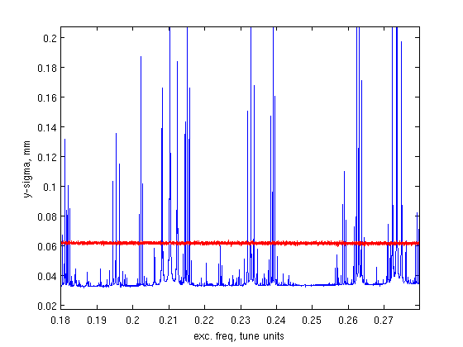
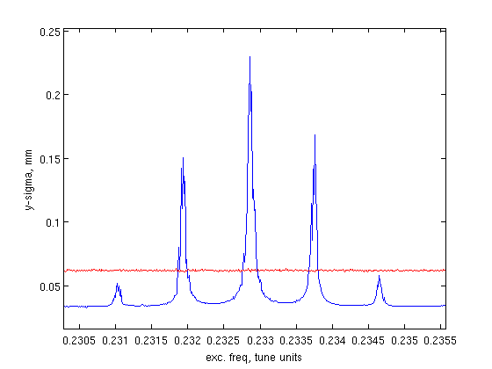
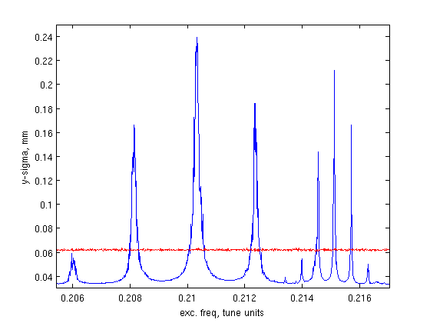
Zoom on peaks
Example: Feb 2014
Qscan=[0.168 – 0.28]
Qspeed: 1.24e-5/sec (rate at which exc. Tune is changed)
WP=(0.1486, 0.3726) ; Qs=0.0056
So, we are a bit lost about the reason for these peaks.
Suggestions are welcome
Nevertheless, let’s try to see if we can see some lifetime drop between this forest of peaks
0.2329
0.2103
0.2151
1e-3
2.2e-3
6e-4

Slide 10
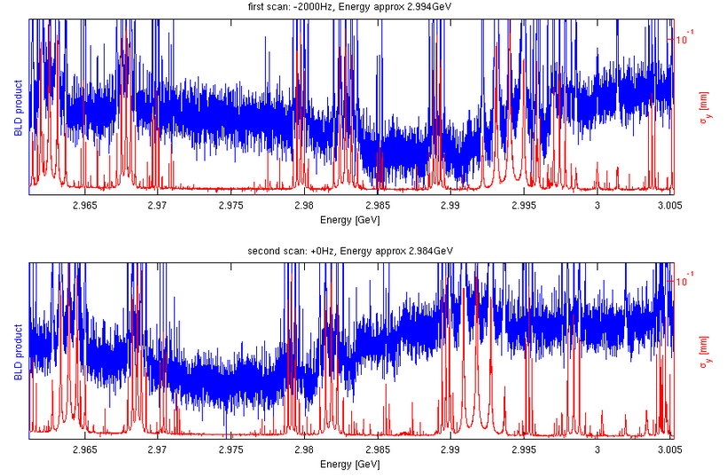
Two tests at different f_{rf}
Moving frf by -2kHz ;
E=2.994GeV
Nominal RF frequency ;
E=2.984GeV
There seems to be a valley in the lifetime product, which moves consistently with the f_{rf}.
But it is very difficult to distinguish it among the peaks, where the lifetime increases

Slide 11
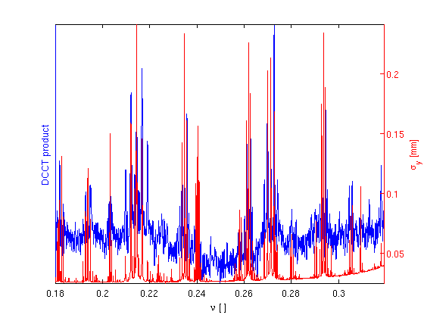
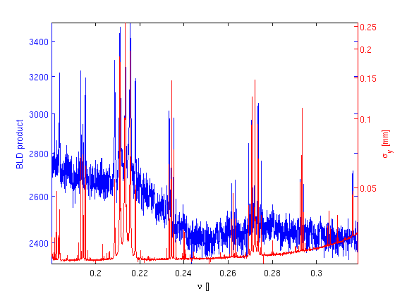
Looking at DCCT and BLD
DCCT Lifetime
BLD counts
Rather than a sudden drop, we are looking a slow decay

Slide 12
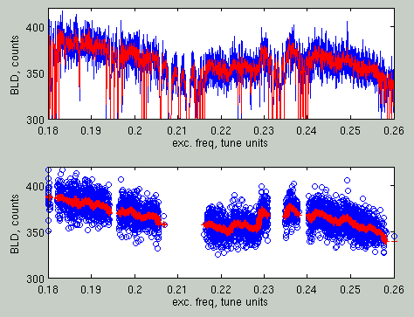
Energy Determination
Data manipulation based on the beam size evolution
Raw Data
BLD Evolution removing data when σy>1.10*σy
0.2224
0.2352
0.2289
(only presentable in a DEELS workshop)
According to these peaks in BLD, energy is 2.9837+/-5e4 GeV

Slide 13
Summary and Questions
The energy scans at ALBA have been limited by the presence of non understandable resonances
These resonances produce vertical beam size increase, which make the lifetime to increase
To detect the resonances, best monitor is the beam size
To detect losses, best monitor is the scintillator based BLD
All in all, the drops in lifetime or sudden increases in BLD seems to indicate a beam energy of 2.984 GeV
Precision cannot be fully determined due to the presence of these peaks.

