Slide 1
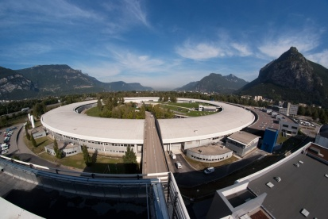
Purity measurement at SOLEIL
DEELS
12-13 May 2014
ESRF, Grenoble
System description
Misunderstood observations and future improvements
Nicolas HUBERT#
on behalf of the diagnostics group:
N. Hubert, L. Cassinari, F. Dohou, M. El Ajjouri, M. Labat, D. Pédeau, J-P. Ricaud
# nicolas.hubert@synchrotron-soleil.fr

Slide 2
Beam purity measurement setup
Objective:
Validate the absence of electrons in free buckets in the storage ring
Measure the relative intensity ratio of (unwanted) satellite bunches with respect to the main bunch
Quality measurement of the beam delivered to users
Used in hybrid (3 quarters + 1 bunch), 8 bunches or 1 bunch filling patterns (100 % of the user beam time in 2013)
Specification:
Resolution better than 10⁻⁵ (users request 10⁻⁴)
Operation:
System in operation since 2009
Purity measurement done at least every 8 hours.

Slide 3
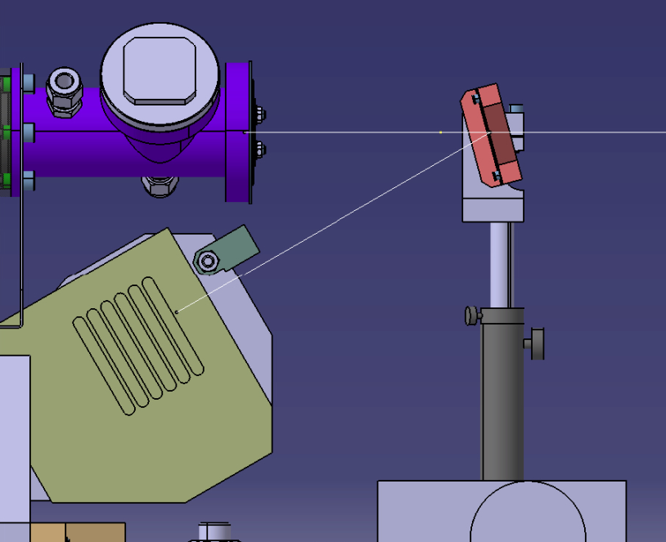
Beam purity measurement setup
How does it work?:
In–air detection
On the same photon beam than the one used for the transverse profile measurement (pinhole camera)
1 mm aluminium window
Copper attenuator
1 mm aluminium window
Copper attenuator
Copper fluorescence X-rays are partially collected by an avalanche photodiode (APD) radiation hardened by a lead shield
Sensor block is motorized (protection against radiation induced damages at the measurement position)
APD in lead shied

Slide 4
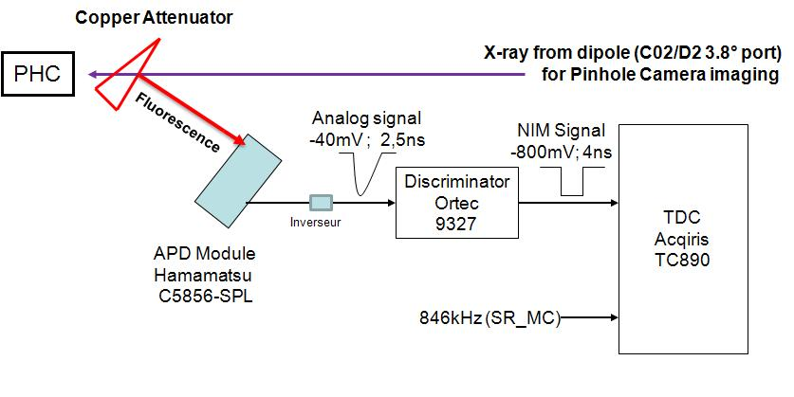
Beam purity measurement setup
Acquisition scheme:
Measurement based on the time-correlated single photon counting (TC-SPC) method
The probability of detecting a photon is less that one per turn
No (or limited) pile up
Linear measurement
Temporal distribution of the pulses reflects temporal distribution of electrons circulating in the storage ring
TDC:
23624 channels, 50 ps wide
Covering the 1,18 µs storage ring rev. period
APD S5343

Slide 5
Beam purity measurement
Initial configuration for 430 mA:
Counting rate around 4000 counts/mA/s that depends on:
APD position
APD polarization voltage
Discriminator threshold
Limitation of the counting rate to stay in a linear range
If APD polarization voltage is to high, counting rate increase but linearity is lost (pile-up?)
Accumulation is done until reaching required resolution (10⁶)
Takes 50 seconds with 5 mA in the main bunch
Typical measurements just after the storage ring filling:
Purity of ~10⁻⁵ for the bunch that follows immediately the main bunch
Purity of ~10⁻⁶ for the other empty bunches

Slide 6
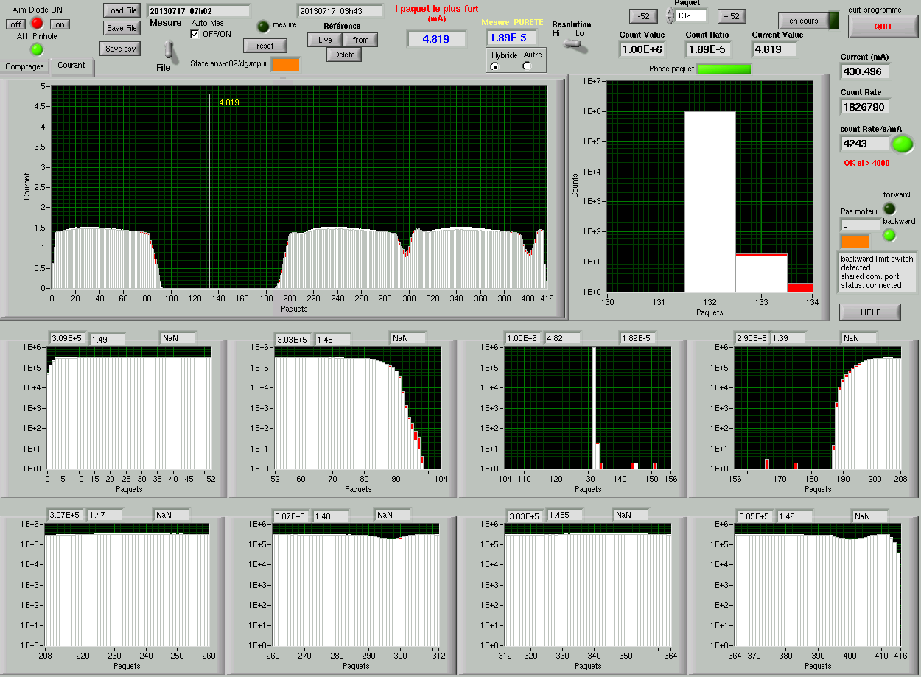
Beam purity measurement
416 bunches
Linear scale
Bunch of interest
Log scale
Zoom on each eighth of the ring (52 bunches)
Log scale

Slide 7
Beam purity measurement
Setting is:
very sensitive to:
APD polarization voltage
Discriminator threshold
dependant to:
The APD that is used (same reference)
Impacts the counting rate and then the measurement resolution and linearity
All settings have to be redone when changing the APD
Future improvements:
Tests ongoing to simplify the acquisition chain by suppressing the discriminator

Slide 8
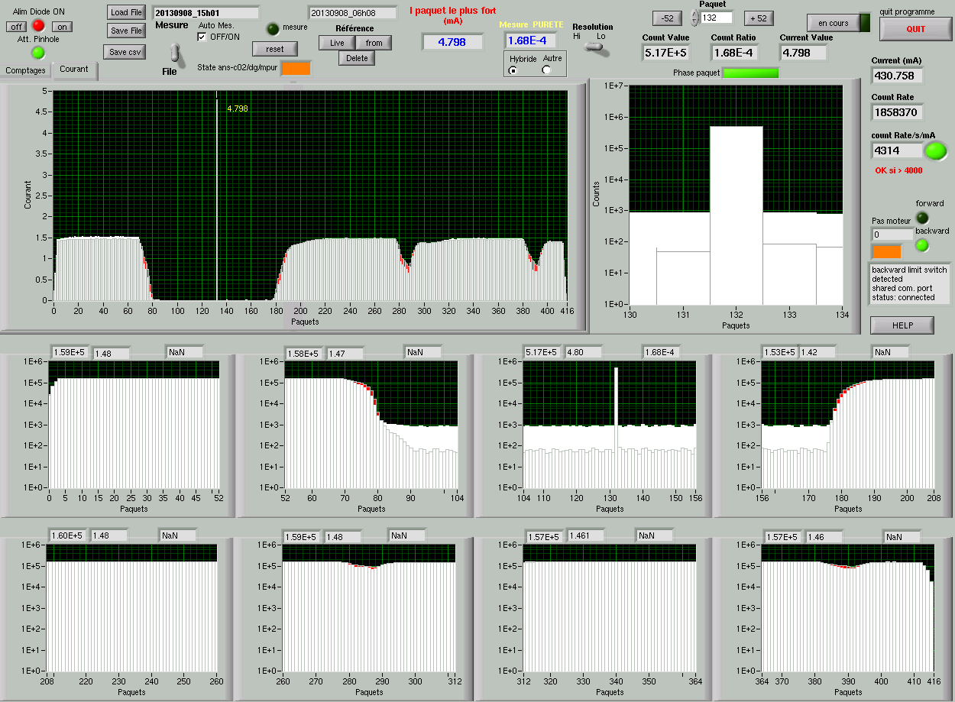
Beam purity measurement
Misunderstood observations:
Measurement is deteriorated if integration time is too long (>1 min) or measurements repeated frequently (due to APD heating?)
Usual measurement
Noisy measurement
High resolution (channels) view shows counts in channels where it’s not possible to have electrons/photons
-> Integration time limited to one minute
-> repeated measurements may give deteriorated results
-> Switching OFF APD power-supply between measurements is mandatory

Slide 9
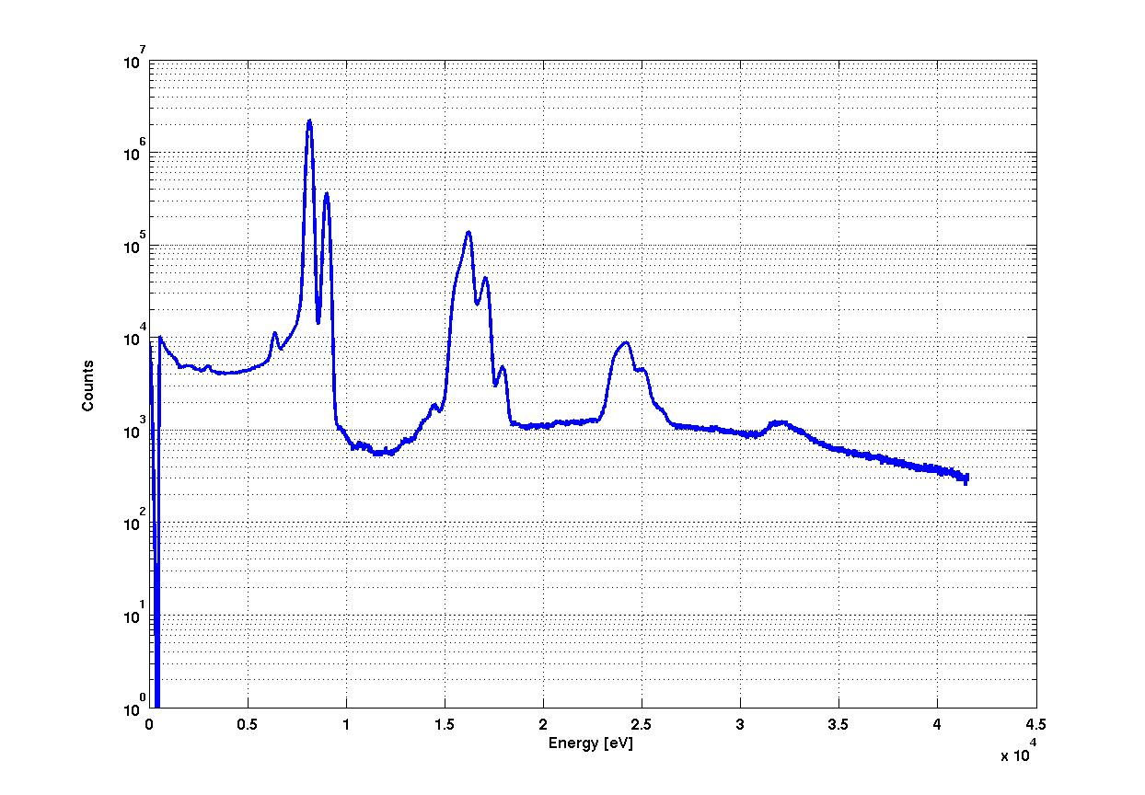
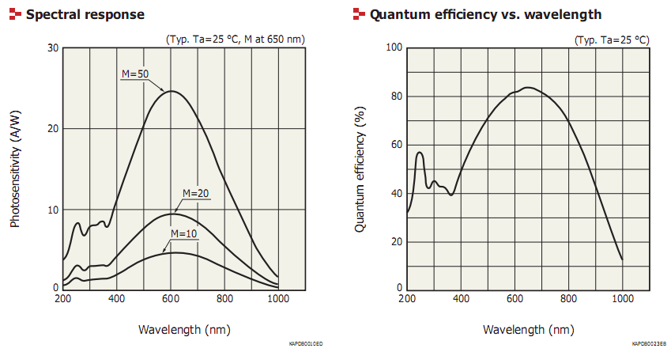
Beam purity measurement
Misunderstood observations:
Whereas we expect detecting only Cu fluorescence photons, APD counting rate is affected by standard (black) scotch layer in front of the APD (used to prevent visible light hitting the APD):
One additional layer divided the counting rate by a factor of 2
Are we really counting only copper fluorescence X-rays?
Silicon drift detector spectrum measurement
Cu
(Kα=8,05 keV, Kβ=8,91 keV)
Cu pile up
APD efficiency is given down to 200 nm only
What about shorter wavelengths?
High energy (>1 kEv) photon spectrum shows as expected only copper fluorescence lines

Slide 10
Beam purity measurement
Conclusion:
Purity measurement is a daily used diagnostic at SOLEIL
Achieved resolution is 10⁻⁶ , enough for our need so far.
But:
Some observations are still not well understood
Setting is still to long to optimize
Feedback from you:
From your experience any advice is welcome to:
Better understand why we can’t perform repeated measurements without apparition of background noise.
Better understand the spectrum of the photons that are detected
Optimize (simplify) the setting
Thank you for your attention

