Slide 1




Review of PETRA III Diagnostics
(five years of operational experience)
Gero Kube
for the PETRA III diagnostics team
DESY Hamburg
PETRA III: present status and extension project
quick glance at diagnostic systems:
BPMs beam losses
emittance diagnostics spurious bunches
beam current (FCTs)

Slide 2


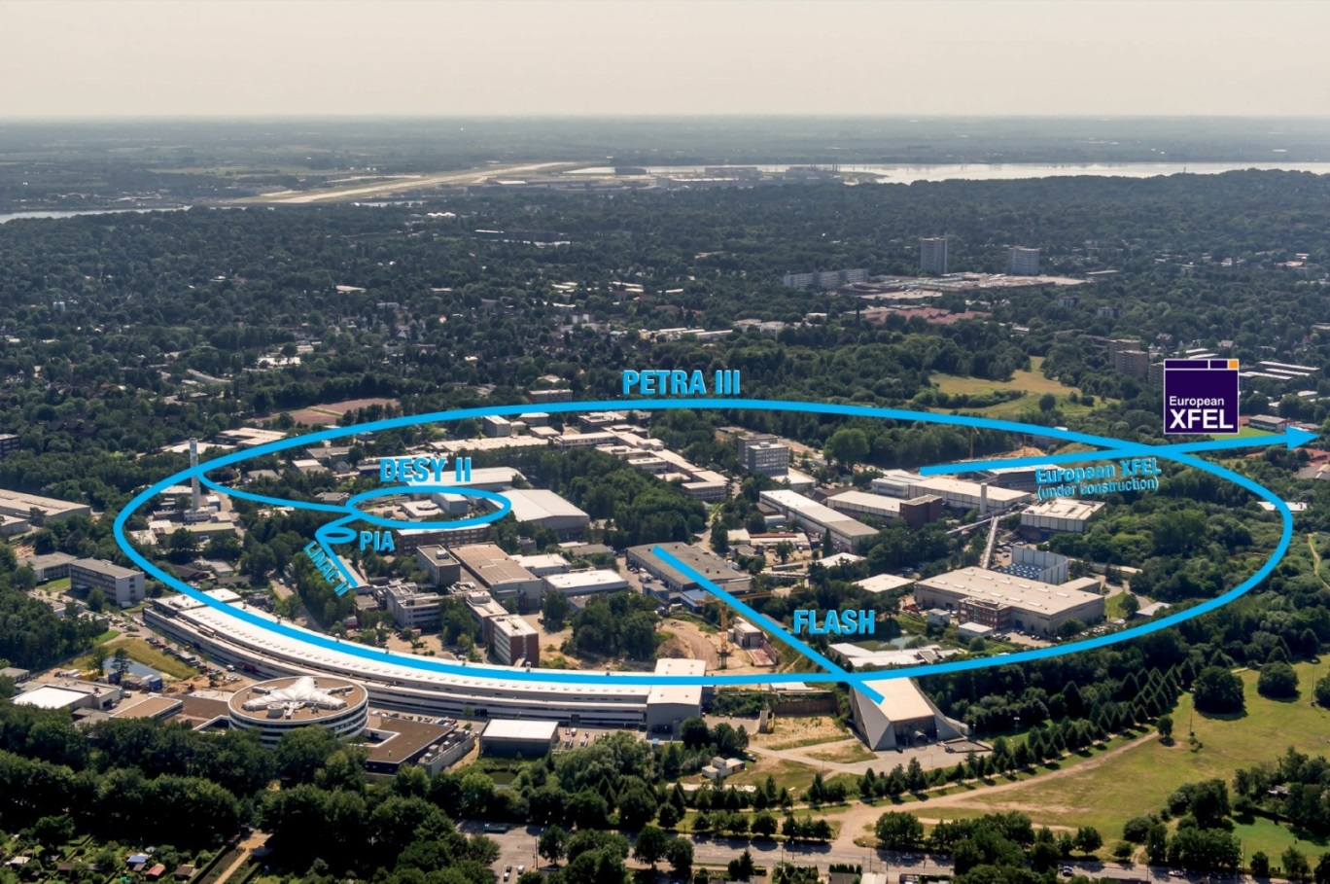
PETRA III @ DESY
DESY site in Hamburg
PETRA III parameters
circumference: 2304 m
energy: 6 GeV
emittance: 1 nm.rad
emittance coupling : 1%
current: 100 mA
# bunches: 40 / 960
straight sections: 9
user beamlines: 14
undulator length: 2, 5, 10 m
PETRA history
1979 – 1986: e⁺e⁻ collider (up to 23.3 GeV / beam)
1988 – 2007: pre-accelerator for HERA (p @ 40 GeV, e @12 GeV)
since 2009: dedicated 3rd generation light source, cost-effective supplement to E-XFEL
Gero Kube, DESY / MDI
DEELS 2014 Workshop @ ESRF, 12.05.2014

Slide 3
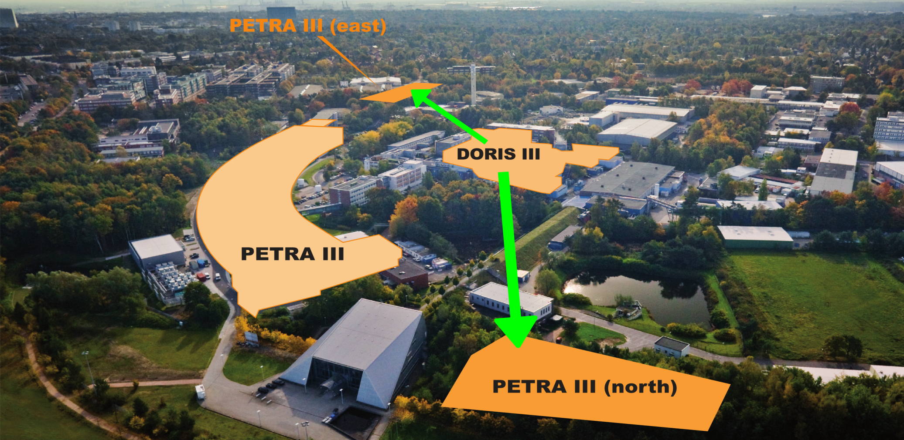
PETRA Extension
P3X motivation
DORIS III shutdown in 01/2013
→ continuation of successful experiments @ PETRA
increase number of user beamlines
→ 2 new experimental halls,10 new beamlines
Gero Kube, DESY / MDI
DEELS 2014 Workshop @ ESRF, 12.05.2014

Slide 4
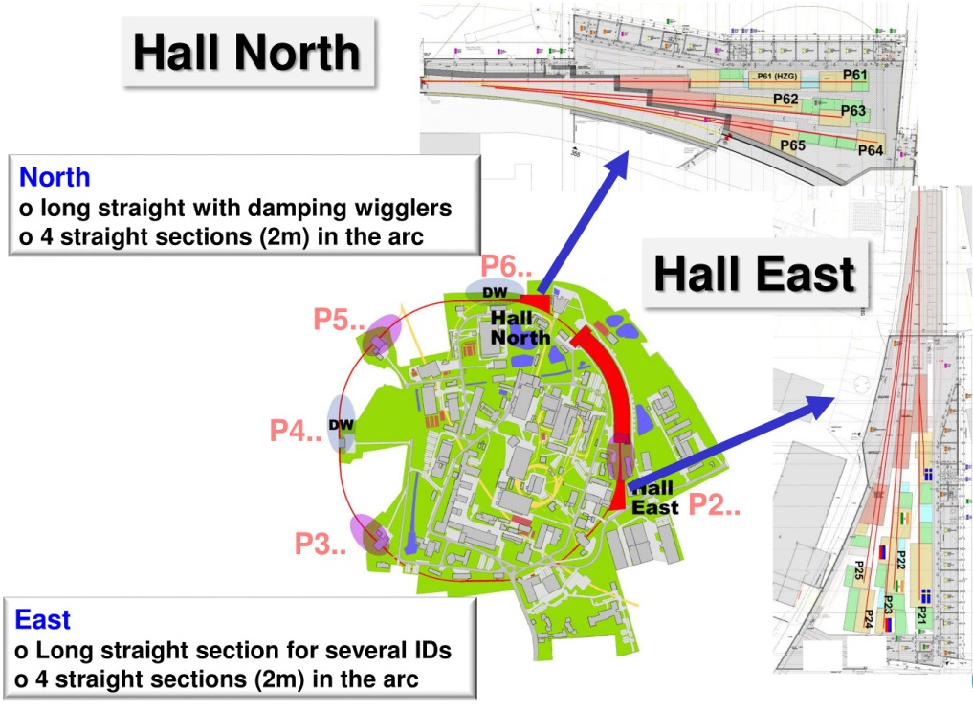
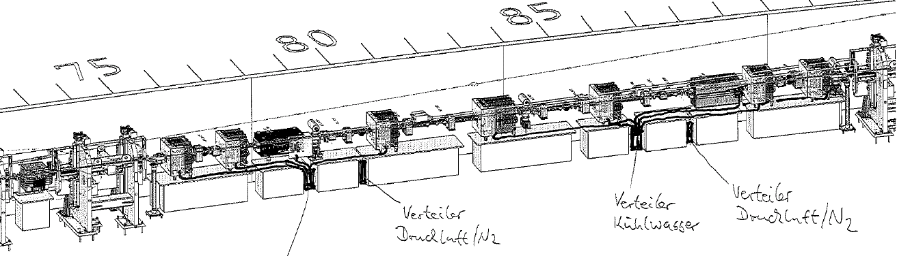
PETRA Extension
P3X
long PETRA shutdown started 02/2014
construction work in progress
back in user operation after about 1 year
accelerator modifications
about 50m of the storage ring will be modified on either side
short dipoles, no sextupoles, space for undulators
concrete base instead of girders
beam diagnostics
copy and paste of existing P3 diagnostics
→ no time for new developments
Gero Kube, DESY / MDI
DEELS 2014 Workshop @ ESRF, 12.05.2014

Slide 5
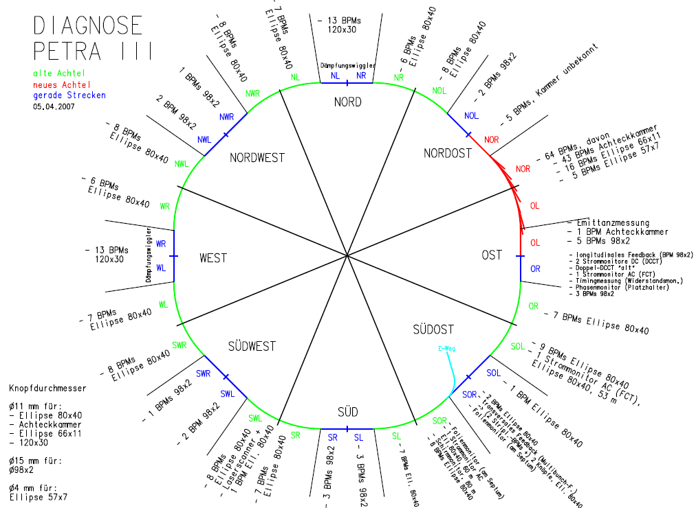
Diagnostics (P3 Design Report)
PETRA III:
228 BPMs
→ 226 for Orbit
→ 227 Libera Brilliance
6 current monitors
2 Stripline-BPMs and
2 Button-BPMs for
Multibunch Feedback
1 Button-BPM for longi-
tudinal Feedback
1 Wall Gap Monitor
1 Laser Wire Scanner
2 Beamlines for Emit-
tance Diagnostics
3 Screens
Transfer Lines:
20 BPMs
10 Current Monitors
4 Wall Gap Monitors
11 Screens
not sufficient:
beam losses
bunch purity
Gero Kube, DESY / MDI
DEELS 2014 Workshop @ ESRF, 12.05.2014

Slide 6
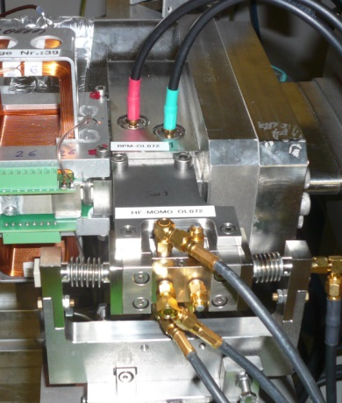
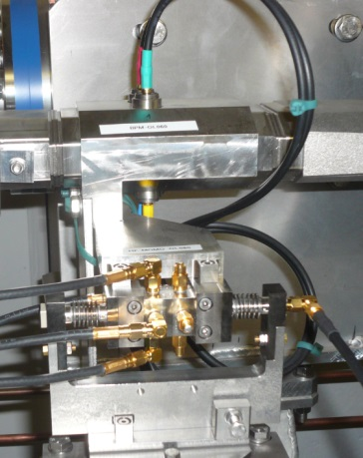
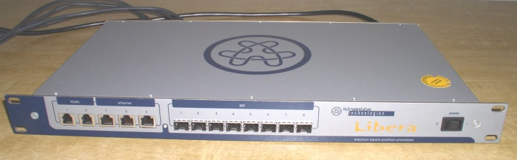
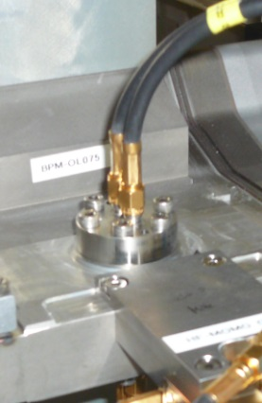
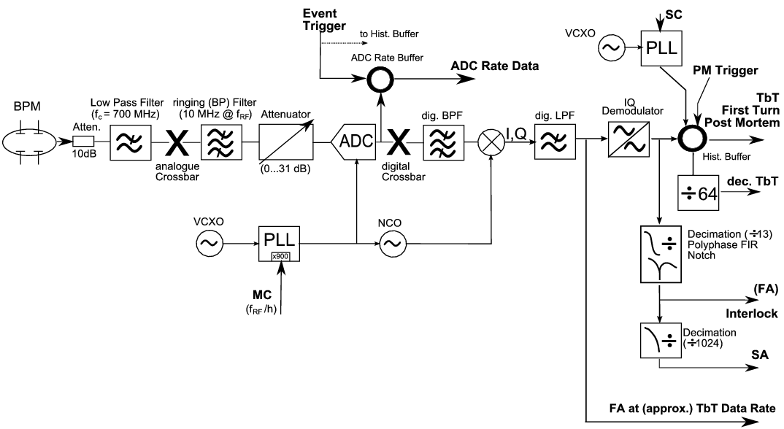
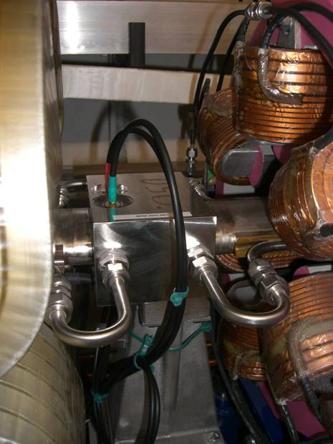
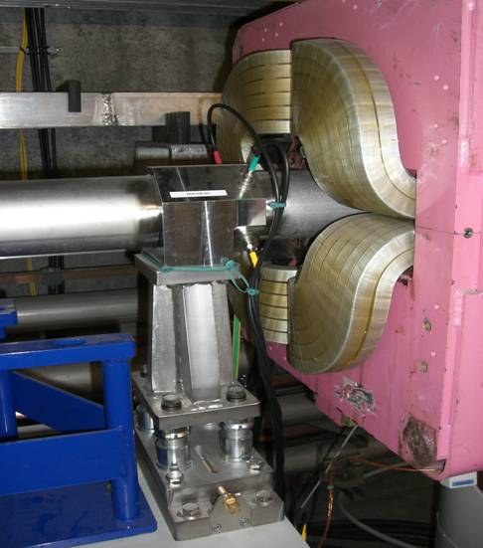
BPM System Overview
BPM pickups: 8 different pickup types
BPM electronics: Libera Brilliance
new octant
P3 setup
old octants
→ software release 1.87
P3X: upgrade to 2.09
number increases for P3X
I. Krouptchenkov et al., Proc. DIPAC 2009, Basel, TUPD03, p. 291
Gero Kube, DESY / MDI
DEELS 2014 Workshop @ ESRF, 12.05.2014

Slide 7



BPMs: Operational Experience (1)
BPM pickups
BPMs between canted undulator cells never used
→ requirement from MAC
→ design adapted on the rush from APS
→ strong non-linearities
quasi elliptical shape: 57x7 mm
button distance: 9.652 mm
button diameter 3.9878 mm
unphysical behaviour from single BPM
→ vertical reading not usable
→ threshold behaviour (single bunch current)
→ BPM switched off from orbit control
HOMs ???
Gero Kube, DESY / MDI
DEELS 2014 Workshop @ ESRF, 12.05.2014

Slide 8
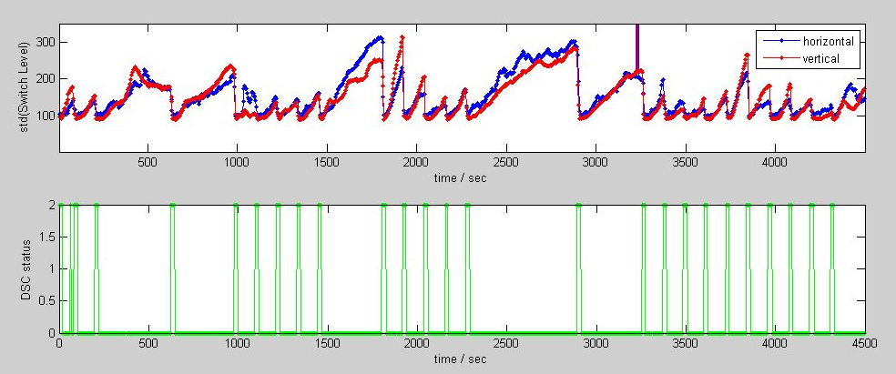
BPMs: Operational Experience (2)
BPM electronics
in principle Libera Brilliance works fine, but requires some work-arounds
digital signal conditioning (DSC) algorithm
→ switching artefacts in TbT data
→ sometimes blocked DSC coefficients
→ learning during strong signal level changes may corrupt coefficients
F. Schmidt-Föhre et al.,
Proc. DIPAC 2011, Hamburg, TUPD21, p. 350
work-around: from time to time DSC auto-learning
Gero Kube, DESY / MDI
DEELS 2014 Workshop @ ESRF, 12.05.2014

Slide 9
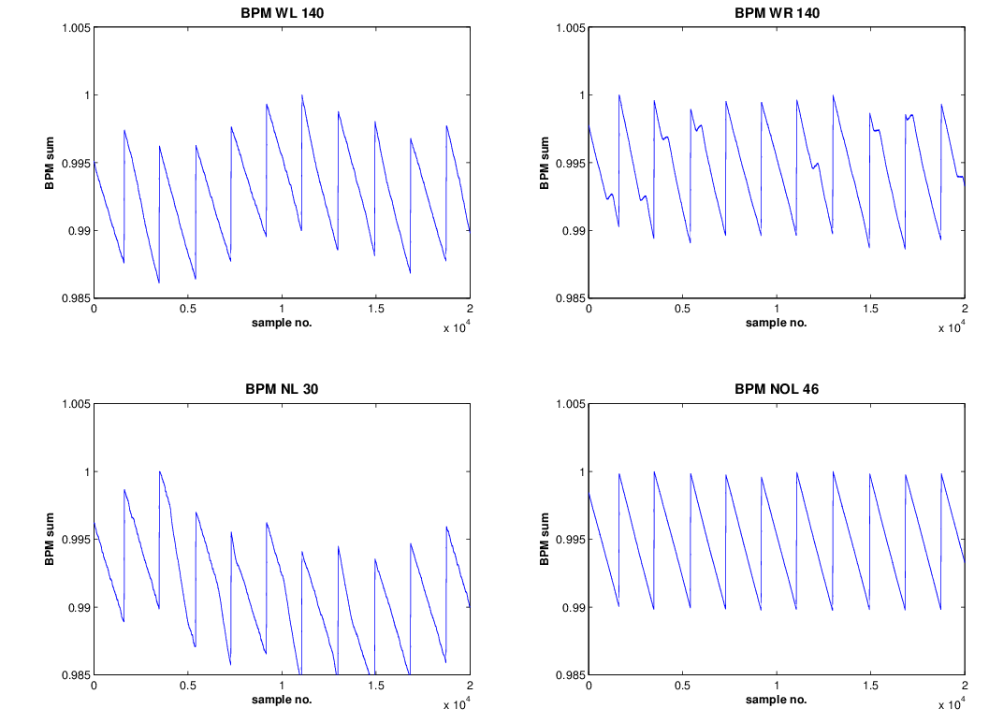
BPMs: Operational Experience (3)
BPM electronics (cont.)
fast lifetime measurement via BPM sum signal
→ several BPMs show unstable sum signal
→ ESRF: temperature and position influence
→ unstable DSC
P3X: improved DSC
algorithm with 2.09 upgrade
I-Tech: “Angel confirmed that the
DSC now works OK at Alba.”
failure of 12 V supply power
→ about 10 times in 5 years, reason not yet understood (and investigated)
pile-up from task system
→ useless cronjob, compromising the performance (work-around: scanning all Liberas, removing by hand)
→ problem seems to be solved by software updates
Gero Kube, DESY / MDI
DEELS 2014 Workshop @ ESRF, 12.05.2014

Slide 10
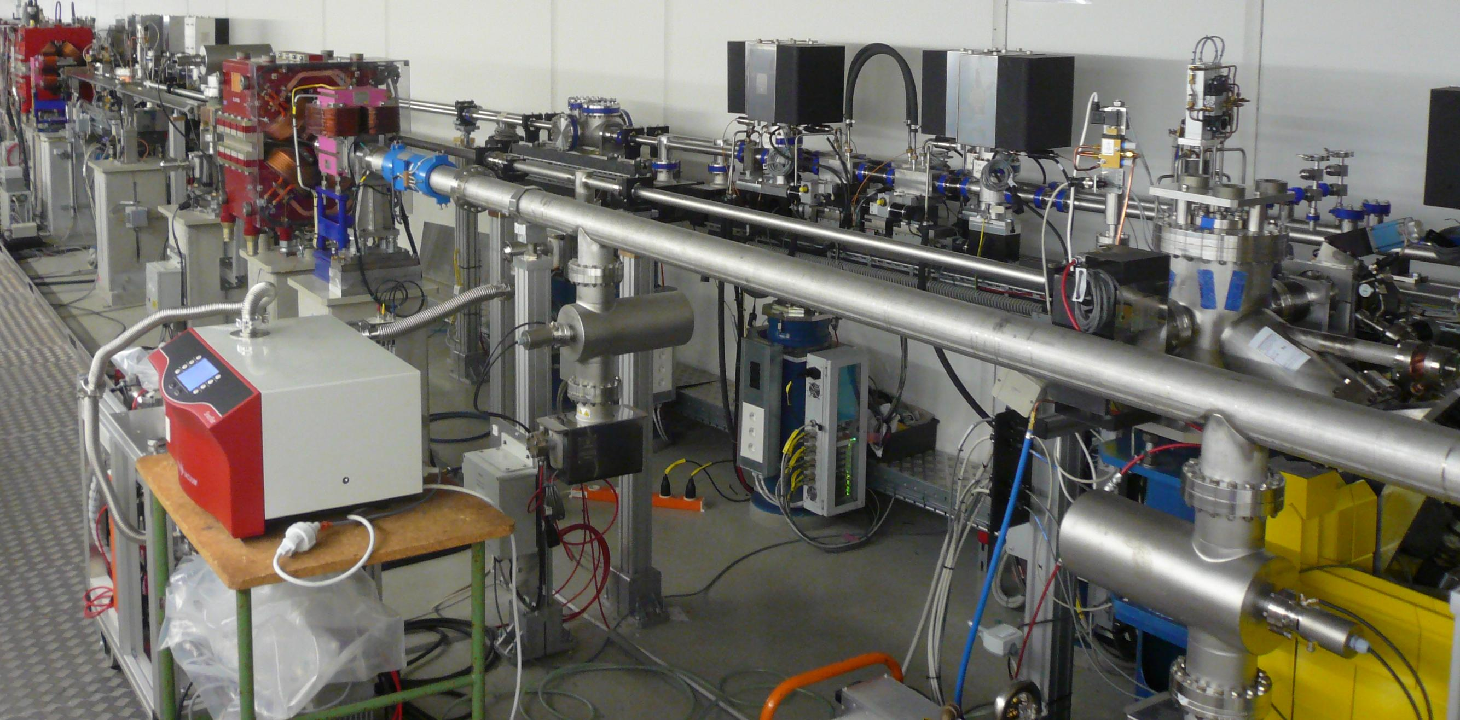
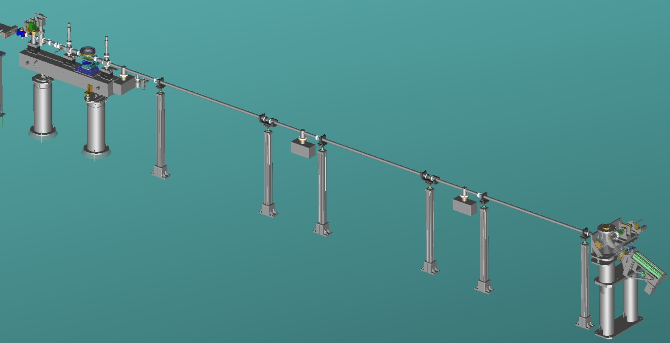
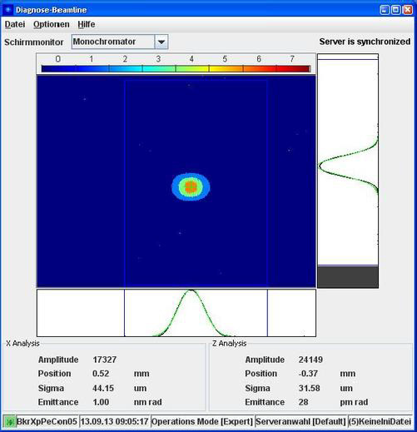
Emittance Diagnostics
imaging with Compound Refractive Lens (CRL) optics: X-ray beamline
CCD
X-ray optics
CCD
X-ray optics
Monochromator
Si (311)
Monochromator
Si (311)
design photon energy
→ ħω = 20 keV
vertical resolution broadening
→ design emittance: ε_{v} = 10 pm.rad
Gero Kube, DESY / MDI
DEELS 2014 Workshop @ ESRF, 12.05.2014

Slide 11
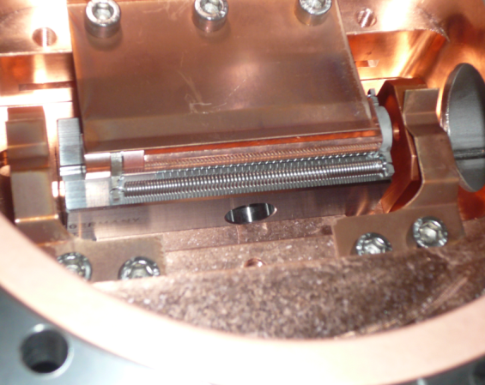
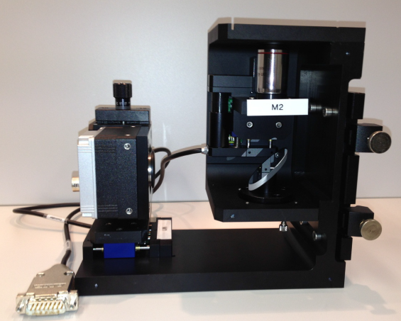
Emittance Diagnostics (2)
setup improvements
exchange of monochromator crystal
improved CRL mounting
improved detector setup
→ measured vertical emittance nearly
unaffected
assumption
photon energy slightly below 20 keV
→ indication from test measurement before shut-down
machine studies: Ultimate Storage Ring
natural beam emittance
reduction of beam energy: 3 GeV (instead of 6 GeV)
→ emittance reduction by factor 4
→ damping wiggler contribution: ε_{h} = 158 pm.rad
SR critical energy
→ SR spectrum by factor 8 → ħω_{c} = 2.6 keV
X-ray beamline: 20 keV
optical method
Gero Kube, DESY / MDI
DEELS 2014 Workshop @ ESRF, 12.05.2014

Slide 12
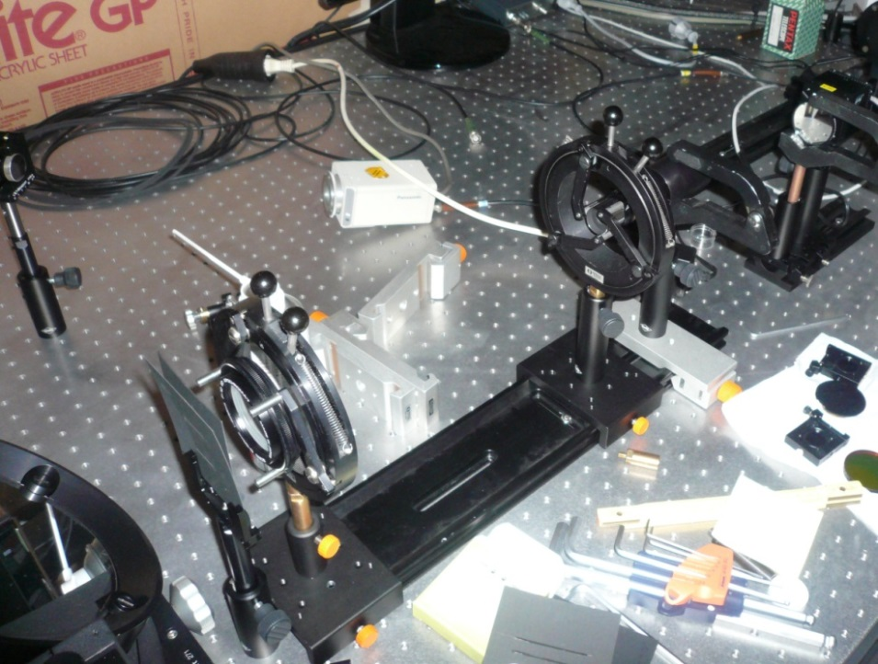
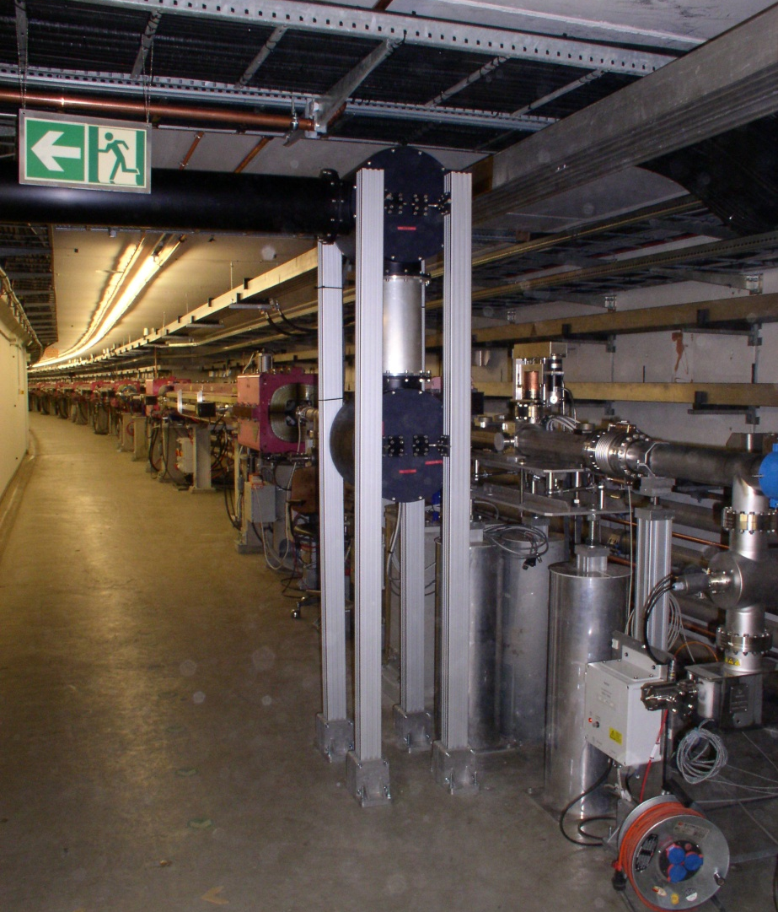
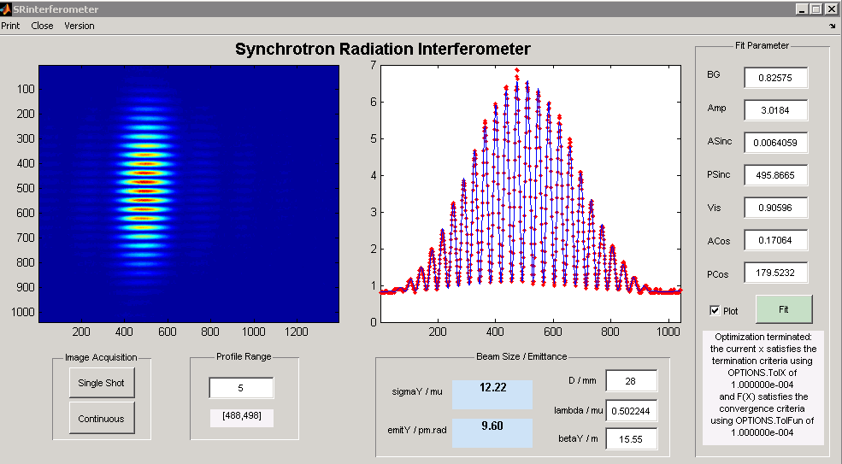
SR-Interferometer @ PETRA
setup in optical hutch
optical beamline (bunch length diagnostics)
Glan-Thomson polariser
Ü
magnification lens
lens
visible light beampipe
mirror boxes
double slit
bandpass filter & CCD
synchrotron light from
bending magnet NL 50
alignment mirror
vertical design emittance confirmed
30 m beam transport via relay optical system
Gero Kube, DESY / MDI
DEELS 2014 Workshop @ ESRF, 12.05.2014

Slide 13
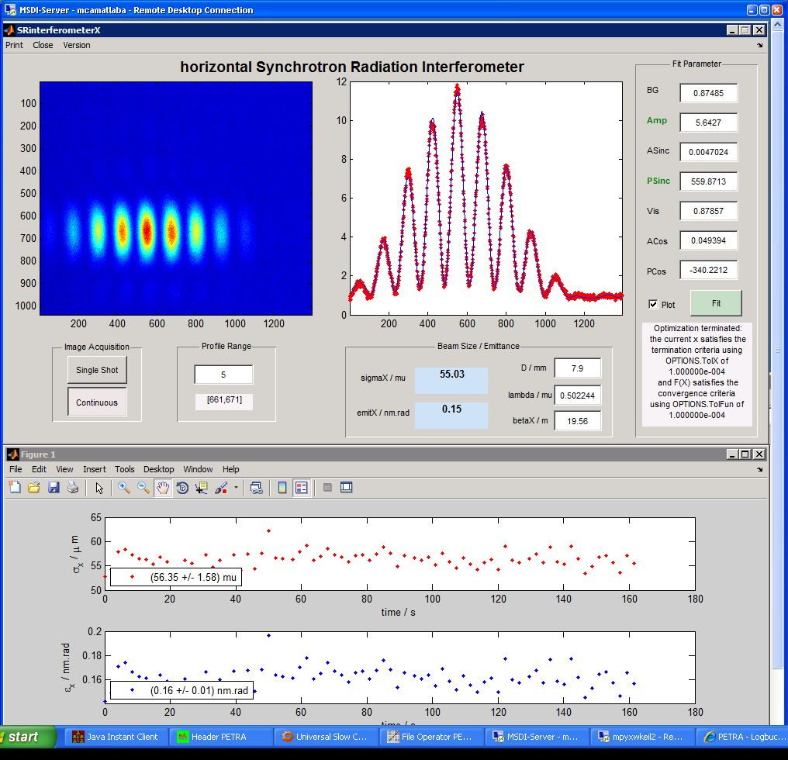
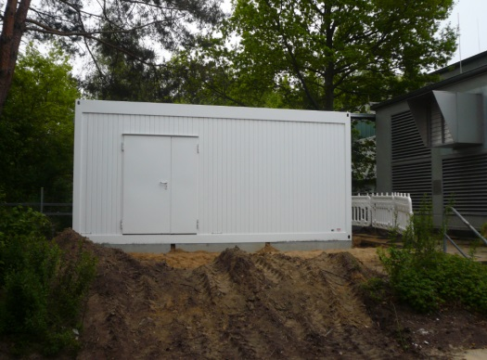
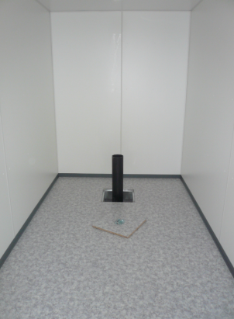
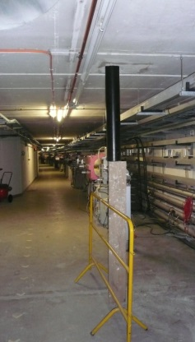
SR-Interferometer @ PETRA
USR studies
drawbacks
confirmation of 3 GeV hor. emittance
beamline with relay optics
→ additional uncertainties (lenses)
setup blocks Streak camera system
→ dismount interferometer for bunch
length measurement
space for only one interferometer
→ modify setup for measurement in
other transverse plane
beamline originally not designed for interferometric measurements
new optical beamline for P3X
construction work in progress
→ status 6.5.2014
Gero Kube, DESY / MDI
DEELS 2014 Workshop @ ESRF, 12.05.2014

Slide 14
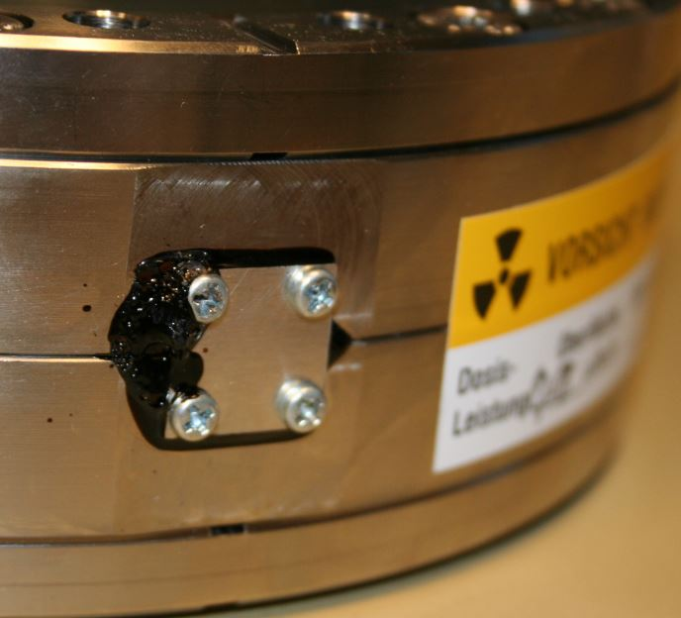
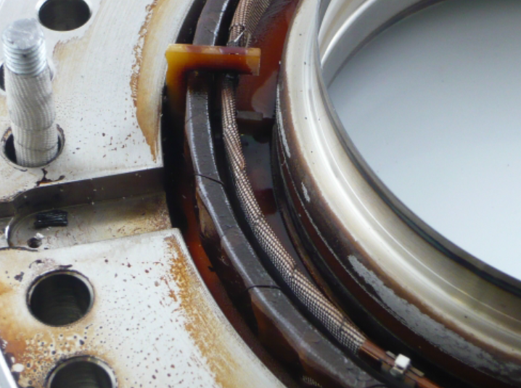
In-Flange Fast Current Transformers
3 In-Flange FCTs installed in PETRA
1st damaged after longer operation with 40 bunches @ 10¹¹ particles (80 mA)
2nd damaged after 40 bunch operation in 90 mA 1.5 years later
installation of (provisional) air cooling
investigation from Bergoz:
black residue on flanges inner surface (material seems to be cyanoacrylate impregnating the magnetic cores)
outer core wrapping: polyester tape burnt
inner core wrapping: fiberglass tape blackened
epoxy holding the core in the flanges browned and retracted
50Ω load: one resistor blown
one end of the 20‐turn winding desoldered
20‐turn winding inductance 150μH (instead of 4.5mH initially)
→ relative permeability dropped from about 120000 to 4000
assumption: temperatures of much more than 100°C inside the monitor due to transient losses
Gero Kube, DESY / MDI
DEELS 2014 Workshop @ ESRF, 12.05.2014

Slide 15
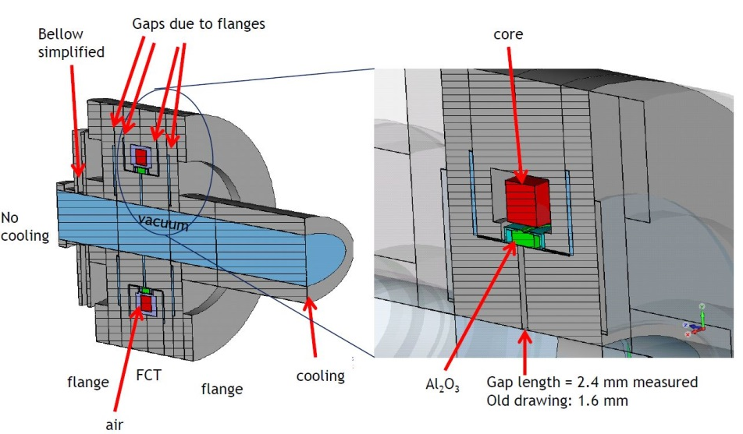
In-Flange FCTs
thermal simulations with CST
courtesy: D. Lipka (DESY/MDI)
high thermal losses in 40 bunch mode
→ transient effects
dominant mode
→ leaking through FCT gap
→ power deposition in thermally
isolated core
temperatures between 100°C and 200°C possible
→ depending on thermal coupling
https://www.cst.com/Applications/Article/Heat-Load-Investigation-Of-A-PETRA-III-Toroid
monitor improvements (Bergoz)
replacement of magnet core
→ material with higher Curie temperature
better air cooling of magnet core
installation of temperature sensor
→ temperature at magnet core
mechanical modifications
→ better air circulation
new monitors installed for P3X
Gero Kube, DESY / MDI
DEELS 2014 Workshop @ ESRF, 12.05.2014

Slide 16
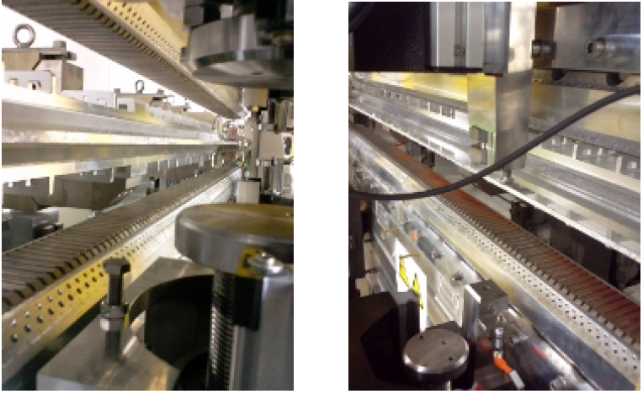
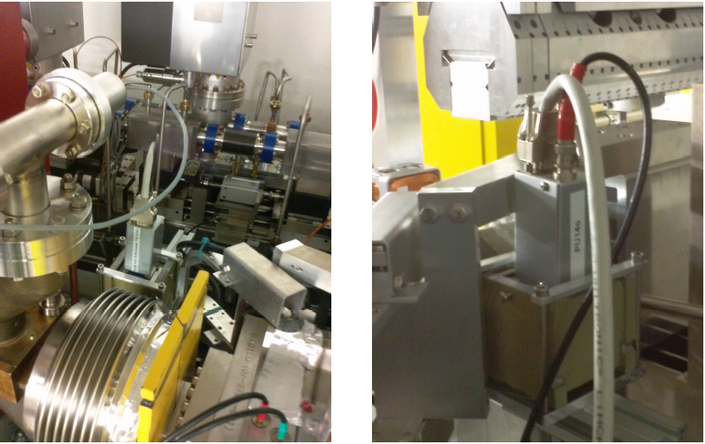
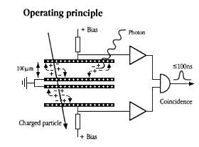
Beam Loss Monitoring
BLM system originally not planned for PETRA
operation in time resolved (40 bunch) mode
Touschek limited lifetime
→ τ ≈ 1.4 h
top-up operation
observation of radiation damage
→ rust at undulator magnets
→ undulator performance degradation
→ damaged cables
installation of HERA BLM system close to IDs
monitor
→ 2 PIN-photodiodes mounted face-to-face
coincidence counting: insensitive to synchrotron radiation
→ up to 10 MHz count rate
→ dynamic range > 1E8
→ 13 years successful operation at HERA
Gero Kube, DESY / MDI
DEELS 2014 Workshop @ ESRF, 12.05.2014

Slide 17
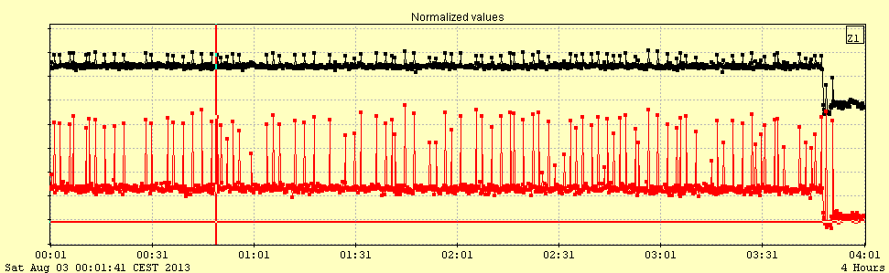
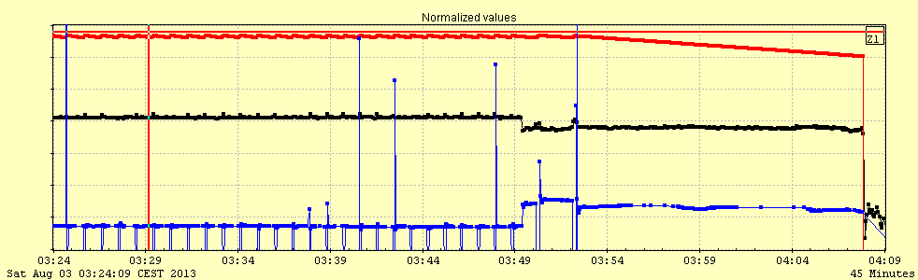
BLM Experience
injected beam losses
BLM₁
BLM₂
circulating beam losses
DC current
reduced Touschek contribution
BLM rate
life time
Gero Kube, DESY / MDI
DEELS 2014 Workshop @ ESRF, 12.05.2014

Slide 18
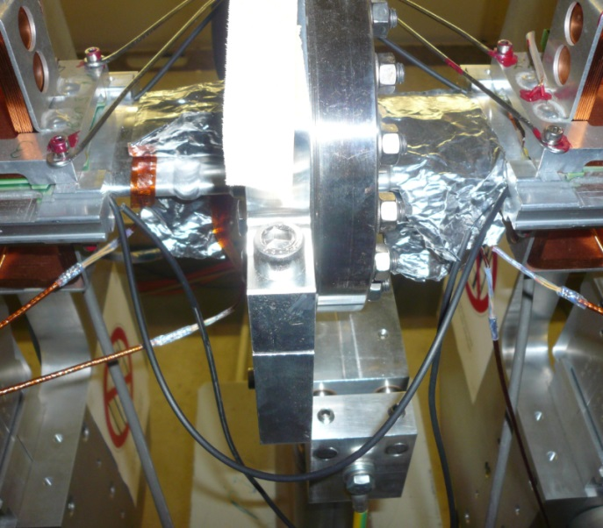
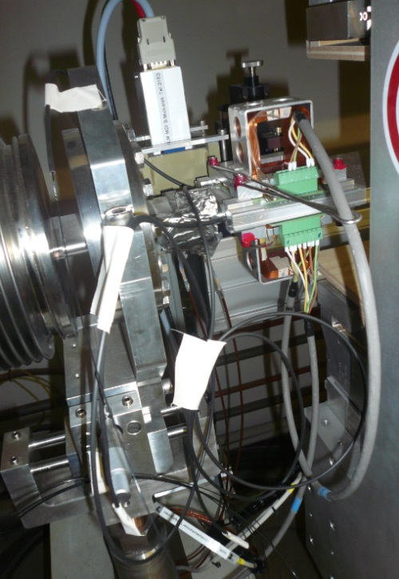
Loss Contribution
observation of beam losses from
injected beam
circulating beam
dominant loss contribution ???
BLM system
counting of losses
no information about energy deposition
BLM system with sensitivity on deposited energy
Cherenkov (scintillator) fiber based BLMs
test installation at 2 IDs
studies with beam
→ only injection beam losses
installation of 1mm thick scintillating fiber
observation of losses only from injected beam
studies continue after P3X commissioning
Gero Kube, DESY / MDI
DEELS 2014 Workshop @ ESRF, 12.05.2014

Slide 19
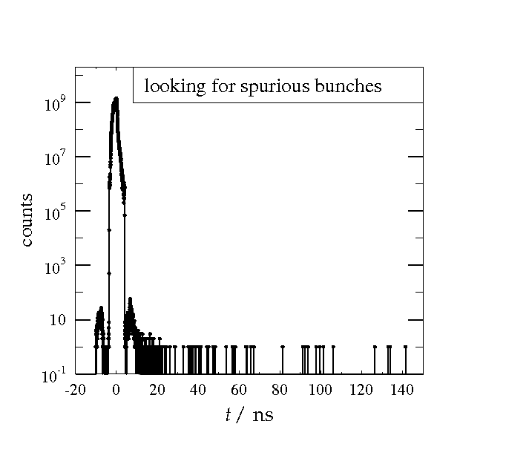
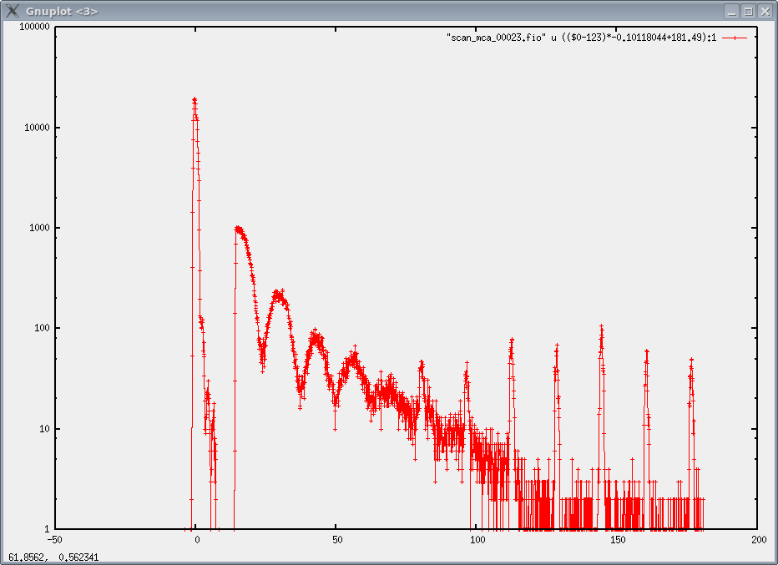
Spurious Bunches
trouble-free operation until mid of 2012
suddenly user complaints
time resolved mode (40 bunches operation)
→ nuclear forward scattering experiments with synchrotron radiation (i.e. Mössbauer in time domain)
observation of 16 ns time structure in NFS temporal beat pattern
courtesy: H.-Ch. Wille (DESY)
spurious bunches at 8 ns with 10⁻⁷ intensity
APD noise up to 20ns ?
clean from 20 ns up
2 h sample time, sp. bunch rate < 5 Hz, regular with 16ns distance
prompt at t = 0 ns measured only for fraction of a second
detector noise < 0.1 Hz
Gero Kube, DESY / MDI
DEELS 2014 Workshop @ ESRF, 12.05.2014

Slide 20
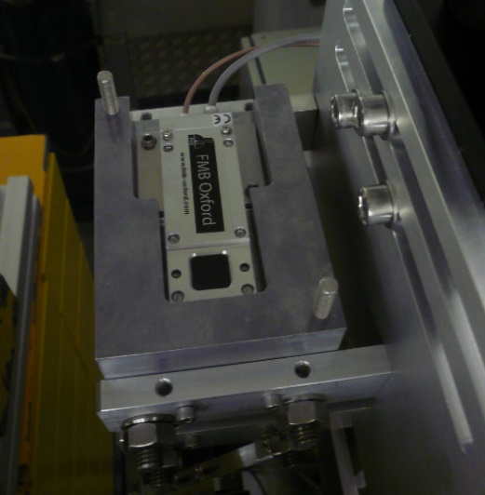
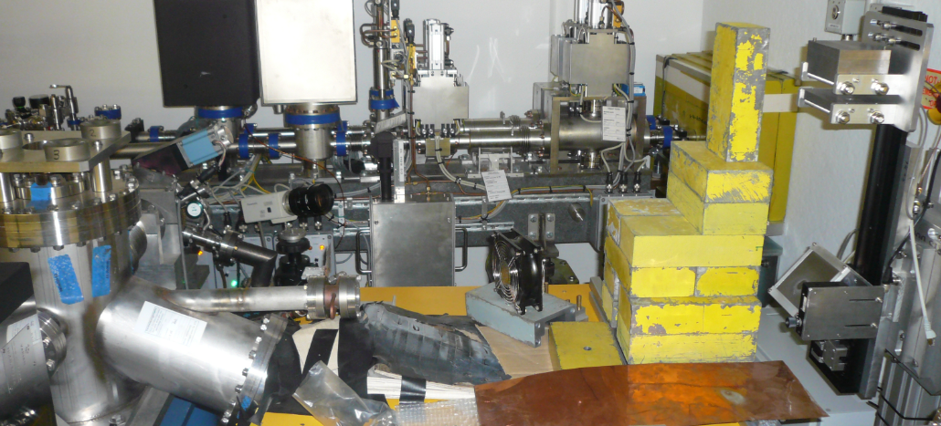
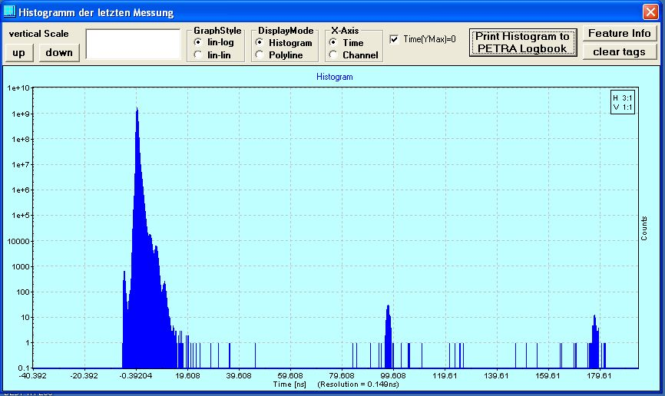
Spurious Bunches
decision to build user independent spurious bunch monitor
X-ray Avalanche Photo Diode
free port behind monochromator of X-ray diagnostic beamline
→ dirty surrounding in tunnel
→ background due to X-ray fluorescence
APD detector
monochromator chamber
γ
diffuse scatterer
monitor extensively used for studies
spurious bunches due to timing issues in injector chain
→ users are happy with present situation
monitor suffers from dirty surrounding
→ so far only qualitative measurements of bunch purity level
optimization still ongoing
Gero Kube, DESY / MDI
DEELS 2014 Workshop @ ESRF, 12.05.2014

Slide 21


Summary and Outlook
status of PETRA III and PETRA III extension project
operation of PETRA III diagnostics in general stable and reliable
for some tasks work-arounds required
diagnostics as planned in PETRA design report was not sufficient
commissioning of P3X with additional and improved diagnostics is waiting
some faulty devices
→ FCTs
→ BPMs (pickup and Liberas)
Libera DSC coefficients
optical diagnostics beamline
spurious bunches
BLMs → hot topic: degradation of IDs
many thanks ….
to all colleagues from the P3 diagnostics team
especially to M.Bieler, R.Neumann, D. Nölle, D.Lipka, F.Schmidt-Föhre, H.-Ch. Wille, K.Wittenburg (DESY)
J.Bergoz and F.Stulle (Bergoz Instrumentation)
and finally special thanks to Kees Scheidt, Philippa Gaget for organizing the workshop
Gero Kube, DESY / MDI
DEELS 2014 Workshop @ ESRF, 12.05.2014

Slide 22
BPMs: Temperature Influence
temperature influence of Libera Brilliance
Gero Kube, DESY / MDI
DEELS 2014 Workshop @ ESRF, 12.05.2014

