Slide 1
CERN SPS Upgrade
New 200 MHz and 800 MHz amplifiers

Slide 2
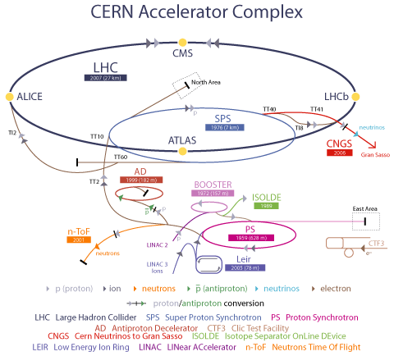
CERN Accelerator Complex
Protons and Lead Ions to maximum acceleration
  LINAC2 (proton) or Linac 3 (Lead ions)
  Booster (protons) or Leir (lead ions)
  PS (Proton Synchrotron)
  SPS (Super Proton Synchrotron)
  LHC (Large Hadron Collider)
Several other experiences :
  n_TOF – The neutron time-of-flight facility; a neutron source that has been operating at CERN since 2001
  AD – The Antiproton Decelerator; manufacturing antimatter providing low-energy antiprotons for studies of antimatter
  ISOLDE – Isotope Separator On-Line; source of low-energy beams of radioactive isotopes
  CLIC – the Compact Linear Collider Study; an international collaboration working on a concept for a post LHC machine to collide electrons and positrons head on at energies up to several TeV

Slide 3
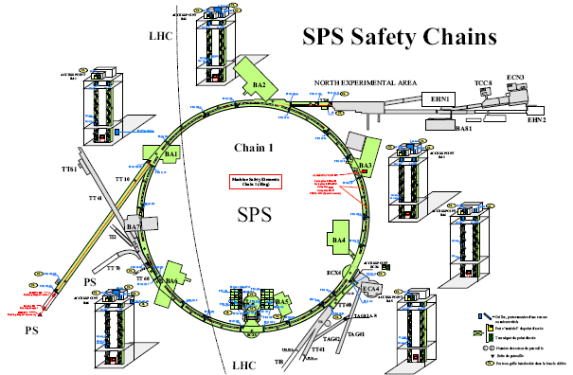
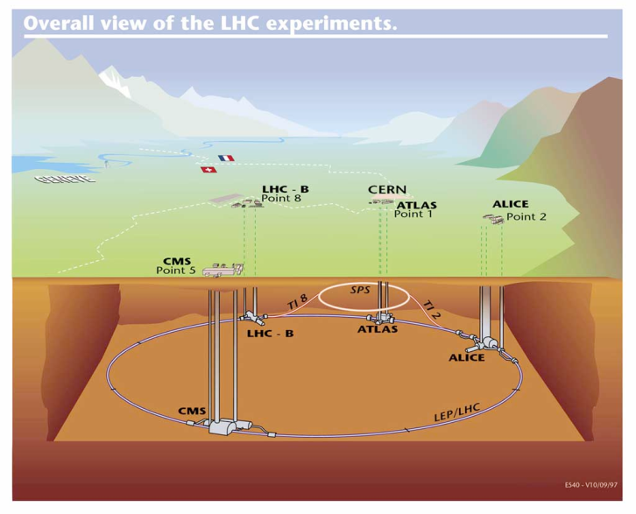
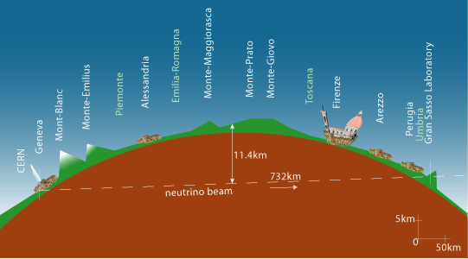
CERN SPS – the Super Proton Synchrotron
The second largest machine in CERN’s accelerator complex, nearly 7 km in circumference. It was switched on in 1976 (CERN Nobel-prize for discovery of W and Z particles in 1983)
Presently, SPS accelerates particles to provide beams for the:
  FT (Fixed Target) program (North Area)
  CNGS project
  LHC (Large Hadron Collider)
  And Many Machine Developments
North Experimental area
SPS as LHC injector
CNGS : CERN Neutrions to Gran Sasso

Slide 4
200 MHz RF in the SPS
The RF-SPS started up in 1976 with two accelerating cavities
Since 1980, for the new role of SPS as proton-antiproton collider, there are four cavities operating @ 200 MHz
We have 4 lines :
  2 x Siemens: 20 x RS2004
  2 x Philips: 68 x YL1530
1975
1976
TWC#1 / TX1
TWC#2 / TX2
1980
1990
2000
2010
1979
TWC#4 / TX4
1978
TWC#3 / TX3
1980
TWC#1 / TX1+TX2
TWC#2 / TX3+TX4
TWC#3 / TX5+TX6
TWC#4 / TX7+TX8
Configuration of one of the four
200 MHz power plant
Transmitter (TXA)
Coaxial transmission line
(feeder line)
125 to 160 meters
mW
Dummy load
Terminating loads
Power
combiner
Transmitter (TXB)
Accelerating cavity

Slide 5
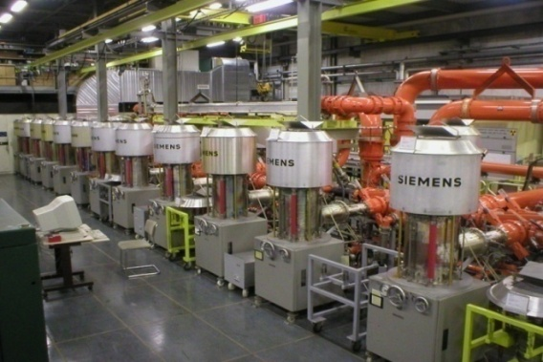
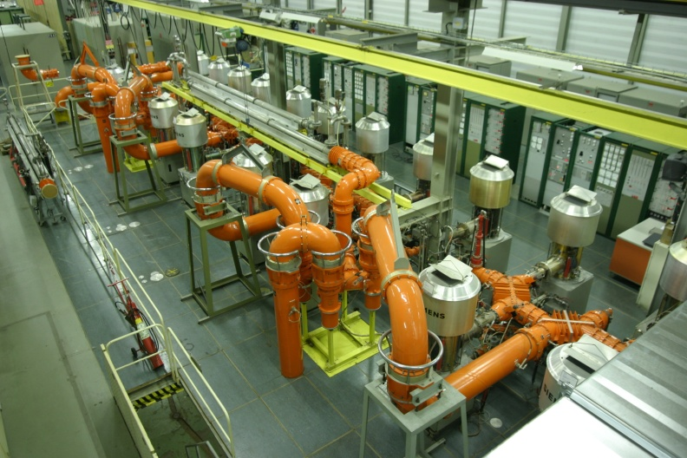
Two ‘Siemens’ lines = 20 x RS2004

Slide 6
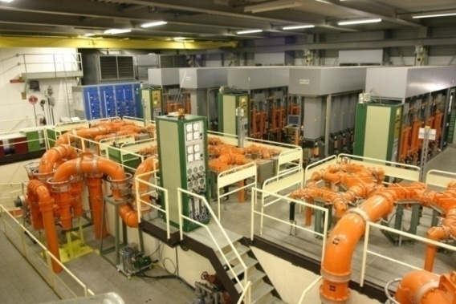
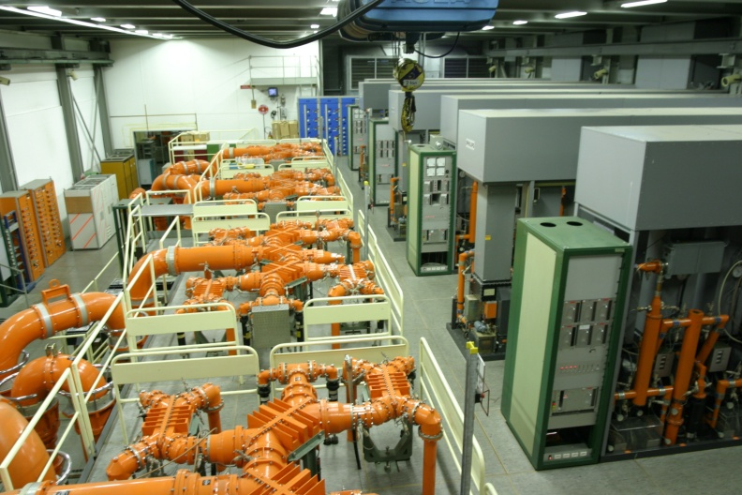
Two ‘Philips’ lines = 68 x YL1530

Slide 7
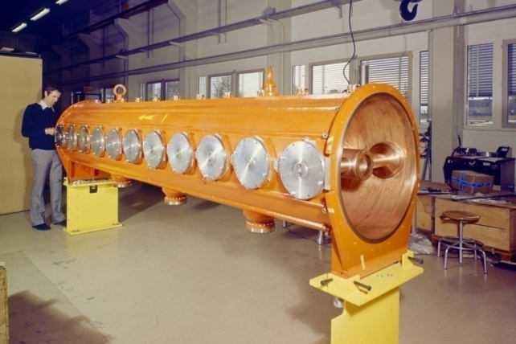
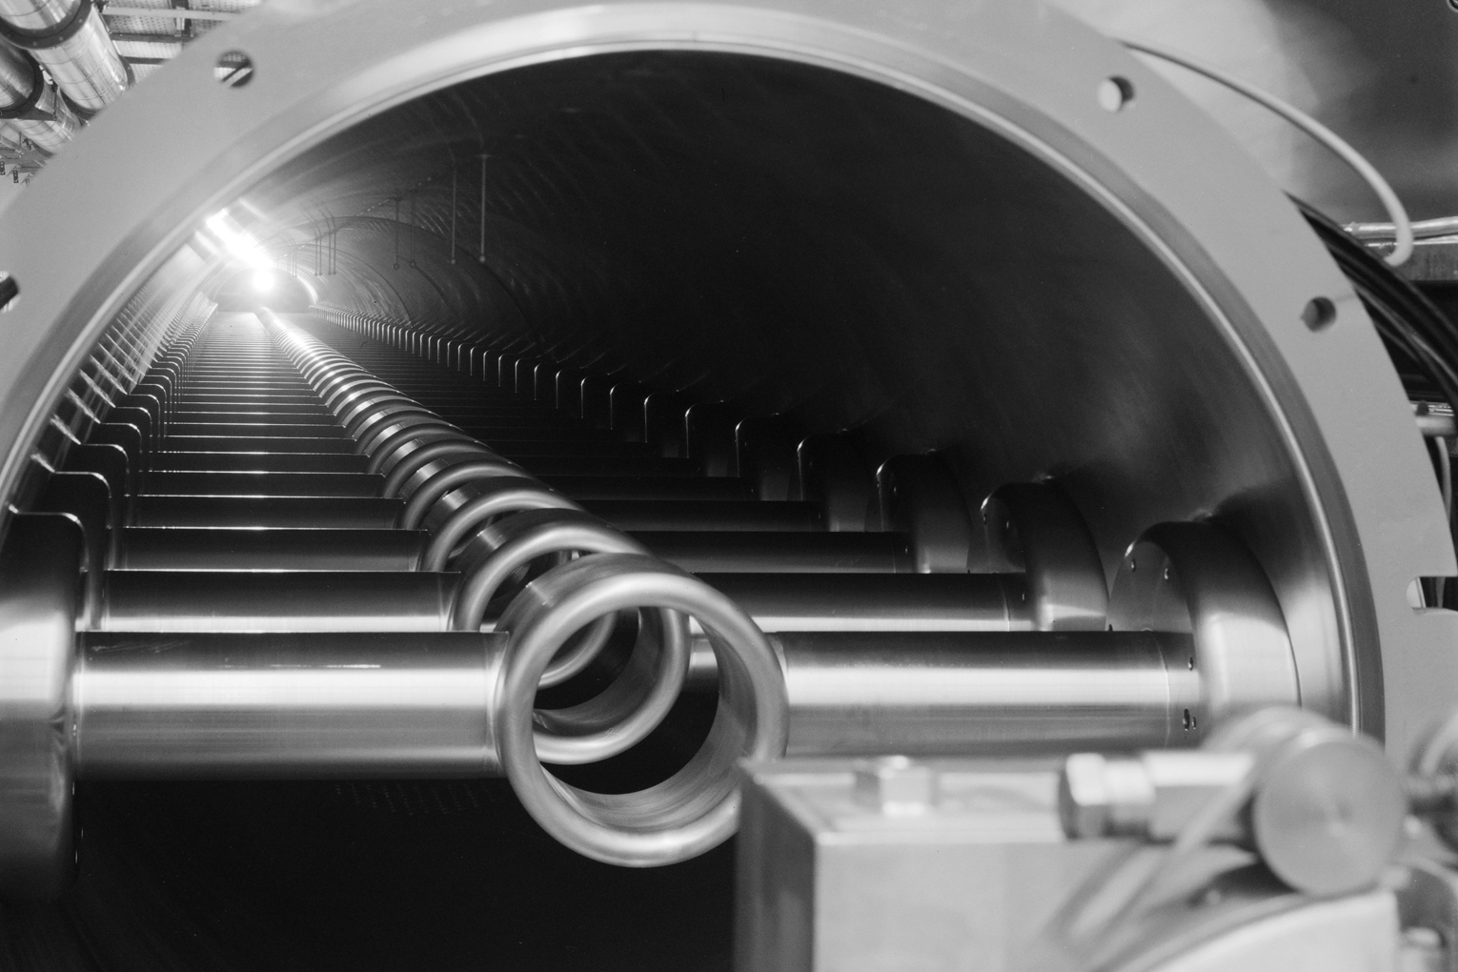
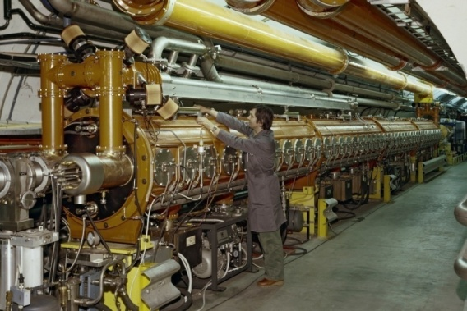
Travelling Wave Cavities
One section = 11 drift tubes
2 x 4 sections Siemens plants
2 x 5 sections Philips plants
4 Main Power Couplers
  2 input couplers
  2 output couplers
2 x 550 kW terminating power loads
One section: 11 drift tubes
One 4 sections cavity

Slide 8
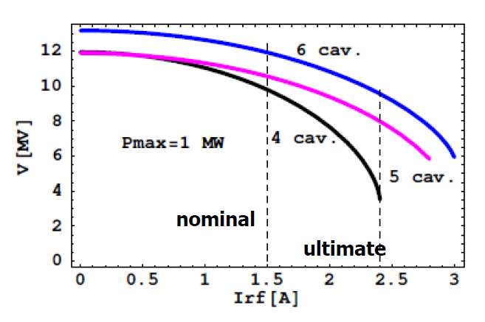
200 MHz limitations
With present 4 cavities configuration we will have problems at ultimate LHC current
The increased number of shorter cavities with 2 extra power plants should significantly improve the RF performance for ultimate LHC intensities
The best compromise is 6 cavities:
  4 x 3 sections cavities with 1.0 MW
  2 x 4 sections cavities with 1.4 MW
Courtesy of Elena Shaposhnikova
Total voltage possible on the flat top vs beam current with :
  4 cavities (present situation) with 1.0 MW
  5 cavities with 1.0 MW RF
  6 cavities with 4 x 1.0 MW + 2 x 1.4 MW
  Dashed lines are at nominal and ultimate beam currents.

Slide 9
Cavities redistribution
2011 : 4 cavities
2 x 4 sections
2 x 5 sections
+ 3 spare sections
2018 : 6 cavities
2 x 4 sections
4 x 3 sections
+ 1 spare section

Slide 10
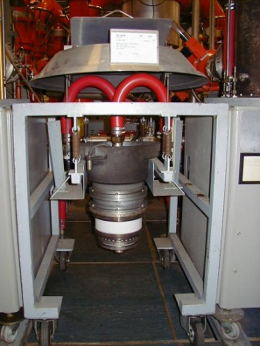
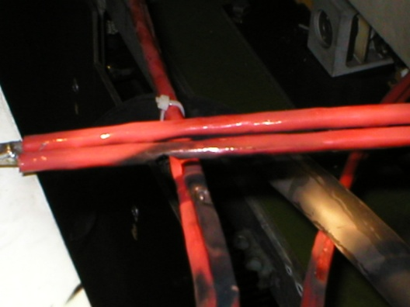
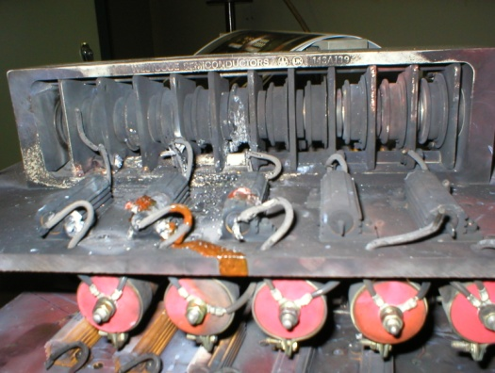
First upgrade: Present amplifiers
Ratings | Present | Future
CW 5 seconds | 650 kW | 700kW
Pulsed 43 kHz | 900 kW | 1100 kW
BW_{-3dB} | 2.6 MHz | 2.3 MHz
Tubes per year | 6 + 16 | 7 + 18
HVPS need a full re-cabling and an air cooling improvement to allow higher pulsed mode
Tetrodes:
Present lifetime statistics, operating ~650 kW cw:
RS2004 : 20’000 hrs
: 6 tubes per year
YL1530 : 25’000 hrs
: 16 tubes per year
HVPS need a full re-cabling and air cooling improvement to allow higher pulsed mode

Slide 11
New RF power plant
New RF Amplifier
LSS3 Tunnel integration
New RF Building
New RF Building
1 mW
1.7 MW
RF amplifier
Coaxial transmission line
150 meters
1 mW
1.7 MW
RF amplifier
Accelerating cavity
Accelerating cavity

Slide 12
2018 : two new power amplifiers
Must be reliable:
  24/24 hours
  300/365 days
  (2 months winter Technical stop)
  20 years of operation,
  with 3 years of operation + 1 year off cycle
Pulse mode: 1.7 MW max
Average: 850 kW (thermal limitation)
2 x 1.7 MW Klystron
2 x 4 x 450 kW Diacrodes
2 x 8 x 225 kW IOTs
2 x 8 x 225 kW tetrodes
  Equivalent to ‘Siemens’
2 x 16 x 110 kW tetrodes
  Equivalent to ‘Philips’
2 x 1700 x 1 kW SSA

Slide 13
1.7 MW amplifier, i.e 1.4 MW cavity
To have 1.4 MW available at the cavity input, 1.7 MW at the Final output are needed
Taking advantage of the long experience we have with tetrodes and combiners, a possible solution could be a 16 x tetrodes combined through 3 dB combiners
A major improvement to present systems would be to have individual SSA drivers per tetrodes
Four contracts :
  Drivers (SSA)
  Finals (SSA or Tetrodes)
  Combiners (3 dB above 100 kW)
  Transmission lines (coaxial, 345 mm outer)
From Beam Control
Drivers
16 SSA
1/16 splitter
Final
16 Tubes
or SSA
1.7 MW
3 dB
combiners
and power loads
-0.6 dB total
1.5 MW
120 m and 180 m
Coaxial lines
-0.2 dB
To cavity input 120 m away
1.4 MW

Slide 14
SSA vs Tetrodes
Overdesign requirements :
  14/16 tubes shall provide full power, i.e. each tube shall deliver up to 138 kW
  SSA are more ‘reliable’: 2000/2048 of the total number of devices shall deliver full power
Tetrodes tube costs over 20 years will be added :
  20 year * 3/4 * 335 * 24 = 120’000 total hours
  With 20’000 hours per tube = ~ 200 tubes
  Reduced by warranty lifetime
SSA obsolescence shall be integrated:
  i.e. 20% additional transistors, not module, single chips (still under discussion, need experts inputs)
Final | Tetrodes (gain = 12 dB) | SSA (Gain = 20 dB)
Nominal ratings | 16 x 106 kW = 1700 kW | 2048 x 830 W = 1700 kW
Maximum ratings For 1400 kW at cavity input | Maximum 2 faulty tubes 14 x 138 kW = 1932 kW | Maximum 48 faulty modules 2000 x 891 W = 1782 kW
Maximum ratings Driver | 16 x 8.7 kW | 16 x 1.1 kW
Wall plug efficiency will be part of the adjudication
  HVPS included (Tetrodes)
  Losses in all SSA combiners, circulators and loads included

Slide 15
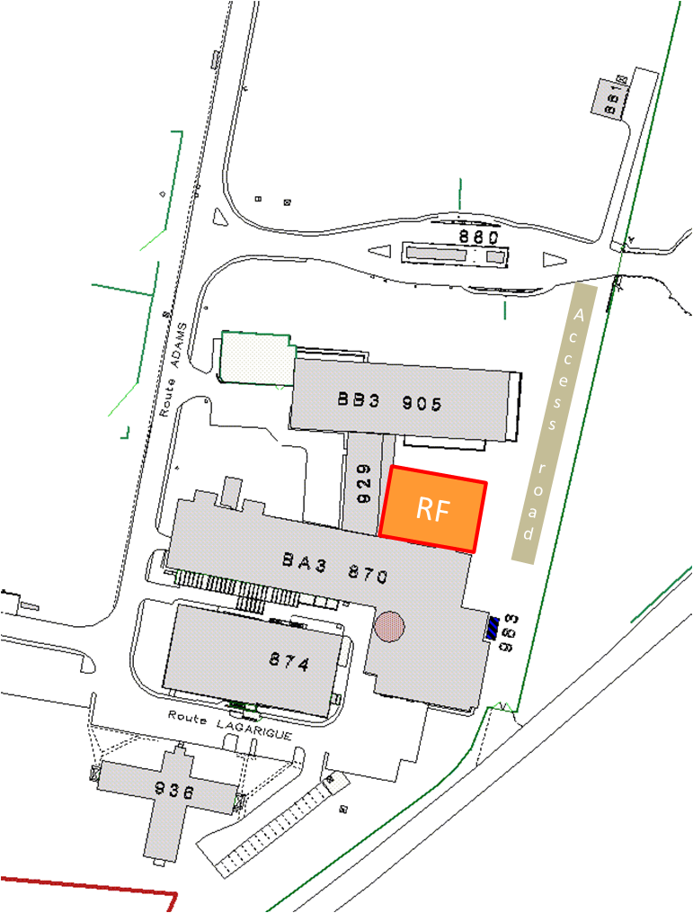
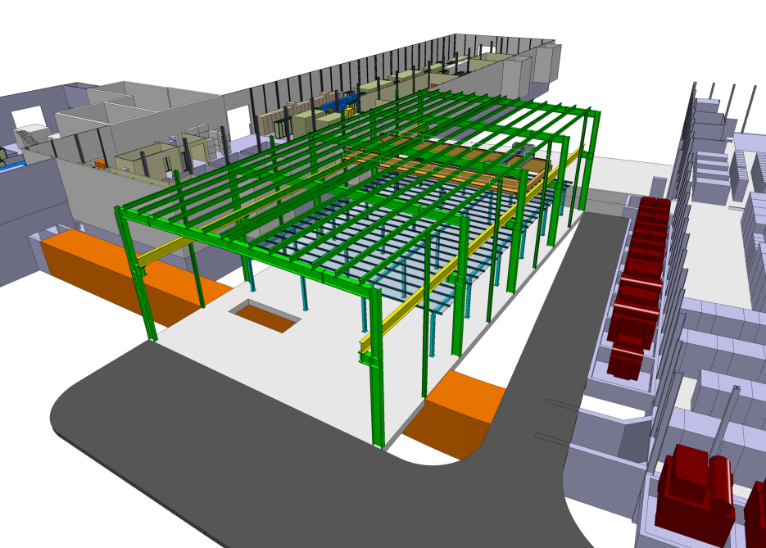
New RF building
Only possible location is between two existing buildings
Maximum ‘RF’ foot floor will be
2 x 450 m2
Whatever the solution, SSA or Tetrodes, the same building, no impact on the choice
800 MHz
RF workshop
Siemens
Faraday Cage
Philips

Slide 16
Draft schedule
Year 1
Year 2
Year 3
Year 4
Year 5
Year 6
Year 7
2011
2012
2013
2014
2015
2016
2017
2018
RF :
Studies (amplifiers, couplers, cavities)
Cavities re-arrangement within a LS ( > 6 months)
MS
Tendering
Build new hardware
Tunnel :
Studies
Install
Build New hardware
Commissioning
Installation phase 1
(pickups + dampers + CV + EL + …)
Installation phase 2
(cavities)
Building:
Studies
Authorizations
Building
Services

Slide 17
200 MHZ upgrade Conclusions
We will have two new 1.7 MW pulsed / 850 kW average RF power amplifiers
Building will be the same, no impact
The less expensive solution beetween SSA and Tetrode will be selected !

Slide 18
800 MHz RF in the SPS
The proton beams for the LHC are intense and unless careful precautions are taken they become unstable in the SPS and cannot be accepted by the LHC
One of the most important systems in the SPS used to keep the beams stable and of the highest quality is the 800 MHz RF system acting at the second harmonic of the main accelerating 200 MHz RF system
This 800 MHz system in the SPS is essential for maintaining stability of the LHC beams. It is required at every point in the cycle from injection to extraction. It works by increasing the synchrotron frequency spread in the beam
Stability is problematic above 1/5 nominal without the 800 MHz
By applying RF voltages of ~ 1 MV (about 1/7 of the main RF system) via two cavities in the SPS ring this “Landau Damping” system increases the natural spread of synchrotron frequencies in the individual proton bunches, prevents them acting together, and thus ensures stability
The RF power source and its ancillary equipment for this 800 MHz system must be of the highest reliability to ensure beams are available for the LHC at all times

Slide 19
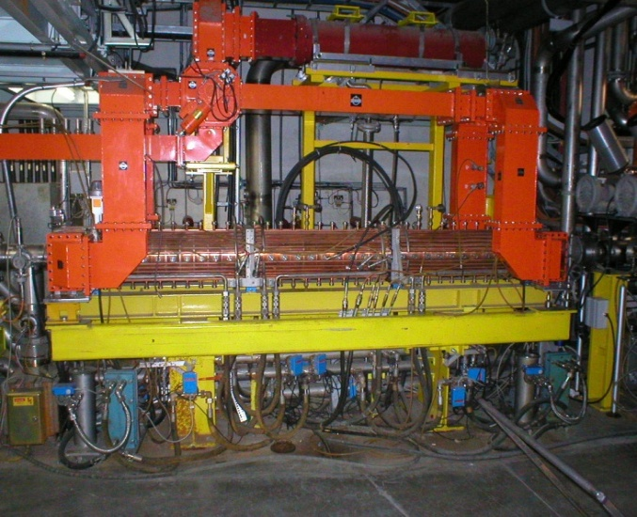
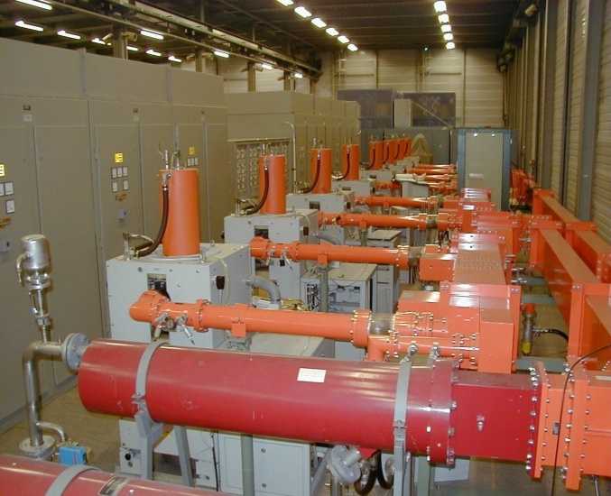
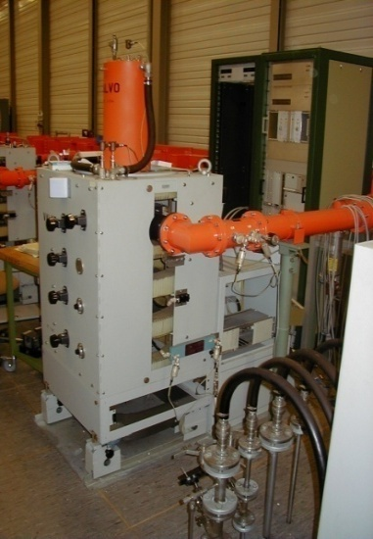
Old 800 MHz system (1)
Since 1980, the system is composed of :
2 Travelling Wave Cavities
2 transmitters of 225 kW each connected via ~ 120m waveguides to the TWC
4 x 56 kW klystrons Valvo YK1198 per transmitter combined using 3 dB hybrids

Slide 20
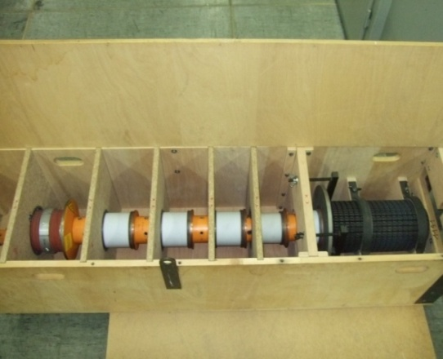
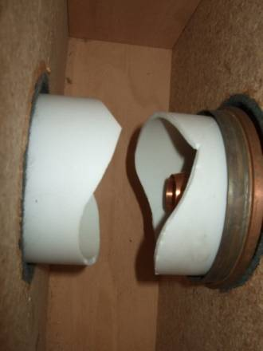
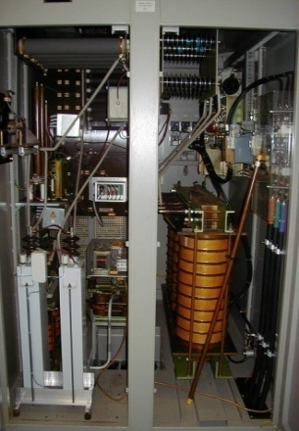
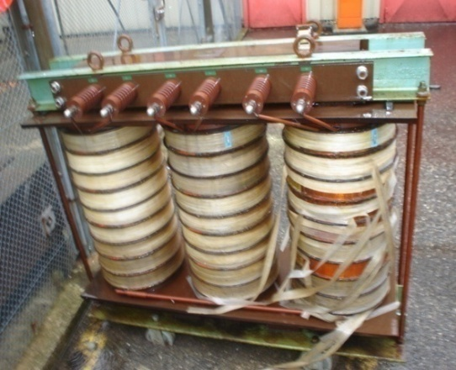
Old 800 MHz system (2)
Unfortunately, that system has not been used for a very long time and has not been properly maintained.
We still only have :
  2 simultaneous klystrons available on 1 cavity
  6 operational klystrons
  10 broken klystrons (could be repaired for 100’000 $ each)
We also had major difficulties with power converter transformers :
  9/9 burnt
  4 repaired

Slide 21
Upgrade proposal
Replace Klystron Transmitters with IOT Transmitters and re-use all existing peripherals
Maximum power will be slightly increased up to 240 kW CW
BW_{-1dB} will be increased:
  1.0 MHz with Klystrons
  6.0 MHz with IOTs
New transmitters will include:
  RF power amplifiers chain
  Final amplifier IOT based
  Individual power converters
  Individual Monitoring and control compatible with CERN interface
In total it will be 8 + 1 transmitters
One 800 MHz Line
Layout
One 240 kW Transmitter
Layout
Splitter
RF Power Amplifier 60 kW cw
Ø shifter
Attenuator
Monitoring
and
Controls
Power converters
Amplifiers
3dB Combiner
Power load
RF Power Amplifier 60 kW cw
Cavity and Transmitter
Monitoring and Controls
(CERN)
Monitoring
and
Controls
Power converters
Amplifiers
Ø shifter
Attenuator
3dB Combiner
Power load
RF Power Amplifier 60 kW cw
Monitoring
and
Controls
Power converters
Amplifiers
Ø shifter
Attenuator
3dB Combiner
waveguide line
(125 meters )
RF Power Amplifier 60 kW cw
Monitoring
and
Controls
Power converters
Amplifiers
Cavity
Terminating load
Ø shifter
Attenuator
Power load

Slide 22

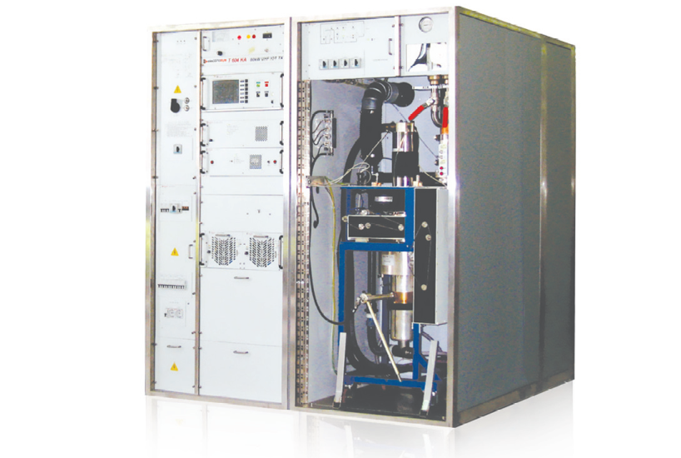
Selected supplier : Electrosys
Two companies per member state have been contacted (40 companies)
Six companies have been compliant to our specifications
Electrosys has been selected
‘Quasi’ off the shelves Transmitter
Possibility to have Thales or e2v trolleys and tubes for the same price

Slide 23
Factory Acceptance Tests: various operational modes
Continuous operation | 24/24 hours CW for 10 months continuously | 24 hours made prior to our visit. 4 hours made with us
Very Long Pulses operation Fc = 800.888 MHz +/- 0.5 MHz : 100% from 0 to 240kW with rise and fall time < 0.5 µs 5 seconds ON / 5 seconds OFF |  | One hour made with us
AM modulation #1 Fc = 800.888 MHz +/- 0.5 MHz : 100% from 0 to 240kW with rise and fall time < 0.5 µs Repetition time 10 µs (100kHz) |  | One hour made with us
AM modulation #2 Fc = 800.888 MHz +/- 0.5 MHz : 0 to 240kW with 4 MHz triangle AM 25 % in power Rise and fall time < 0.5 µs Flat top pulse and off pulse length of 11 us Repetition time 23 µs (43kHz) This cycle for 20 second then 1 second OFF. |  | One hour made with us

Slide 24
Factory Acceptance Tests:
Bandwidth
Power Amplifier (Driver + Final)
Operating frequency :
800.888 MHz
Bandwidth at -1dB :
6.0 MHz (+/- 3.0 MHz)
CW output minimum power :
60 kW
Amplifier meets all requirements
Pmax = 61.0 kW
Pmax -1dB = 47.5 kW
BW-1dB = 7.0 MHz (-3/+4 MHz)

Slide 25
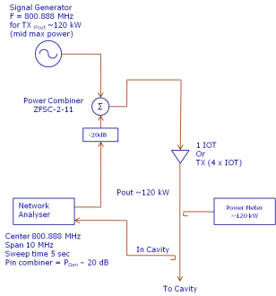
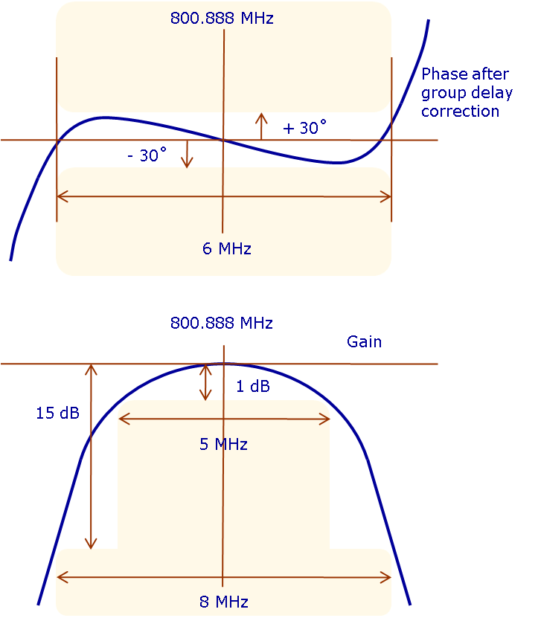
Factory acceptance tests:
Phase stability
Carrier f₀ at mid power (30 kW)
with additional - 20 dB power sweep
Fully fulfill specification
Measurements to be made with each Power Amplifier AND with the whole Transmitter (i.e. four Power Amplifiers combined together)
Measurements with a 800.888 MHz carrier at Pmax/2 and a frequency sweep 20dB below carrier : Non linear phase distortion at +/-3.0 MHz: max. +/- 10° Passband at -1 dB: 5.0 MHz Passband at -15 dB: 8.0 MHz

Slide 26
Factory acceptance tests:
Power Sweep
Measurements to be made with each Power Amplifier AND with the whole Transmitter (i.e. four Power Amplifiers combined together)
With four PA : Po = 240 kW With one PA : Po = 60 kW Pout vs Pin must be monotonic from zero to Po Small signal differential gain g = dPout/dPin, in the range 0.1 Po to 0.9 Po Local slope variation max +/-15% Can vary by 3 dB maximum. | Gain saturation curve | Small signal differential gain in the range 0.1 Po to 0.9 Po: Local slope variation +/- 5% (+/- 2% averaged) Vary by 2.0 dB maximum
Non linear phase distortion (CW): Δ φ_{max} < 10º | Non linear phase distortion curve | Phase distortion < 3°
0.1 P_{max}
0.9 P_{max}

Slide 27
Factory Acceptance Tests: conclusion
All factory acceptance tests have shown compliance respect to the specification, and even better :
  Linearity
  Monotonous
  Phase stability
  Maximum output power
All requirements were fulfilled (we repeated all the tests twice to confirm the results)
We checked modularity of the equipments
We controlled noise level
We checked protections:
  driver output reflected power operated while making tests (due to over range power sweep)
  Water cooling, air temperature, current limits, etc …

Slide 28
CERN Acceptance Tests
Pre-series Amplifier has been integrated within CERN operational area
All tests cycles have been done for 4 hours each, no trouble has been discovered

Slide 29
Long duration tests:
CW mode
When we launch CW long duration tests, difficulties arose
While doing the test over six weeks, we were not able to obtain a stable operation
Maximum time slots were :
  115 hours : 1
  66 hours : 2
  33 hours : 5
  < 24 hours : 18
→ Not stable enough in CW mode

Slide 30
Air temperature sensitivity
Transmitter has shown to be Temperature sensible :
  Water Temp = 26.4 +/- 0.5
  Air Temps = 22.1 +/- 2.6
  Driver Gain = 6.7 %
  Cold IOT = + 7.5 % to - 38 %
  Hot IOT = +/- 4.9 %
Drivers are inverse temp, while IOT is direct Temp
Restart a cold IOT must be done readjusting the drive within the first three minutes
CERN LLRF will manage these variations

Slide 31
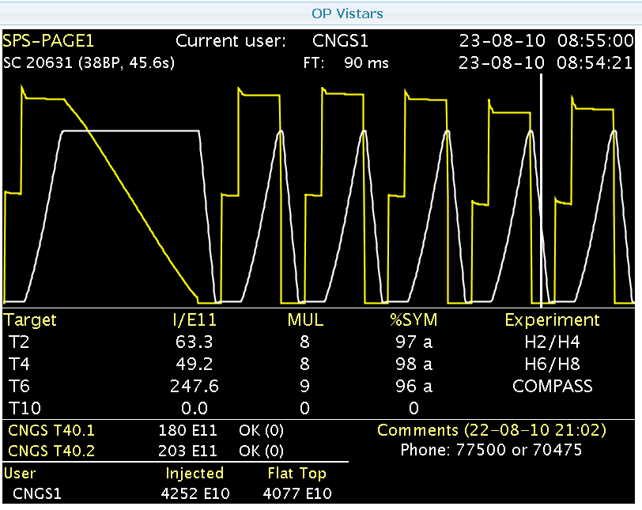
Long duration tests:
Super Cycle mode
To reduce average power and be closer to machine operation, we launched Super Cycle long duration tests, new difficulties arose
While doing the test over four weeks, we were not able again to obtain a stable operation
Time slots were mainly between 12 to 24 hours
The main fault is always the same ‘IGBT 4 gate D’, even with no amplifier connected !
We are convinced the tube itself is not part of the trouble

Slide 32
HVPPS instabilities
We tried a 50% RF signal instead of our super cycle, varying the repetition rate
The HVPPS stability is function of the repetition rate !

Slide 33
800 MHZ upgrade Conclusions
First tests were very promising, but…
Long duration tests shown lack of HVPPS stability
We asked for a conventional linear Power Converter (with thyratron crowbar)
Installation is foreseen next week …

Slide 34
Many thanks
For your attention, and for inviting me to your workshop

Slide 35
RF Group at CERN
RF group is 170 colleagues operating RF over all machines

