Slide 1
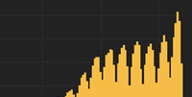
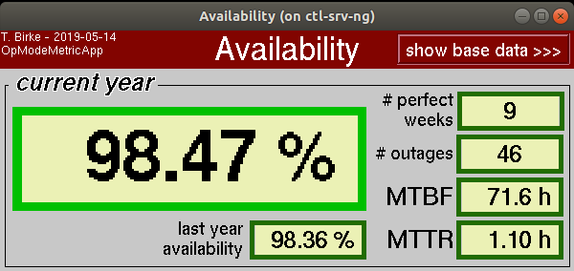
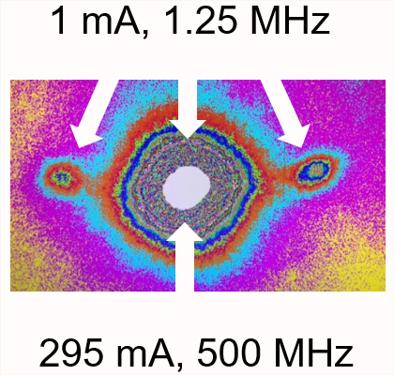
BESSY II status & upgrade
Markus Ries on behalf of the machine group

Slide 2
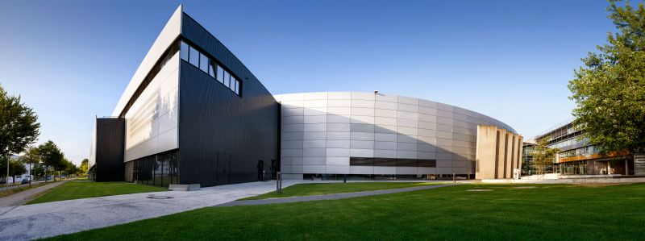
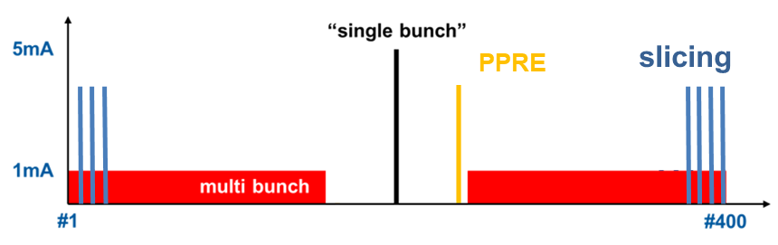
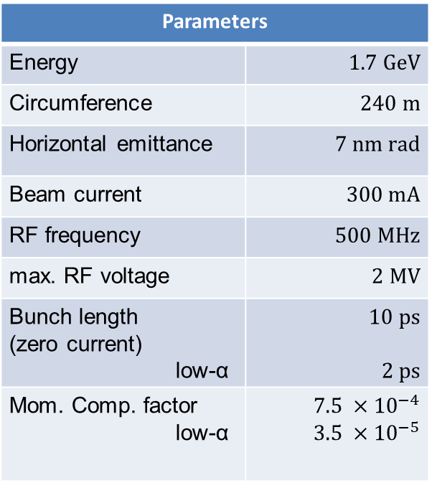
BESSY II
Parameters
Energy | $$1.7 GeV$$
Circumference | $$240 m$$
Horizontal emittance | $$7 nm rad$$
Beam current | $$300 mA$$
RF frequency | $$500 MHz$$
max. RF voltage | $$2 MV$$
Bunch length (zero current) low-α | $$10 ps$$ $$2 ps$$
Mom. Comp. factor low-α | $$7.5 ×{10}^{−4}$$ $$3.5 ×{10}^{−5}$$
in user operation since 1998
diverse user community
offering short x-ray pulses and timing

Slide 3
Outline
management of the COVID-19 pandemic
operation status
upgrades and developments
BESSY III CDR status

Slide 4
Outline
management of the COVID-19 pandemic
operation status
upgrades and developments
BESSY III CDR status

Slide 5
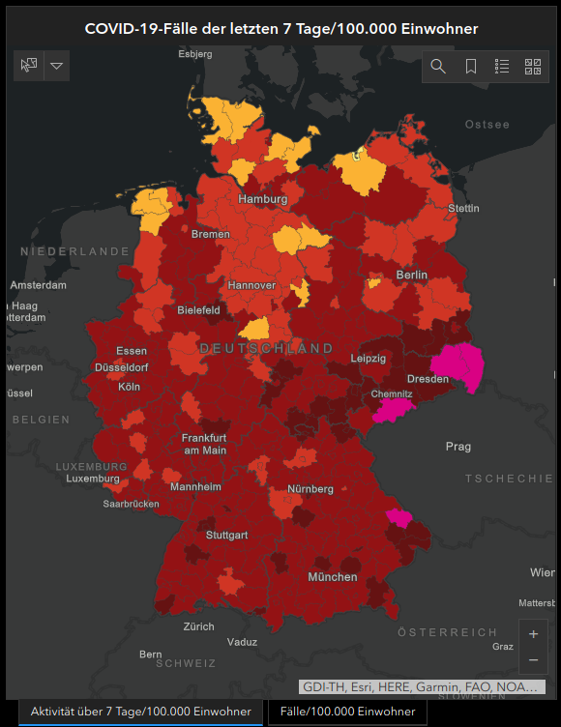
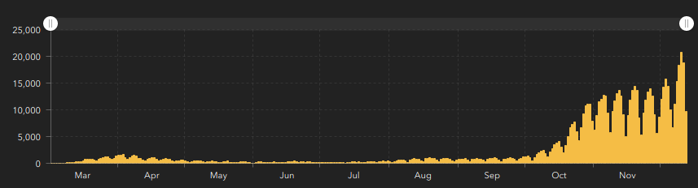
management of the COVID-19 pandemic: recent development
as of today – Germany entered lockdown
BESSY II turned to standby mode (24h ramp-up time)
MLS in minimal operation (1 operator / day)
twice a week supervisors meet for a patrol
machine startup expected mid of January

Slide 6
management of the COVID-19 pandemic: organization point of view
task force
cancelation of all business trips if incidence > 50/100000/7d
very flexible application of home office
→ people urged to work from home as much as possible
quarantine of second order contacts as well
temperature checks upon entering the company area
low-office-density concept, i.e. rolling plans for:
  offices
  functions
video conferencing difficult (Jitsi offered as best-effort, hosting zoom forbidden)

Slide 7
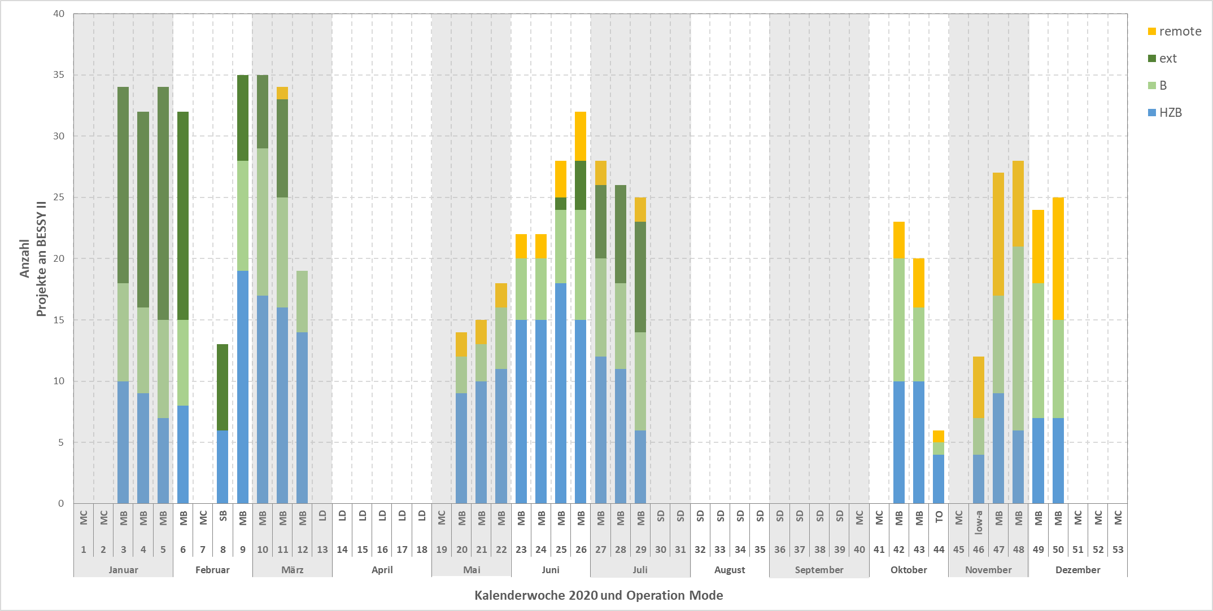
management of the COVID-19 pandemic: facility point of view
Scheduled Beamtime @ BESSY II 2020
staff assisted mail in + staff assisted remote
Users not from the Berlin area
Users from Berlin and CRG
HZB
Corona-beamtime
requested

Slide 8
management of the COVID-19 pandemic: machine point of view
standby mode
  motivation: empty experimental hall
  startup on demand within 24h (requested twice)
dropping all weekly “machine studies” → massive reduction of pro-activeness
  less machine state transitions
  (don’t touch a running system)
  20h more beamtime / week
remote machine commissioning difficult even with operator on site
  Inspect / manipulate hardware
  Security issues
lots of plans and schedules created and discarded (highly dynamic system)
lots of things to do / can be done in home office

Slide 9
Outline
management of the COVID-19 pandemic
operation status
upgrades and developments
BESSY III CDR status

Slide 10
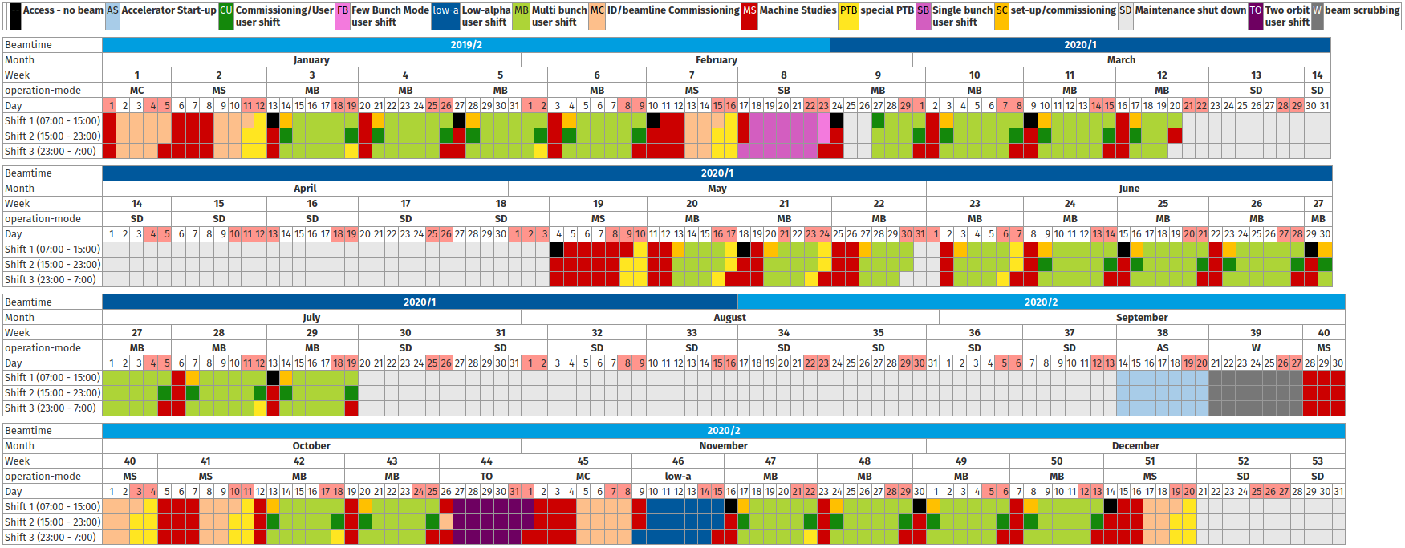
Operation statistics – schedule

Slide 11
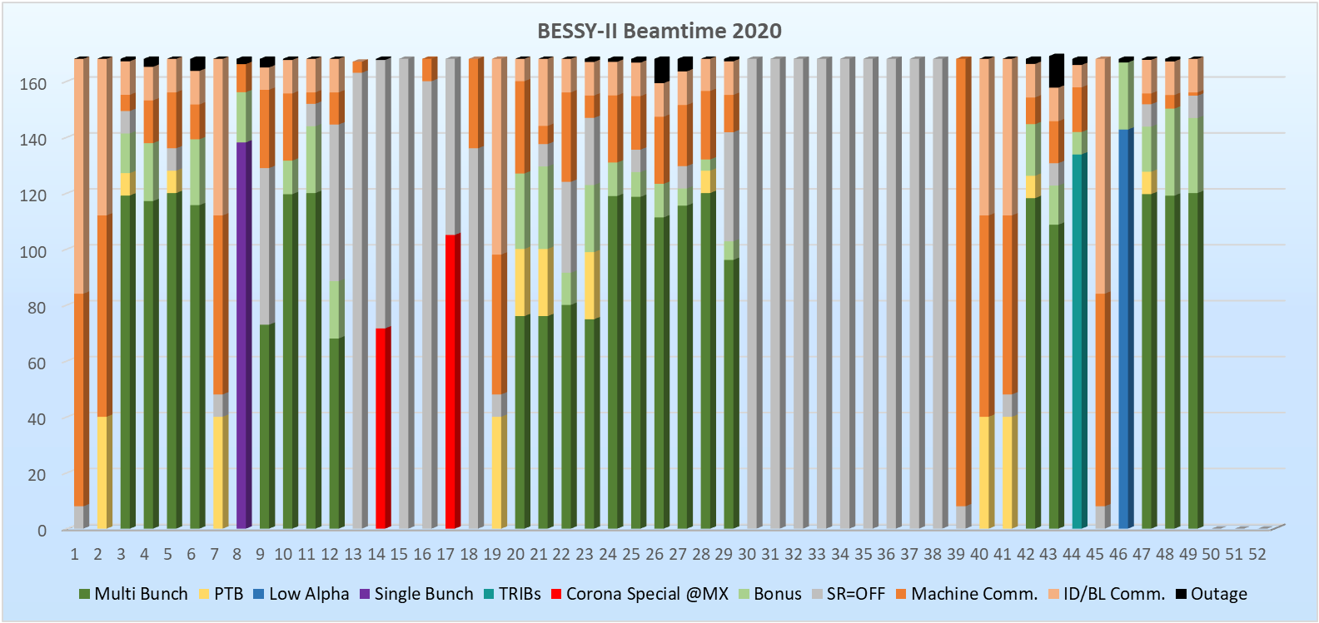

Slide 12
Long term developments
Year | Scheduled | Delivered | +Bonus Time | +Bonus | Downtime | Availability | # Outages | MTBF | MTTR
2013 | 4505 h | 4346 h | 4932 h | 109.5% | 159.3 h | 96.5% | 105 | 42.9 h | 1.52 h
2014 | 5408 h | 5024 h | 5669 h | 104.8% | 384.4 h | 92.9% | 136 | 39.8 h | 2.83 h
2015 | 3896 h | 3804 h | 4187 h | 107.5% | 92.5 h | 97.6% | 90 | 43.3 h | 1.03 h
2016 | 4855 h | 4793 h | 5284 h | 108.6% | 61.9 h | 98.7% | 69 | 70.4 h | 0.91 h
2017 | 4299 h | 4050 h | 4405 h | 102.5% | 249.5 h | 94.2% | 62 | 69.3 h | 4.02 h
2018 | 3578 h | 3550 h | 3965 h | 110.8% | 28.3 h | 99.2% | 51 | 70.2 h | 0.56 h
2019 | 4058 h | 3990 h | 4325 h | 106.6% | 67.7 h | 98.3% | 67 | 60.6 h | 1.01 h
2020* | 3295 h | 3245 h | 3658 h | 111.0% | 49.5 h | 98.5% | 47 | 70.1 h | 1.05 h

Slide 13
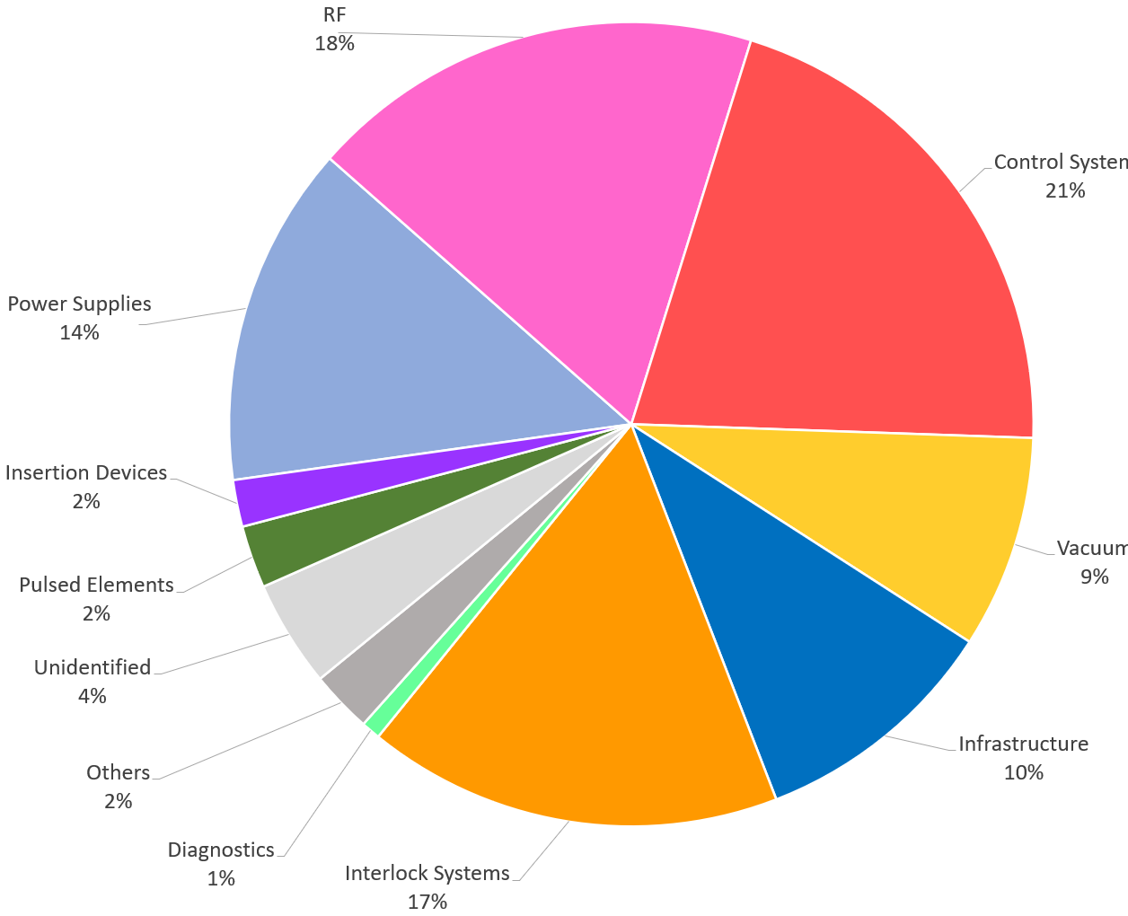
Outage time by component
Total “downtime” (including beam current < 90%) in 2020 = 49.5 h

Slide 14
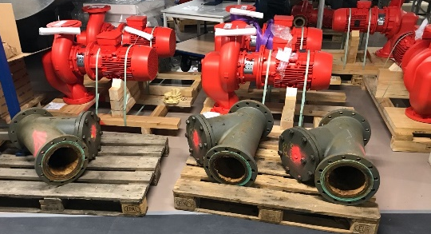
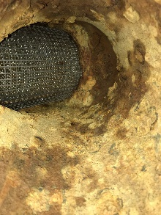
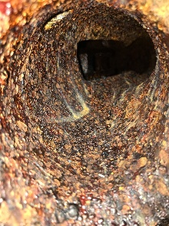
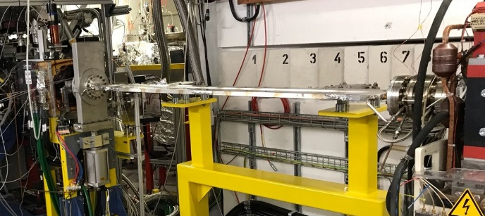
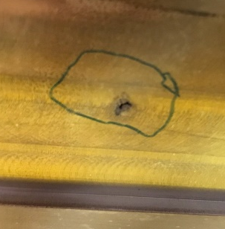
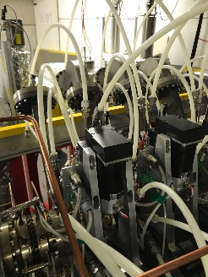
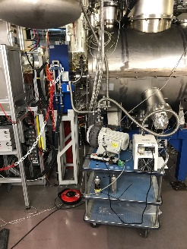
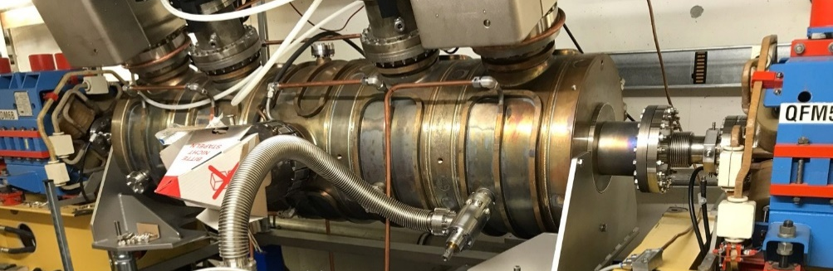
Shutdown activities
cooling water infrastructure
new vacuum chamber for UE48
PSF isolation vacuum fixed
Landau cavities leak fixed
U17 NEG closed activation cycle

Slide 15
Outline
management of the COVID-19 pandemic
operation status
upgrades and developments
BESSY III CDR status

Slide 16
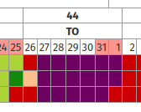
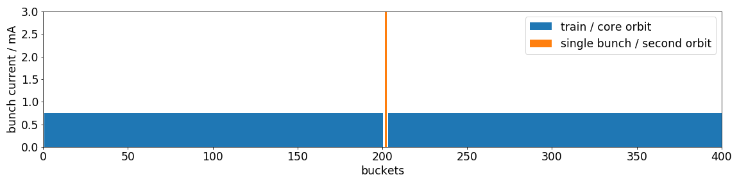
Scheduled TRIBs user operation week
steady operation for the full week
separation in horizontal plane
all IDs usable (except U17 → MPS)
no slicing (no efforts in this direction at the moment)
control system based trigger to blank out injections

Slide 17
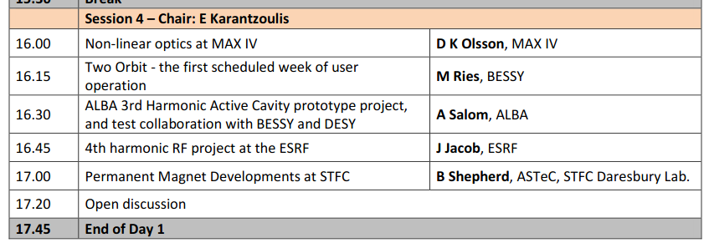
Scheduled TRIBs user operation wwek

Slide 18
Resonant skew excitation

Slide 19
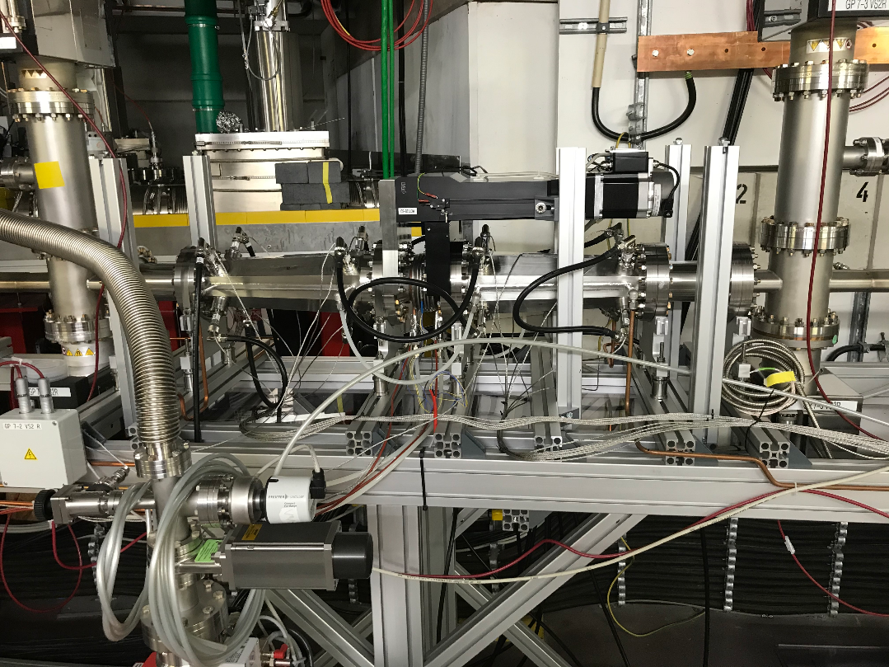
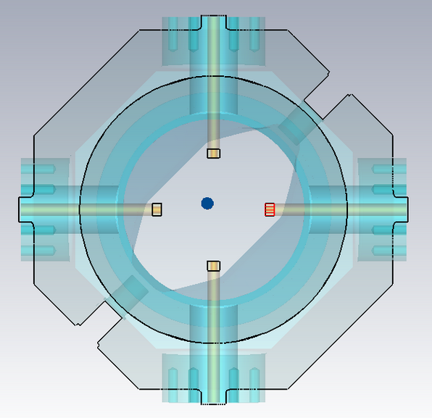
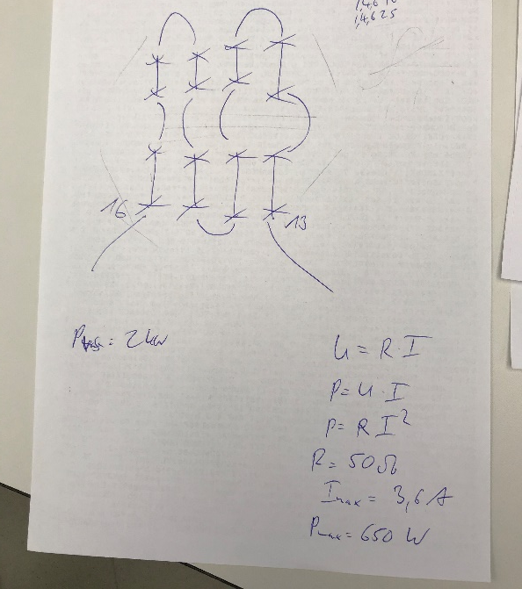
Resonant skew excitation – can we do it?

Slide 20
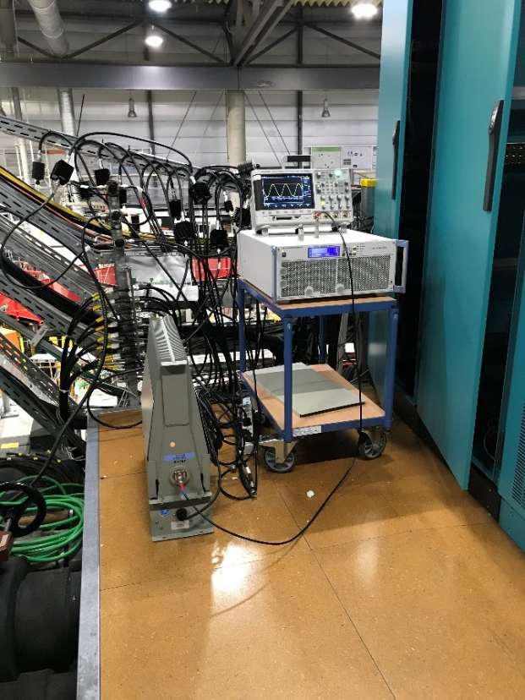
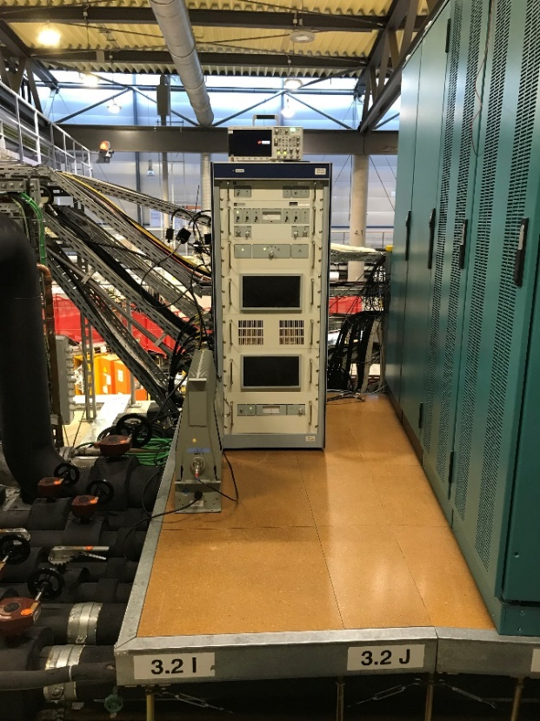
Resonant skew excitation – can we do it?
hammer beats razor this time…

Slide 21
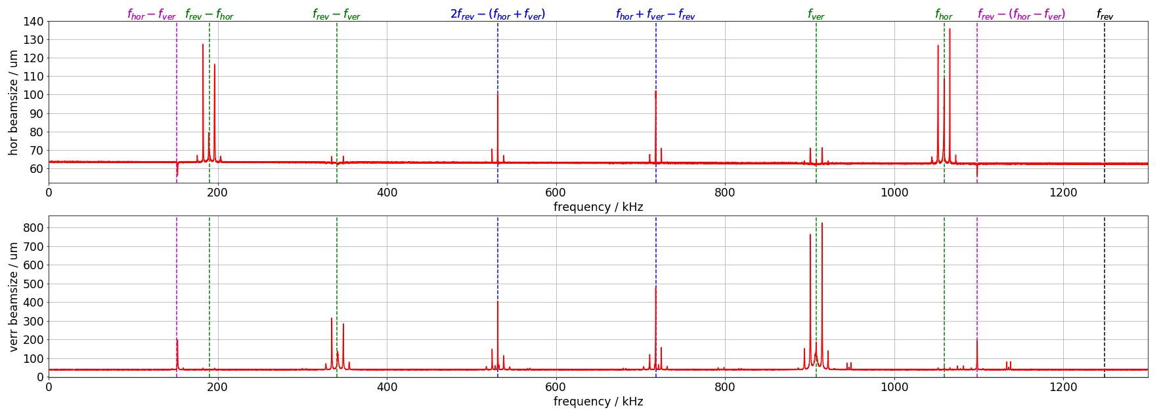
Resonant skew excitation – lets try!

Slide 22
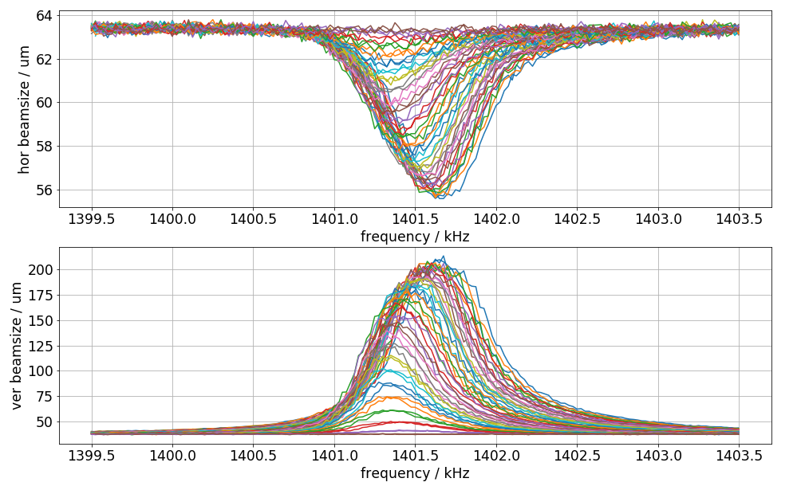
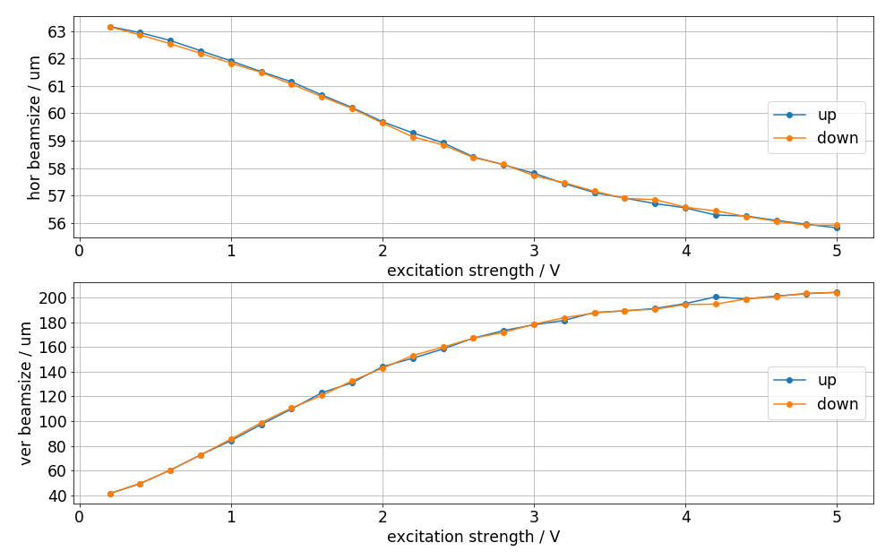
Resonant skew excitation – it works!
horizontal emittance reduced by 25%
amplitude dep. res. frequency shift
scanning range matters – to be expl.
saturation value – to be expl.

Slide 23
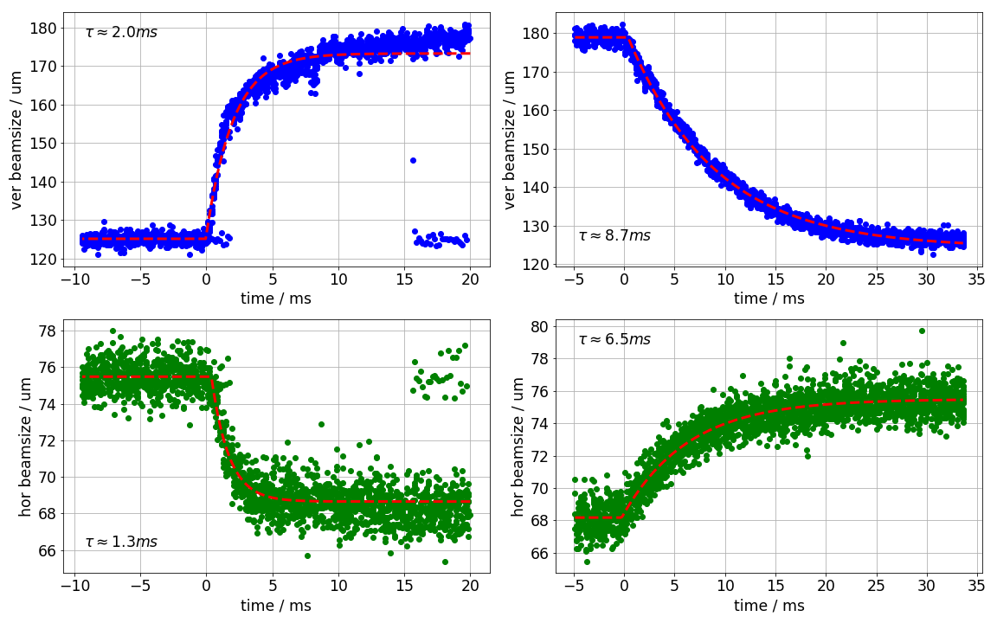
Resonant skew excitation – what are the dynamics?
switching on and off a sine excitation with hard edge
CCD camera used
ICCD camera will give insight on shortest time dynamics
(bunch by bunch)

Slide 24
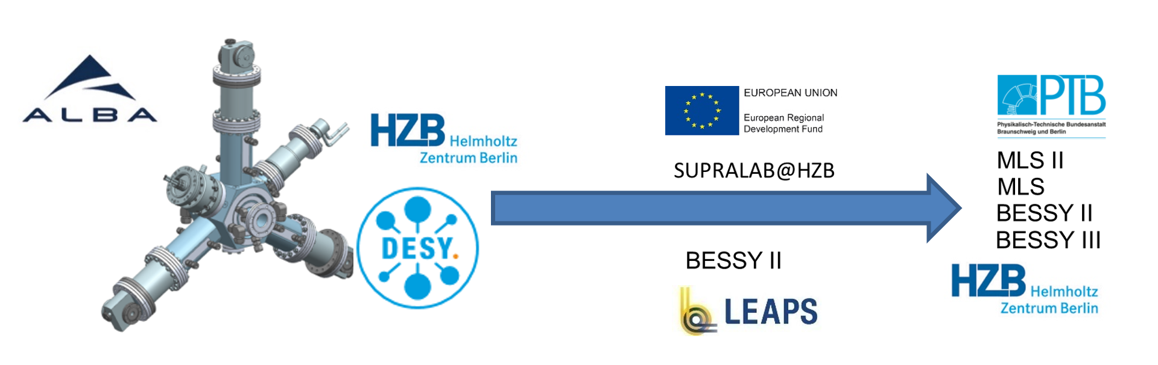
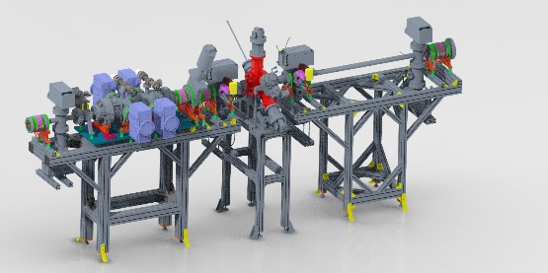
Collaboration: normal conducting, active, HOM-damped, 1.5 GHz / 3rd harmonic cavities
beam current independent bunch length control
harmonic cavities as technological basis for bunch length control required in 4th generation storage rings
→ increasing the pulse length by factors to the scale of 100 ps
→ active cavities may mitigate the impact of complex filling patterns
Beam test planned at BESSY II in 2022!
local project:
A. Matveenko et al.

Slide 25
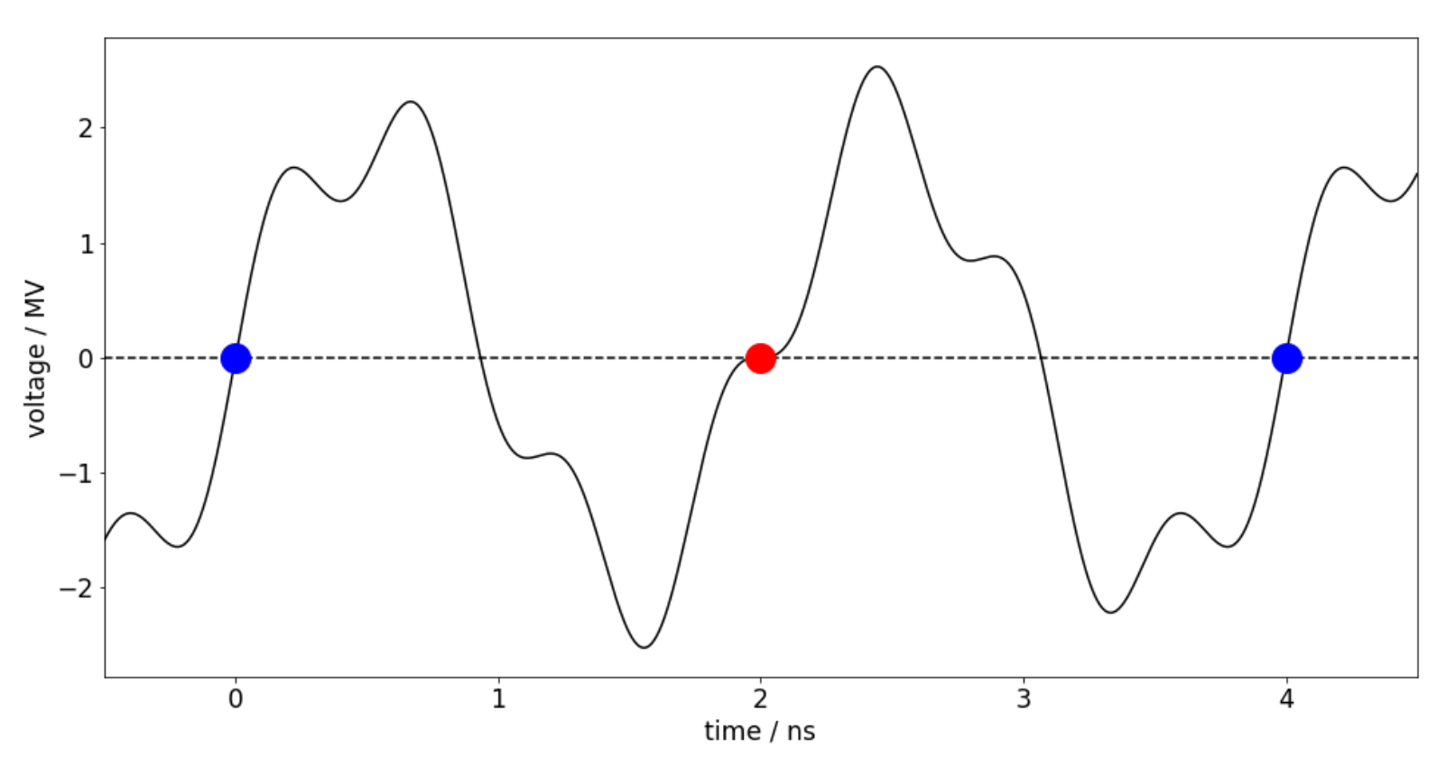
normal conducting, active, HOM-damped, 1.75 GHz / 3.5th harmonic cavitiy
Rescale existing harmonic NC cavities to 1.75 GHz
Generate beating between fundamental 500 MHz and 3.5th harmonic
Preserve the option for ps-scale pulse lengths while providing the required bunch lengthening option
for 4th generation storage rings
Could be tested and applied at BESSY II → 7 ps & 35 ps (rms) simultaneously
In contrast: VSR targets to supply bunch shortening with higher currents as well
Any DLSR light source needs appropriate bunch length control to fight collective effects
and the users would strongly benefit of “some” timing capabilities!

Slide 26
Outline
management of the COVID-19 pandemic
operation status
upgrades and developments
BESSY III CDR status

Slide 27
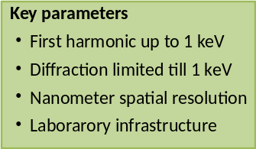
BESSY III – CDR
CDR process started in spring 2020
Formation of a CDR-Team to get the core: “science & experiments, beamlines and accelerator” done
Discussions, Discussions, Discussions with internal and external stakeholders
  14 different Science Expert Groups meet with CDR Team at virtual workshops
    9 already finished and 5 to go
    e.g.: Catalysis, Magnetization Dynamics, Life Science, …
Internal discussions between HZB & PTB
Formation of a steering committee
The BESSY 3 objectives
  PTB / BAM strong partners
Two different rings are needed to match
all scientific requests, tasks and duties

Slide 28
BESSY III – CDR
MLS2
A BESSY II+MLS like machine !?
  energy ~ 1.2 GeV
  (ramp-able down to 150 MeV)
  emittance ~ few tens of nradm
  I = up to 500 mA
  8 straights
  5 m straight length
  circumference < 100 m
  lattice supporting Timing Options
    flexibility
    short pulses: low α, VSR
    repetition rate: PPRE, TRIBs
  spectral range:
  0.1meV - 1eV - 1keV
  TopUp full-energy injection
BESSY3
A low emittance machine
  energy ~ 2.5 GeV
  emittance ~ few hundred pradm
  I = up to 500 mA
  16 straights
  5 m straight length
  circumference ~ 300 m
  MBA with
    higher coherence fraction from
    100 eV to 2.5 keV
    flexible repetition rates: TRIBs
  spectral range:
  100eV - 8keV (60keV demand oriented)
  TopUp full-energy injection

Slide 29
BESSY III – CDR
Complementary layout of BESSY III and MLS II
(spectral overlap at (0.1 … 1) keV)
MBA green field in Berlin Adlershof ☺
off-axis injection
booster synchrotron
selected separated function dipoles(PTB)
mainly out-of-vacuum E-IDs
selected in-vacuum IDs

Slide 30
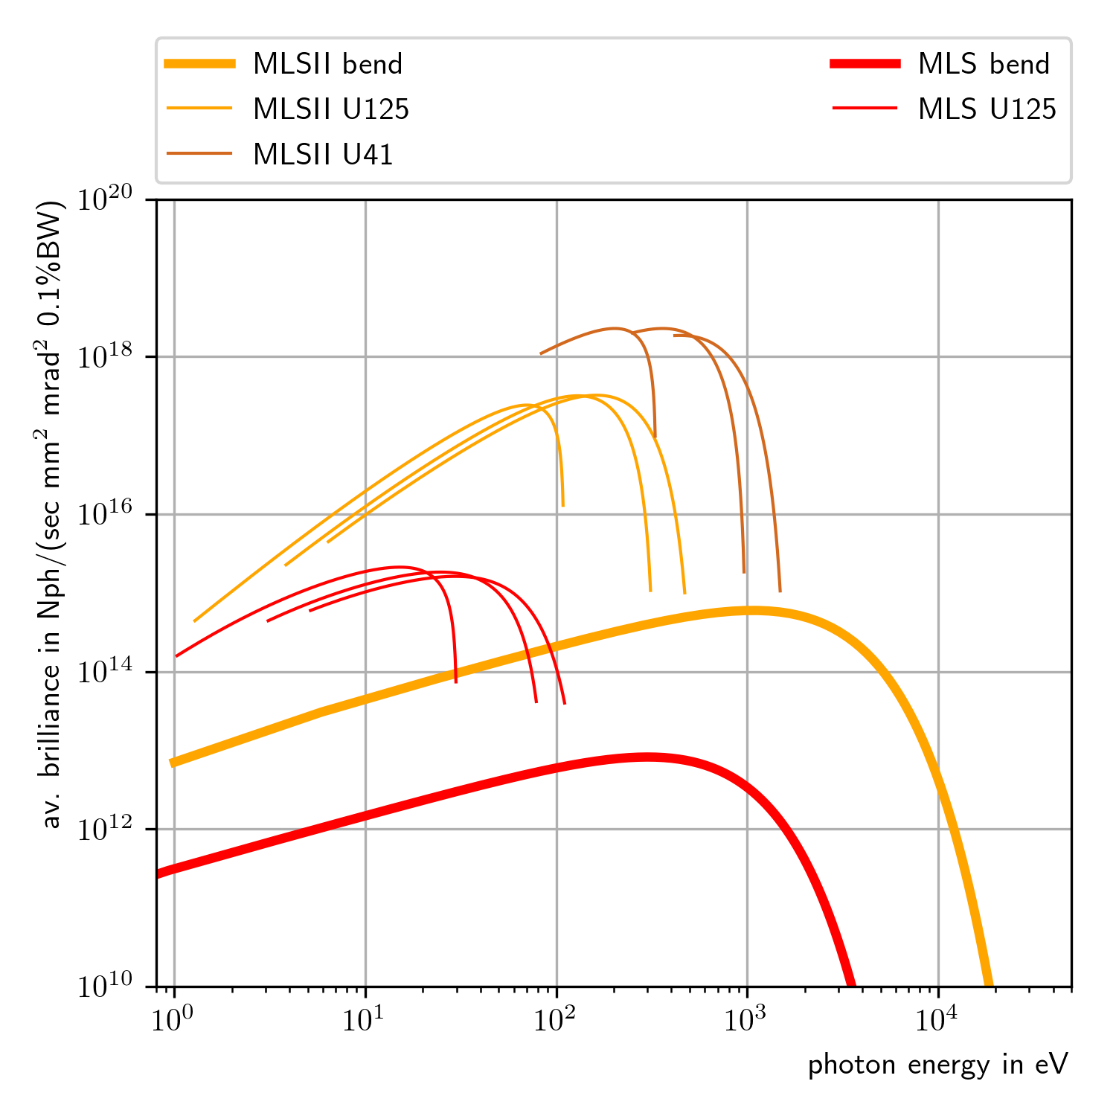
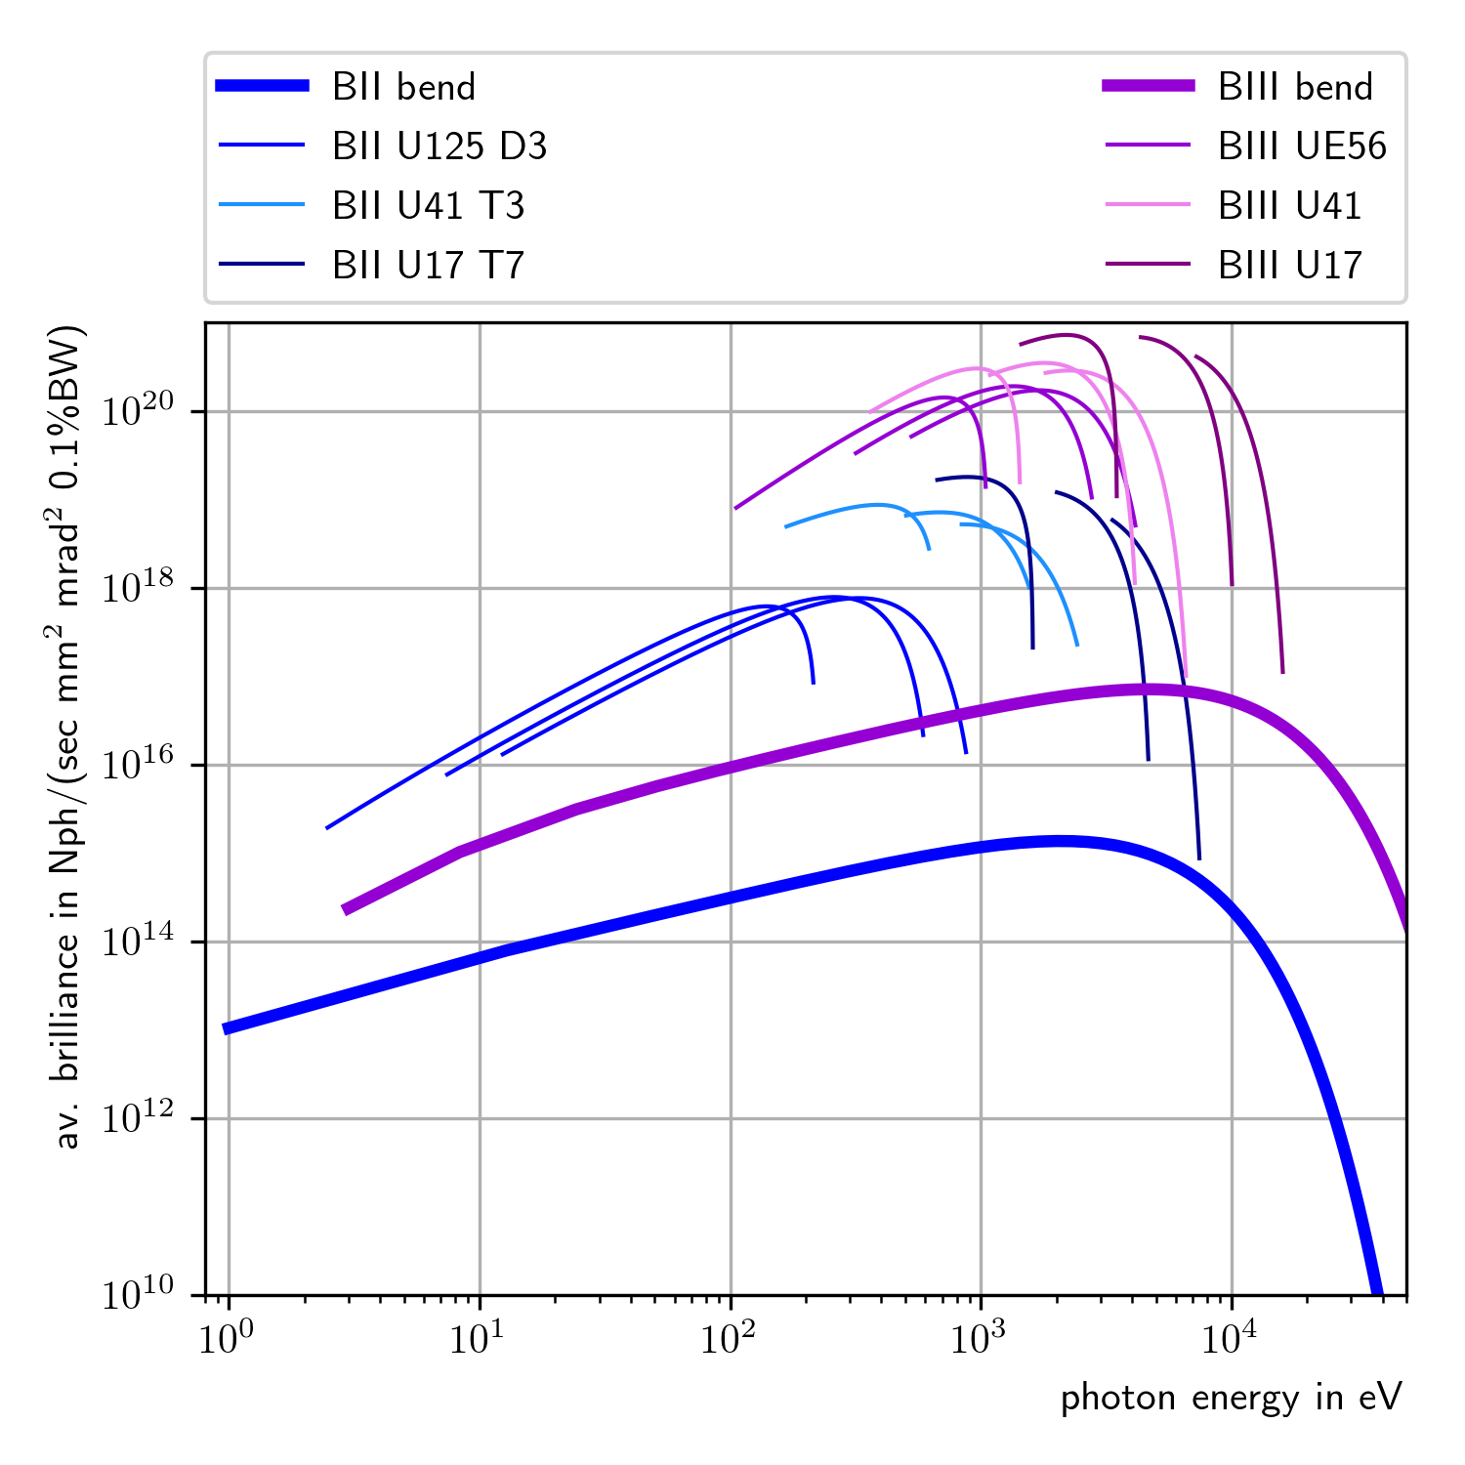
Average spectral brilliance MLS / MLS II
Average spectral brilliance BESSY II / BESSY III
B2: betaxy = 0.3m , 21.0 m
B3: betaxy = 1.0m, 3.0m

Slide 31
Summary
Corona virus measures dominate daily life at BESSY II
BESSY II target reliability preserved (98.5%)
long shutdown, fast recovery
refurbishment ongoing
investigating resonant skew excitation to reduce hor. Emittance
increased the number of slicing bunches (3->7), investigated PPRE
picking up efforts towards a digital twin
BESSY III conceptional design process started
ARD / prototyping refocussed

Slide 32
ACKNOWLEDGEMENT
Michael Abo-Bakr, Wolfgang Anders, Felix Andreas, Terry Atkinson, Yvonne Bergmann, Thomas Birke, Daniel Böhlick, Anne Bundels, Markus Bürger, Rober Burneleit, Emanuel Cambas, Mathias Diehn, Marc Dirsat, Olaf Dreßler, Michael Edling, Silvio Ehlert, Dan Eichel, Volker Dürr, Pablo Echevarria, Fjodor Falkenstern, Jörg Feikes, Nadine Fischer, Roland Fleischhauer, Andre Frahm, Benjamin Franksen, Sabine Giray, Holger Glass, Hans-Walter Glock, Felix Glöckner, Anny Gora, Rainer Görgen, Paul Goslawski, Mario Haucke, Jochen Heinrich, Svenja Heling, Andreas Heugel, Harry Hoffmann, Falk Hoffmann, Karsten Holldack, Holger Huck, Ji-Gwang Hwang, Andreas Jankowiak, Christian Jung, Christian Kalus, Jens Knobloch, Jörg Kolbe, Marten Koopmans, Bernhard Kuner, Jens Kuszynski, Victoria Laux, Nicole Leuschner, Ji Li, Klaus Ludwig, Michael Markert, Aleksandr Matveenko, Meghan McAteer, Tom Mertens, Gert Meyer, Gregor Mielczareck, Ingo Müller, Roland Müller, Christian Nass, Klaus Ott, Fabian Pflocksch, Lutz Pichl, Henry Plötz, Markus Ries, Daniel Romeo, Stefan Rotterdam, Roswitha Schabardin, Andreas Schälicke, Tobias Schneegans, Günter Schindhelm, Ines Seiler, Gregor Schiwietz, Bernhard Schriefer, Thomas Schröter, Michael Schuster, Dirk Schüler, Hannes Stein, Tom Struppert, Ervis Suljoti, Yegor Tamashevich, Michael Ulrich, Stefan Wiese, Daniel Wolk, Antje Vollmer, Sven Wrede, Nora Wunderer … and many more

Slide 33
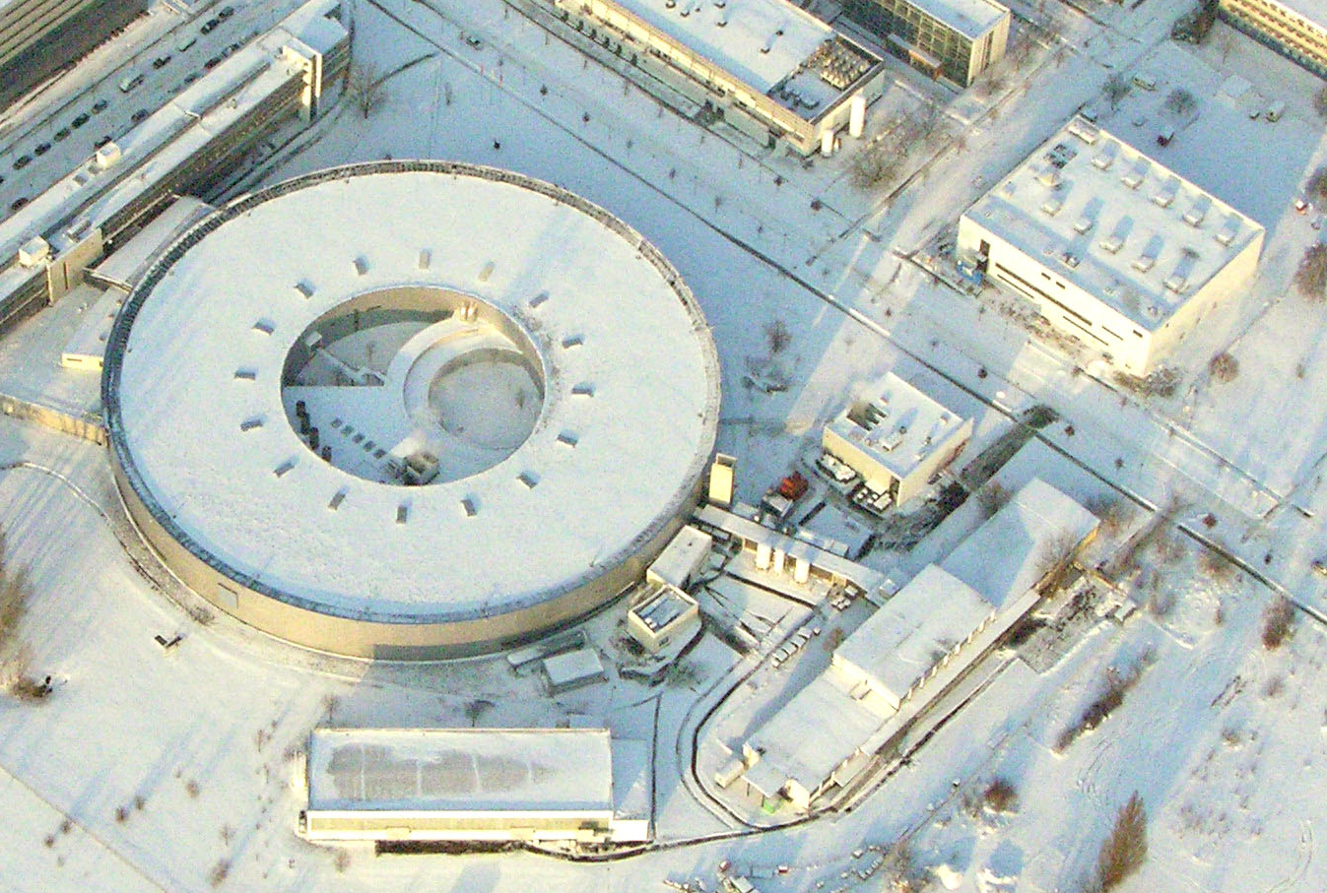
THANK YOU FOR YOUR ATTENTION

Slide 34
Backup

Slide 35
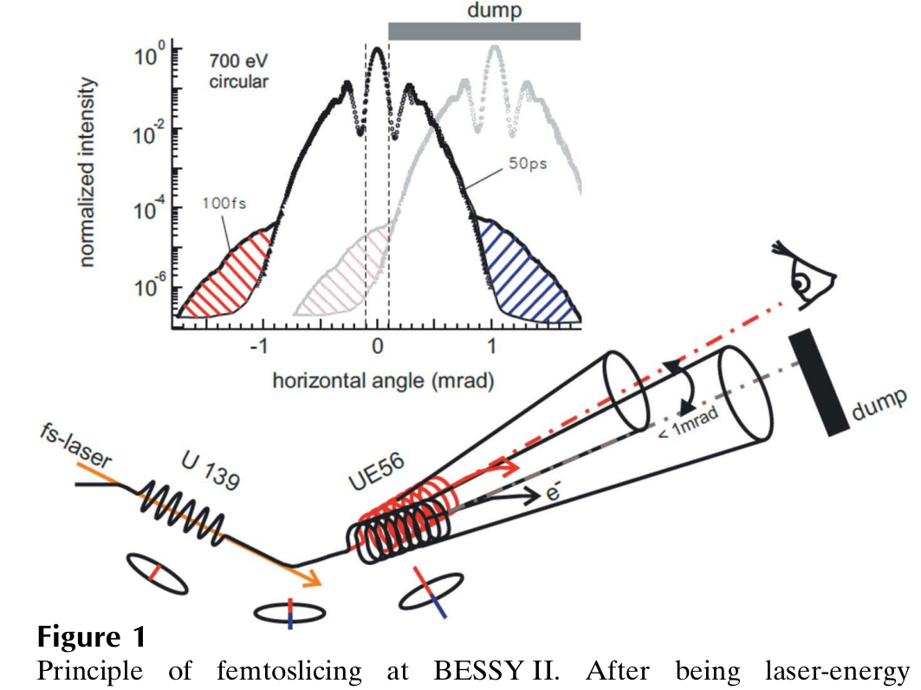
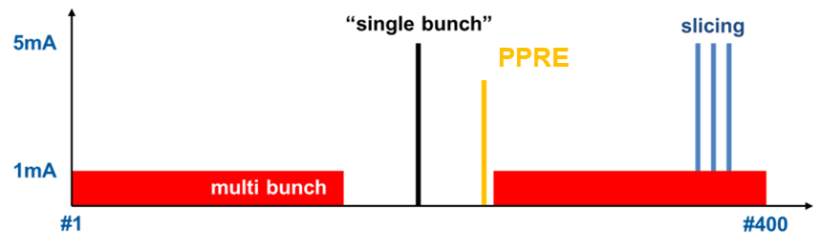
more slicing bunches (3→7) implemented for user operation
FemtoSpeX: a versatile optical pump–soft X-ray probe facility with 100 fs X-ray pulses of variable polarization
K. Holldack et al., J. Synchrotron Rad. (2014). 21, 1090–1104
rep. rate limited to 6kHz by laser
S/N dominated by halo-dynamics
bunch number increased from 3 to 7
bunch current decreased from 4 mA to 3 mA

Slide 36
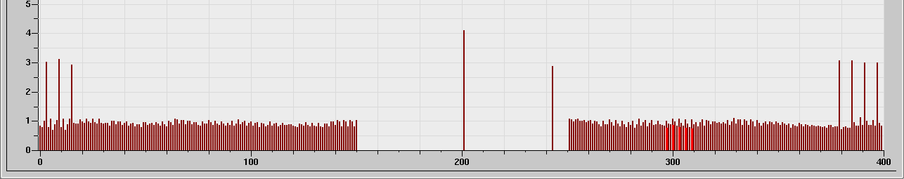
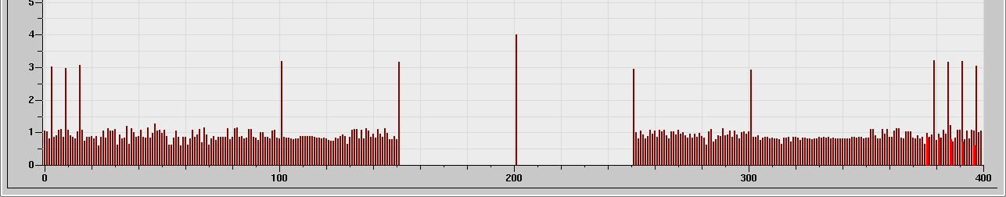
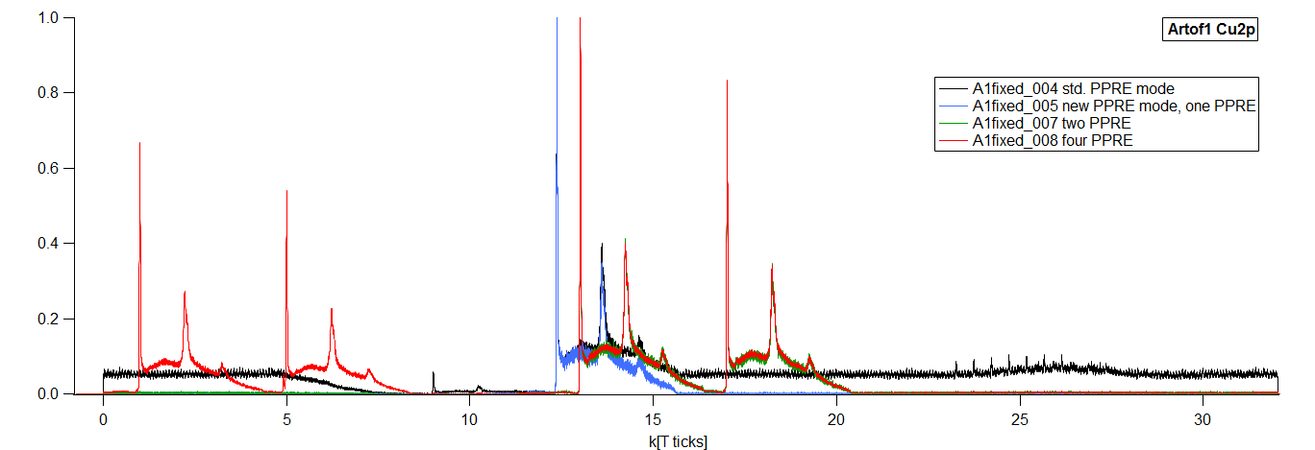
more PPRE bunches investigated
?
ARTOF user not flux but rep-rate-limited
new broad band amplifiers allow use of train-bunches
same separation plane as slicing
Leitner et al.

Slide 37
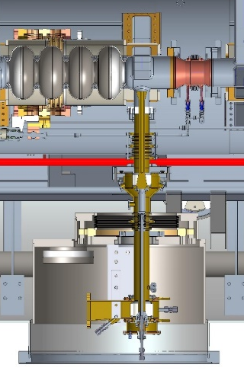
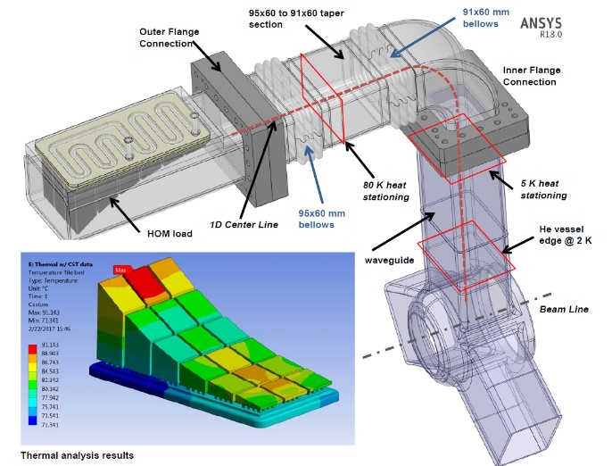
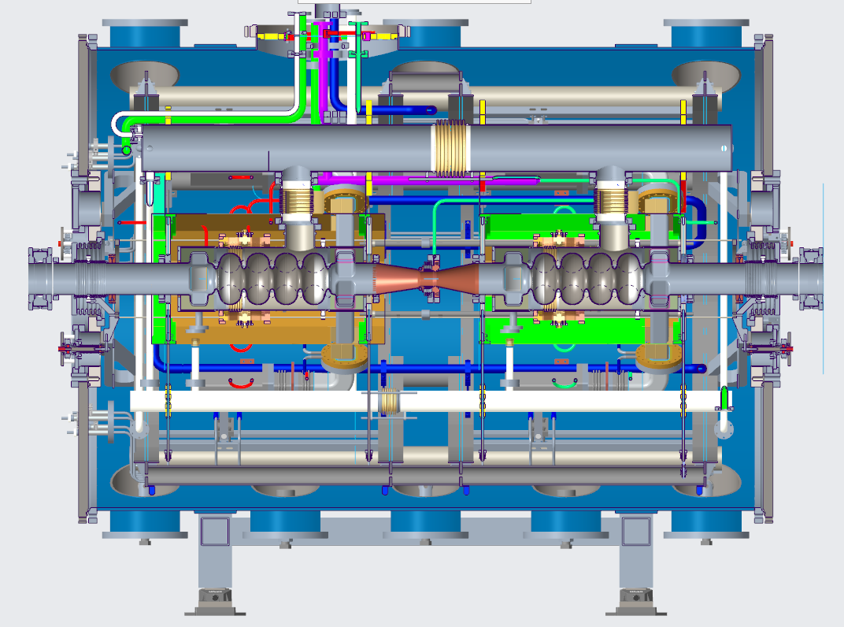
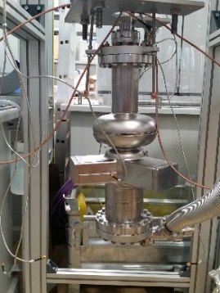
STATUS OF BESSY VSR DEMO
Module commissioning
2020
2021
2022
2023
2024
2025
2026
Contract cavities &
Couplers & start procurement cryo-module parts
Testing of components
Cold-string and cryo-module assembly
Integration in bERLinPro bunker
A. Velez et al.

Slide 38
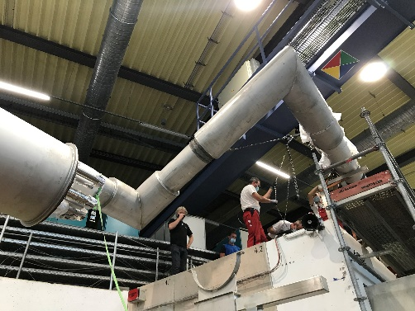
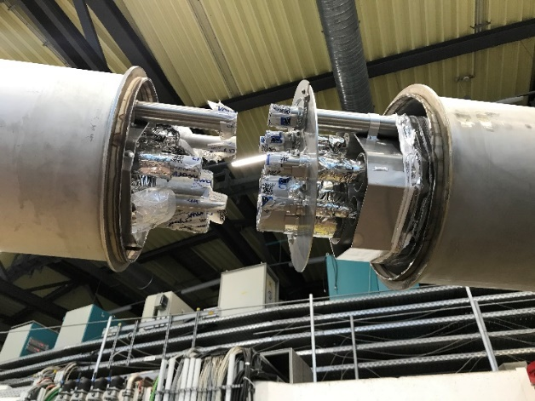



Slide 39


Shutdown recovery
fully operational after one week of beam scrubbing, no incidents

Slide 40


BESSY II – Preservation & Modernisation projects 2020-2022
Status 2020
  Cooling water infrastructure refurbishment and
  additional cooling tower installed (see. SD 2020)
  Additional PETRA cavity for the Booster
  Radiation monitors electronics refurbishment and
  calibration continued (already 50/65 units upgraded)
  renewal of Vacuum- und Safety Interlock
  at segments 1, 4, 6, 15, 16, incl. new Siemens PSI at segments 1 & 16
  Two spare HOM cavities ordered (delivery expected Q4/2021)
  New White-circuit Booster PS ordered (delivery expected Q3/2022)
Under preparation
  New booster injection/extraction pulser
  New digital BPM system
  New quadrupole power converters
  Modernization of network technology and data storage
  Further modernization Vacuum and Safety Interlocks

