Slide 1
Emittance exchange in electron booster synchrotron by coupling resonance crossing
Jonas Kallestrup :: Paul Scherrer Institute
European Synchrotron Light Source workshop 2020

Slide 2
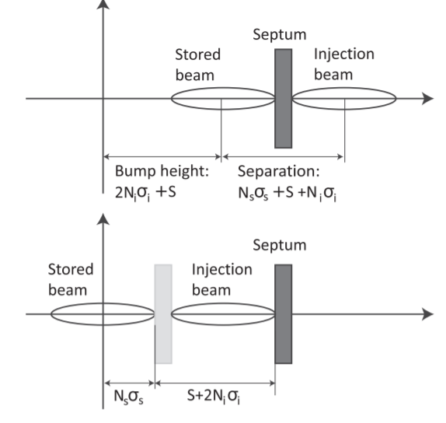
Why emittance exchange?
SLS 2.0 plans for injection procedure in three stages:
Horizontal off-axis injection with kicker-bump
Aperture-sharing with short-pulse kicker ($≈$10 ns pulse length)
Longitudinal on-axis injection with ultra short-pulse ($<$ 2 ns)
Dynamic aperture needed for horizontal kicker-bump injection: $A_{x}=N_{s}σ_{x,s }+2N_{i}σ_{x,i}+S$
Booster synchrotrons: $ε_{x}≫ε_{y}$
Decrease $σ_{x,i}$ by exchanging $ε_{x,i}↔ε_{y,i}$
Several benefits:
relaxed $A_{x}$ requirement
relaxed septum blade thickness
relaxed bump amplitude

Slide 3
Ways to emittance exchange
Arrangement of skew quadrupoles in transfer line
requires $≥$5 skew quads + dispersion-free transfer line
Linear difference resonance crossing in booster synchrotron
no additional magnets needed
requires good flexibility to modify booster-ramps
Pulsed- or AC-skew quadrupole

Slide 4
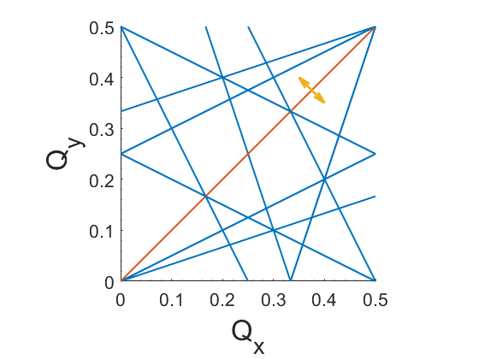
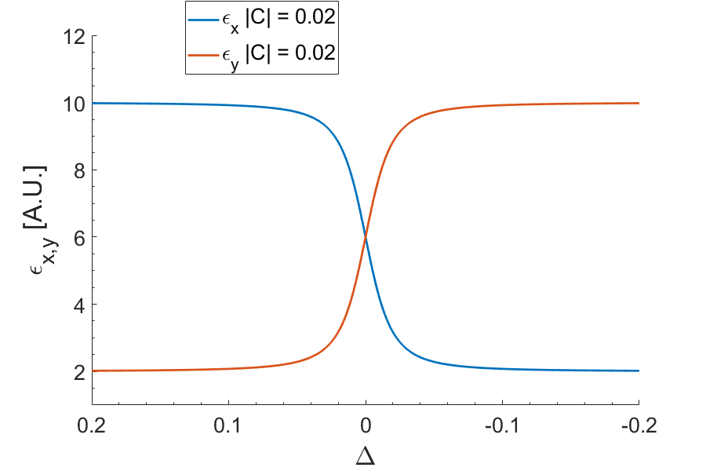
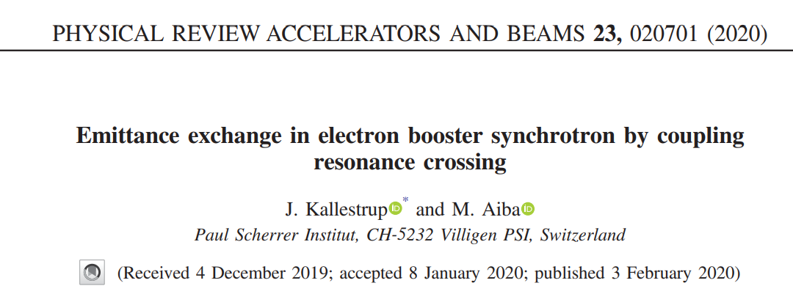
Why emittance exchange by coupling resonance crossing?
Emittance exchange by crossing linear difference resonance: $Q_{x}−Q_{y}=p$
Only small tune changes required ⇨ No change to the linear optics
Things to consider:
Damping
Do exchange shortly before extraction
Transverse coupling
Small coupling requires slow crossing
i.e. more damping
For details, see:
$$Δ=Q_{x}−Q_{y}−p$$

Slide 5
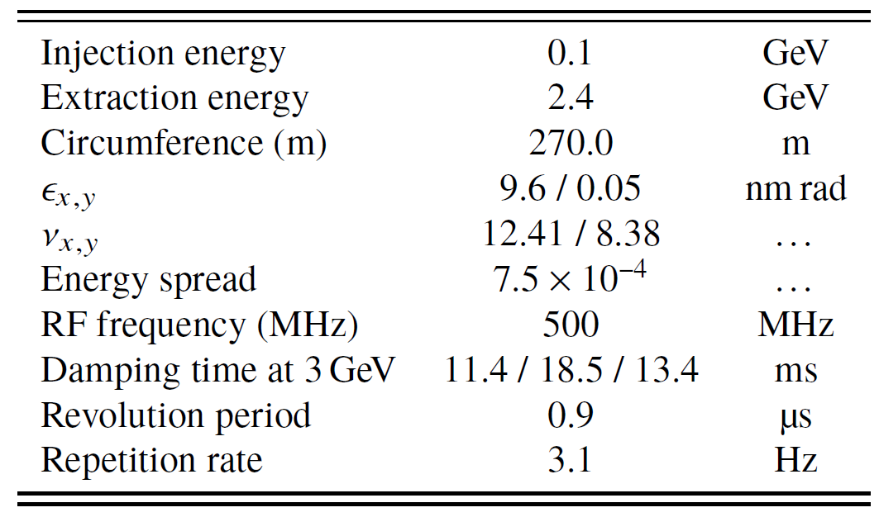
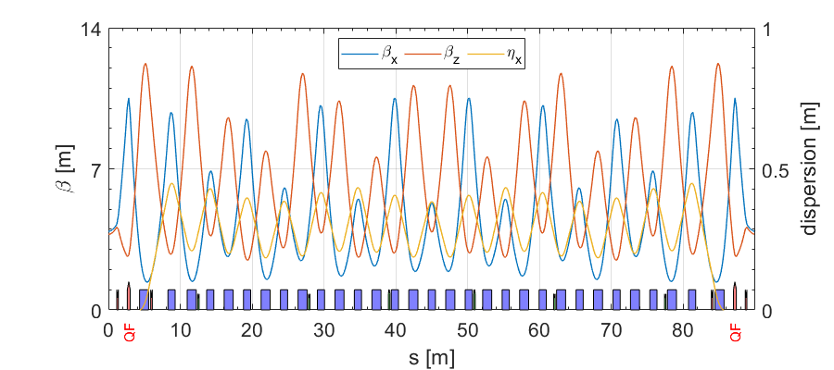
Measurements in SLS booster
Highlights
First booster built specifically for top-up operation
Mounted on inner wall of Storage Ring tunnel
≈ same circumference as SR
Low horizontal emittance: $ε_{x}≈10$ nm
Vertical emittance ~2-3 nm (theoretical minimum of 0.05 nm)
Digital magnet power supply control
Flexible and easily controllable!

Slide 6
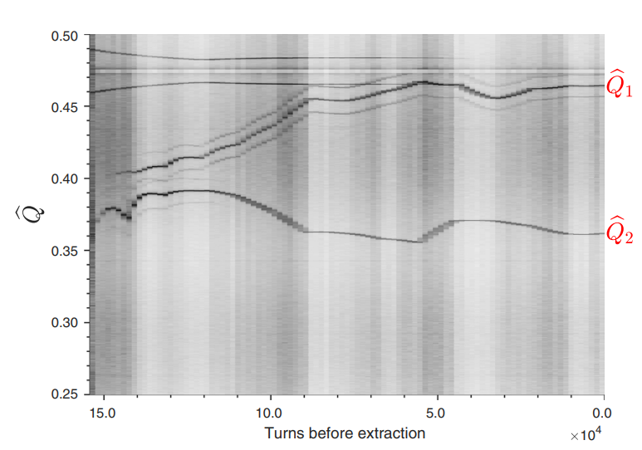
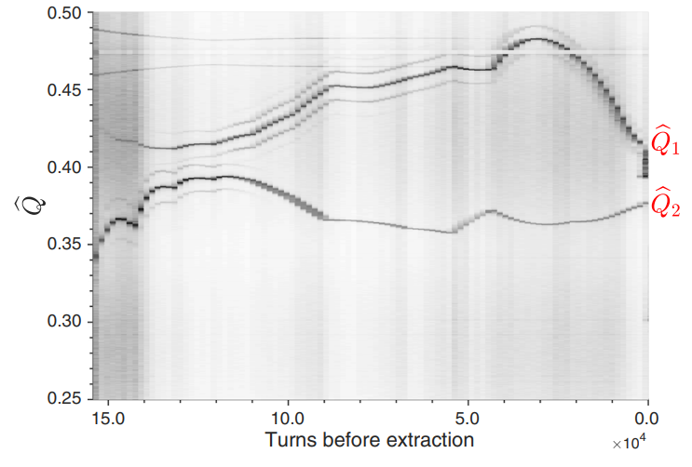
Measurements in SLS booster
Implementation at the end of ramp
Injection
Extraction
Injection
Extraction

Slide 7
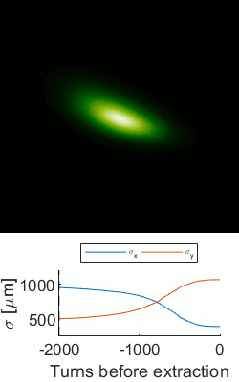
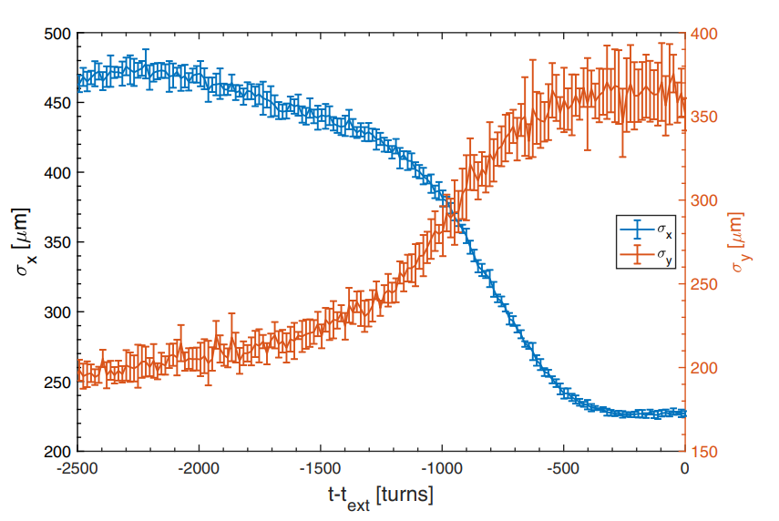
Measurements in SLS booster
Beam sizes measured in transfer line
Factor ≈4 decrease in $ε_{x}$
Limited by vertical emittance (≈2-3 nmrad)
(different optics for visualization)

Slide 8
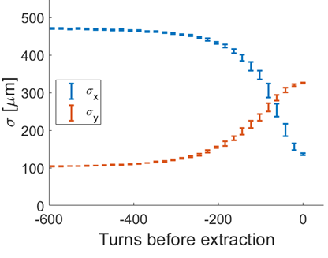
Measurements in SLS booster
Improvement of $ε_{y}$ and $\left|C\right|$ (see SLS status talk from yesterday)
Factor $≈9$ decrease in $ε_{x}$
Very valuable improvement for SLS 2.0!

Slide 9
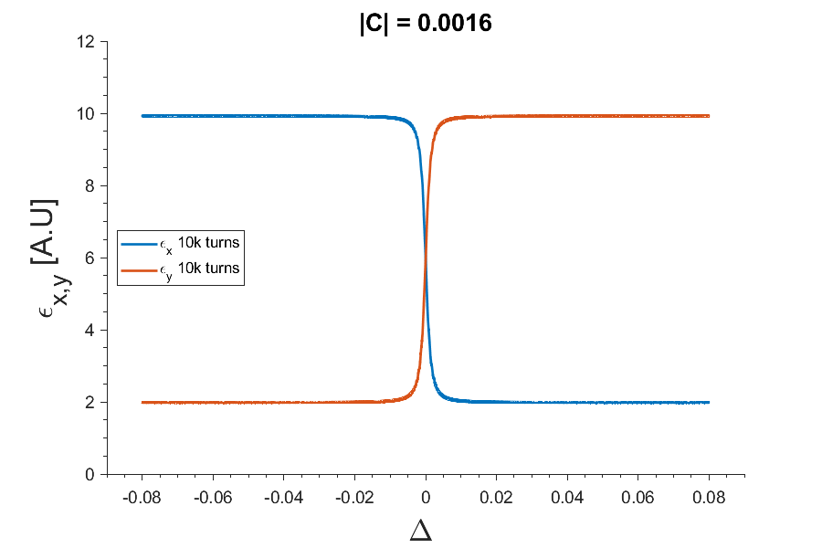
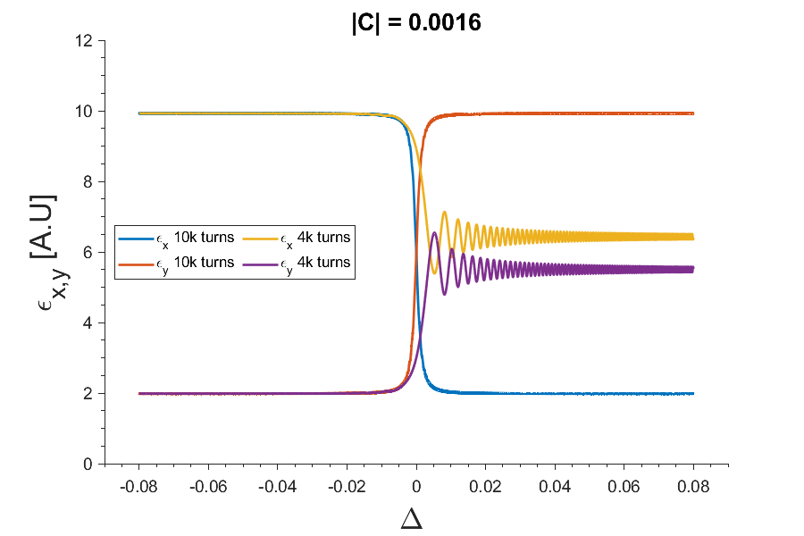
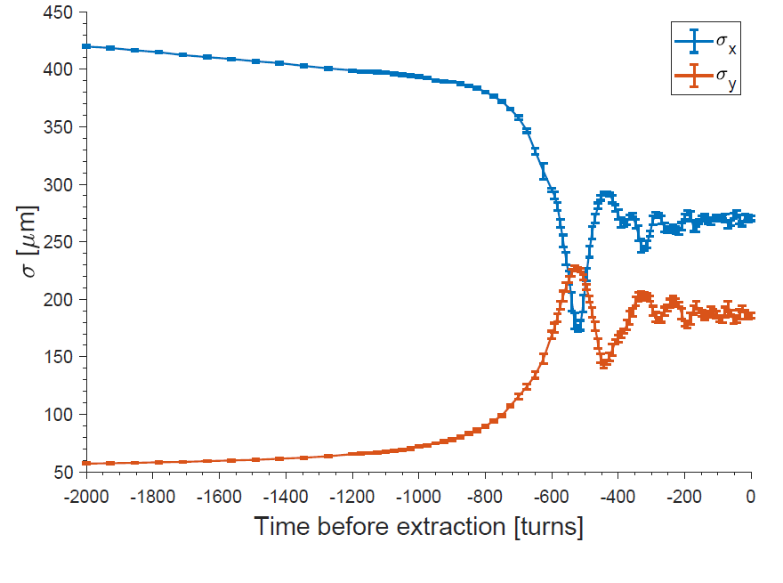
Non-adiabatic crossing
Mismatch between |C| and crossing speed ⇨ “Non-adiabatic exchange”
Simulation
Experiment

Slide 10
Outlook & summary
Advantages
Emittance exchange (in general) for horizontal kicker-bump injection has several advantages
Less horizontal dynamic aperture required
Relaxation of e.g. septum blade thickness
Small bump amplitude needed
Coupling resonance crossing is a simple option
Readily implementable in modern booster synchrotrons
“Free”: no extra magnets needed
Challenges
Difficult in high-energy machines with short damping times
Can be harmful with very small vertical apertures in storage ring

Slide 11
Thank for your attention!
Additional material on emittance exchange by coupling resonance crossing (chronological)
C. Carli and C. Cyvoct, CERN-PS-2001-018, 2001
E. Metral, CERN-PS-2001-066
A. Franchi, E. Metral and R. Tomas, Phys. Rev. Accel. ST Accel. Beams 10, 064003, 2007
P. Kuske and F. Kramer, IPAC’16 proceedings, pp. 2028-2031
J. Kallestrup and M. Aiba, Phys. Rev. Accel. Beams 23, 020701, 2020
M. Aiba and J. Kallestrup, Phys. Rev. Accel. Beams 23, 044003, 2020

Slide 12
Extra slides

Slide 13
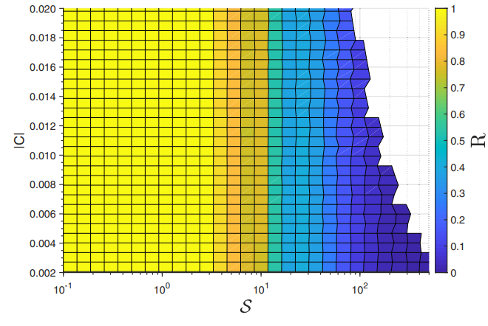
More on non-adiabatic crossing
Crossing the coupling resonance too quickly will lead to ‘non-adiabatic’ emittance exchange, deteriorating the quality
$R=\frac{ε_{x,end}−ε_{y,0}}{ε_{x,0}−ε_{y,0}}$ $𝒮=\frac{\dot{Δ}}{{\left|C\right|}^{2}}$
If the coupling $(\left|C\right|)$ is small, the crossing speed $(\dot{Δ})$must be very small
Increase $\left|C\right|$ in a controlled fashion
Decrease $\dot{Δ}$
Non-adiabatic region

Slide 14
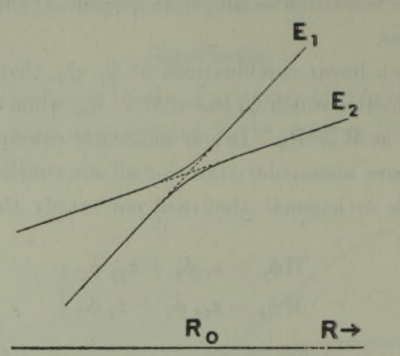
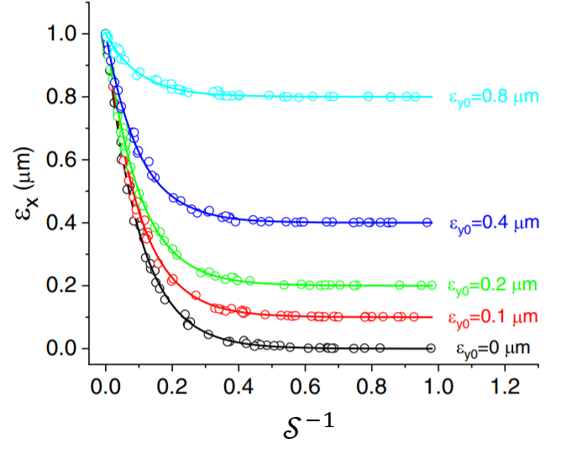
and its relation to quantum mechanics
More on non-adiabatic crossing
Q.M. : avoided crossing of energy levels
We can use the same mathematics!
The Landau-Zener formula for probability for non-adiabatic transition in two-level systems: $P_{na}=\exp\left(−\frac{2π{\left|H_{12}\right|}^{2}}{ℏ|α|}\right)$
The Accelerator Physics equivalent:
$$P_{na}=\exp\left(−π^{2}\frac{{\left|C\right|}^{2}}{\dot{Δ }}\right)=\exp\left(−\frac{π^{2}}{𝒮}\right)$$ with
$$ε_{x}=P_{na}ε_{x0}+\left(1−P_{na}\right)ε_{y0} \\ ε_{y}=\left(1−P_{na}\right)ε_{x0}+P_{na}ε_{y0}$$
Illu. avoided crossing,
C. Zener, 1932

Slide 15
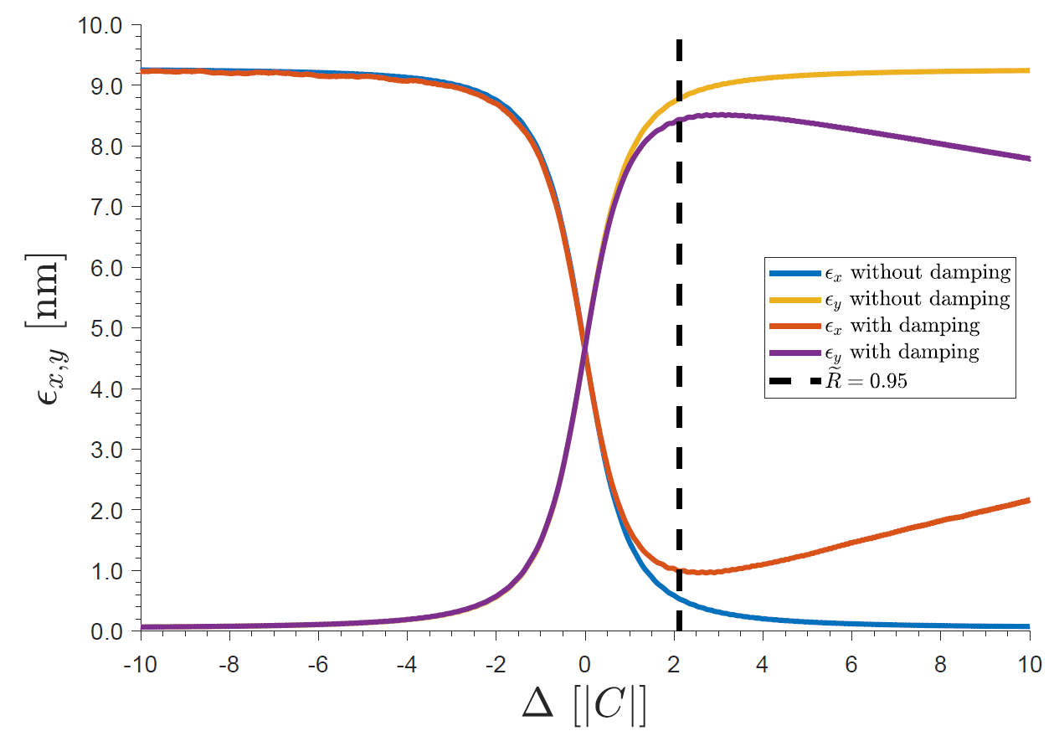
Synchrotron radiation damping
When emittances are out equilibrium, the synchrotron radiation will attempt to restore
Starts for $Δ=Q_{x}−Q_{y}−p>0$ (for $Δ<0$ from the beginning)
Beam must be extracted shortly after the exchange
At the same time $\left|Δ\right|≫0$required for good exchange

Slide 16
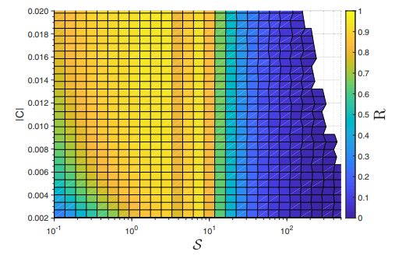
Synchrotron radiation damping
Damping added, fixed extraction
$R=\frac{ε_{x,end}−ε_{y,0}}{ε_{x,0}−ε_{y,0}}$ $𝒮=\frac{\dot{Δ}}{{\left|C\right|}^{2}}$
Extraction-point must be optimized to decrease radiative impact

