Slide 1

New frontiers in geoscience
with a nanoscope
Catherine McCammon
Bayerisches Geoinsitut, Universität Bayreuth, Germany
http://istasounds.org/
EBS Workshop on Nuclear Resonance Scattering
11 – 12 March 2019

Slide 2
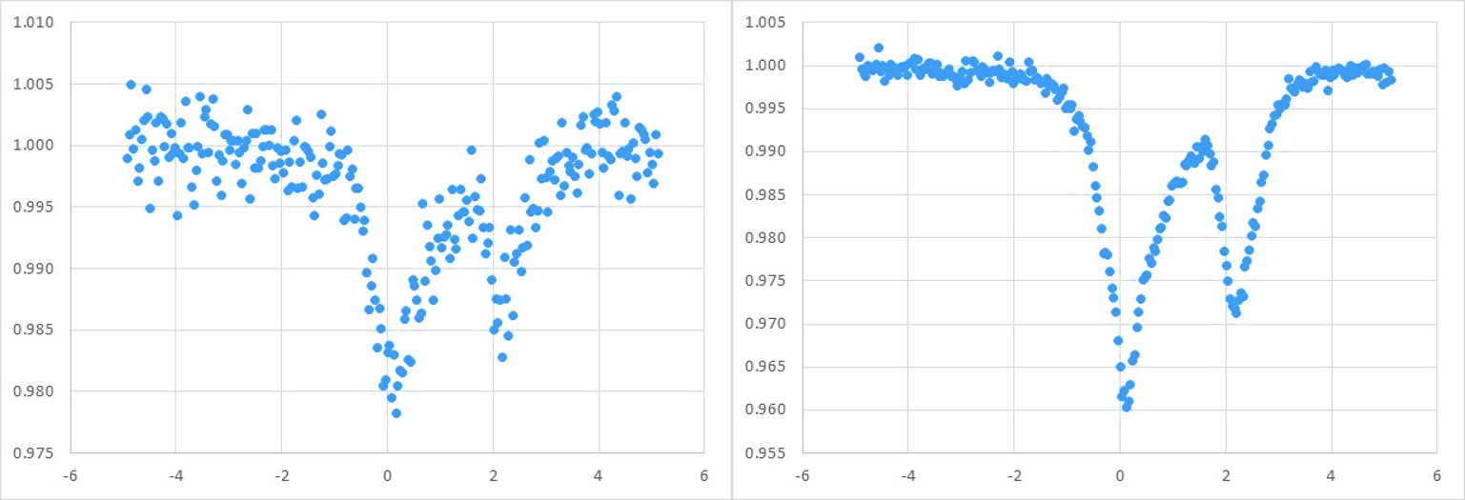
source comparison #1
(Fe_{0.1}Mg_{0.9})(Ca_{0.7}Li_{0.3})Si₂O₆ clinopyroxene
V. Cerantola master project
radioactive conventional source
563 c/s
measured 26 hours
signal:noise = 10
radioactive point source
5766 c/s
measured 26 hours
signal:noise = 58
ø 3 mm
How long do we need to measure with the conventional source to get the same S:N?
36 days

Slide 3
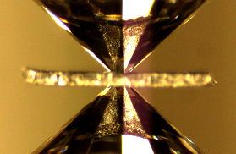
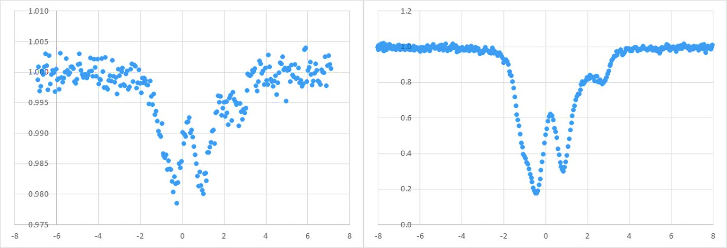
source comparison #2
Fe_{0.4}Mg_{0.6}Si_{0.63}Al_{0.37}O₃ bridgmanite at 93 GPa
V. Potapkin PhD project
radioactive point source
160 c/s
measured 7 days
signal:noise = 13
synchrotron source
5923 c/s
measured 10 minutes
signal:noise = 98
ø 30 μm
How long do we need to measure with the point source to get the same S:N?
397 days

Slide 4
source comparison #3
FeO at 230 GPa
courtesy of L. Dubrovinsky
synchrotron source
measured 24 hours
signal:noise = 9
beam diameter 20 μm
EBS-ESRF nanoscope
beam diameter 2 μm
adjust count rate for
beam diameter
ø 3 μm
come back in 2020 …
How long do we need to measure with EBS-ESRF to get ten times the S:N of SMS?
5 minutes

Slide 5
what are the research questions?
high pressure point source | high pressure synchrotron source | quenched from high pressure | diamond inclusions | rare/unusual natural samples | heterogeneous samples

Slide 6
what are the research questions?
high pressure point source | high pressure synchrotron source | quenched from high pressure | diamond inclusions | rare/unusual natural samples | heterogeneous samples
63

Slide 7
what are the research questions?
high pressure point source | high pressure synchrotron source | quenched from high pressure | diamond inclusions | rare/unusual natural samples | heterogeneous samples
63 | 71

Slide 8
what are the research questions?
high pressure point source | high pressure synchrotron source | quenched from high pressure | diamond inclusions | rare/unusual natural samples | heterogeneous samples
63 | 71 | 62

Slide 9
what are the research questions?
high pressure point source | high pressure synchrotron source | quenched from high pressure | diamond inclusions | rare/unusual natural samples | heterogeneous samples
63 | 71 | 62 | 9

Slide 10
what are the research questions?
high pressure point source | high pressure synchrotron source | quenched from high pressure | diamond inclusions | rare/unusual natural samples | heterogeneous samples
63 | 71 | 62 | 9 | 29

Slide 11
what are the research questions?
high pressure point source | high pressure synchrotron source | quenched from high pressure | diamond inclusions | rare/unusual natural samples | heterogeneous samples
63 | 71 | 62 | 9 | 29 | 7

Slide 12
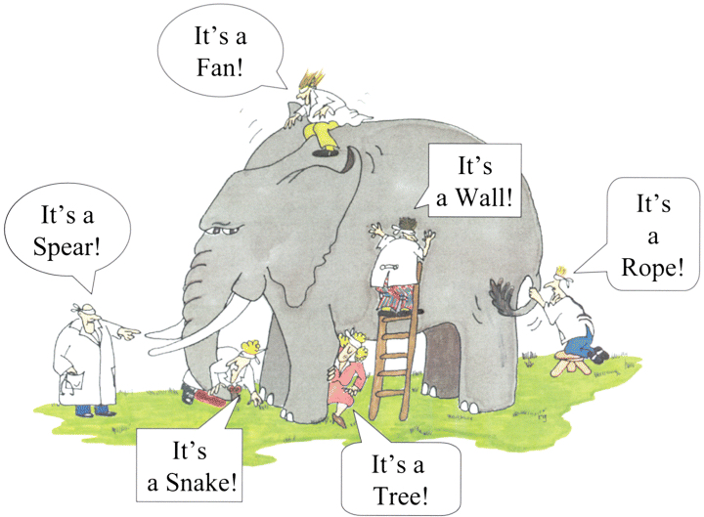
what are the new research questions?
high pressure point source | high pressure synchrotron source | quenched from high pressure | diamond inclusions | rare/unusual natural samples | heterogeneous samples
single phase -> multiphase
chemical reactions!
post mortem from DAC (deep Earth)
S. Dominijanni PhD project -> see poster
20 μm

Slide 13
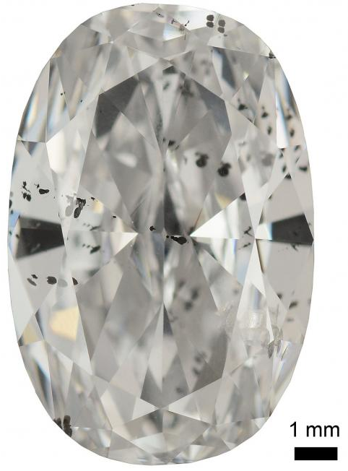
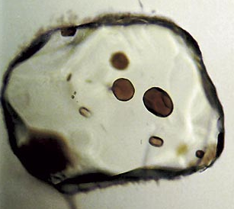
what are the new research questions?
high pressure point source | high pressure synchrotron source | quenched from high pressure | diamond inclusions | rare/unusual natural samples | heterogeneous samples
most inclusions are small; only a tiny fraction have been studied using Mössbauer spectroscopy
50 μm
Nobu Shimizu
Jae Liao

Slide 14
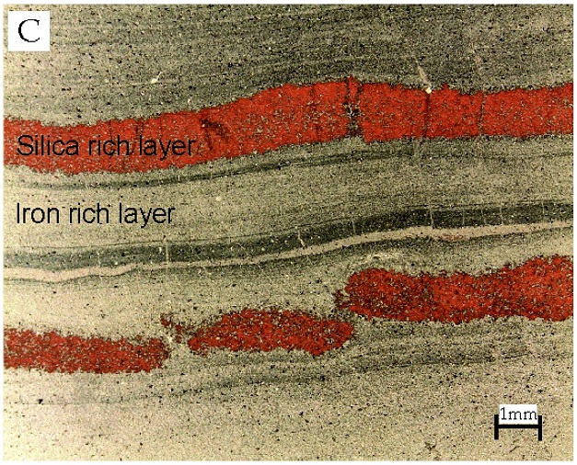
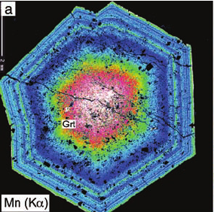
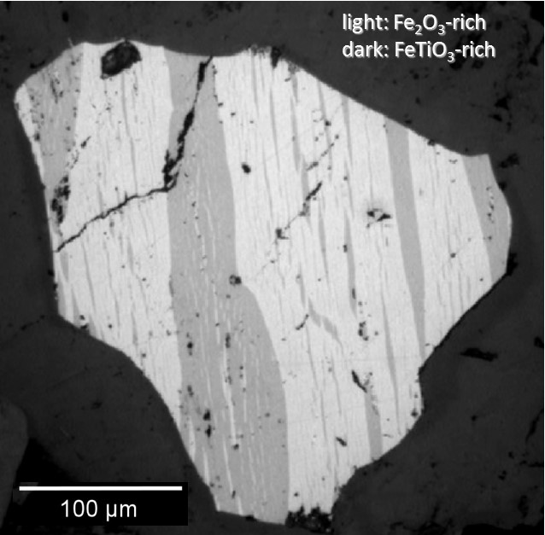
what are the new research questions?
high pressure point source | high pressure synchrotron source | quenched from high pressure | diamond inclusions | rare/unusual natural samples | heterogeneous samples
Patterns in minerals can be read like a book to reveal Earth’s history
2 mm
Sumit K. Mukherjee
Tsujimori & Harlow (2012)
McCammon et al (2009)
banded iron formations
zoned minerals
exsolution lamellae

Slide 15
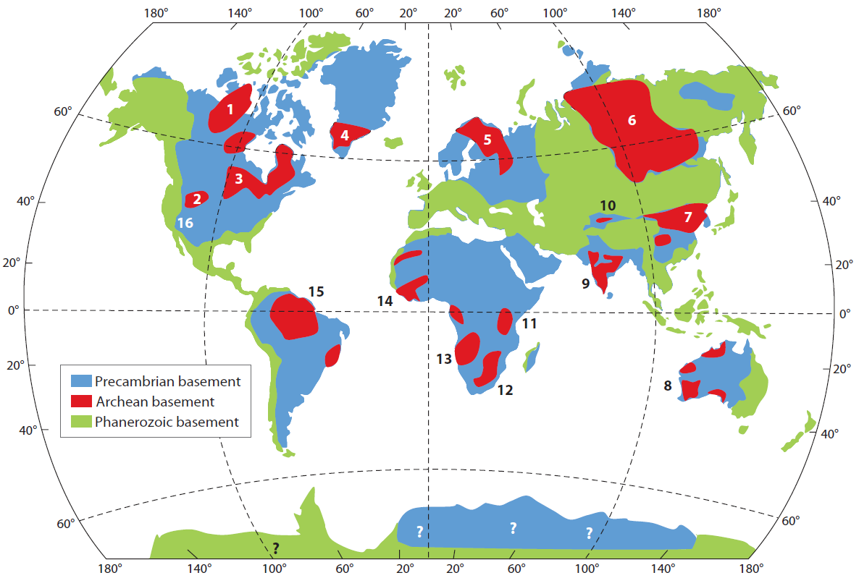
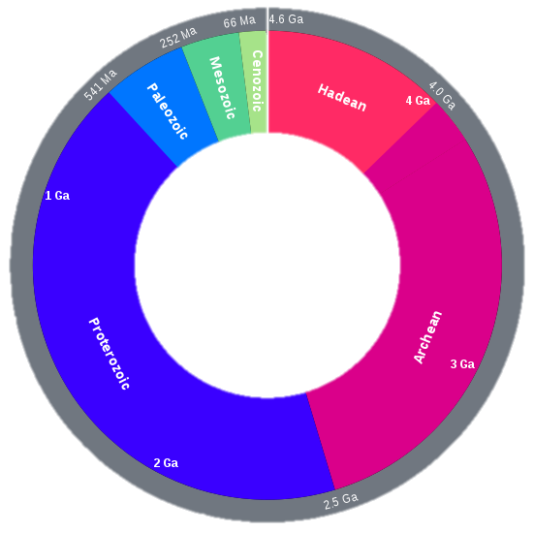
Earth’s rock record
today
541 My
4 Gy
Phan
Protoerzoikum
Archaikum
Arch
Phanerozoikum
Prot
2.5 Gy
Lee et al (2011)

Slide 16
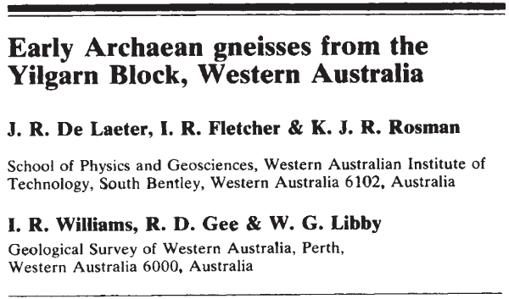
Earth’s oldest rocks
3.6 billion years old

Slide 17
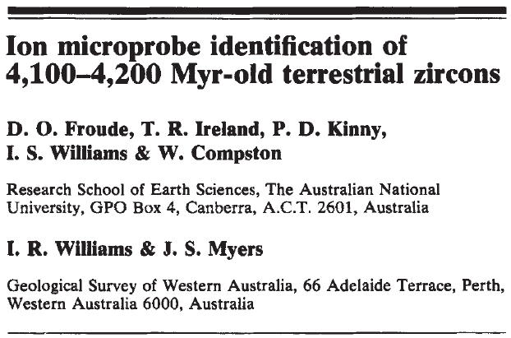
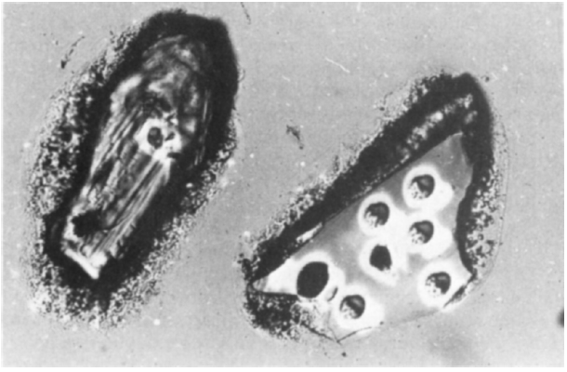
even older minerals
Ø 25 µm

Slide 18
Earth’s rock record revisited
today
560 My
4 Gy
Phan
Protoerzoikum
Archaikum
Arch
Phanerozoikum
Prot
2.5 Gy
Lee et al (2011)

Slide 19

Image credit: Steve Munsinger | Science Source

Slide 20

Image credit: Don Dixon | cosmographica.com

