Slide 1
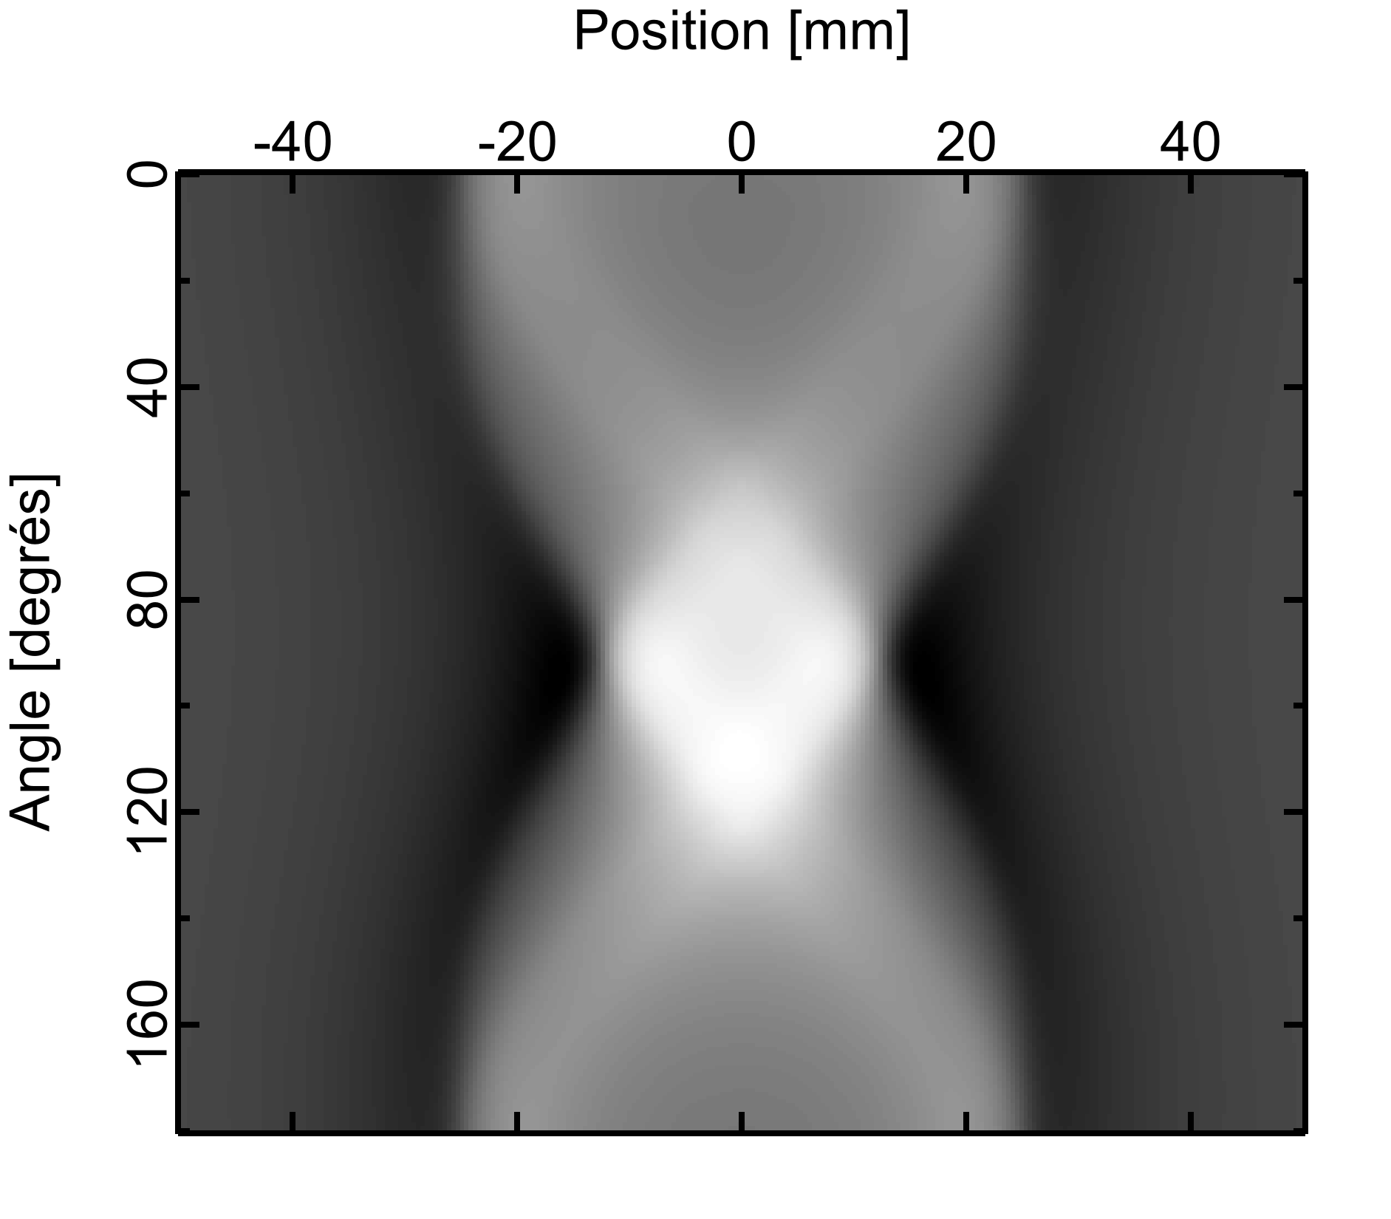
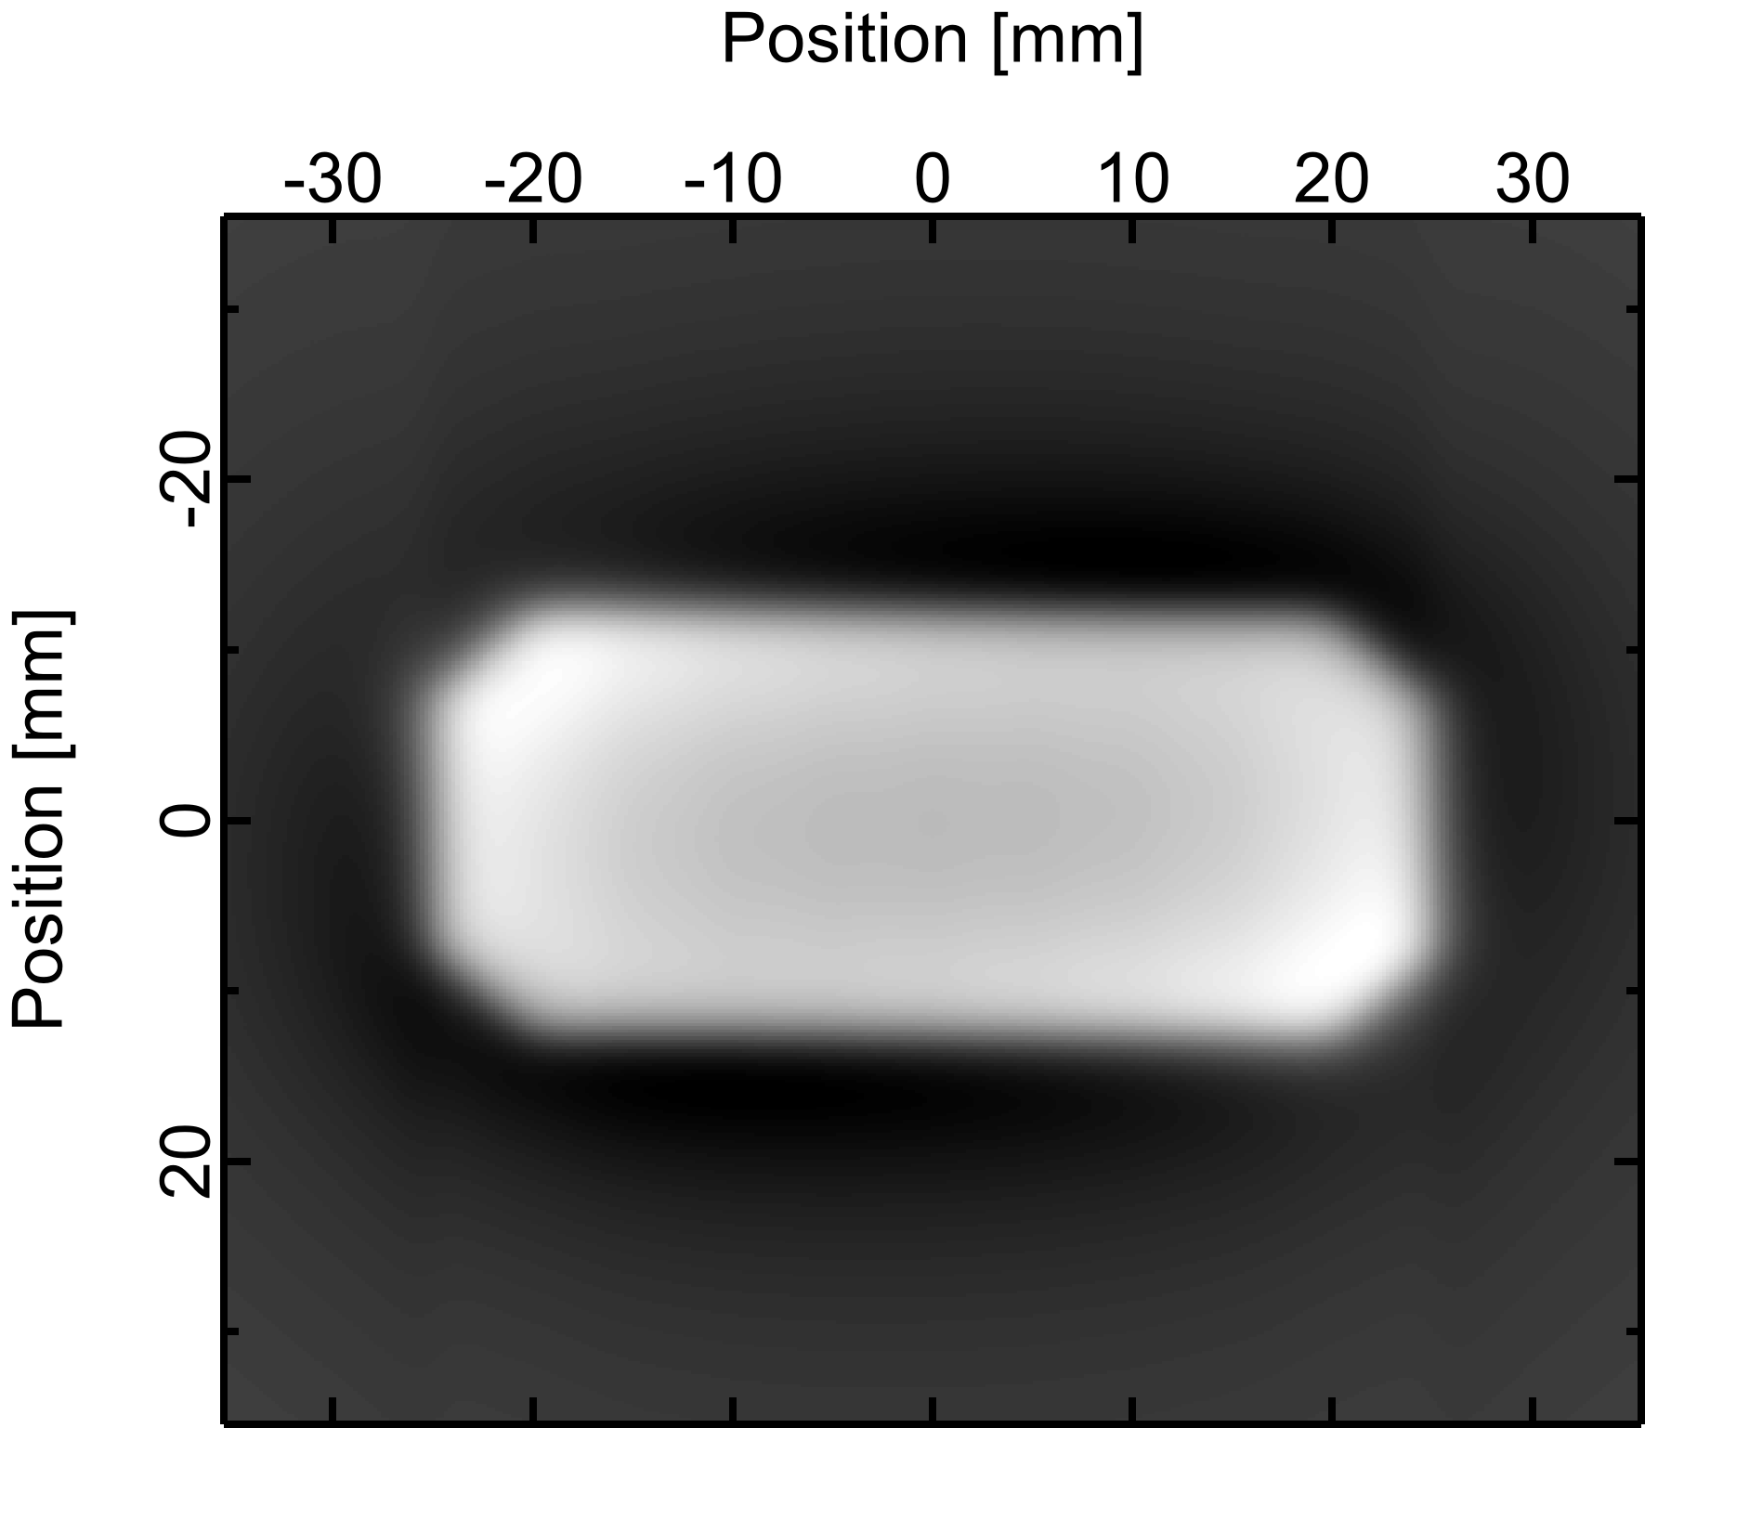
21st International Magnetic Measurement workshop
Grenoble, 24-28 June 2019
Stretched wire measurement R&D at the ESRF SW impedance and SW tomography
Gaël Le Bec

Slide 2
Outline
Stretched wire impedance measurement
Stretched wire tomography
Conclusion

Slide 3
Outline
Stretched wire impedance measurement
Stretched wire tomography
Conclusion

Slide 4
Streched wire impedance Measurement
Principle
Coil
Time-varying flux
Time-varying fields and/or coil motion
Induced voltage
Fluxmeters
Search coils
Rotating coils
Moving stretched wire
Magnetic flux

Slide 5
Streched wire impedance Measurement
Principle
Coil
Accurate displacement of a coil?
(e.g. installed on an undulator bench)
Needs side access
Integrators, etc…
Time-varying flux
Static field
Coil motion
Local meas.
Induced voltage
Current driven coil deformation?
Magnetic flux
Use a vibrating wire!

Slide 6
Streched wire impedance Measurement
Principle
$$B\left(x,y,z\right)$$
I
Mechanical deformation of the wire
Vibrating and pulsed wire methods

Slide 7
Streched wire impedance Measurement
Principle
$$B\left(x,y,z\right)$$
I
Current and voltage measurements
Stretched wire impedance method

Slide 8
Streched wire impedance Measurement
Principle
Faraday’s law $e=−\frac{dφ}{dt}$
Area cut by the wire motion $S∝BI$
Induced voltage $e∝B^{2}\frac{dI}{dt}$
The wire as an inductive behavior
Its impedance varies with $B^{2}$
Impedances measured at different wire modes may give information on the field variations along the wire
Can we measure this effect? Is it completely negligeable?

Slide 9
Streched wire impedance Measurement
Equations of the wire impedance
Field along the wire: $B≈\sum_{n=0}^{N}{\left(a_{n}\cos{\frac{2πy}{L}}+b_{n}\sin{\frac{2πy}{L}}\right)}$
(considering only one field component, neglecting transverse field variations, neglecting dispersion)
Wire’s transverse position:
$$x_{W}=Re\left[Ie^{iωt}\sum_{n=0}^{N}{\frac{1}{n^{2}π^{2}{T^{2}}/{L^{2}}−m_{l}ω^{2}+iα_{l}ω}\left\{b_{n}\sin{\frac{nπy}{L}}+a_{n}\left(\cos{\frac{nπy}{L}}−F\right)\right\}}\right]$$
with $F=e^{y\sqrt{}}−2\left(\frac{1−{\left(−1\right)}^{n}e^{−L\sqrt{}}}{1−e^{−2L\sqrt{}}}\right)sinh{y\sqrt{}}$
and $\sqrt{}=\sqrt{\frac{m_{l}ω^{2}−iωα_{l}}{T}}$
(see [Temnykh, NIMA, 1997] for the vibrating wire equations, [Le Bec, IMMW19, 2015] for the $a_{n}$ terms)
$$H_{n}\left(ω\right)$$
$$S_{n}\left(y\right)$$
$$C_{n}\left(y\right)$$
$L$ wire length
$T$ wire tension
$m_{l}$ linear mass density
$α_{l}$ damping coef. x linear mass dens.

Slide 10
Streched wire impedance Measurement
Equations of the wire impedance
Induced voltage
$e=−\frac{dφ}{dt}$=$−\int{B\frac{dx}{dt}dy}=−iω\int{xBdy}=Lω$I$e^{iωt}$
$$=\left[−i\int{dy\left(\sum_{n≥0}{H_{n}\left(b_{n}S_{n}+a_{n}\left(C_{n}−F\right)\right)}\right)\sum_{n≥0}{\left(a_{n}C_{n}+b_{n}S_{n}\right)} }\right]ωe^{iωt}I$$
$$=\left[−i\left(\sum_{m≥0}{\sum_{n≥0}{H_{m}\int{\left(b_{m}S_{m}+a_{m}\left(C_{m}−F\right)\right)\left(a_{n}C_{n}+b_{n}S_{n}\right)dy}}}\right)\right]ωe^{iωt}I$$
Inductance of the wire
Depends on ${a_{m}}^{2}+{b_{m}}^{2}$+ integrals of oscillation terms

Slide 11
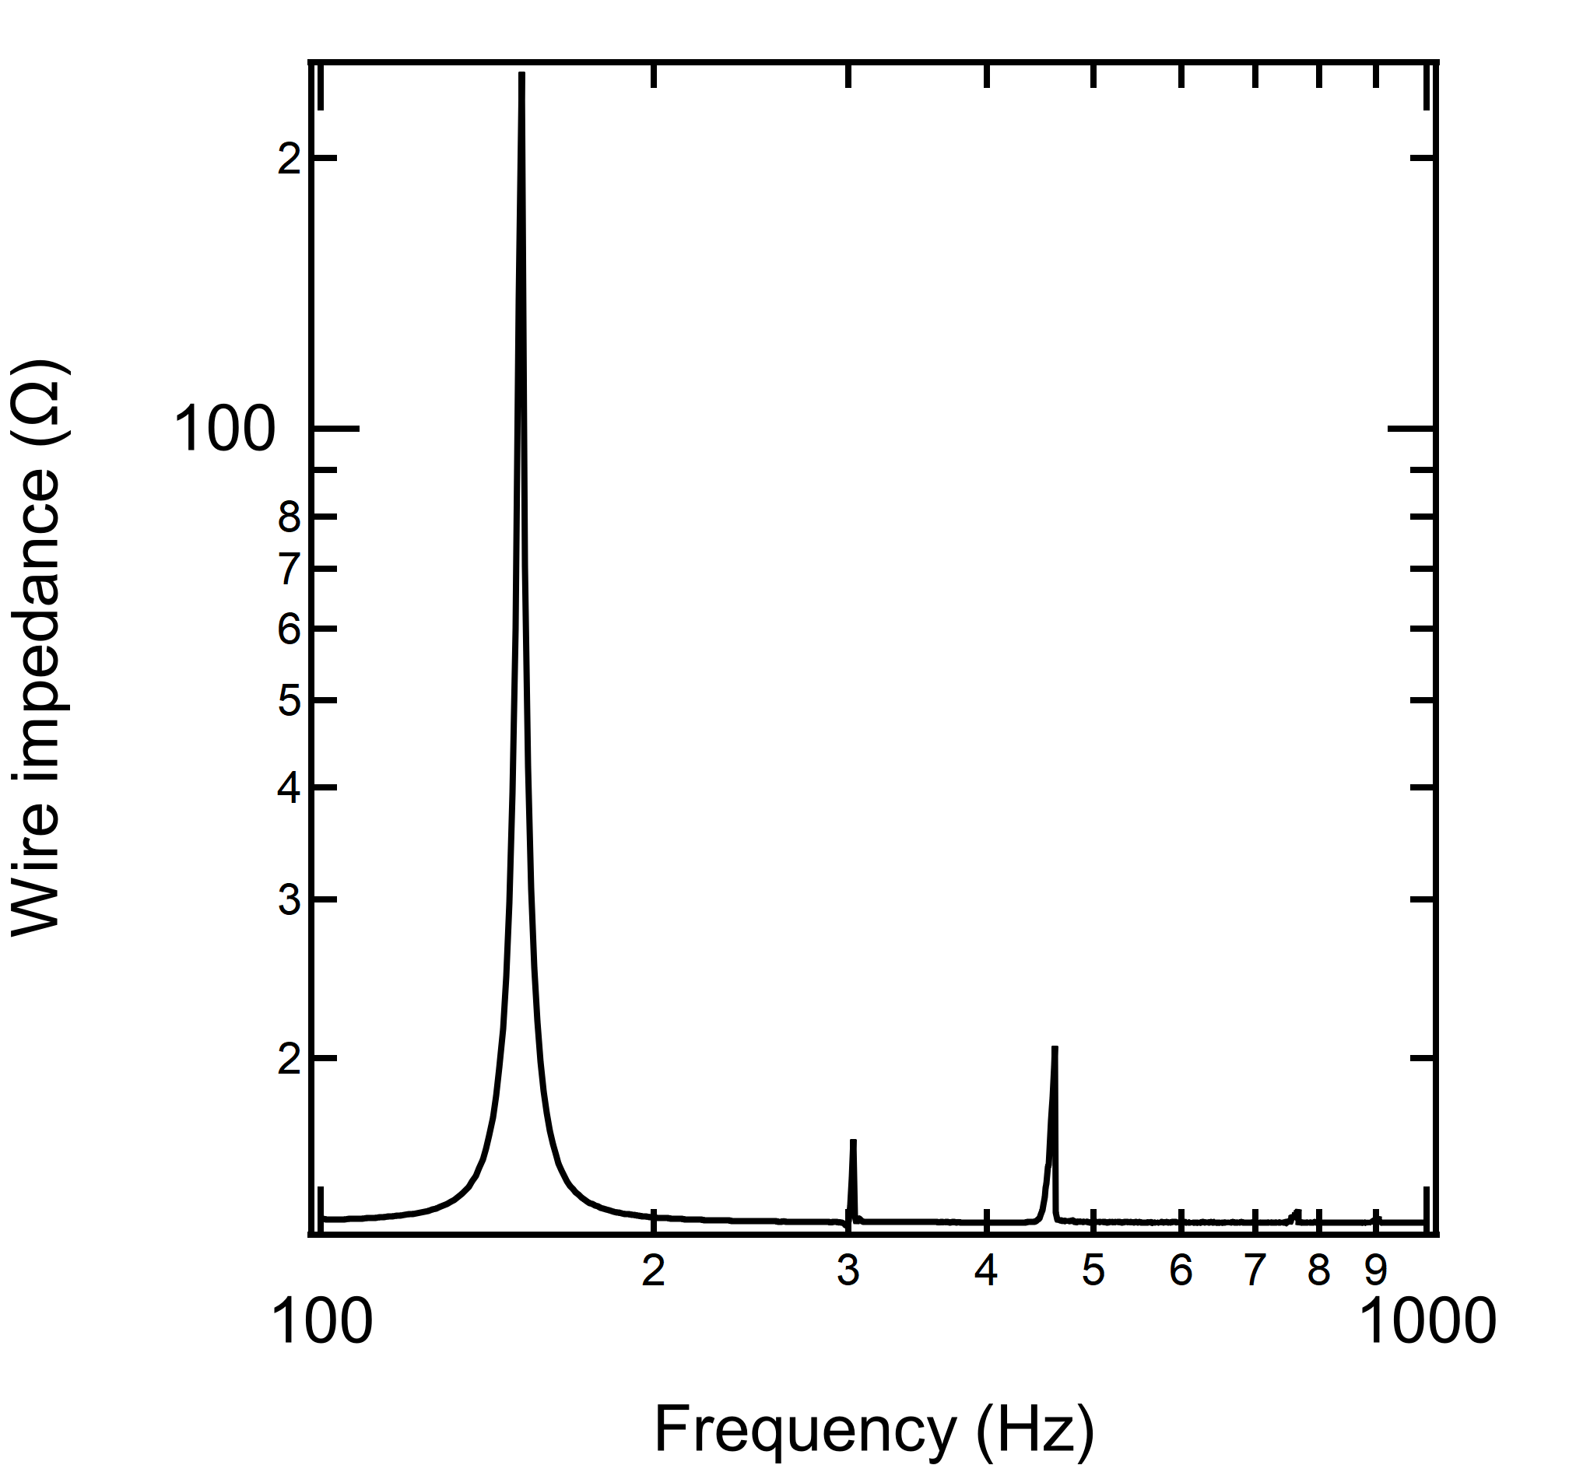
Streched wire impedance Measurement
First tests
A (PM) quadrupole was installed on a stretched wire measurement bench
A 0.1 mm diameter Al₉₉Si₁ wire was used
Impedance spectrum
Significant signal for the first harmonics
Weak signal for the higher harmonics
$h_{2}≠0$ ➔ the magnet is not centered longitudinally
h₁
250 Ω
h₃
20.7 Ω
h₂
16.3 Ω
h₅
13.6 Ω
DC
13.2 Ω

Slide 12
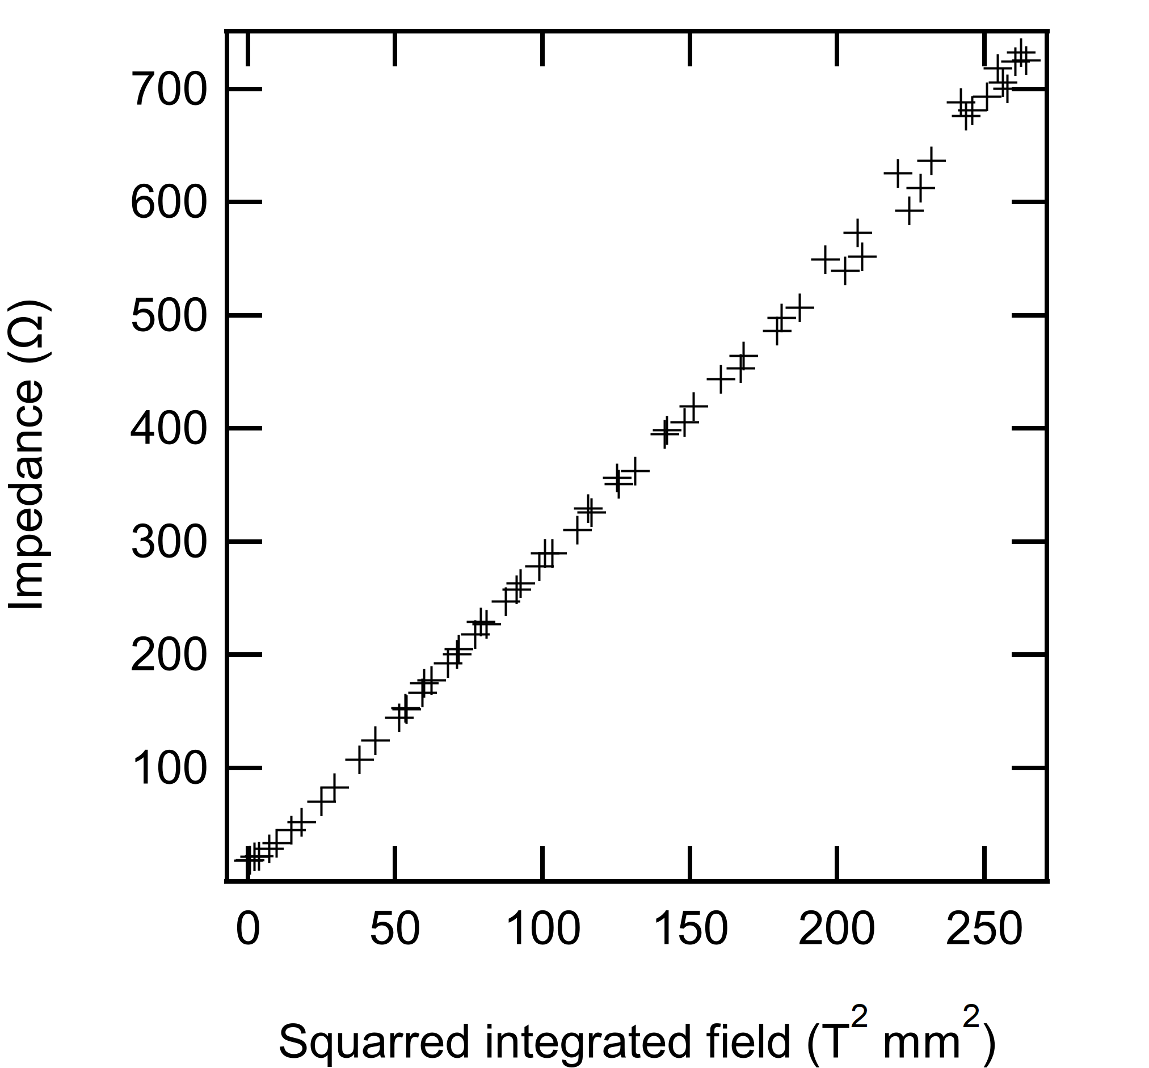
Streched wire impedance Measurement
First tests
A (PM) quadrupole was installed on a stretched wire measurement bench
A 0.1 mm diameter Al₉₉Si₁ wire was used
Impedance at first harmonic
Compared to standard SW measurements (squared)
$Z∝B^{2}$ dependence observed

Slide 13
Streched wire impedance Measurement
Possible applications
Field measurements?
May be used to measure average field (h₁) and gradient (h₂)
Low longitudinal resolution expected (weak signal for higher harmonics)
Scale factor to be investigated in more details
Polarizarion needed for weak field measurements
Provide additional information during moving or vibrating wire meas.
Very simple setup
May be used to lock-in the first wire modes
Sensitive to the longitudinal centering of the magnet (h₂)

Slide 14
Outline
Stretched wire impedance measurement
Stretched wire tomography
Conclusion

Slide 15
Stretched wire tomography
Tomographic reconstruction
Widely used in medical CT-scans
Widely used in synchrotron light sources facilities
position
Radon transform
X-ray source
X-ray detecor
position
$N$ angles
angle
Signal
Acquisition
Reconstruction

Slide 16
Stretched wire tomography
Tomographic reconstruction
X-ray tomographs measure the Radon transform of an object
$$s$$
$$f\left(x,y\right)$$
$$α$$

Slide 17
Stretched wire tomography
Tomographic reconstruction
X-ray tomographs measure the Radon transform of an object
$$s$$
$$s$$
Projection, i.e. integrals
$$Rf\left(α_{0},s\right)$$
$$α_{0}$$
$$α$$

Slide 18
Stretched wire tomography
Tomographic reconstruction
X-ray tomographs measure the Radon transform of an object
$$s$$
$$s$$
$$Rf\left(α_{1},s\right)$$
$$α_{1}$$
$$α$$

Slide 19
Stretched wire tomography
Tomographic reconstruction
X-ray tomographs measure the Radon transform of an object
$$s$$
$$α_{k}$$
$$Rf\left(α_{k},s\right)$$
$$s$$
$$α$$

Slide 20
Stretched wire tomography
Tomographic reconstruction
X-ray tomographs measure the Radon transform of an object
$$s$$
$$s$$
$$Rf\left(α_{N−1},s\right)$$
$$α_{N−1}$$
Definition of the Radon transform
$$Rf\left(L\right)=\int_{L}{f\left(x\right)\left|dx\right|}$$
$$α$$
$L:$ straight line

Slide 21
Stretched wire tomography
Tomographic reconstruction
X-ray tomographs measure the Radon transform of an object
Reconstruction methods
Ill-posed problem
Filtered Backprojection (standard function in Matlab, Mathematica, etc.)
Iterative methods
…
But what is the link with stretched wire magnetic measurements?
Stretched wire induced voltage:
$$e=−v\int_{SW}{B_{⊥}\left(x\right)dx}$$
This is a projection of the field! Local values of the field can be computed from a set of SW measurements.

Slide 22
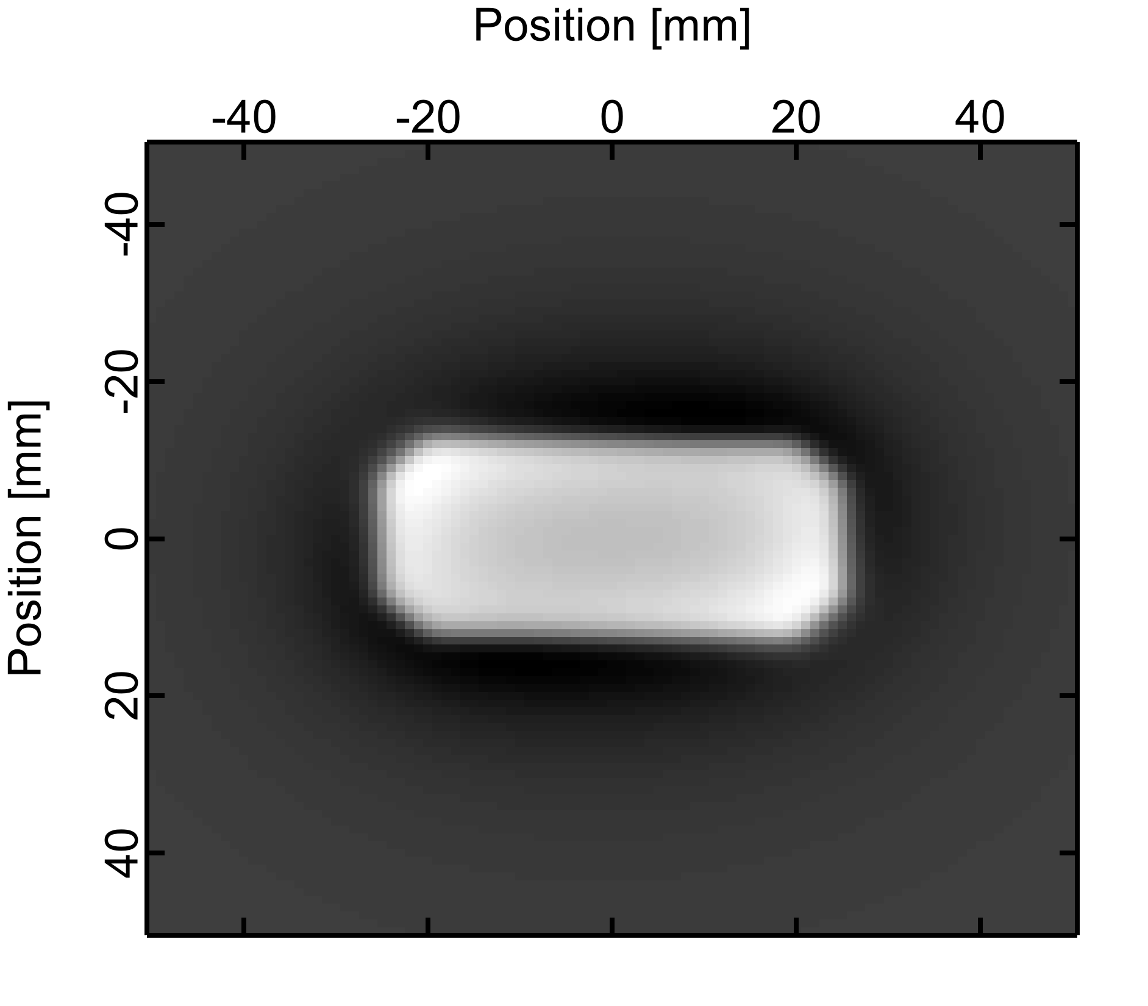
Stretched wire tomography
Simulation of a SW tomography experiment
Modelization of a PM block with the Radia code
Assumption: easy-axis distribution dominated by the field applied during die pressing ➔ easy-axes follows field lines ➔ A 2nd order model of the applied field was used (16 parameters)
M
View of the 3D model of the PM block.
Direct field computation (Radia)
Set of field integrals, i.e. Radon transform
Inverse Radon transform (filtered backprojection)

Slide 23
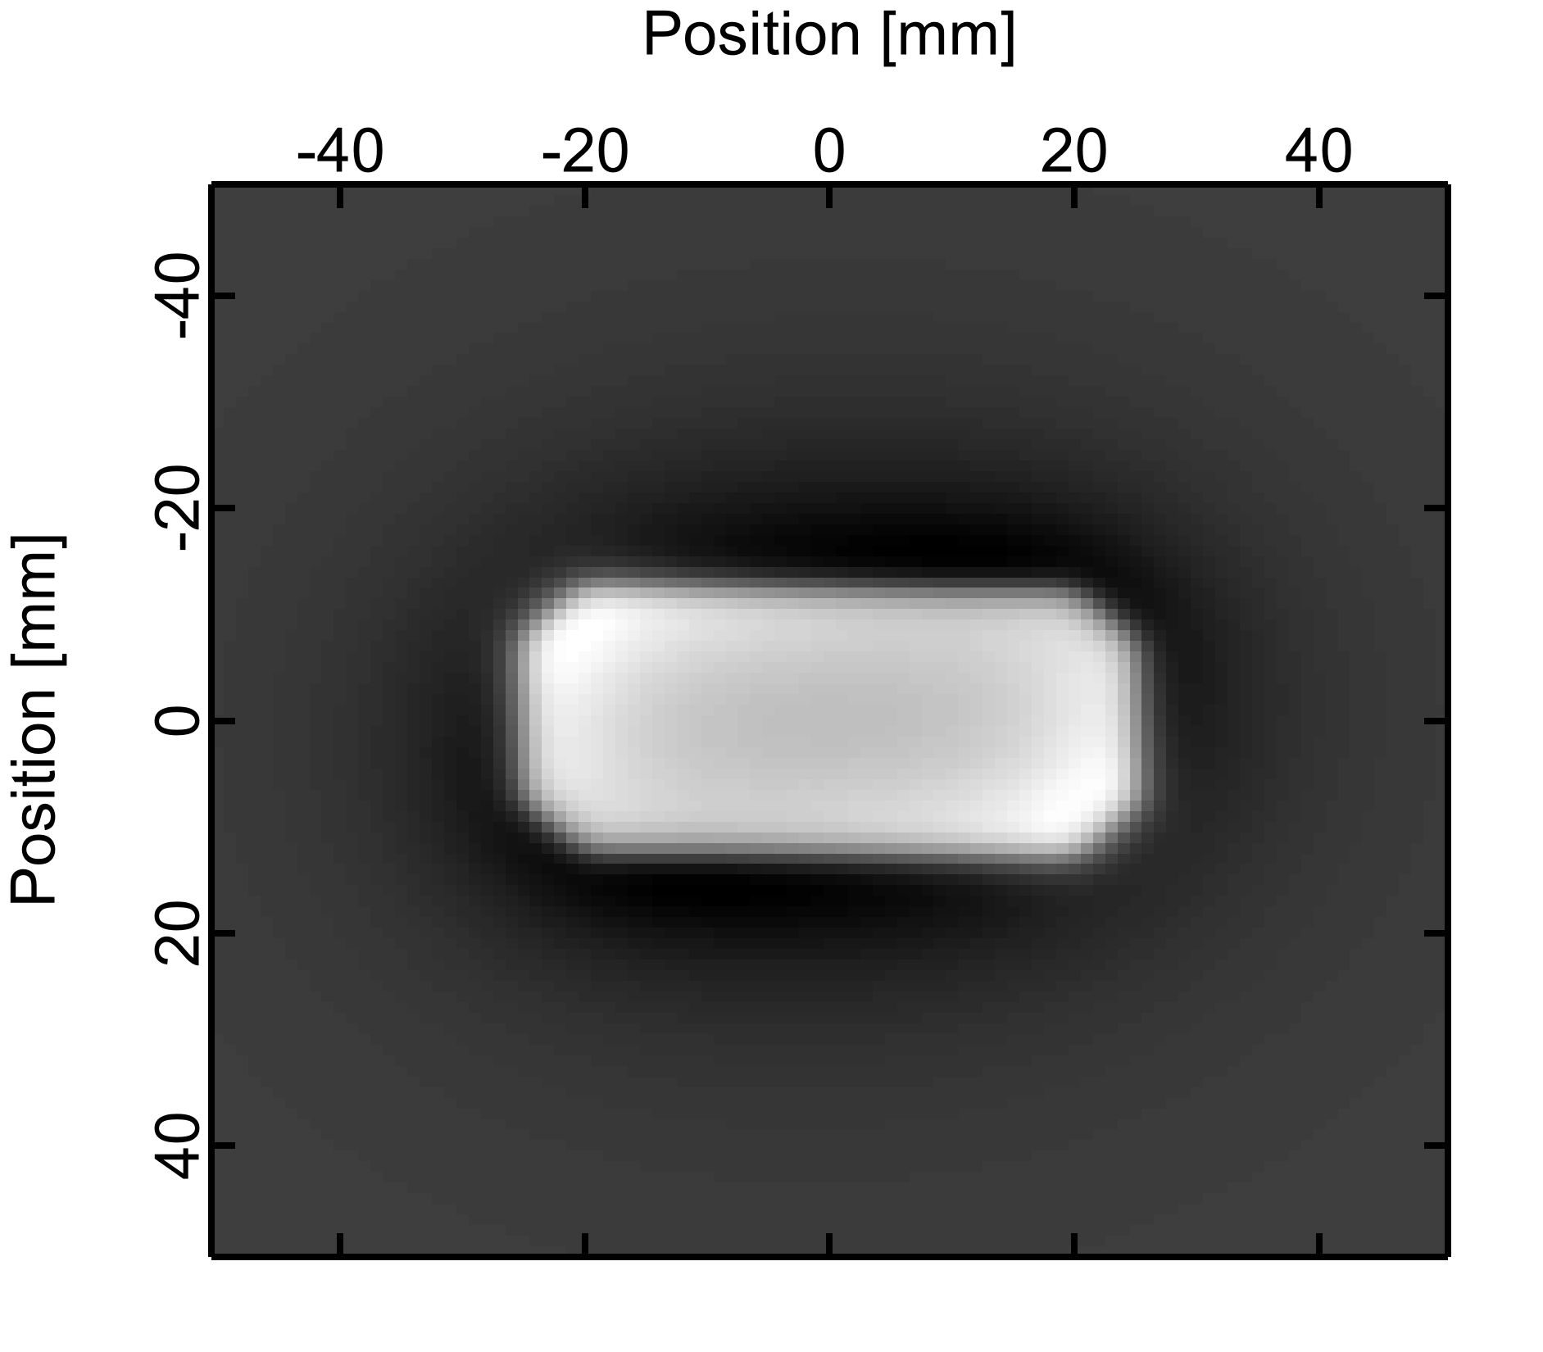
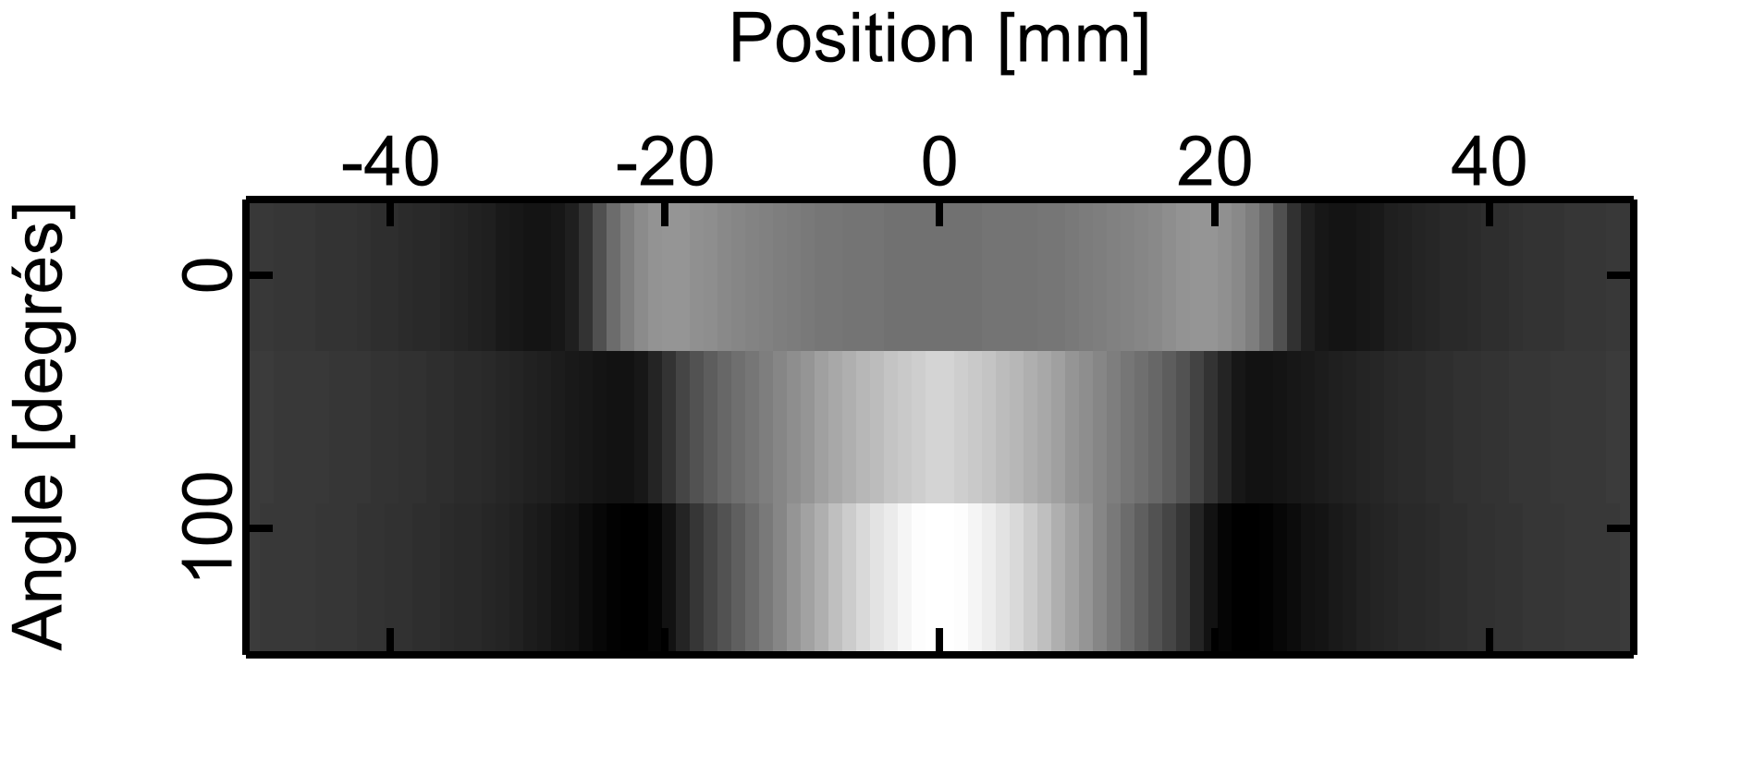
Stretched wire tomography
Simulation of a SW tomography experiment
Reconstruction of a 2D field map
Needs a lot of angles for reconstruction
➔ Long acquisition time!
Identification of model parameters
Reduced number of angles
Magnet dimensions known
Easy-axis distribution in the PM block
M
View of the 3D model of the PM block.
Direct field computation (Radia)
SW measurements at 3 angles
Reconstruction from parameters (easy-axis) identification

Slide 24
Stretched wire tomography
First tests
Acquisition sequence
Go to initial position
Rotate the stage to $α_{k}$
Translate and acquire the voltage
Rotate the stage to $α_{k+1}$
…
Main parameters
$N=256$ samples
±100 mm translation
Sample to wire: 4 mm
Hardware
Newport stages and drivers
Keithley K2182 voltmeter
PM sample
Stretched wire
Rotating stage
M
Linear stage
Experimental setup

Slide 25
Stretched wire tomography
First tests
PM sample
Stretched wire
Angles
Rotating stage
M
Positions
Measured field integrals
Linear stage
Experimental setup
Magnetic field map (filtered backprojection)

Slide 26
Stretched wire tomography
To do
Extract the position and orientation of the sample
Try the parameter identification based reconstruction on real samples
Refine the magnetization distribution model
Design a dedicated bench
…
PM sample
Stretched wire
Rotating stage
M
Linear stage
Experimental setup

Slide 27
Stretched wire tomography
To do
Extract the position and orientation of the sample
Try the parameter identification based reconstruction on real samples
Refine the magnetization distribution model
Design a dedicated bench
…
PM sample
Stretched wire
Rotating stage
M
Linear stage
Experimental setup

Slide 28
Outline
Stretched wire impedance measurement
Stretched wire tomography
Conclusion

Slide 29
Conclusion
Two measurement methods developed
Stretched wire impedance
The wire impedance varies with $B^{2}$
Demonstrated experimentally
Low longitudinal resolution, but almost for free
Stretched wire tomography
SW meas are projections
Radon transforms of the field can be measured
Demonstrated experimentally
May give information on magnetization distribution
Data processing to be further developped

Slide 30
Acknowledgments
Insertion devices and magnet group
Christophe Penel
Marceau Neufselle
Joel Chavanne

Slide 31
Many thanks for your attention

