Slide 1
HC-2585: Probing Shock Melting of Mo via Laser-Driven Compression Combined with EXAFS
ESRF: Richard Briggs
University of Edinburgh: Prof. Malcolm McMahon
LLNL: Ray Smith, Yuan Ping, Federica Coppari, Rip Collins, Jon Eggert

Slide 2
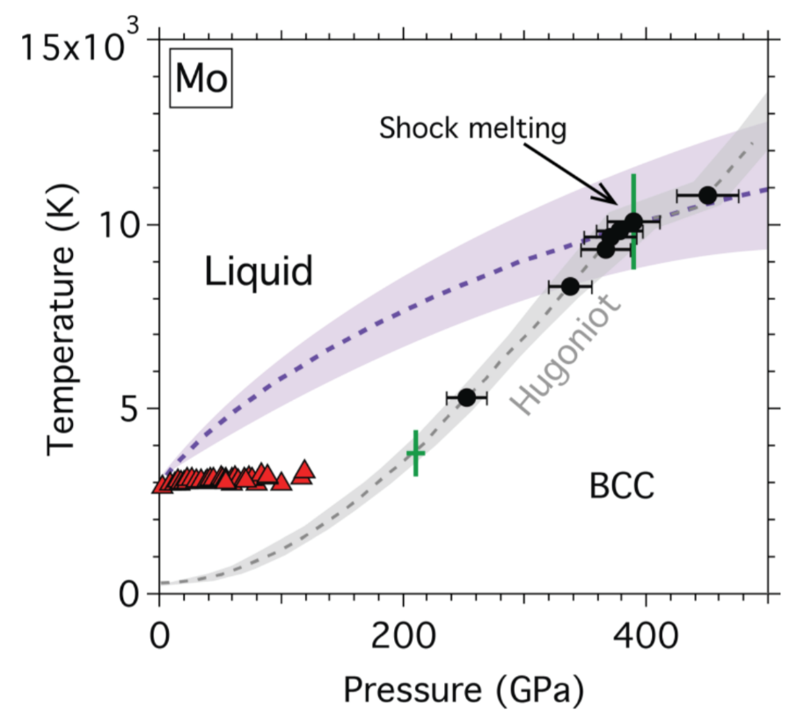
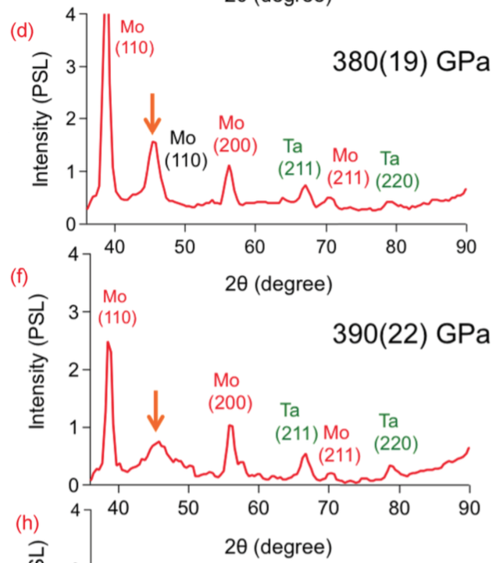
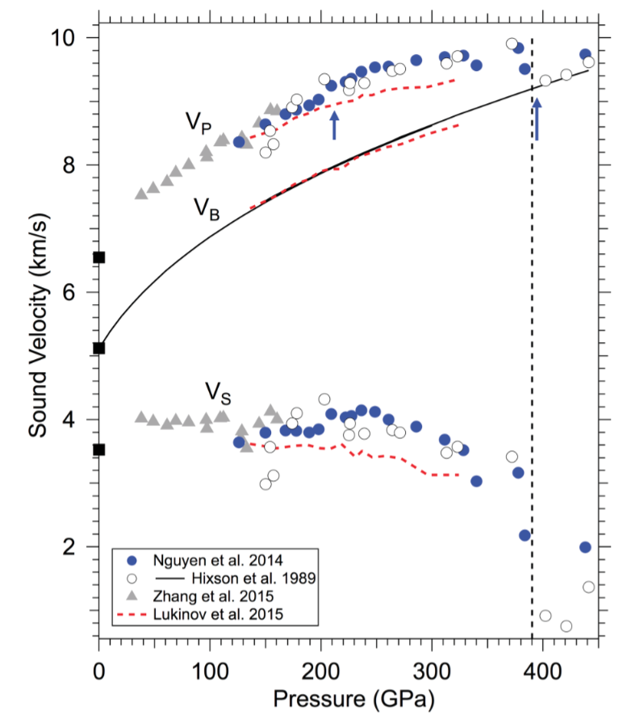
Scientific background:
Melting curve from LH-DAC < 3500 K
Shock melting observed above 350 GPa and ~ 10,000 K
Abrupt change in sound velocity above 210 GPa (usually indicative of melting) and at 390 GPa from previous shock data
New shock data (with XRD) and ab initio MD calculations now suggest no kink at 210 GPa, agree with a kink at 390 GPa

Slide 3
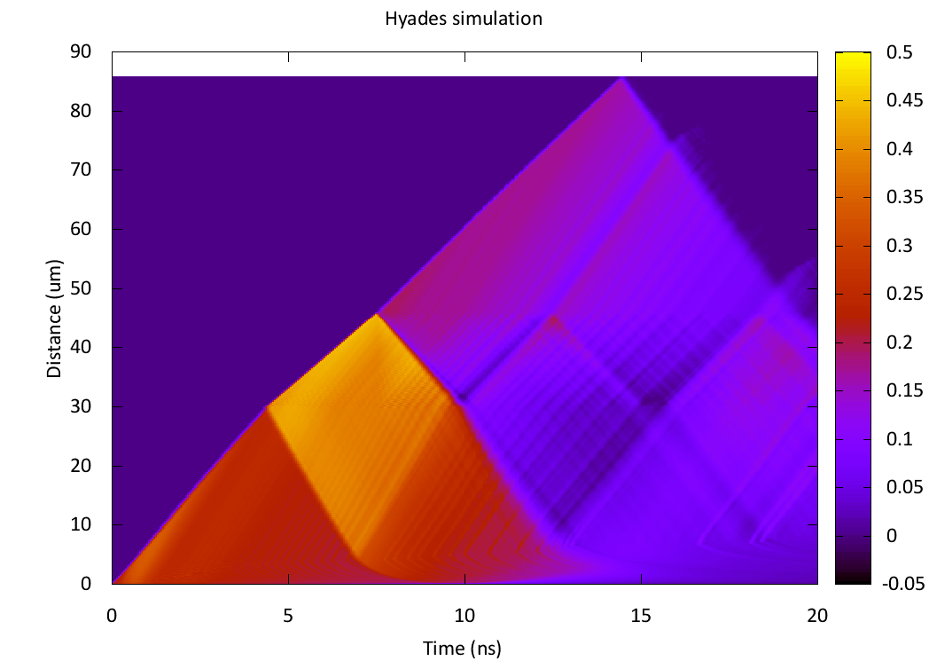
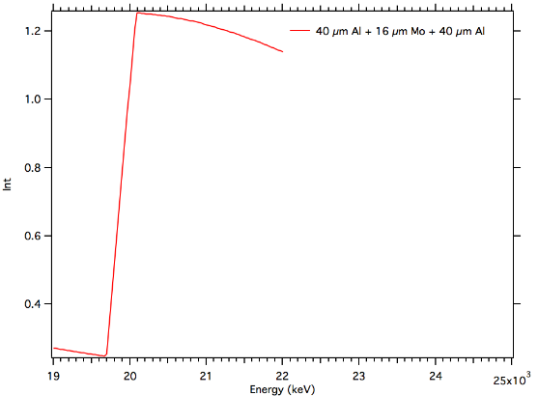
Al | Mo | Al (for window demonstration)
<90%
<10%
1 ns timing window*
<10%
Small amount of material either ambient or released to a lower pressure
What would XANES/EXAFS signal look like with < 10 % material at different P?
Steady shock? Would need Al|Mo|LiF shots with VISAR
Large release wave at the Mo|Window interface
LiF, C, CH, Al will all induce a large drop in pressure
Release wave will reduce pressure rapidly within the Mo; no confinement

Slide 4
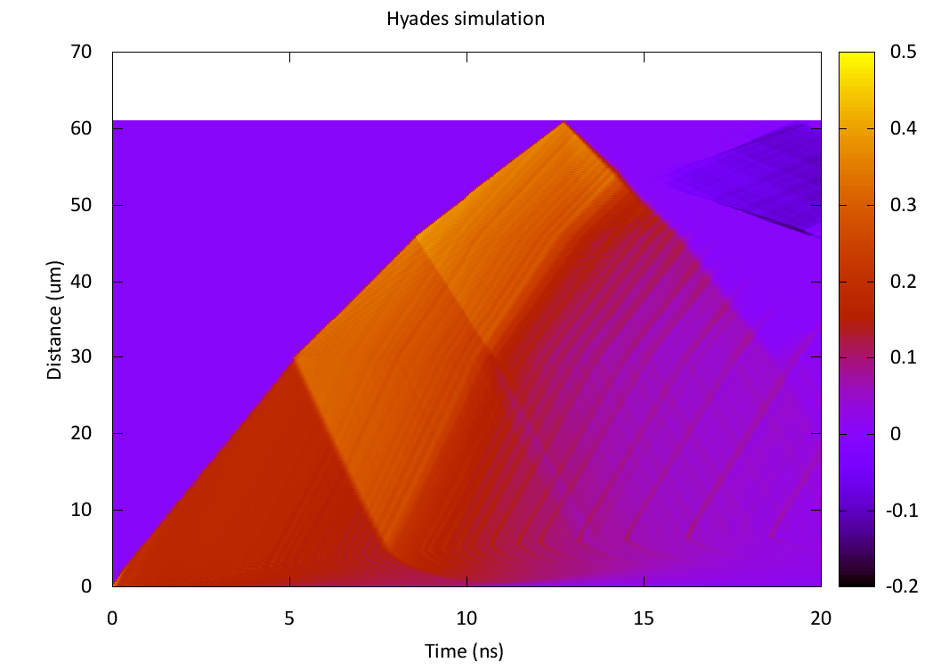
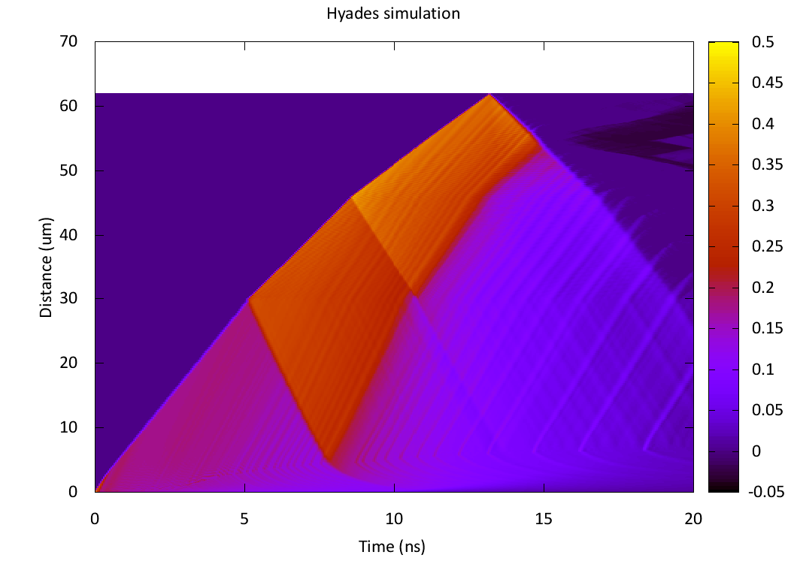
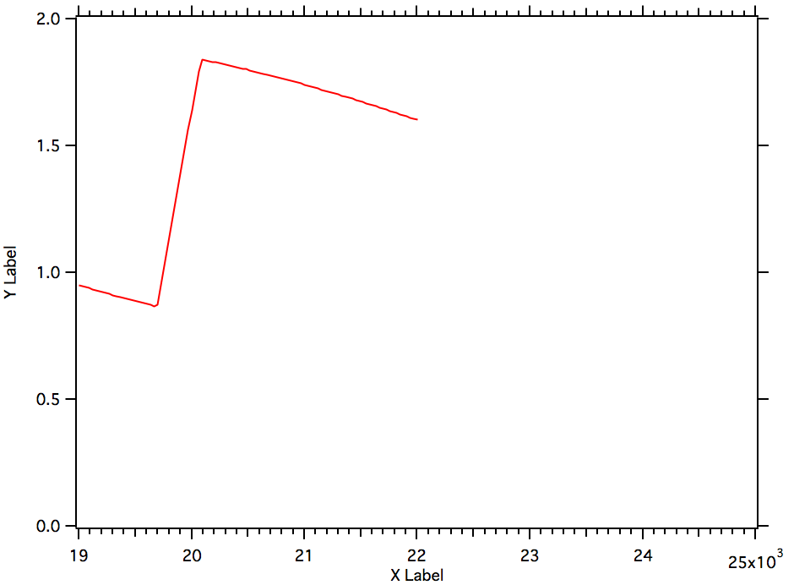
Al | Mo | Ta
Al | Mo | Au
1 ns timing window*
1 ns timing window*
Ta layer would still result in a small release in the Mo, but much smaller P drop.
Reduced signal for XAS.
<90%
<10%

Slide 5
P-T coverage
30 um CH + Al Flash
350 µm (phase plate)
Laser intensity (TW/cm²) | Pressure (Mbar)
0.5 | 0.3
1.0 | 0.6
1.5 | 0.95
2.0 | 1.2
4.0 | 2.0
220 µm focused beam
Laser intensity (TW/cm²) | Pressure (Mbar)
10 (~ 35 J) | 4
5 (~ 16 J) | 2.5

Slide 6
P-T coverage
30 um CH + Al Flash
350 µm (phase plate)
Laser intensity (TW/cm²) | Pressure (Mbar)
0.5 | 0.3
1.0 | 0.6
1.5 | 0.95
2.0 | 1.2
4.0 | 2.0
220 µm focused beam
Laser intensity (TW/cm²) | Pressure (Mbar)
10 (~ 35 J) | 4
5 (~ 16 J) | 2.5

