Slide 2
Investigation of local structure of laser shocked GeO₂
CELIA
Benuzzi
T. Vinci
A. Ravasio
R. Torchio
O. Mathon
S. Pascarelli
F. Dorchies
Notes:
So, my name is Olivier Mathon. I am working at the European Synchrotron Facility and I originally proposed a talk entiteled X-ray Absorption under Extremes. Extremes means extreme conditions of Pressure Temperature and magnetic field. But as I am in a session dedicated to “time resolved methods”, I am going to slightly change my proposal and to talk about XAS under extremes…. Using time resolved techniques….

Slide 3
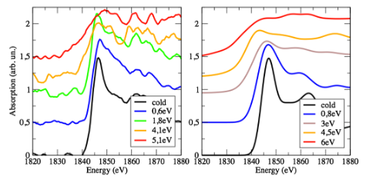
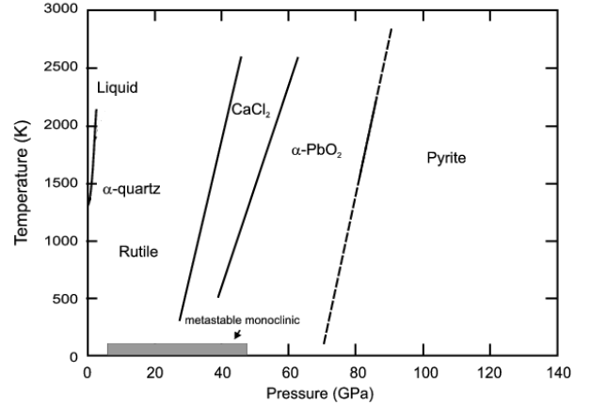
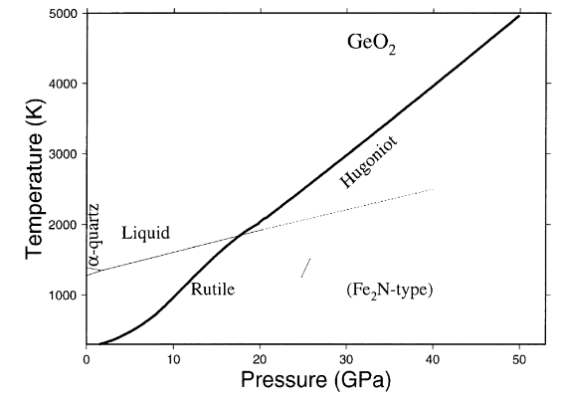
the scientific case
GeO₂ is chemical and structural analogue
of SiO2, a major component of earth’s interior
A. Denoeud, PRL 2014
GeO2 polymorphs: tetragonal rutile; quartz-type hexagonal; glass.
crystalline rutile
glass
Liu and Basset 1986
Hugoniot
calculated
T. Vinci
Jackson and Ahrens 1979
the structure of any GeO₂ polymorph was never investigated under dynamic compression
data on the molten phase are lacking also in static compression

Slide 4
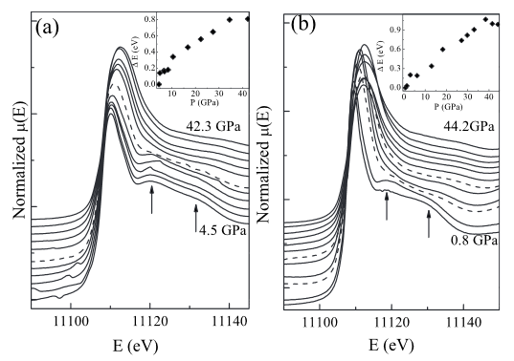
PROBLEMS and plans
easy decomposition of GeO₂
the company (DEPHIS) that does the deposit is unable to know in advance
which density and structure will come from the deposit.
Likely the amorphous phase is the easiest to make, crystalline deposition can be
tried but is extremely expensive!!
amorphous phase deposition: test + realization 5160 euro
crystalline phase deposition: test + realization 7800 euro
Ge target: 2400 euro
in the glass phase above
10 GPa a coordination increase
is observed under static compression
amorphous → LiF
crystalline → diamant
M. Baldini, PRB 2010

