Slide 2
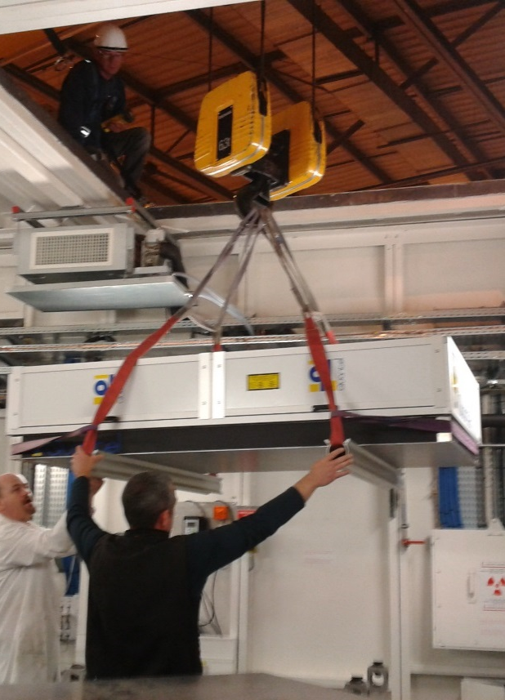
Preparation meeting
XAS under LASER shock compression
Notes:
So, my name is Olivier Mathon. I am working at the European Synchrotron Facility and I originally proposed a talk entiteled X-ray Absorption under Extremes. Extremes means extreme conditions of Pressure Temperature and magnetic field. But as I am in a session dedicated to “time resolved methods”, I am going to slightly change my proposal and to talk about XAS under extremes…. Using time resolved techniques….

Slide 3
Agenda
09H30 1- Welcome and agenda (Sakura, 5)
2- General introduction, schedule and acquisition mode (Olivier, 15+10)
3- Report on tests at different energies (Florent, 15+15)
4- GCLT status (Arnaud, 15+15)
11H00 Coffee break
11H15 5- Diagnostics status and VISAR (Arnaud, 15+15)
6- Experiment design (Olivier, Florent, Sebastien, 60)
12H45 Lunch
14H00 7- Sample/target design and status
- Raffaella : guidelines for target preparation and FeNi status (20)
- Florent, Laurent, Fe and Ta proposal (10)
- Tommaso, Ge proposal (10)
- Richard, Mo proposal (10)
- Guillaume, FeO proposal (10)
8- Discussion, Resume, Schedule and to do list (Sakura, 60)
16H00 End of the meeting

Slide 4
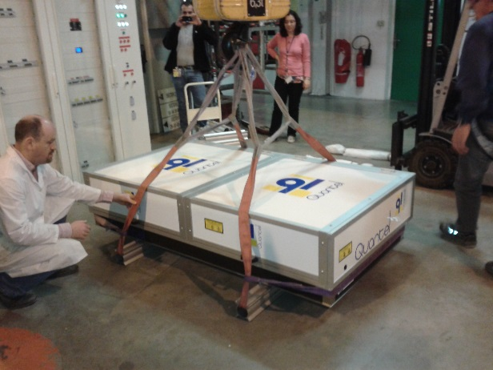
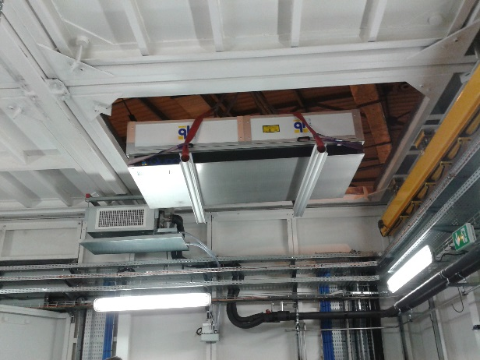

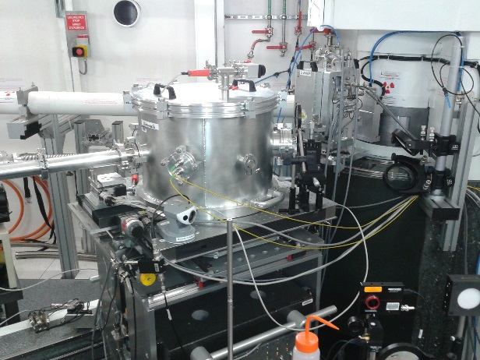
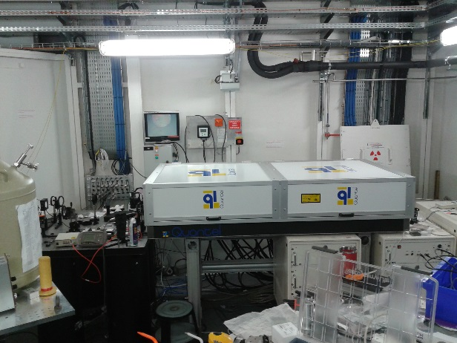
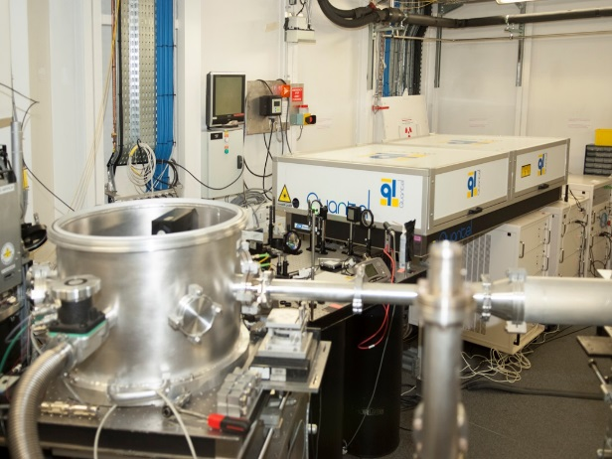
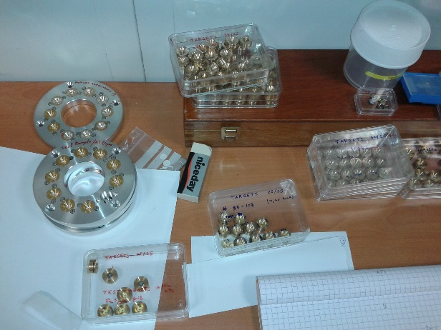
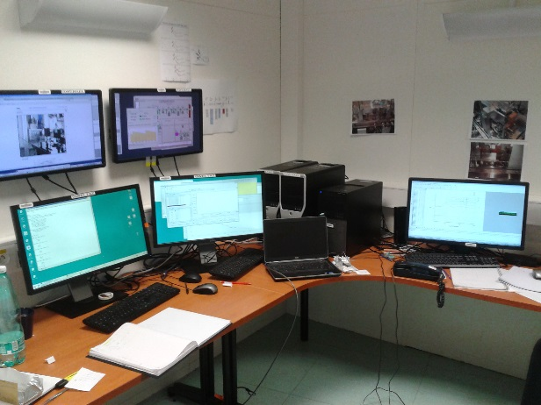
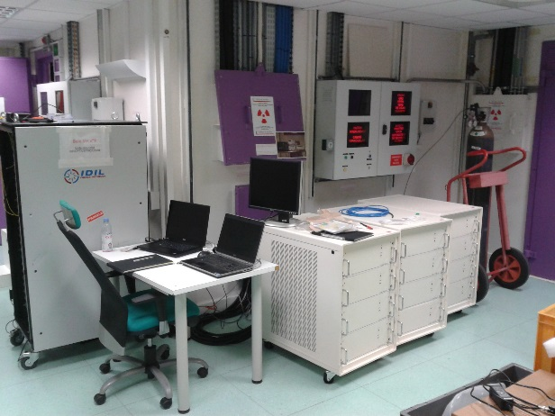
May 2014

Slide 5
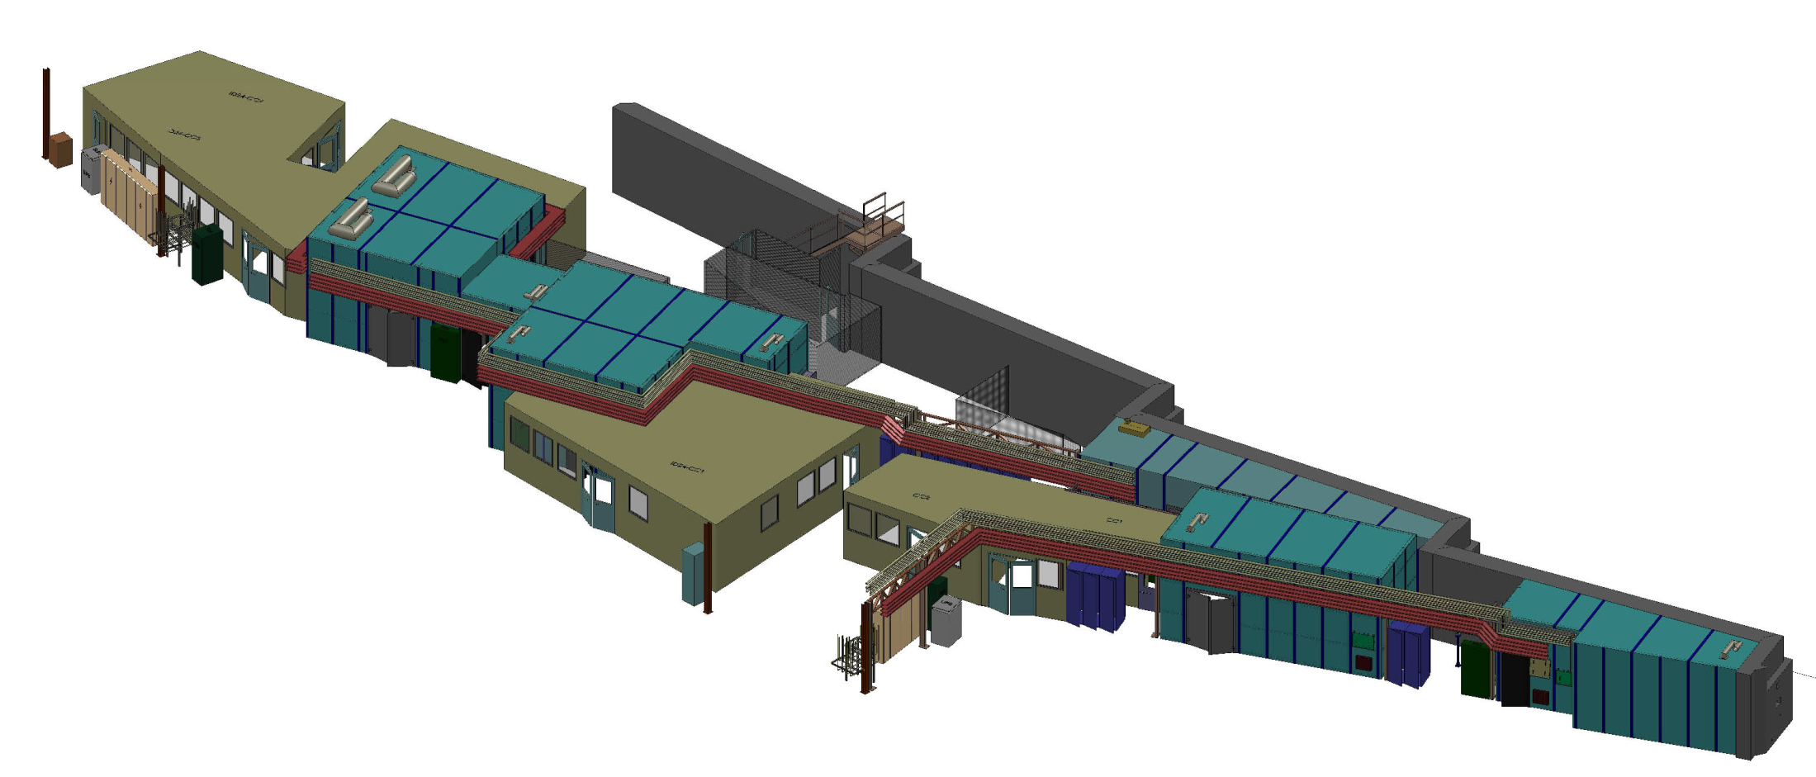
TEXAS project
TEXAS : ID24 and BM23
2 beamlines dedicated to
Time resolved and Extreme conditions
X-ray Absorption Spectroscopy
ID24 : energy dispersive beamline
On an undulator source
BM23 : scanning EXAFS beamline
On a bending magnet source
Notes:
Within the upgrade program phase 1 of the ESRF, we have completely reconstructed two beamlines ID24 and BM23 within a project dedicated to Time resolved and Extreme conditions X-ray Absorption Spectroscopy, called TEXAS project.
BM23 is a conventional scanning EXASFS beamline based on a bending magnet source
Whereas ID24 is an energy dispersive XAS beamline with 2 experimental stations based on an undulator source.

Slide 6
XAS Energy dispersive beamline principle
θ_{Blue} < θ_{Red}
E_{Blue} > E_{Red}
λ= 2d.sinθ
Polychromator :
Bent Si(111, 220, 311) crystal with elliptical shape
Focal spot = sample
Pink X-ray source
Provide the users’ community a unique instrument
PSD detector
small focal spot ~ few μm
high flux (~ 10¹⁴ ph/s)
fast acquisition (100 ps)
The strategy: minimize the sample size and interaction time to drastically reduce the energy needed to reach extreme thermodynamical states
Notes:
ID24 is an energy dispersive beamline based on a polychromator.
A polychromator is a Si crystal with an elliptical shape. If I highlight the crystal with an Xray source located on the first focus of the elliptical shape, two things are happening:
First, all X-rays diffracted by the crystal will be focused in the second focus of the ellipse, leading to a small focal spot
And Second, you can see on the figure that the angle of incidence varies continously from one side to the other side of the crystal. It means that the energy of the Xrays diffracted by the crystal varies continuously from one side to the other side of the crystal. From low angles to high angles, means form high energy to low energy. The polychromator introduces a correlation between the direction of propagation and the energy. By using a position sensitive detector, you can measure a different energy in each pixel of your detector. By choosing a proper geometry and putting the sample In the focal plane, you can record a XAS spectrum in a single image of your detector.
The goal of this beamline is to provide to the users community a unique instrument combining a small focal spot, a high flux, and a fast acquisition time to perfom XAS.
For Extreme conditions, the strategy is is take benefit of the small focal spot to reduce the interaction zone, of the high flux and the fast acquisition scheme to reduce the interaction time, to drastically reduce the energy needed to reach ectreme thermodynamical states.

Slide 7
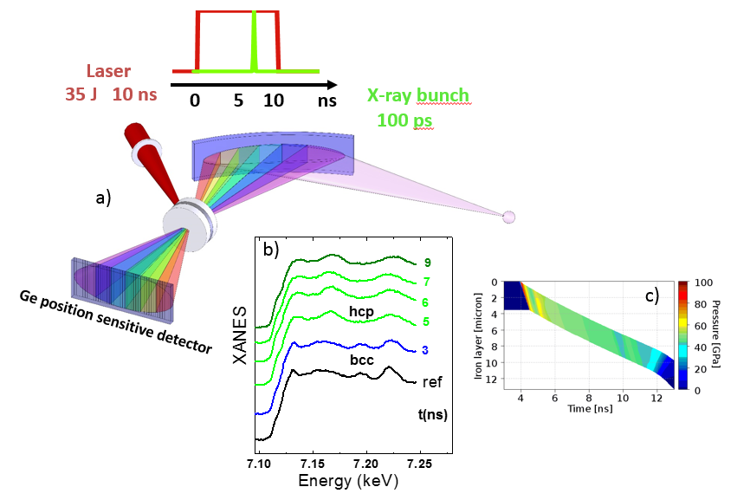
High pressure generated by laser Shock : principle
First test experiment on ID24, combining ED-XAS and LASER shock
Notes:
This possibility of single bunch pump-and probe acquisition could be used to study matter at very high pressure and temperature generated by a laser driven shock.
The principle is simple. If you highlight a sandwich of Diamond/Fe/and diamond with a 30 Joules powerful laser during few ns, you create in the sample a shock wave that will compress and heat the sample . Due to the diamond windows, you can maintain HP/HT conditions during the laser pulse duration. For example with a laser of 10 ns and 30 Joules, you can maintain pressure more than 500 GPa and 14000 K during few ns.
You have then plenty of time, to perform your XAS analysis with your 100 ps single X-ray bunch provided by the synchrotron.
This experiment is completely irreversible as at the end of the laser pulse the sample is destroyed. You need to obtain a sufficiently good signal-to-noise ratio only with this unique accumulation.

Slide 8

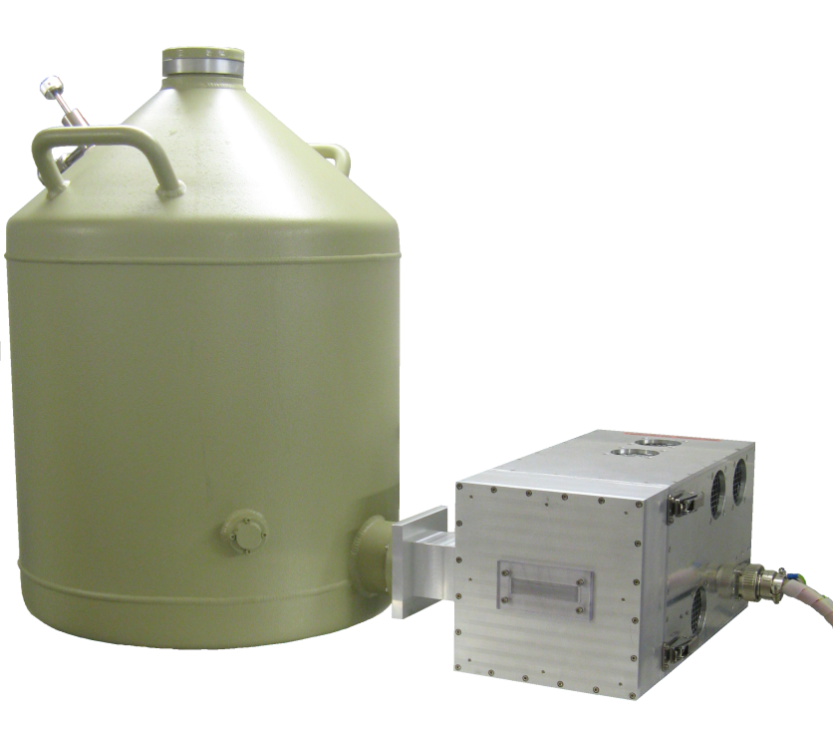
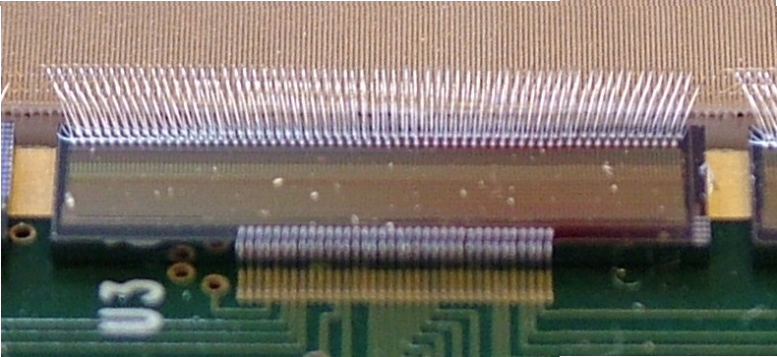
Xh – ge detector
Time scale from the ms down to 100 ps
XH Ge detector and XCHIP3 electronic
XH detector
1 mm thick Ge sensor, 1024 strips
50 µm pitch, 3 mm strip height,
LSF 2 strips
Leakage current < 30 pA / strip
W. Helsby, J. Headspith et al.
New XCHIP3 readout ASIC
Variable preamplifier gain.
Minimum integration time: 100ns
Readout time: 2 µs
Repetition rate (16-bit): 2.8 µs
Notes:
For fastest time scale, the CCD based technology is not fast enough and we have developed, in collaboration with the STFC in the U.K., a detector called XH and based on a 1024 micro strips linear array in Germanium. The 1 mm thick Ge sensor allows 100 % efficiency direct detection up to the highest energy of the beamline at 27 keV, avoiding radiation damage. The size of each strip is 50 microns pitch by 3 mm height.
The sensor is coupled to a specially developed XCHIP3 readout ASIC. It allows a minimum integration time of 100 ns and a repetition rate of 2.8 microsecond, both characteristics matching the ESRF ring timing modes. The detector is fully synchronizable both with the ring frequency and the experiment trigering.
Between the ms and roughly 10 microsecond, the time structure of the X-ray beam can be neglected and the detector can operate in movie mode. In this case we are interesting in its ability to operate at a very high frequency corresponding to one ring revolution.
Below the microsecond, the detector operates in pump-and-probe mode; and we are consequently very interesting in its minimum integration time to catch and isolate a single X-ray bunch.

Slide 9
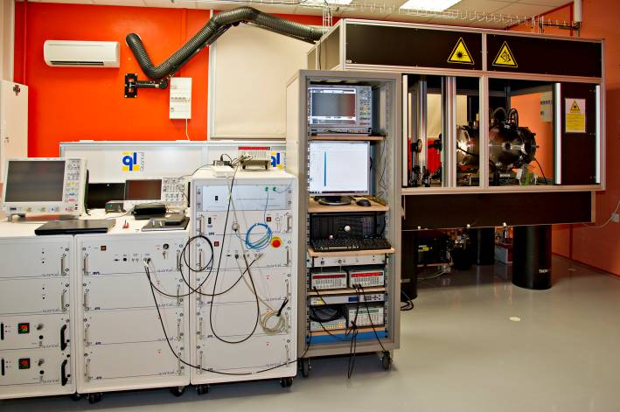


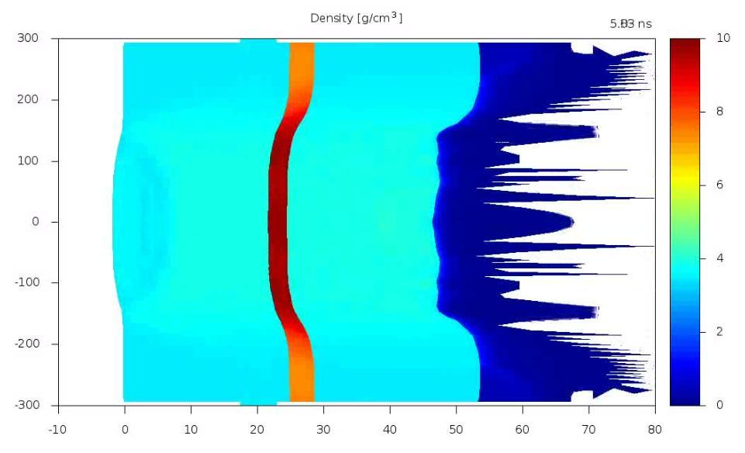
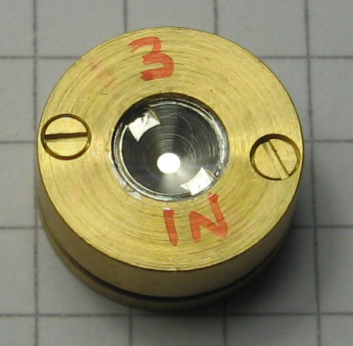
High pressure generated by laser Shock : laser and target
GCLT LASER provided by the CEA (40J, 10ns).
(A. Sollier, E. Lescoute et al.)
Target design (pre-heating and 2D effects)
(R. Torchio, L. Videau, T. Vinci et al.)
diamond Fe diamond CH
40 µm
50 µm
P<100 GPa
laser foc 300µm
2D effects
P>100 GPa
laser foc 90µm
Fe
25 µm
25 µm
µm
density (g/cm³)
(F. Occelli et al.)
diamond
diamond
µm
Notes:
A key point of the experiment is the couple formed by the laser and the target design. The laser is provided by the CEA with the GCLT laser. This laser has been conceived as a transportable laser dedicated to chock experiments. It is able to deliver up to 40 Joules with variable length between 4 and 100 ns, and the possibility also to perform ramp. The associated target design has been also developed by the the CEA, with inputs from the LULI. This special design must take into account the LASER parameters and the X-ray constrains, in particular to take maximum benefit of the miniaturization of the experiment.
Two different targets were developed, one for the low pressure part in the Fe solid phase, and one for higher pressure to reach the Fe liquid phase.
All diamond/Fe sandwiches are mounted in this sort of miniature HP cell.
A total of 200 cell were prepared and measured during the experiment week.

Slide 10

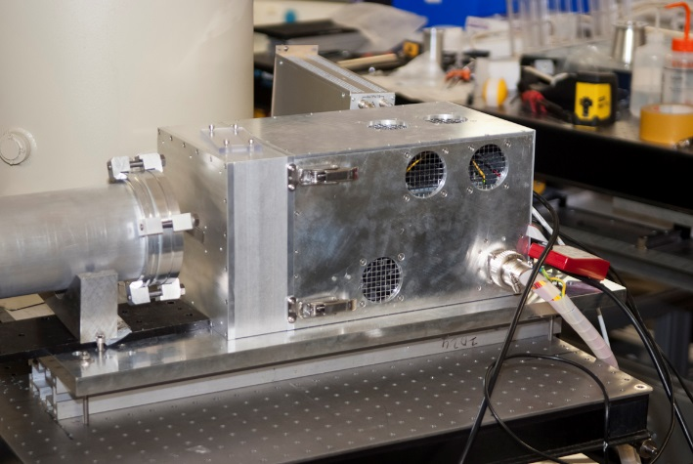
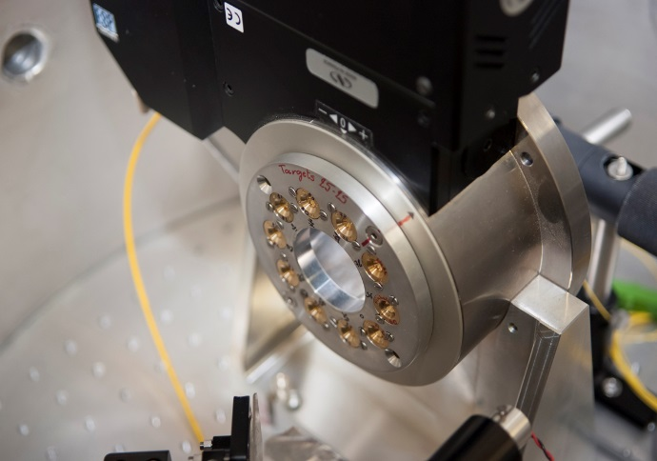
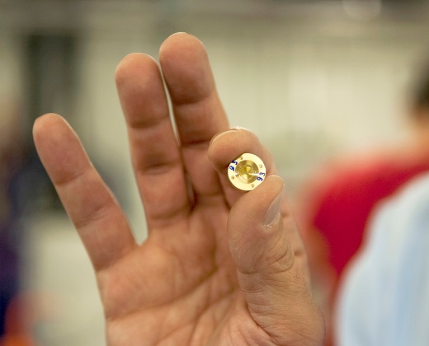
High pressure generated by laser Shock
GCLT laser 40J-10 ns
laser
x rays
XH detector
Target
Sample changer
under vacuum
Notes:
This slide presents some pictures of the experiment with the principal key components of the experiment, with the laser mounted inside the ID24 experimental hutch. The interaction chamber under vacuum where the laser beam and the X-ray beam must be coincident.
The sample changer, inside the vacuum chamber, with 10 samples mounted simultaneously.
And the XH detector for single bunch acquisition

Slide 11
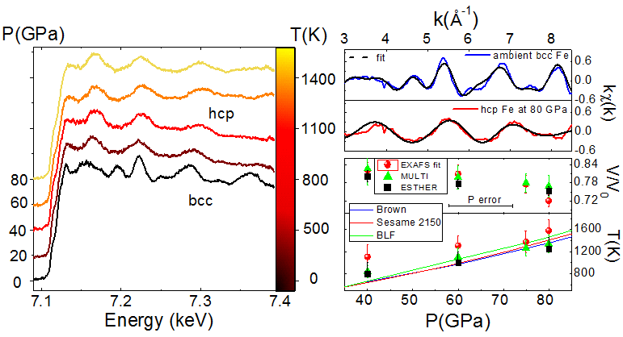
High pressure generated by laser Shock
laser parameters
E = 30 J, t = 10 ns
focal spot (with phase plate ~300 µm)
I ~ 4 10¹² W/cm²
X-rays 5 x 90 µm
80 GPa, 1400K
Good quality EXAFS data
Single 100 ps bunch acquisition
R. Torchio et al., submitted to SR (2015)
Notes:
In this slide you can see the results obtained in the Fe solid phase.
In this first series of test, the laser parameter were fixed to a maximum of 4 ten to the 12 W/cm2, using a phase plate of 400 microns. It leads to a pressure and a temperature estimated by hydo-simulation codes to a maximum pressure of 90 GPa and 1500 K.
You can see on the spectrum on the left the quality of the XAS spectrum obtained, I remind you with a single 100 ps X-ray bunch. A XANES with good energy resolution and a good quality EXAFS up to K=8 A-1, are obtained.
By varying the energy of the laser pulse, it is possible to vary the pressure temperature reach in the target. And following the Hugoniot curve, to cross the bcc to hcp phase transition of Fe. All features of the transition can be seen , in the edge , or on the two first oscillations.
The energy of the laser is increased from 0.5 up to 4 10 to the 12 W/cm2. The effect of the compression, shifting the EXAFS oscillation to higher energy, and of the temperature, reducing the oscillation amplitudes can be observed.
From this data we were able to extract the volume and deduce the compression, and to extract the temperature. The data are in good agreement with the hydro-dynamical simulation provided by ESTER and MULTI code for the compression and EXAFS gives a slithly higher temperature than the code, probably due to an under estimation by the codes of pre-heating effects.

Slide 12
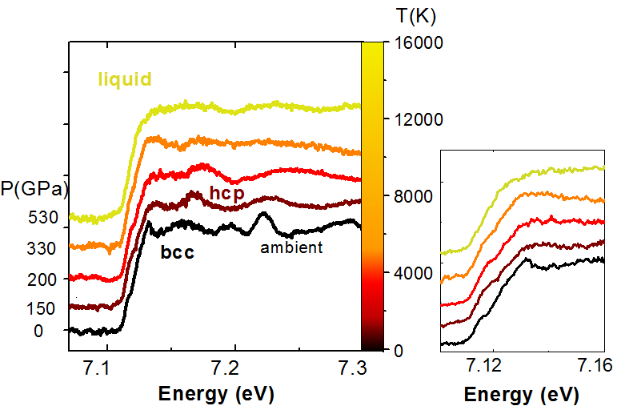
High pressure generated by laser Shock
laser parameters
E = 31 J, t = 10 ns
focal spot (no phase plate ~90 µm)
I ~ 5 10¹³ W/cm²
X-rays 5 x 7 µm
550 GPa, 14000K
Lower (but still good) data quality :
Clear trend to the liquid phase can be followed
R. Torchio et al., submitted to SR(2015)
Notes:
To go to higher shock energy and to reach the liquid phase, we have removed the phase plate leading to a laser focal spot of 90 microns and a power density of 5.10 to the 13 W/cm2.
In the same time, we have also focused the X-ray beam in vertical, leading to a focal X-ray spot of 5 by 7 square microns.
The quality of the XAS data is lower for many reasons. First, in this focused configuration, there is less Xray photons and consequently the statistical noise is higher. The second one, and probably the main one, is also that by removing the laser phase plate, the homogeneity of the laser focal spot is very poor, and to the presence 2D effect with this small focal spot, leading to a non homogeneity of the thermodynamical conditions within the probed volume.
But we can still measure a clear trend to the liquid phase, in particular in the edge region with features that could be observed also in static HP/HT experiment on the beamline.
The colors of the spectrum are reported in the Fe phase diagram, where the thermodynamic conditions are estimated by simulation. The sequence bcc – hcp – hcp compressed – melting is observed. The quality of the data is sufficient to detect similar evolution of features a,b,c and in particular d, as predicted by ab initio molecular dynamics calculations. However the shift toward lower energy of the edge is smaller than the one predicted by the theory. At the highest loading of 5.10to the 13, we think that the thermodynamic conditions corresponds to 550 GPa and 14000 Kelvin, much higher that what can be reached in static conditions.

Slide 13
High pressure generated by laser Shock
our data slightly extend recent
significant works range
most importantly energy range and
data quality are much improved
the data quality allows to compare to
theoretical models
R. Torchio et al., submitted to SR(2015)

Slide 14
General schedule
26/04 : GCLT at ESRF
27/04 – 29/04 Installation on ID24/EDXAS-L
02/05 – 06/05 : GCLT setup
07/05 – 11/05 : GCLT, ID24, diag setup
12/05 – 14/06 : experiment
14/06 – 16/06 : dismounting
16/06 : GCLT ready to leave ESRF
Notes:
To summarize my presentation, I try to show the interest of using energy dispersive XAS time resolved techniques to study matter under extremes. Using pulsed mode to perform extremes allows to reach magnetic field, temperature and pressure conditions very difficult or impossible to obtain in static mode. It allows also to study the dynamic of a system after such excitation.
I try also to present the effort that we have done in term of instrumentation development, in particular for detection and around the sample
On ID24, using the dispersive setup, reversible or non-reversible phenomena, with time resolution down to 100 ps.
And to illustrate the various possibilities offered by the beamline ID24, I have presented 3 different examples.

Slide 15
Filling mode
11/05 – 16/05 : 16 bunch mode
17/05 – 23/05 : 4 bunch mode
23/05 – 02/06 : shutdown
02/06 – 14/06 : 7/8 + 1
Notes:
To summarize my presentation, I try to show the interest of using energy dispersive XAS time resolved techniques to study matter under extremes. Using pulsed mode to perform extremes allows to reach magnetic field, temperature and pressure conditions very difficult or impossible to obtain in static mode. It allows also to study the dynamic of a system after such excitation.
I try also to present the effort that we have done in term of instrumentation development, in particular for detection and around the sample
On ID24, using the dispersive setup, reversible or non-reversible phenomena, with time resolution down to 100 ps.
And to illustrate the various possibilities offered by the beamline ID24, I have presented 3 different examples.

Slide 16
Filling mode : 16 bunch mode
176 ns
11/05 – 16/05 : 16 bunch mode
17/05 – 23/05 : 4 bunch mode
23/05 – 02/06 : shutdown
02/06 – 14/06 : 7/8 + 1
2.8 μs
16 equally spaced bunches
90 mA – 50 mA (+ top up foreseen)
distance between bunches = 176 ns
5.6 down to 3.1 mA/bunch
Status : Fully tested
Notes:
To summarize my presentation, I try to show the interest of using energy dispersive XAS time resolved techniques to study matter under extremes. Using pulsed mode to perform extremes allows to reach magnetic field, temperature and pressure conditions very difficult or impossible to obtain in static mode. It allows also to study the dynamic of a system after such excitation.
I try also to present the effort that we have done in term of instrumentation development, in particular for detection and around the sample
On ID24, using the dispersive setup, reversible or non-reversible phenomena, with time resolution down to 100 ps.
And to illustrate the various possibilities offered by the beamline ID24, I have presented 3 different examples.

Slide 17
Filling mode : 4 bunch mode
700 ns
11/05 – 16/05 : 16 bunch mode
17/05 – 23/05 : 4 bunch mode
23/05 – 02/06 : shutdown
02/06 – 14/06 : 7/8 + 1
2.8 μs
4 equally spaced bunches
40 mA – 20 mA (+ top up foreseen)
distance between bunches = 700 ns
10 down to 5 mA/bunch
Status : Fully tested
Best timing mode
Notes:
To summarize my presentation, I try to show the interest of using energy dispersive XAS time resolved techniques to study matter under extremes. Using pulsed mode to perform extremes allows to reach magnetic field, temperature and pressure conditions very difficult or impossible to obtain in static mode. It allows also to study the dynamic of a system after such excitation.
I try also to present the effort that we have done in term of instrumentation development, in particular for detection and around the sample
On ID24, using the dispersive setup, reversible or non-reversible phenomena, with time resolution down to 100 ps.
And to illustrate the various possibilities offered by the beamline ID24, I have presented 3 different examples.

Slide 18
Filling mode : 7/8 + 1
2.45 μs = 200 mA
11/05 – 16/05 : 16 bunch mode
17/05 – 23/05 : 4 bunch mode
23/05 – 02/06 : shutdown
02/06 – 14/06 : 7/8 + 1
2.8 μs
Single bunch 8 mA
Two bunches 1/4 intensity
7/8th of the ring filled with 868 bunches + 1 bunch in the middle of the last 1/8th
8 mA – 2 mA (+ top up foreseen, to be decided during the shutdown)
distance between bunches = 176 ns
8 mA/bunch
Status : not tested
promising timing mode
Risk with the machine
Notes:
To summarize my presentation, I try to show the interest of using energy dispersive XAS time resolved techniques to study matter under extremes. Using pulsed mode to perform extremes allows to reach magnetic field, temperature and pressure conditions very difficult or impossible to obtain in static mode. It allows also to study the dynamic of a system after such excitation.
I try also to present the effort that we have done in term of instrumentation development, in particular for detection and around the sample
On ID24, using the dispersive setup, reversible or non-reversible phenomena, with time resolution down to 100 ps.
And to illustrate the various possibilities offered by the beamline ID24, I have presented 3 different examples.

Slide 19
Proposal for experiment schedule
11/05 – 16/05 : 16 bunch mode
setup ID24
setup timing
FeNi proposal
17/05 – 23/05 : 4 bunch mode
17, 18 Fe proposal
19 FeO proposal
20 setup at Ta L3
21, 22 Ta proposal
23/05 – 02/06 : 7/8 + 1
2, 3 restart and setup
4, 5, 6 Ge proposal
02/06 – 14/06 : 7/8 + 1
8, 9 setup at Mo (Laue)
10/13 Mo proposal
Notes:
To summarize my presentation, I try to show the interest of using energy dispersive XAS time resolved techniques to study matter under extremes. Using pulsed mode to perform extremes allows to reach magnetic field, temperature and pressure conditions very difficult or impossible to obtain in static mode. It allows also to study the dynamic of a system after such excitation.
I try also to present the effort that we have done in term of instrumentation development, in particular for detection and around the sample
On ID24, using the dispersive setup, reversible or non-reversible phenomena, with time resolution down to 100 ps.
And to illustrate the various possibilities offered by the beamline ID24, I have presented 3 different examples.

Slide 20
Proposal for experiment schedule
Schedule to be re-discussed at the end of the meeting
Following target design status
I will check also with the user office how to organize the beamtime
Notes:
To finish, I would like to warmly thanks all our collaborators on these projects and in particular the CEA team of Paul Loubeyre
And I would like also to thank you for your attention.

Slide 21
Agenda
09H30 1- Welcome and agenda (Sakura, 5)
2- General introduction, schedule and acquisition mode (Olivier, 15+10)
3- Report on tests at different energies (Florent, 15+15)
4- GCLT status (Arnaud, 15+15)
11H00 Coffee break
11H15 5- Diagnostics status and VISAR (Arnaud, 15+15)
6- Experiment design (Olivier, Florent, Sebastien, 60)
12H45 Lunch
14H00 7- Sample/target design and status
- Raffaella : guidelines for target preparation and FeNi status (20)
- Florent, Laurent, Fe and Ta proposal (10)
- Tommaso, Ge proposal (10)
- Richard, Mo proposal (10)
- Guillaume, FeO proposal (10)
8- Discussion, Resume, Schedule and to do list (Sakura, 60)
16H00 End of the meeting

Slide 22

General setup : lifting
Additional requirements
New GCLT setup ? Can we have the drawings to simulate the lifting procedure

Slide 23
General setup at Iron

Slide 24
General setup at Ta-L3 and Ge

Slide 25
General setup at Molybdenum

Slide 26
Vertical refocusing mirror and vacuum tubes

Slide 27
Vacuum chamber
See Florent presentation

Slide 28
Diagnostics/visar setup
Fe case
Tables :
Standard 700x700 mm
IR table 1500x1200 mm
Lab 1200x900 mm
Mo case

Slide 29
Synchronization general
OPIOM TIMING CARD
CLK 5Hz
DELAY 1
FLASH
GCLT
DELAY 2
QSWITCH 0,022 Hz
DELAY 3&4
QSWITCH
CLK 5Hz
CLK 0.022 Hz
DELAY 5
BCDU8 TIMING GENERATOR
CLK = 62 PERIODS
laser
BUNCH SYNC = 992 PERIODS
X-ray
APD
ESRF
RF = 355 MHz
Oscillo
« START »
XH DETECTOR
CLK IN
SYNC IN
Synchro integration out
SPEC

Slide 30
Synchronization laser : any update ? Any needs ?

Slide 31
Synchronization laser and X-ray beam
GCLT
laser
To be discussed : is there a way to improve the diagnostics for the alignment between LASER beam and X-ray beam ?
X-ray
APD
Oscillo
« START »
XH DETECTOR
Synchro integration out

Slide 32
software
Acquisition sequence :
1- Laser setup
Laser is ON, received always the 5 and 0.022 Hz
signal from the OPIOM
Check LASER profile and energy
Absorber into the path to the sample
2- Start of the acquisition sequence
The absorber is removed, when LASER is ready (manual procedure)
The acquisition XH detector is armed
single trig, multiframe
3- Acquisition sequence
At the next 0.022 Hz trig, OPIOM send also a trig to the
camera
A series of 64 acquisition (every 5.6 μs) is performed
Compressed data at, acquisition 20 (for example)
Data before acq 20 as reference cold data
Data after acq 20 as “no sample check”
4- End of the acquisition sequence
I0 is measured at the same position (no sample anymore)
soft start, multiframe
Background measurement, signal calculation, data saved

Slide 33
software
Data saved :
- header file
- raw data
I0 (E, I0) raw, I1 (E, 64 x I1) raw
I0_bk (E, I0_bk) and I1_bk (E, I1_bk)
- results
(E, 64 abs spectra)
Any additional needs ?
Switch “absorber open”, to start automatically the acquisition procedure ?
Soft start with dedicated question ?

Slide 34
safety
ESRF Safety group agreed to apply same rules than in 05/2014
Probably red experiment
Single inhibit key to the LASER responsible
When out, inhibit key back to the floor coordinator
A priori, a single “safety risk analysis” will be required for all proposals
Florent (?)
I will see with Safety group and User office how to deal with site entrance, guest house… but I will need the precise schedule of everyone.

Slide 35
Schedule (end of the meeting)
11/05 – 16/05 : 16 bunch mode
setup ID24
setup timing
FeNi proposal
17/05 – 23/05 : 4 bunch mode
17, 18 Fe proposal
19 FeO proposal
20 setup at Ta L3
21, 22 Ta proposal
23/05 – 02/06 : 7/8 + 1
2, 3 restart and setup
4, 5, 6 Ge proposal
02/06 – 14/06 : 7/8 + 1
8, 9 setup at Mo (Laue)
10/13 Mo proposal

