Slide 1
The Metrology Light Source - Status
Jörg Feikes, Paul Goslawski, Tobias Goetsch, Markus Ries, Martin Ruprecht, Gode Wüstefeld,
Helmholtz-Zentrum Berlin, Germany
Peter Hermann, Arne Hoehl, Roman Klein, Gerhard Ulm
Physikalisch-Technische Bundesanstalt, Germany

Slide 2
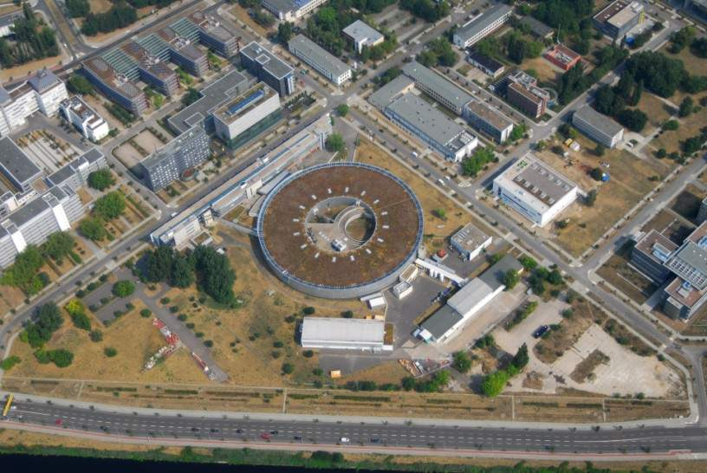
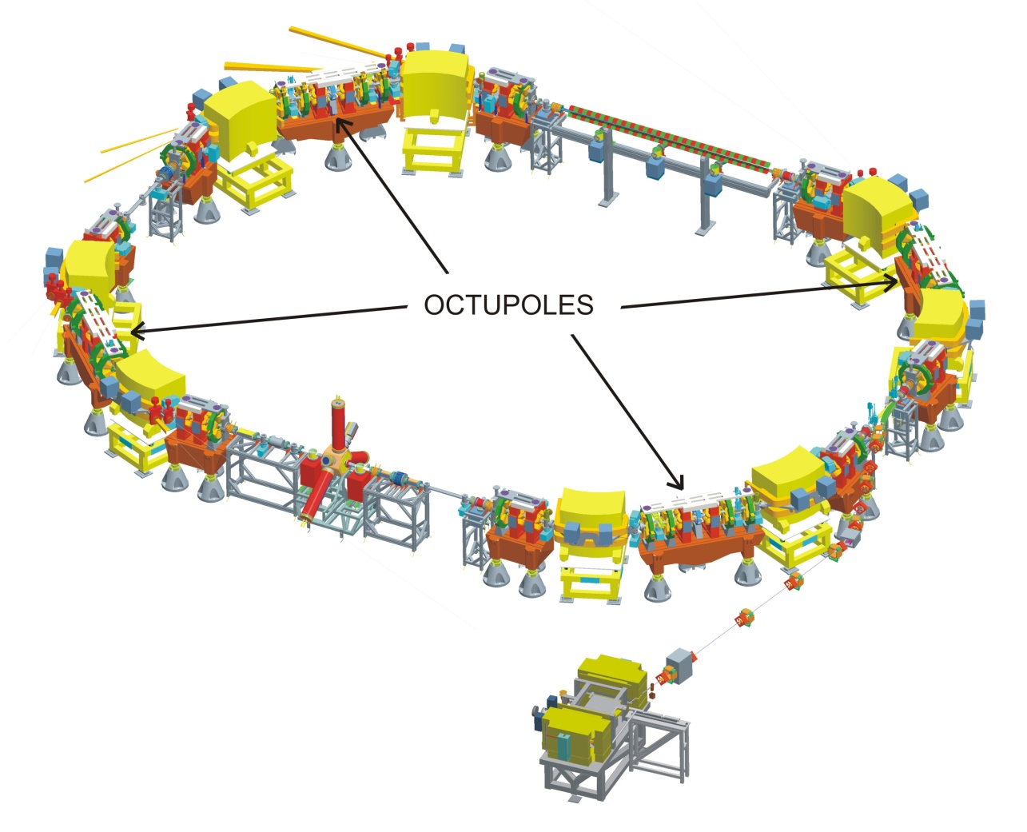
The Metrology Light Source
BESSY II
Metrology Light Source (MLS)
owner and main user: Physikalisch-Technische Bundesanstalt PTB
operated by BESSY-staff
electron energy range = 50 MeV… 630 MeV
storable current = single electron… 200 mA
critical photon energy = 360 eV (at 630 MeV)
bunch length = sub-ps .. 100 ps

Slide 3
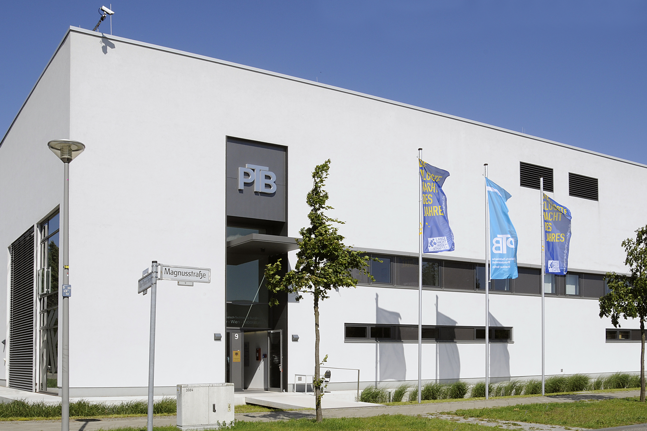
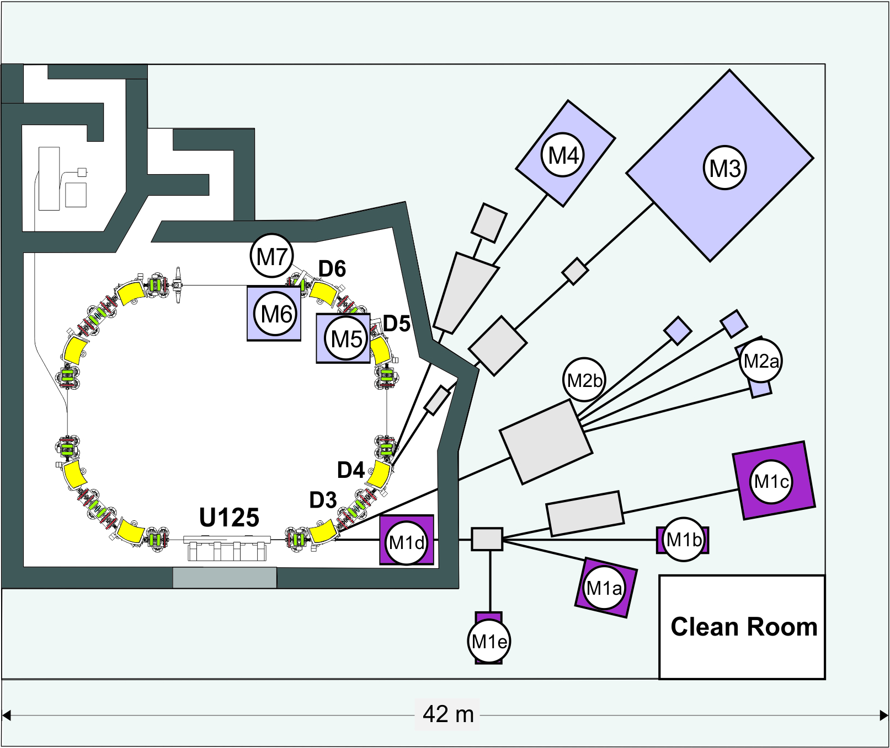
Beam Lines and Working Groups @MLS
M4: UV/VUV Detector Radiometry
and Reflectometry
Cryogenic Radiometer as
Primary Detector Standard
M6: Micro and Nano Spectroscopy in
the IR Regime
Near-field
Microscopy and
Nano-FTIR
Spectroscopy
(PTB/FUB)
M7: Electron Beam
Diagnostics
Size (Imaging)
and low Current
M3: Metrology for EUV Lithography
Characterization of Optics with
Industry Partners (CZ, ASML, …)
M2: MLS as Primary Radiation
Source Standard
Calibration of UV/VUV Radiation
Sources and Space Telescopes
M5: THz Spectroscopy and
Detector Characterization
Applications of Coherent
Synchrotron Radiation
M1: Surface Characterization with
UV/VUV Undulator Radiation
Ellipsometry (PTB/ISAS),
Electron Spectroscopy
(PTB/TUB/HZB), …

Slide 4
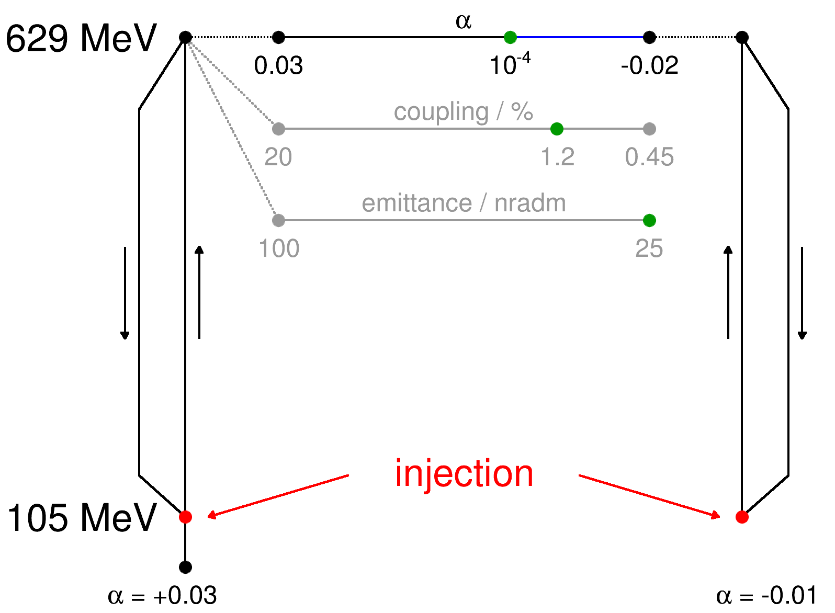
Flexible and Fast Optic Change
frequently demanded user optics
fully automated operation
allows ad hoc change
to desired optic within seconds
(or minutes if new filling required)
positive α - Ramp
negative α - Ramp

Slide 5
Unifying Operation Modes
MLS: strong demand on beam time in low alpha optics ->
THz power in low alpha mode
ESLS 2013: Can low alpha mode made be compatible to „standard user“ needs ?
ESLS 2014: Yes !

Slide 6
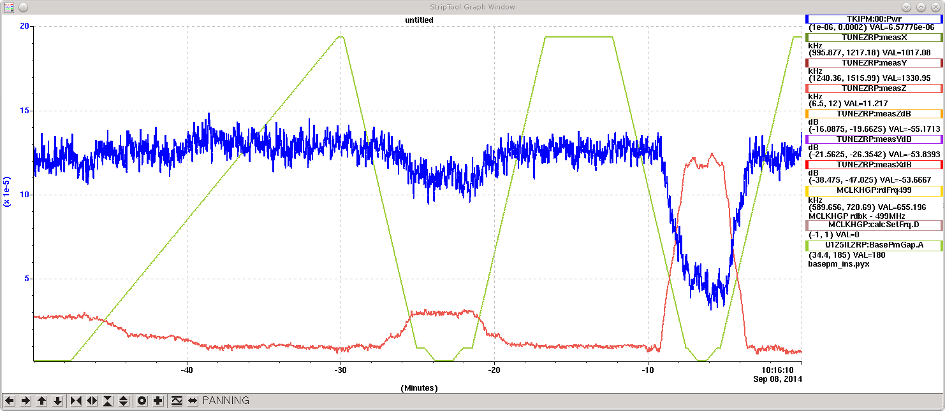
Unifying Operation Modes
Standard User Mode
Working horse due to its temporal stability (2/3 of total beam time)
Low alpha Mode
short bunch operation and THz/Infrared „production“
„Low Source size Low Alpha Mode“ can also be used as „Standard User Mode“ Standard Signal at User Beamlines and THz/IR Beamline Ok (although still in development)
EUV and THz user comunities can be served simultaneasly !
Important: ID (U125) transparent in Low alpha Mode (no change of THz spectra observed)
THz-Power
Undulatorgap

Slide 7
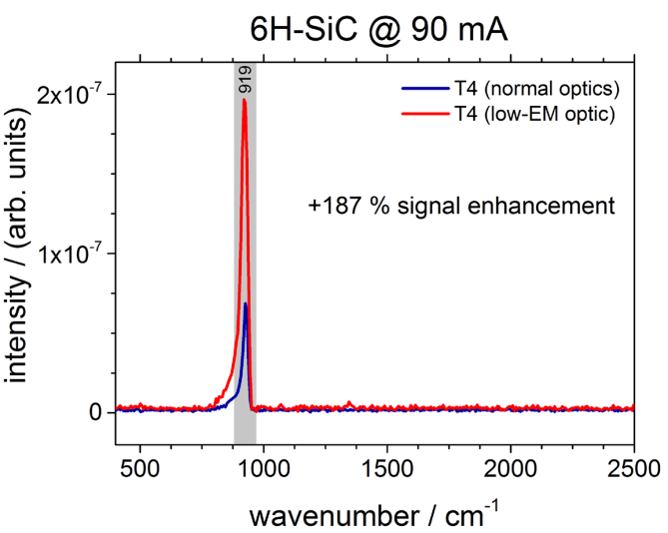
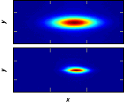
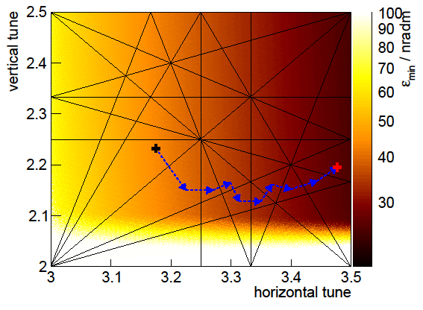
Experience with Low Emittance Optic
Result: higher SiC peak intensity (up to 187 %).
in nano-FTIR spectra recorded in low-emitt. mode
(Peter Hermann et al, „Near-Field Imaging and nano-FTIR Spectroscopy”)
Low Emittance Mode (100 -> 25 nmrad) implemented
as „ad Hoc“ optics and used succesfullyfor measuring at
Storage ring based Near Field Microscope and EUV reflect.
-> other Users become also interested in Low Emittance
although Lifetime < 1 h at I=190mA
good temporal stability as source size shrinks with current ->
brightness nearly constant over hours

Slide 8
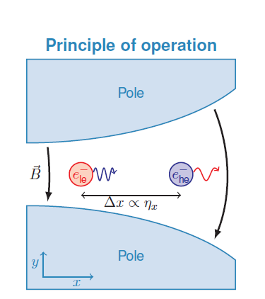
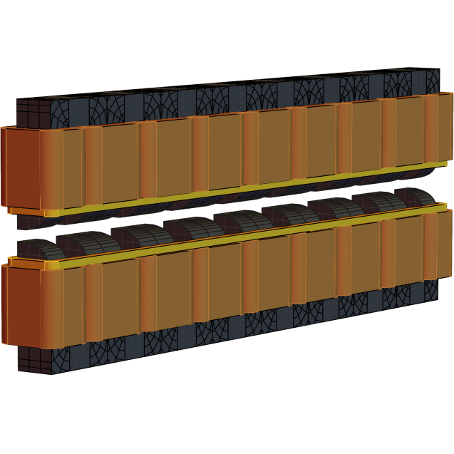
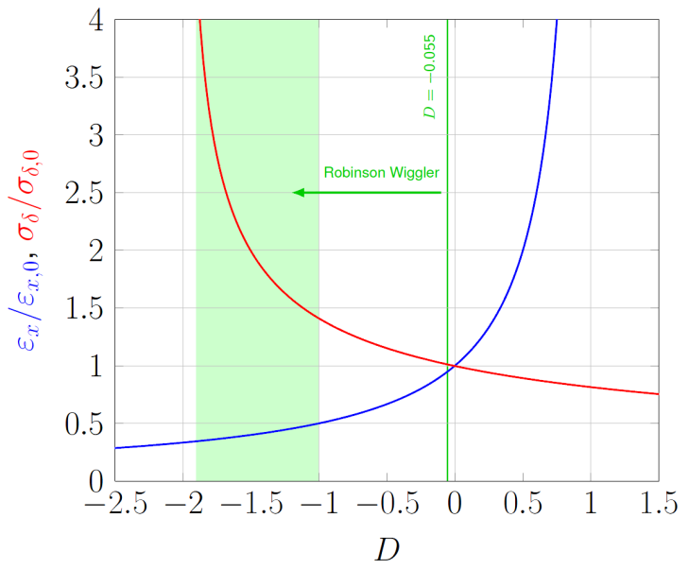
Improving lifetime with a Robinson Wiggler
Hardware Design ready L=1735 mm

Slide 9
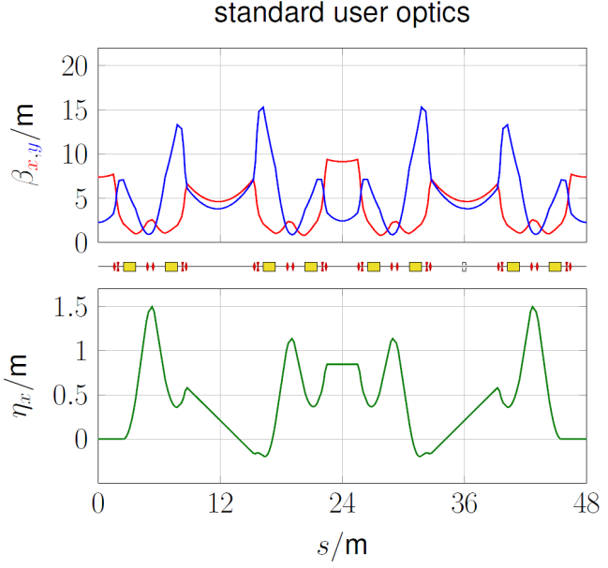
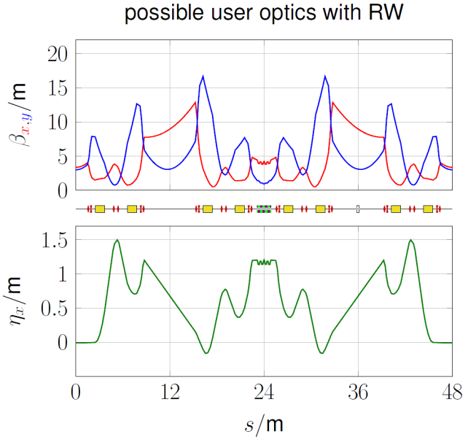
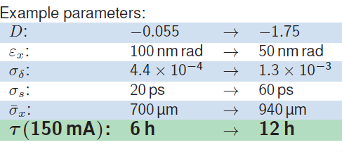
Improving Lifetime with a Robinson Wiggler
user optics with RW
succesfully tested at 375 MeV
Commissioning Spring 2016

Slide 10
And last but not least:
(as there is no user operation on weekends)
MLS is an excellent test bend for all kind machine studies
e.g. Island Buckets (for BESSY VSR) by Paul
if you also want to try something just call or write us

