Slide 1
Status of RF at HZB and SRF at BERLinPro
Wolfgang Anders,
Helmholtz-Zentrum Berlin for materials and energy (HZB)
ESLS-RF Meeting 5.-6.10.2011 ESRF

Slide 2
outline
BESSY II
  Some aging devices at BESSY II
  Status klystrons BESSY II
BERLinPro
  ERL physics
  Project
  Transmitters
  Cavities, couplers and modules

Slide 3
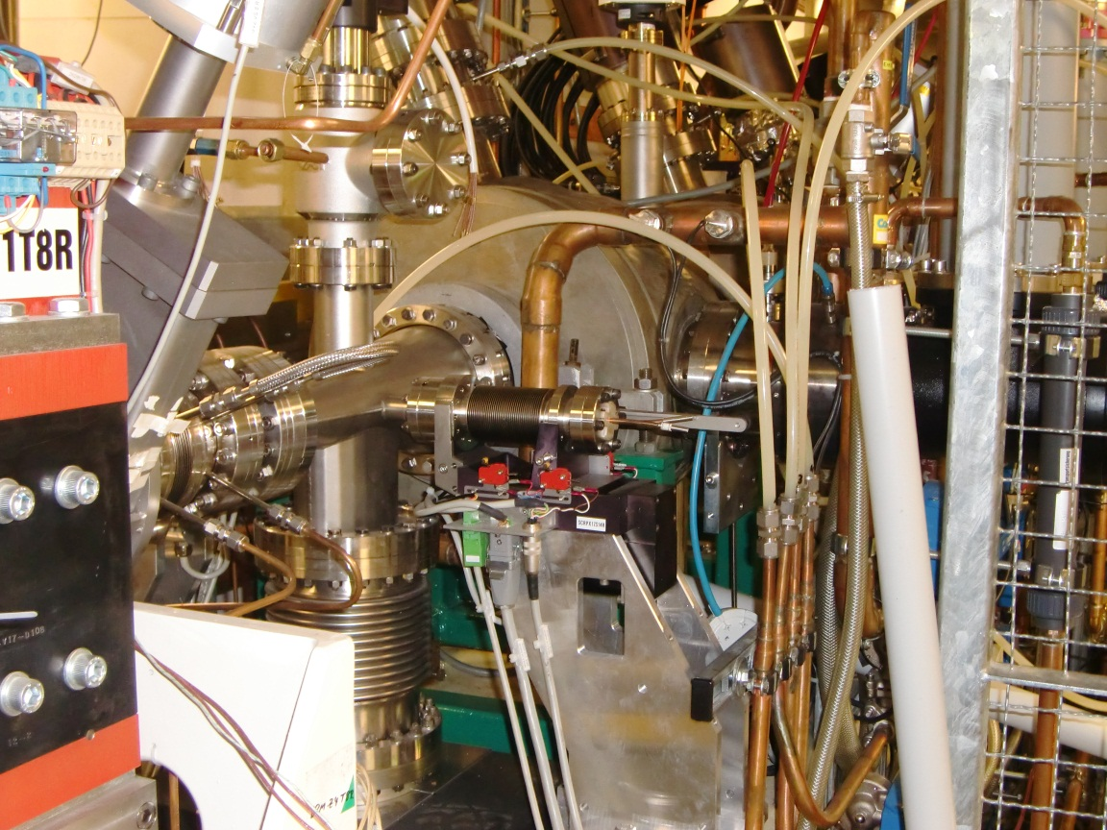
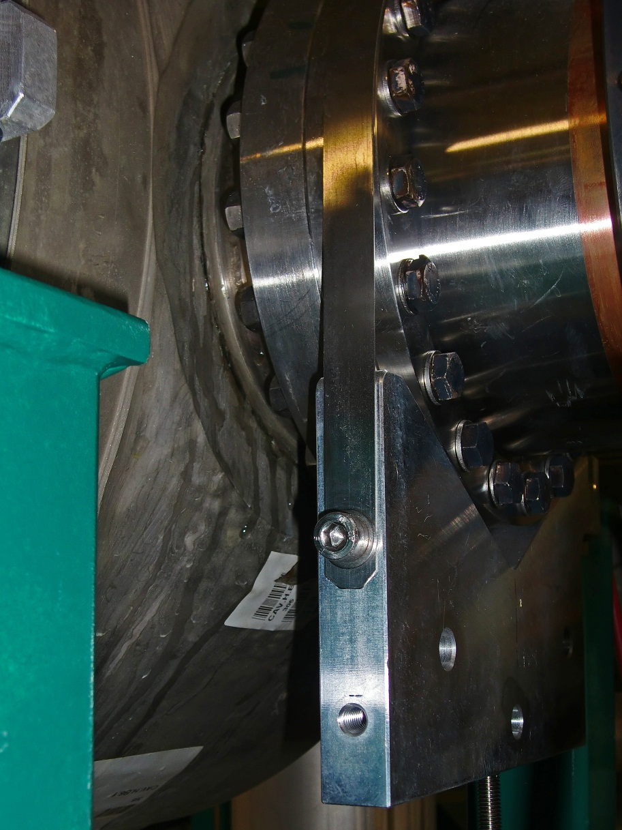
BESSY II: Water leak at Doris cavity
Water leakage of one DORIS body
Now installed last spare cavity!!
KOLUMNE 3

Slide 4
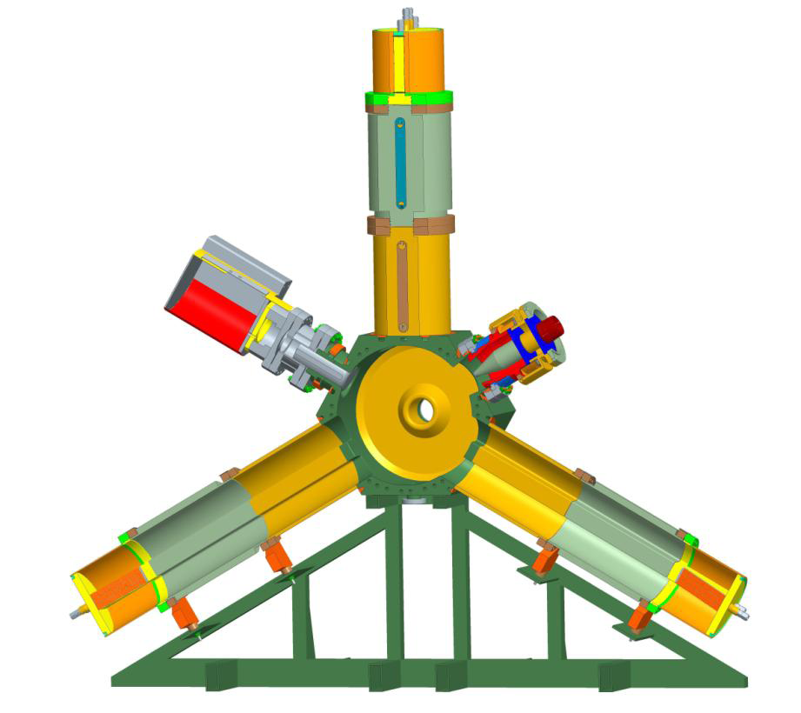
New cavities for Bessy ii ordered
We ordered first two new HOM damped BESSY cavities + one spare for WWL).
They will be delivered summer 2012 and installed spring 2013.
Changed design (in parallel with ESRF) to avoid gap on dampers that made much trouble in past.
First 30 cm of the HOM dampers is part of the cavity body

Slide 5
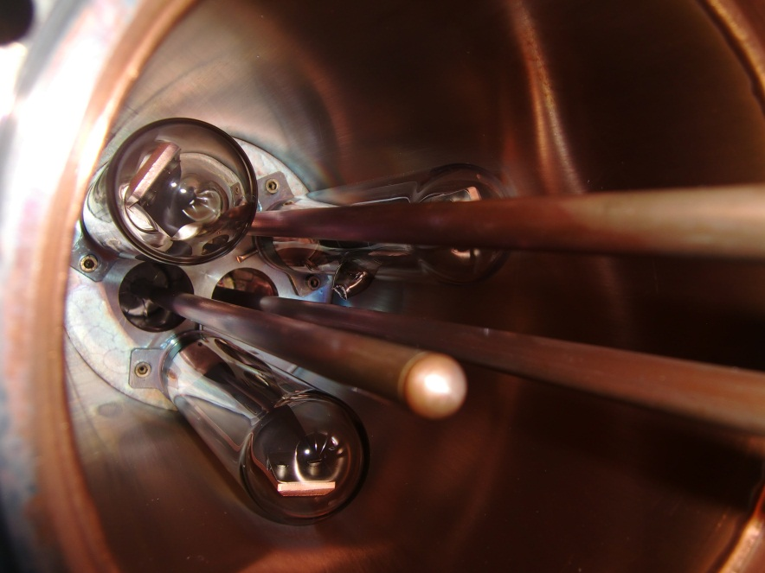

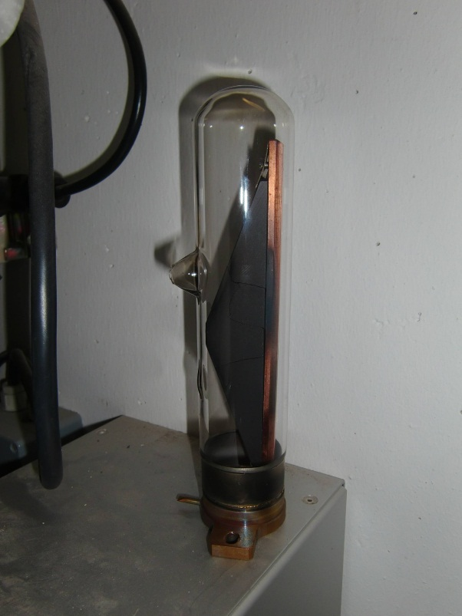
Melted HOM ferrite in Doris Cavity
Melted HOM ferrite glas tube at Cavity 4 (Nov.2010)
HOM dampers are build 1975
In machine studies about 1 year before they made 35 mA single bunch !!!! There has been a short vacuum event…
BESSY II has started with 10 mA in single bunch mode user shift, later they increased to 20 mA --- 35 mA seem to be to much

Slide 6
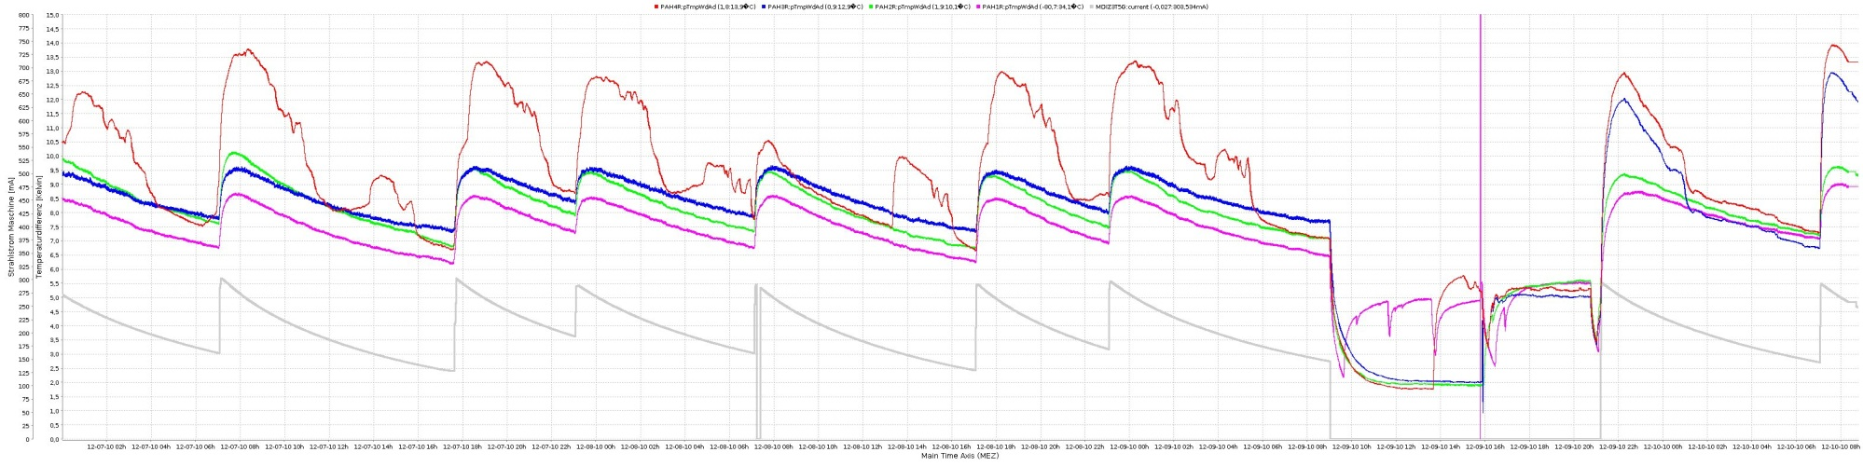
Strange window temperatures
Strange behavior of window temperatures at one of four cavities. Window was old type with lower cooling. Cavity window is changed now → o.k.
Temperature difference of inlet/outlet of the ceramic air cooling of cavity 1-4 at the BESSY II storage ring. Grey is the beam current.

Slide 7
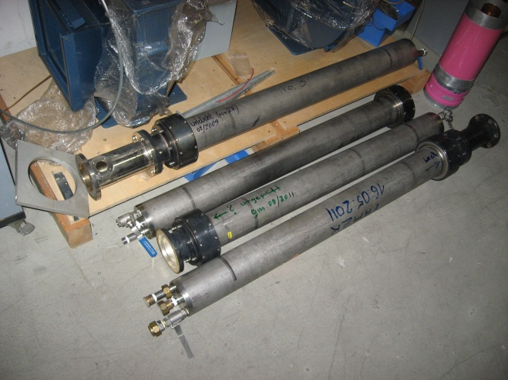
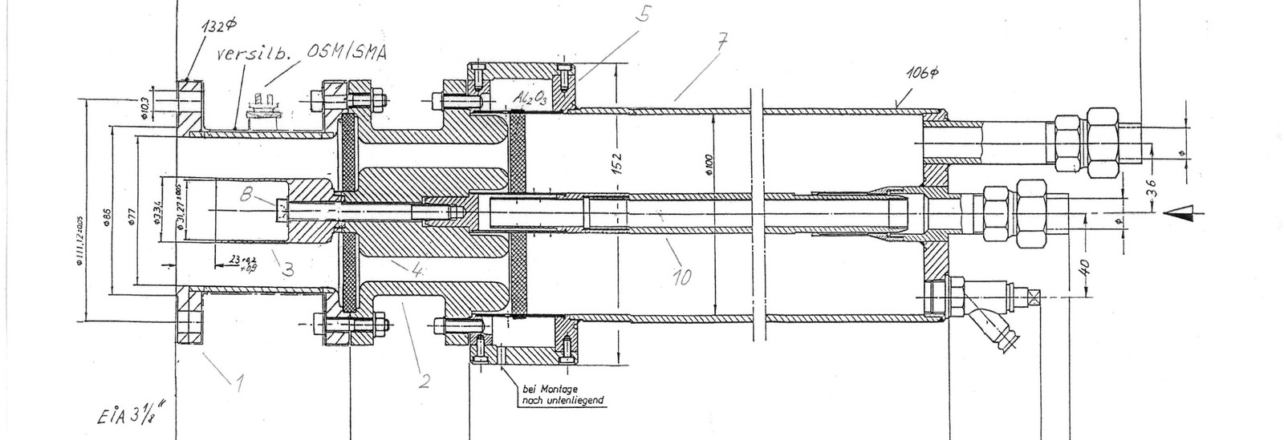
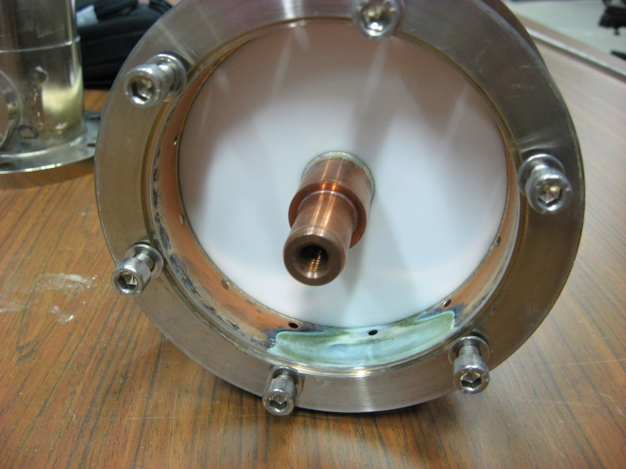
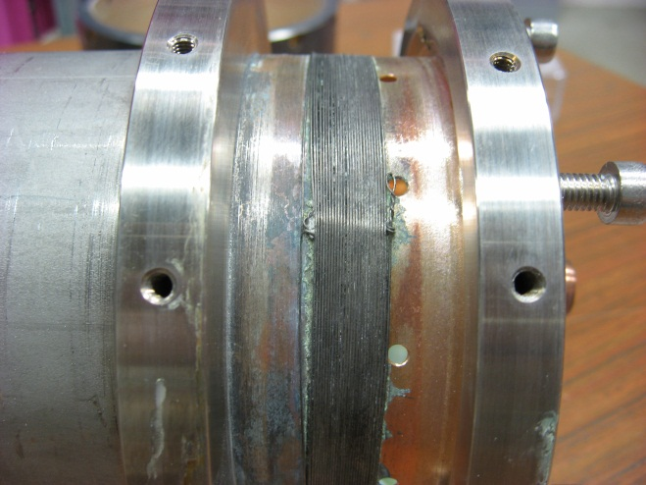
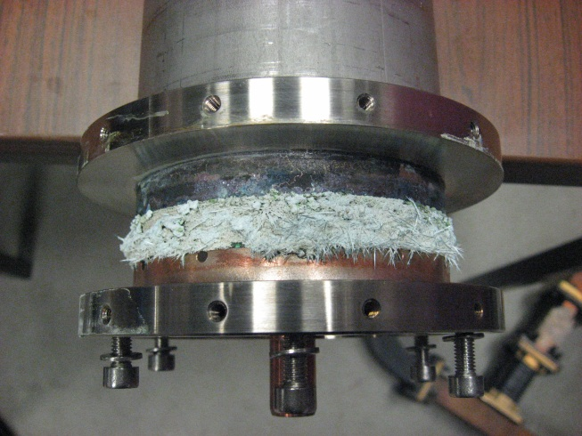
Leaks in water loads
Some of the ~15 years old water loads show water corrosion at the brazing of the ceramic
New loads 125 kW 6^{1/8} inch by Altronic.

Slide 8
BESSY II: Status of Klystron
BESSY klystrons get old:
Booster : >100.000 h 40 kW YK1263 VALVO klystron
Storage ring 1: ~6.000 h 75 kW TH2133 Thales klystron
Storage ring 2: ~98.000 h 75 kW TH2133 Thales klystron
Storage ring 3: ~93.000 h 75 kW K3755 E2V klystron
Storage ring 4: ~66.000 h 75 kW TH2133 Thales klystron
Spare 1: ~27.000 h 75 kW TH2133 Thales klystron
Spare 2: new h 75 kW K3755 E2V klystron
Spare 3: new h 75 kW K3755 E2V klystron
Spare 4: ~81.000 h 75 kW TH2133 Thales klystron water repaired
Spare 5 old 40 kW YK1263 VALVO klystron
Two defect TH2133 one 51.000 h heater and one unknown error old Lund klystron
We need more spare, but:
Thales tube out of production
E2V has not send an offer, several requests since more than one year
CPI has a klystron same power level, but not produced last years

Slide 9
Solid state transmitters for BESSY II
Due to the fact, that we don´t get any spare tubes, we will change to solid state transmitters at BESSY II in the next years.
First money in 2012, but whole RF group now involved in BERLinPro transmitters, first discussions with SOLEIL.
Hopefully next year first news on BESSY II SSA.
Which Lab is also looking forward to get 500 MHz ~75 kW SSA ??

Slide 10

Berlinpro
BERLinPro is an energy recovery linac as a demonstrator to show, that ERL technology is able to fit to requirements for future light sources.
BERLinPro is a funded project 2011-2015
to be realized at the HZB
Funded by Helmholtz-Gemeinschaft, Land Berlin and Helmholtz-Zentrum Berlin

Slide 11
Beampower storage ring ←→linac
Dump
Undulator
Linac
Injektor
11

Slide 12
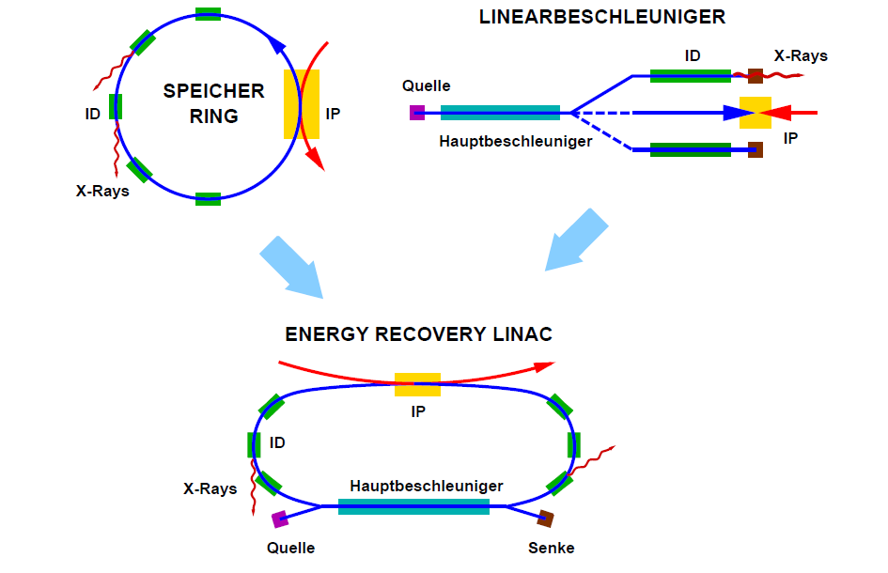
Storage ring + linac = erl

Slide 13
How an ERL works
Dump
E ↑
Undulator(en)
Linac
E ↓
Injektor
13

Slide 14
Berlinpro rf requriements
Booster cavities:
full beam loading
➔450 kW_{cw}
3 x 2 cell cavity, 4.5MeV@100mA
1.5-2MeV@100mA
SRF electron source:
full beam loading
➔200 kW_{cw}
3 x 7 cell cavities, 44MeV
Linac:
energy recovery
➔ < 5 kW kW_{cw}

Slide 15
Basic Parameters of BErlinPro
Energy | ~ 50 MeV
Merger energy | ~ 6.5 MeV
Beam current | 100 mA
Emittance | 1 mm mrad (normalized)
Electron source | superconduncting RF photoinjector
Gun transmitter | 270 kW 1.3 GHz
Booster cavities | 3 x 2-cell
Booster transmitter | 2 x 160 (270) kW + 1x 15 (200) kW
Linac cavities | 3 x 7 cell
Linac transmitter | 3 x 15 kW

Slide 16
Status RF transmitter for Berlinpro
Injector and Booster transmitter
  3 x 270 kW 1.3 GHz (linear range) klystron ordered at CPI
  First klystron will be delivered 2/2013
  Call for tender circulator
  We open negotiations on power supplies with FUG (similar to 80 kW transmitter of MLS)
Linac transmitter
  15 kW 1.3 GHz solid state transmitters
  Call for tender try for first prototype (turnkey by industry) planned soon
We are searching for ~ 3x70 m long
65 kV 25 A two poles cable
or 6x70m 1 pole

Slide 17
Coupler for injector cavities
At the high power injector cavities we will use two couplers each cavity to reduce coupler kicks and reduce power level per coupler
Cornell Koppler
60 kW cw tested
KEK Koppler 170 kW cw planned by cERL (KEK)
50 kWcw and >100 kW long puls tested

Slide 18
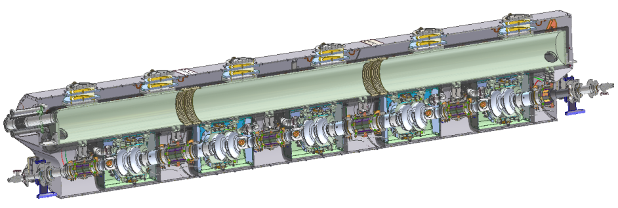
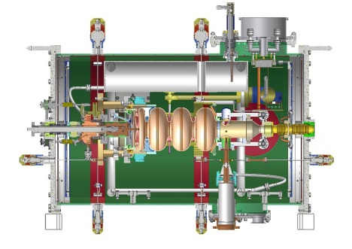
Status Cold Mass
Booster module
  Implementation of KEK coupler now clear, not compatible with Cornell module
  Calculations if it is possible to increase power level of Cornell coupler to stay on Cornell modules
  Rough drawings of KEK module
  Budget price for KEK module asked for quotation at Mitsubishi Heavy Ind.
  Decission of module type in preparation (this fall):
    Modified KEK module or
    Cornell module with modified couplers or
    FZD (SNS) module or
    Own design
Electron source module
  In parallel to booster module
Linac module → not action
KEK module
Cornell module
FZD module

Slide 19
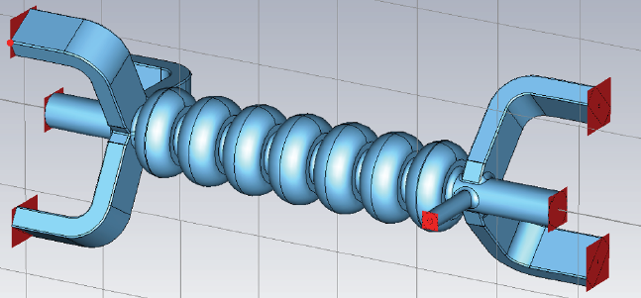
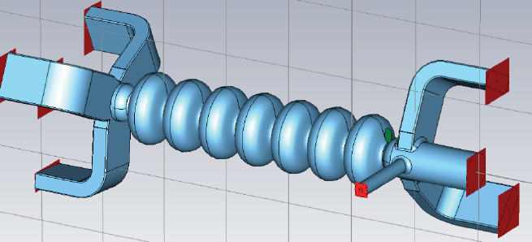
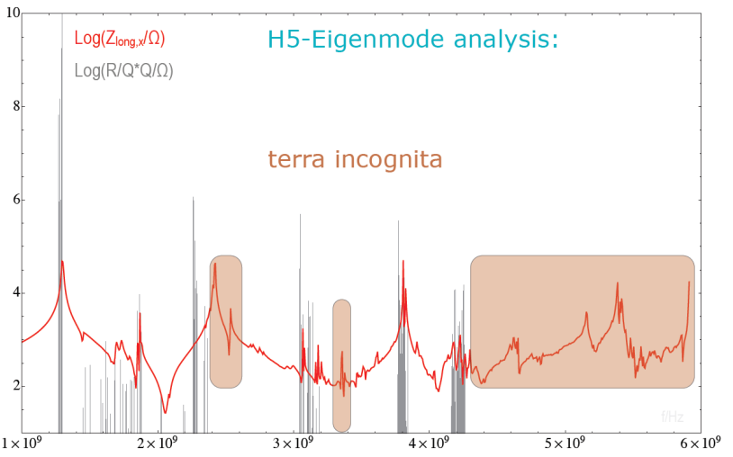
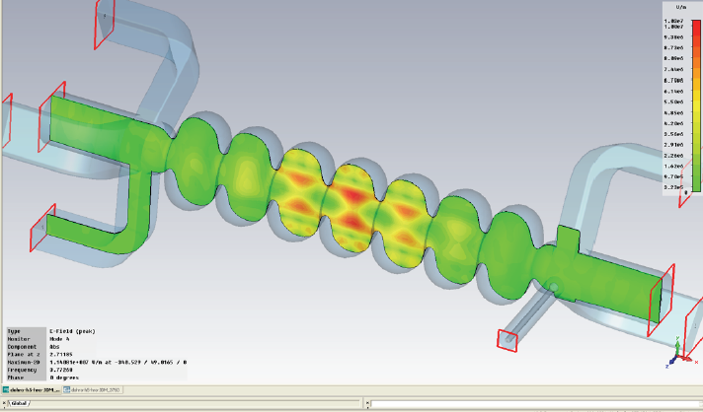
Status Cavity development (Linac)
Linac cavities
  DoHRo Verbundforschung with Universities Dortmund & Rostock Cell shape Cornell ←→Jlab
  5 or 6 WG, optimize WG assembly
  Mode calculations to determine HOM (Verbundforschungsmeeting Rostock) spectrum for BBU calculations
H.W. Glock
H.W. Glock

Slide 20
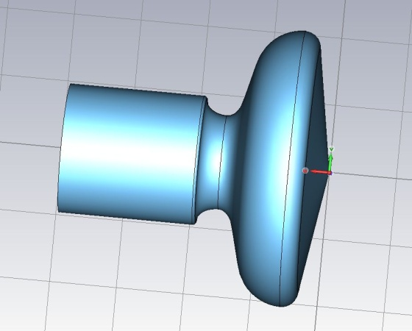
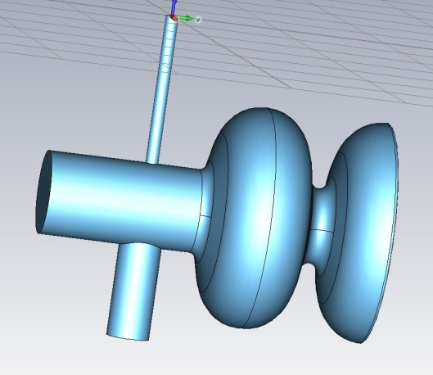
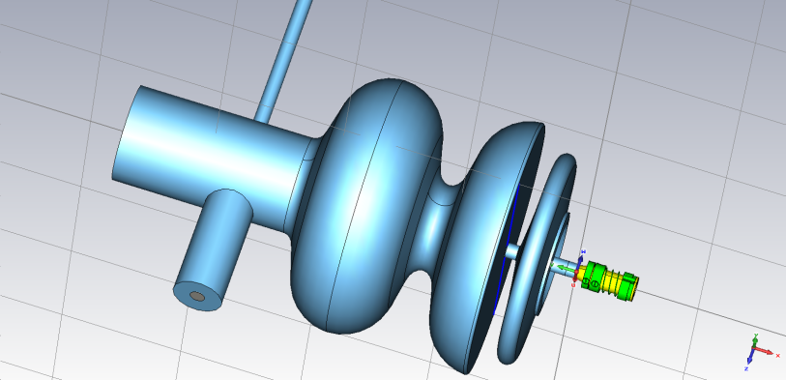
Cavity development (photo Injector)
Electron source cavity
  Started parameter studies to judge half-cell vs. 1.6 cell design:
  Started studies of choke filter design and implement new cathode holder
Booster cavity: 2 cell Cornell design

Slide 21
Gun development in three stages
Stages of gun development
Gun0 is a beam demonstrator experiment with SC Pb cathode (2011), study beam dynamics, cavity performance
For Gun1 add NC cathode with high QE at VIS, study cathode lifetime, slice/projected emittance performance (2013)
For Gun2 add RF input power coupler for 200 kW (2014), study high power operation
 | HoBiCaT Gun0 | Source lab Gun1 | BERLinPro Gun2
Goal | Beam Demonstrator | Brightness R&D gun | Current Production gun
Electron energy | ≥ 1.5 MeV
RF frequency | 1.3 GHz
Design peak field | ≤ 50 MV/m
Operation launch field | ≥ 10 MV/m
Bunch charge | ≤ 77 pC
Repetition rate | 30 kHz | 54 MHz / 25 Hz | 1.3 GHz
Cathode material | Pb | CsK₂Sb | CsK₂Sb
Cathode QE | 5*10^-4 at 258 nm | 10^-1 at 532 nm | 10^-1 at 532 nm
Laser wavelength | 258 nm | 532 nm | 532 nm
Laser pulse energy | 0.15 µJ | 1.8 nJ | 1.8 nJ
Laser pulse shape | Gaussian | Flat-top | Flat-top
Laser pulse length | 2.5 ps FWHM | ≤ 20 ps | 20 ps
Average current | 0.5 µA | ≤ 10 mA / 0.1 mA | 100 mA

Slide 22
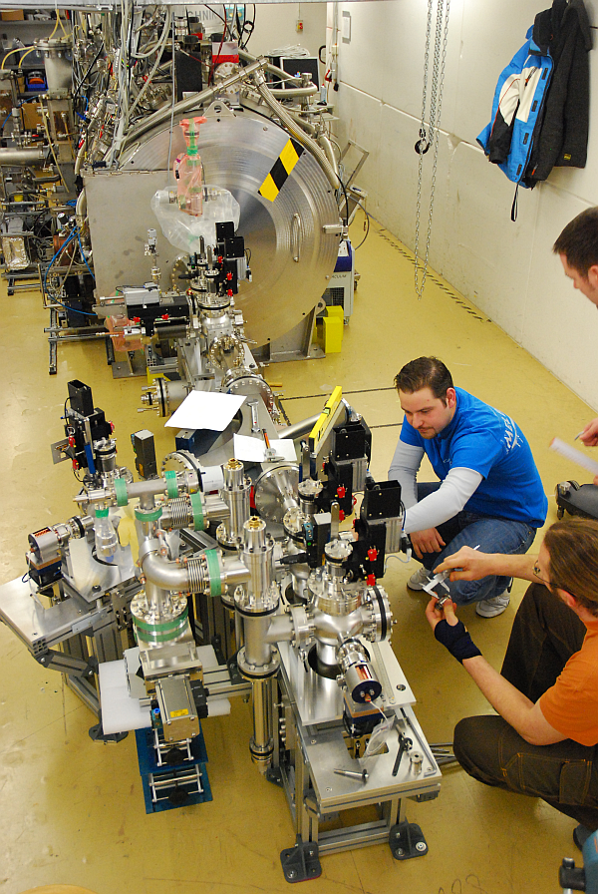
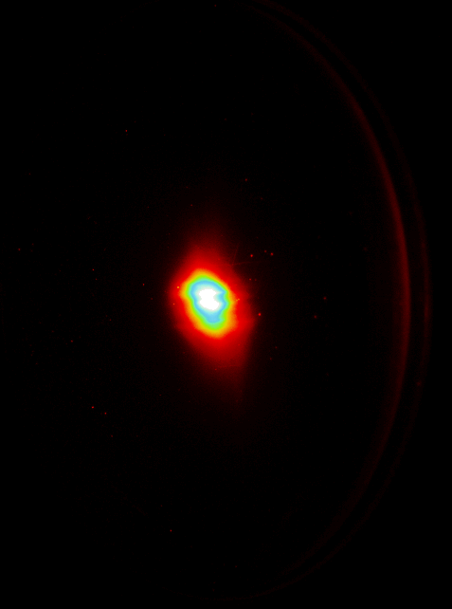
First beam in gun stage 0
Gun stage 0 is installed in HoBiCaT
Cooperation with Jlab, DESY, Soltan Inst. Swierk (Poland)
First beam
21st April 2011

Slide 23
Thank you !

